Slide 1
Design of RF & Microwave Systems
EEC 134 A&B
Lecture 9b: System Analysis
Xiaoguang “Leo” Liu
Assistant Professor
School of Electrical and Computer Engineering
Tel: 530-289-6367
lxgliu@ucdavis.edu
http://ucdart.net

Slide 2
Outline
Cascade Analysis
Link budget calculation

Slide 3
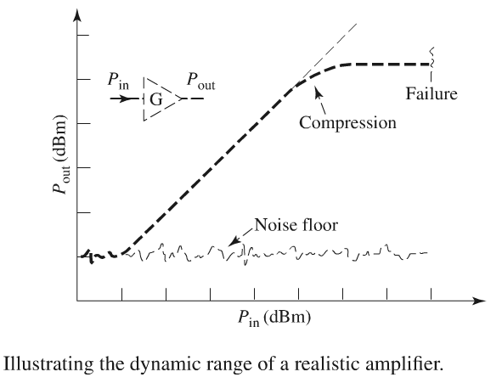
Dynamic Range
Dynamic range determined by noise and non-linearity

Slide 4
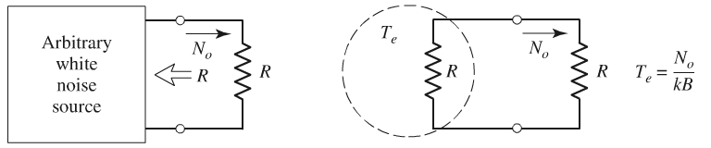
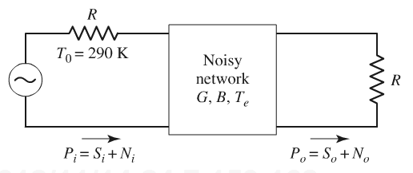
Noise
Noise temperature
Noise figure

Slide 5
Non-linearity
Let
DC
Fundamental
Second
Harmonic
Third
Harmonic

Slide 6
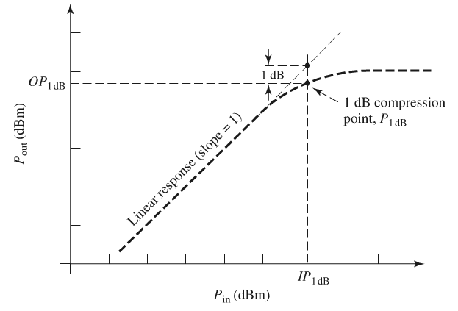
Gain Compression
P_{1dB}: power at 1-dB compression
P_{sat}: power at saturation
P_{sat}

Slide 7
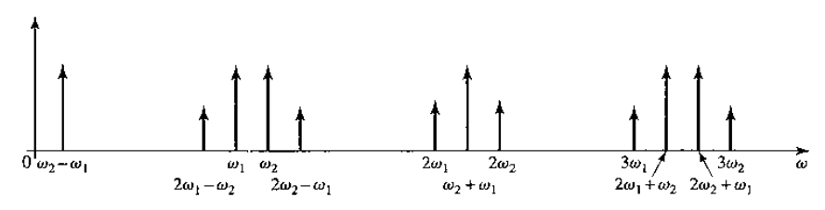
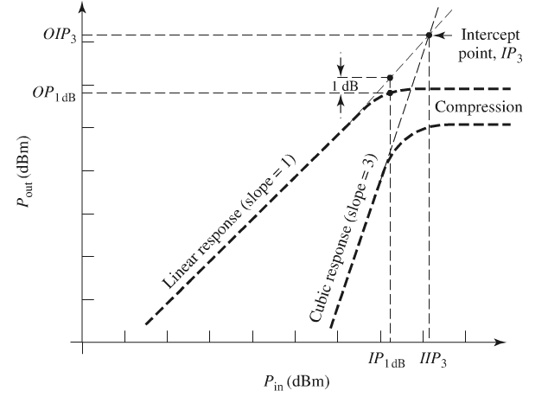
IP3

Slide 8
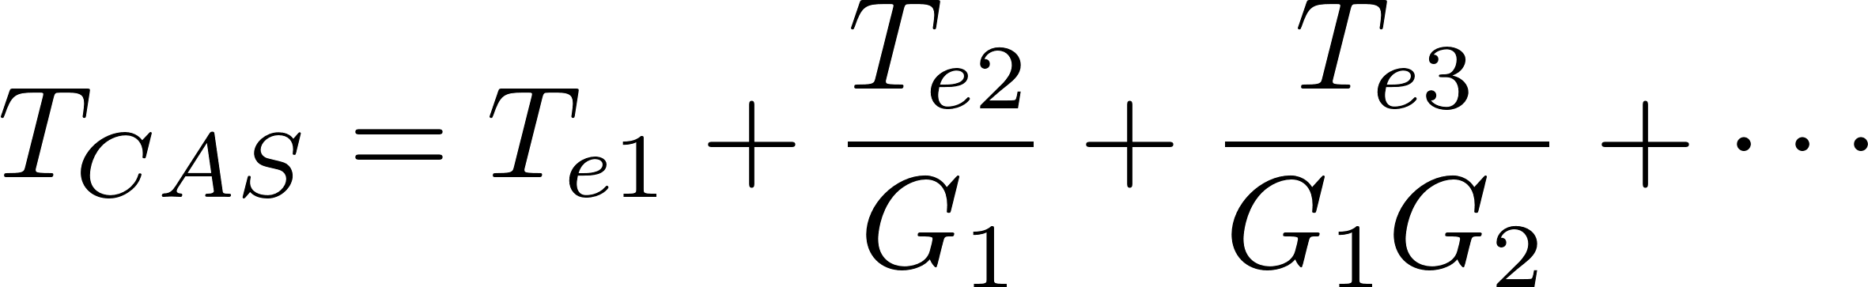
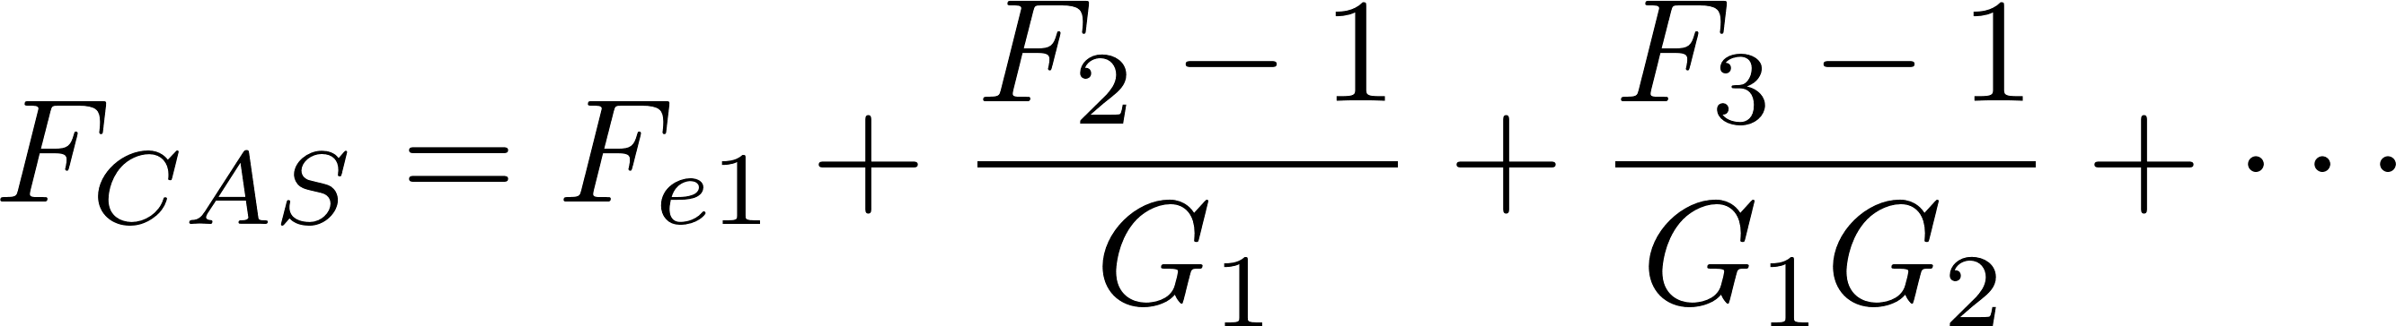
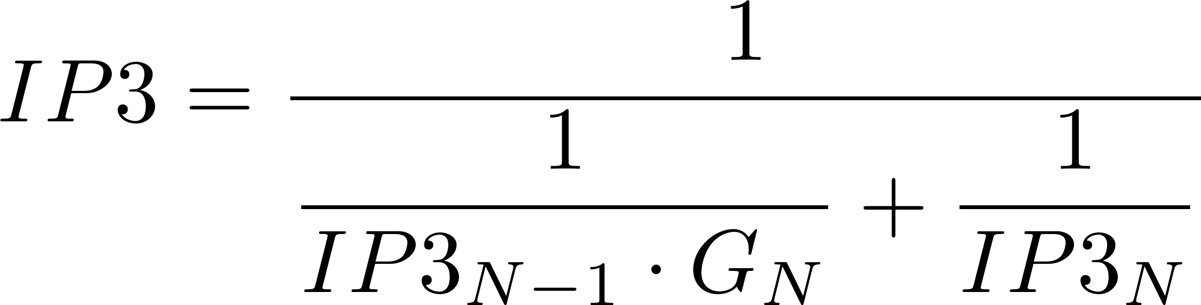
Cascade Blocks
Gain
Noise Figure/Temperature
IP3

Slide 9
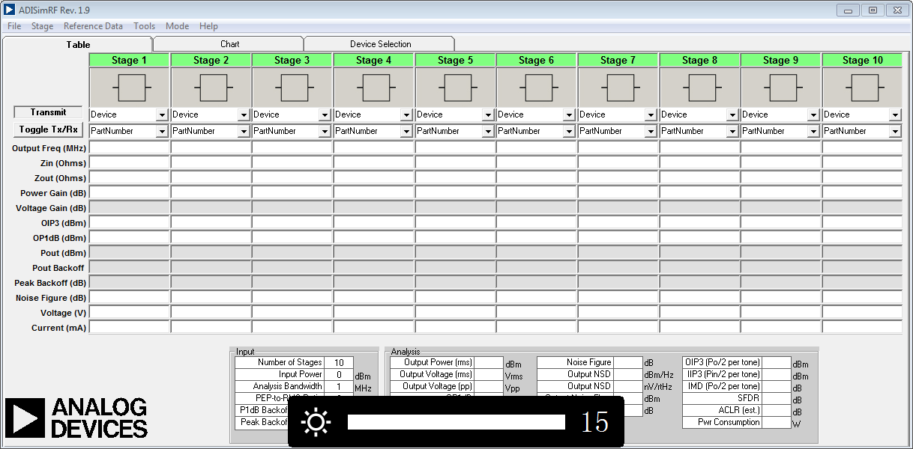
Simulation Tools for Cascade Analysis
Analog Device ADIsimRF

Slide 10

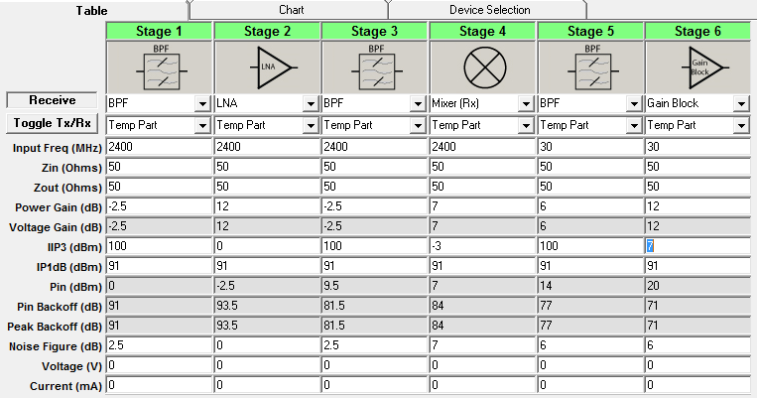
Example
2.400 GHz
30 MHz
2.370 GHz
-7

Slide 11
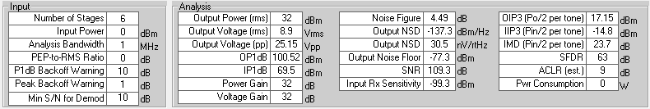
Example
2.400 GHz
30 MHz
2.370 GHz

Slide 12
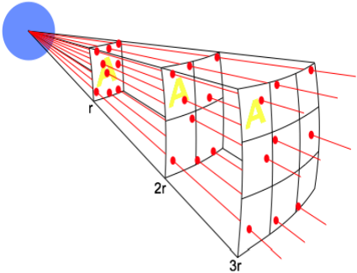
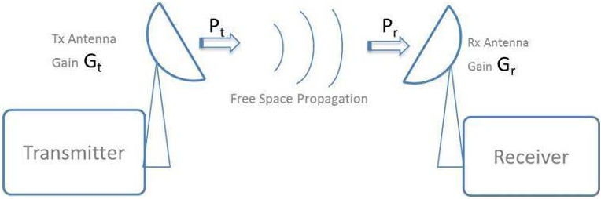
Link Budget Analysis
Free space loss (Path loss)
Signal power is diminished by geometric spreading of the wavefront, commonly known as Free Space Loss.
The power of the signal is spread over a wave front, the area of which increases as the distance from the transmitter increases. Therefore, the power density diminishes
http://www.piscespacific.org/livesite/files/Link_Budget_Calculation.pdf

Slide 13
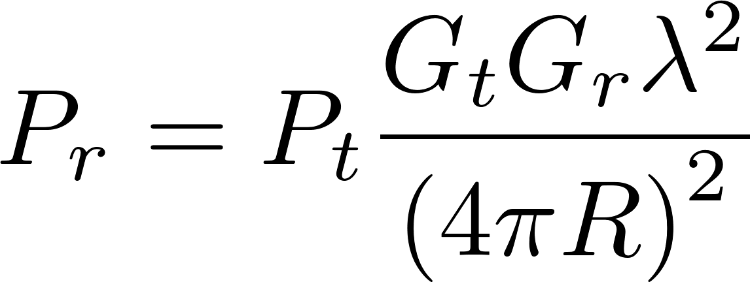
Link Budget Analysis
Free space loss (Path loss)
Friis formula
http://www.rf-mw.org/wireless_communication_systems_link_equation_and_link_budget_link_equation_and_link_budget_.html

Slide 14
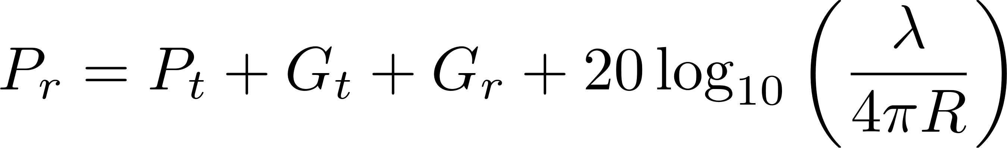
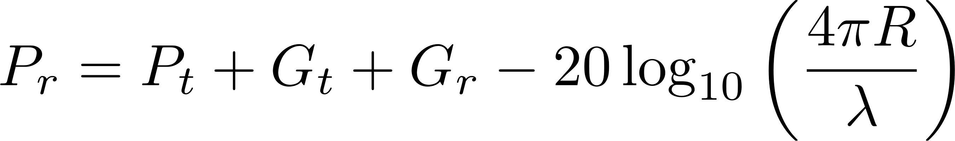
Link Budget Analysis
Friis equation in dB scale
Free space path loss
http://www.rf-mw.org/wireless_communication_systems_link_equation_and_link_budget_link_equation_and_link_budget_.html

Slide 15
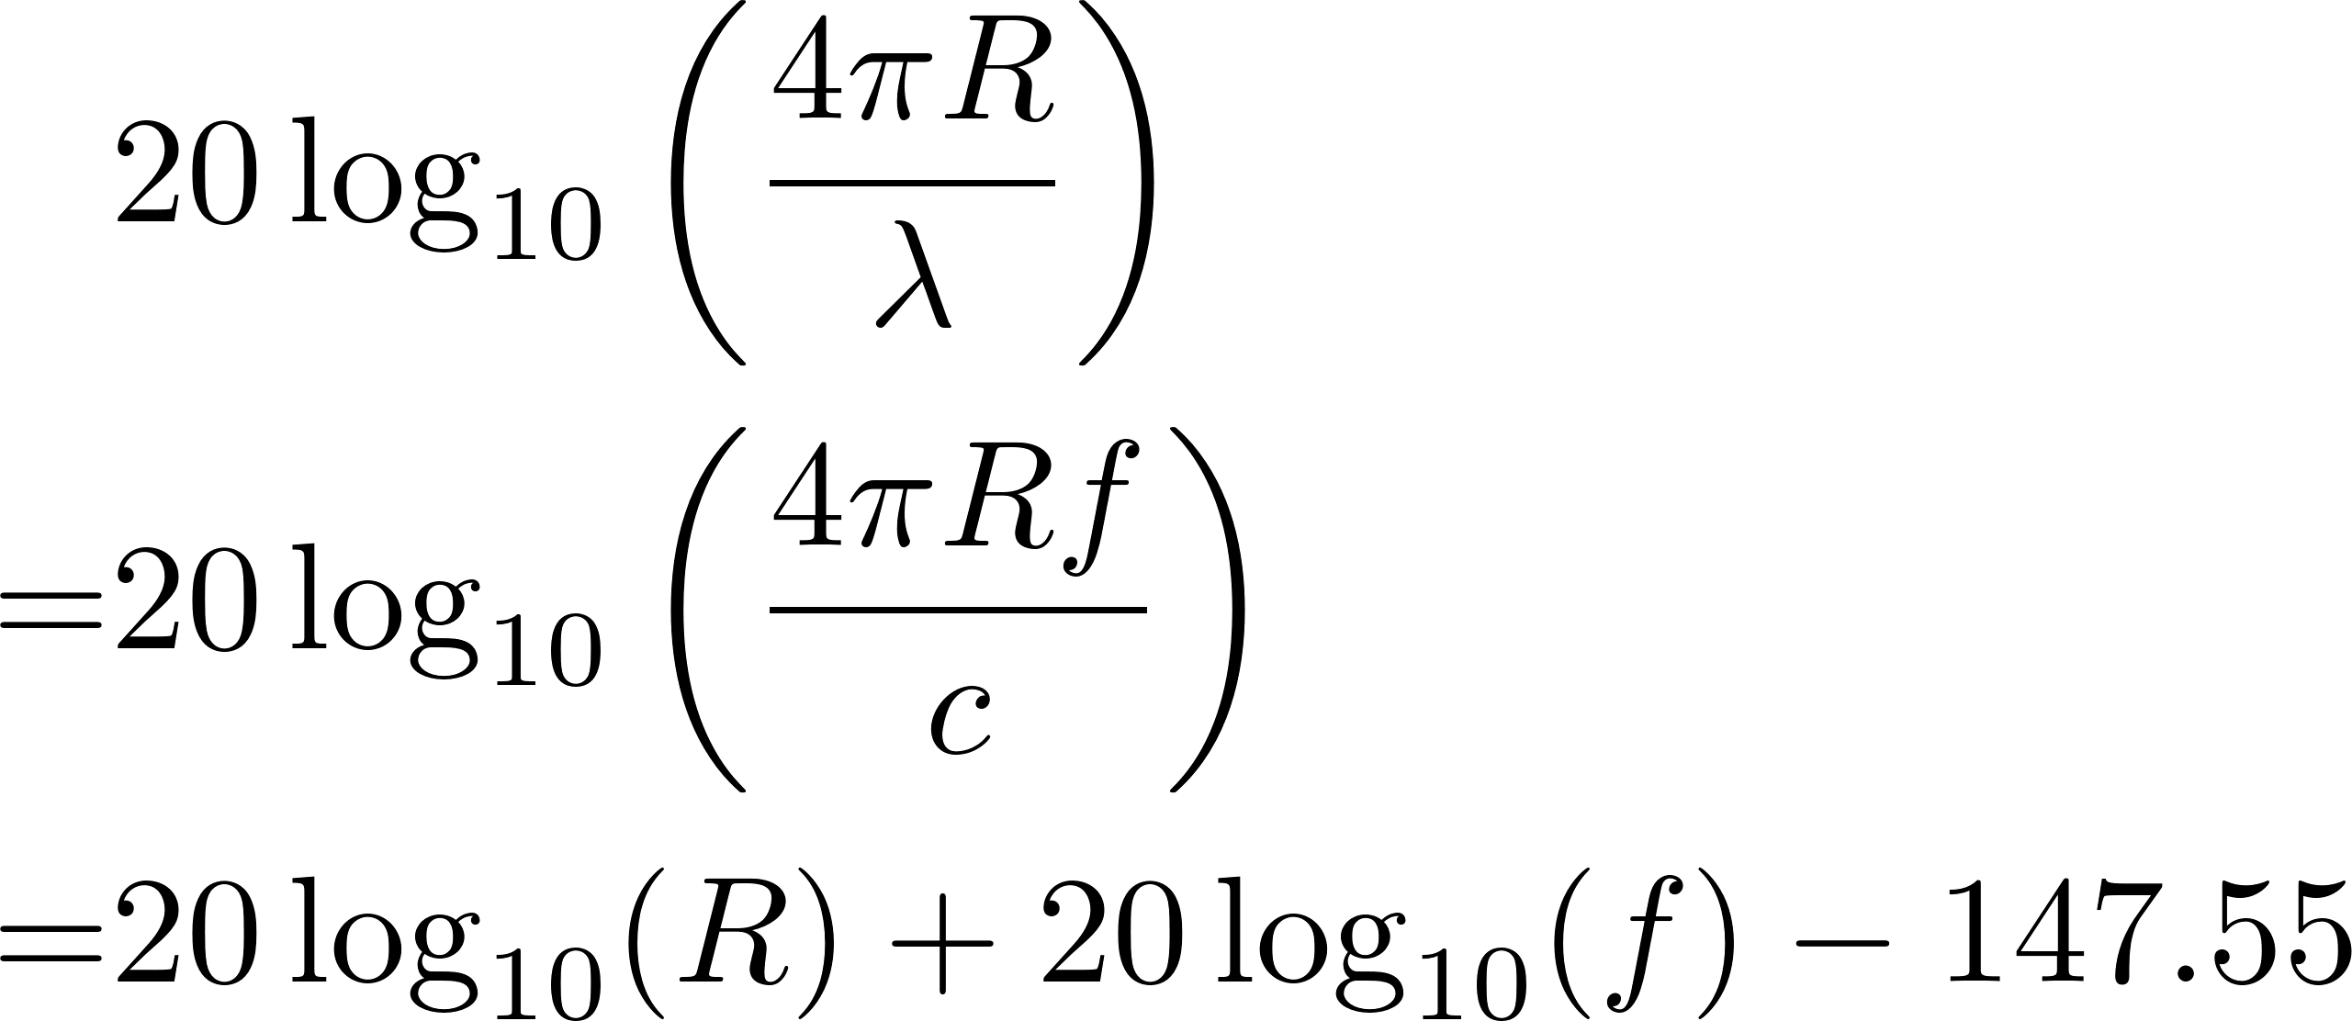
Free Space Path Loss

Slide 16
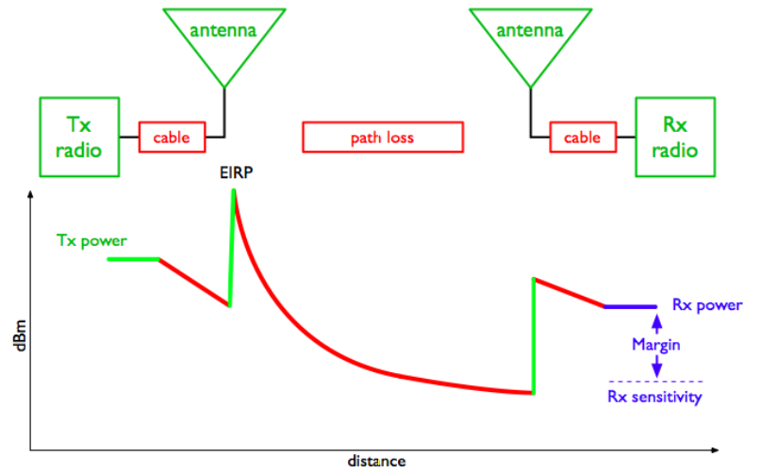
Power distribution in an RF system

Slide 17
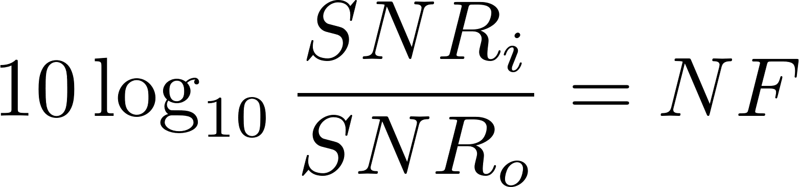
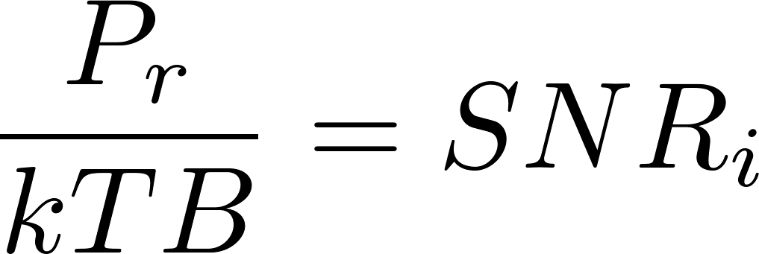
Estimating System Performance
Start with the required signal to noise ratio (SNR_{o})
For communication systems, the SNR determines transmission error rate
For radar systems, the SNR determines whether a successful detection can be achieved
Calculate the system noise figure (NF_{sys}) by cascade analysis
Calculate the input signal to noise ratio (SNR_{i})
Calculate the required receive power P_{r}
From Friis formula, find out either
Required transmit power given a range
Maximum working distance given a transmit power
Double check the non-linearity! (P1dB, IP3, IP2)

