Slide 1
Design of RF & Microwave Systems
EEC 134 A&B
Lecture 5: Building Blocks of RF Systems
– Mixers
Xiaoguang “Leo” Liu
Assistant Professor
School of Electrical and Computer Engineering
Tel: 530-289-6367
lxgliu@ucdavis.edu
http://ucdart.net

Slide 2
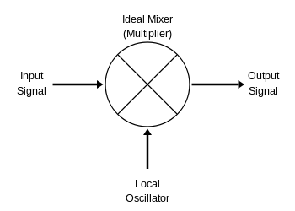
Heterodyne
“Heterodyning is a radio signal processing technique popularized by Canadian inventor-engineer Reginald Fessenden in 1901, in which new frequencies are created by combining or mixing two frequencies.”
“The two frequencies are combined in a nonlinear signal-processing device such as a vacuum tube, transistor, or diode, usually called a mixer. In the most common application, two signals at frequencies f₁ and f₂ are mixed, creating two new signals, one at the sum f₁ + f₂ of the two frequencies, and the other at the difference f₁ − f₂. These new frequencies are called heterodynes. Typically only one of the new frequencies is desired, and the other signal is filtered out of the output of the mixer.”
f₁ + f₂
f₁
f₁ − f₂
f₂

Slide 3


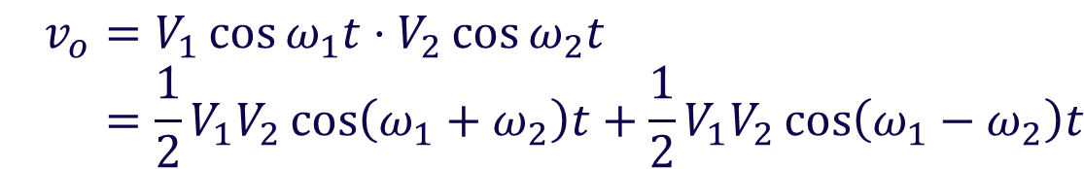


The Ideal Multiplier
A multiplier can realize the mixer function
Consider $v_{1}=V_{1}\cos{ω_{1}t}$, and $v_{2}=V_{2}\cos{ω_{2}t}$
input
output
$$v_{1}$$
$$v_{o}=v_{1}×v_{2}$$
input
$$v_{2}$$
$$v_{o}=V_{1}\cos{ω_{1}t}⋅V_{2}\cos{ω_{2}t } \\ =\frac{1}{2}V_{1}V_{2}\cos\left(ω_{1}+ω_{2}\right)t+\frac{1}{2}V_{1}V_{2}\cos\left(ω_{1}−ω_{2}\right)t$$
Sum and difference
frequencies

Slide 4




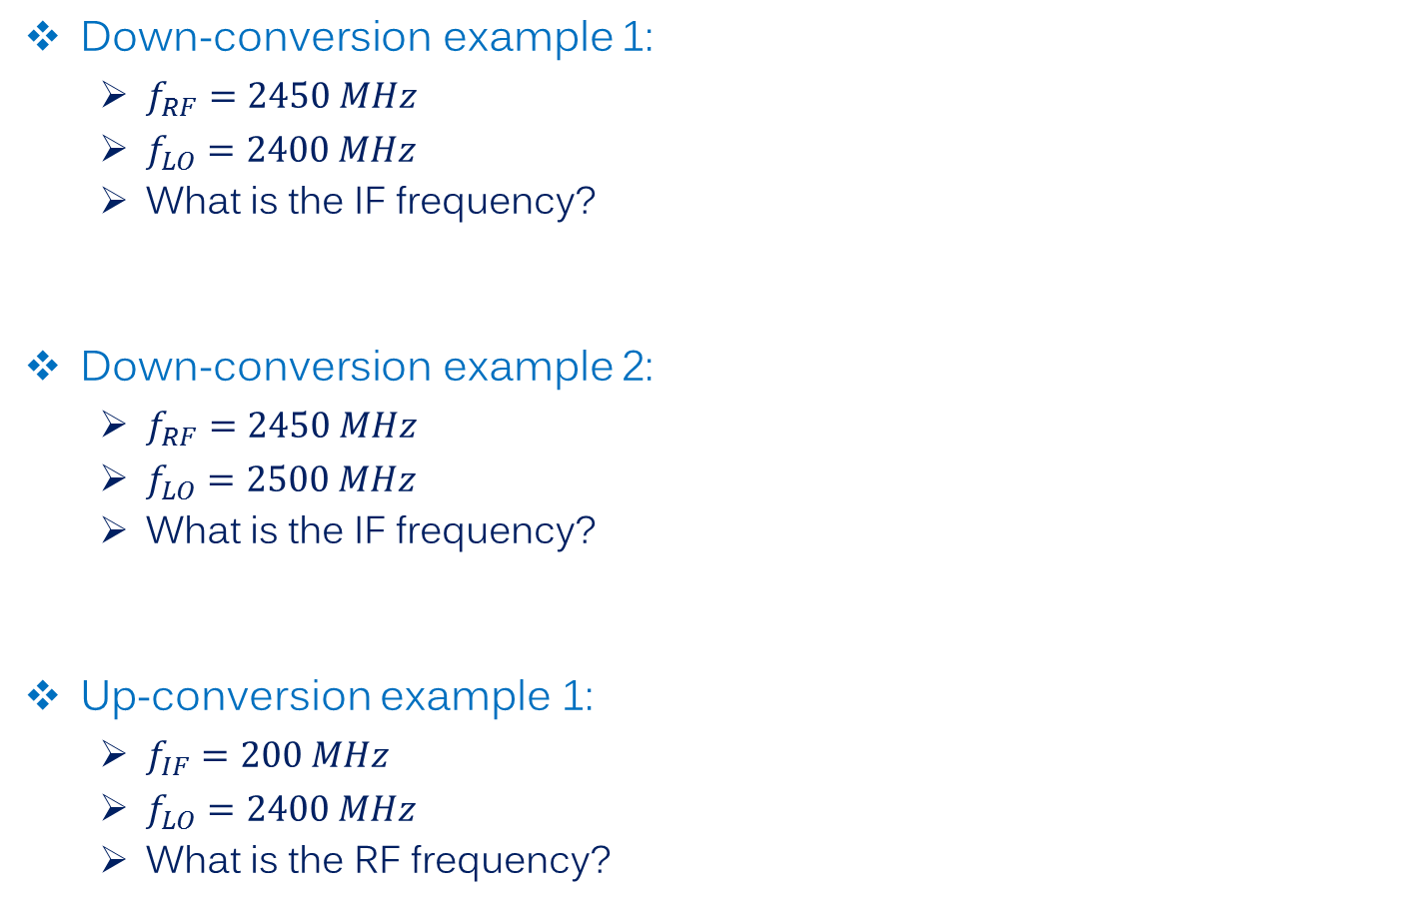






Mixer in an RF System
$$f_{LO}$$
Down-conversion example 1:
$f_{RF}=2450 MHz$
$f_{LO}=2400 MHz$
What is the IF frequency?
Down-conversion example 2:
$f_{RF}=2450 MHz$
$f_{LO}=2500 MHz$
What is the IF frequency?
Up-conversion example 1:
$f_{IF}=200 MHz$
$f_{LO}=2400 MHz$
What is the RF frequency?
$$f_{IF}$$
$$f_{RF}$$
$$f_{LO}$$
$$f_{IF}$$
$$f_{RF}$$
$$f_{LO}$$
$$f_{RF}$$
$$f_{RF}$$
$$f_{IF}$$
http://www.digikey.com/en/articles/techzone/2011/oct/the-basics-of-mixers

Slide 5

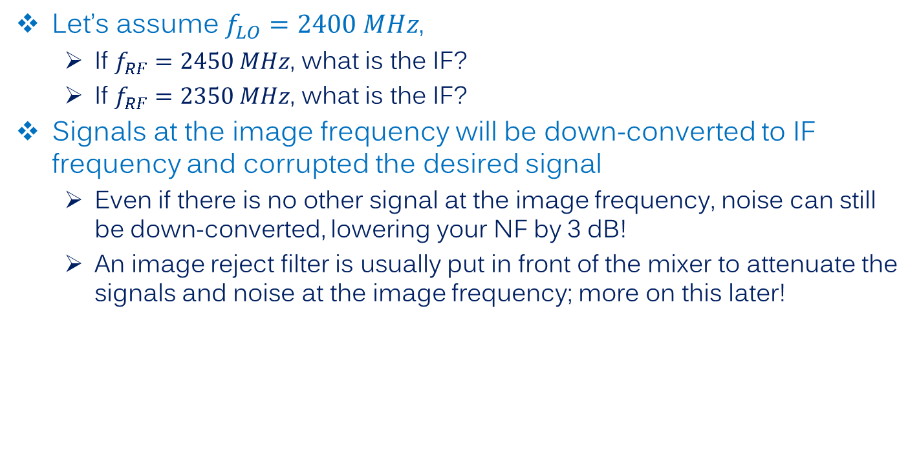



Image Frequency
Let’s assume $f_{LO}=2400 MHz$,
If $f_{RF}=2450 MHz$, what is the IF?
If $f_{RF}=2350 MHz$, what is the IF?
Signals at the image frequency will be down-converted to IF frequency and corrupted the desired signal
Even if there is no other signal at the image frequency, noise can still be down-converted, lowering your NF by 3 dB!
An image reject filter is usually put in front of the mixer to attenuate the signals and noise at the image frequency; more on this later!
$$f_{LO}$$
$$f_{RF}$$
$$f_{image}$$
$$f_{IF}$$

Slide 6
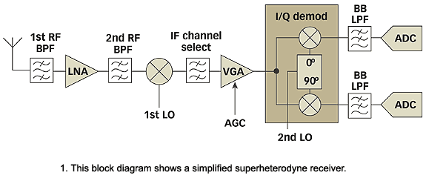
Superheterodyne Receiver
Block diagram with a more modern look
Principles are still the same
http://mwrf.com/components/quad-demodulators-arm-direct-conversion-receivers

Slide 7
Mixer Implementations
Fundamentally, mixing (heterodyning) can happen by two mechanisms
Non-linear circuit
Linear but time-variant circuit
(Of course!) non-linear and time-variant circuit

Slide 8

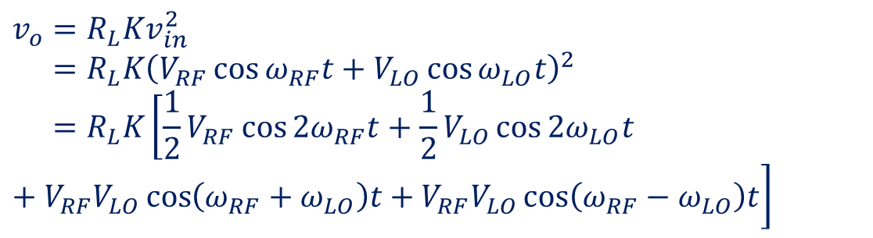





Mixing by Non-linear Circuit
$$i_{o}$$
Example: consider a square-law device (could be a properly biased diode or FET transistor)
$$v_{RF}$$
+
$$R_{L}$$
$$v_{in}$$
$$v_{LO}$$
-
$$i_{o}=Kv_{in}^{2}$$
Spurious signals
$$v_{o}=R_{L}Kv_{in}^{2} \\ =R_{L}K{\left(V_{RF}\cos{ω_{RF}t}+V_{LO}\cos{ω_{LO}t}\right)}^{2} \\ =R_{L}K\left[\frac{1}{2}V_{RF}\cos{2ω_{RF}t}+\frac{1}{2}V_{LO}\cos{2ω_{LO}t}+V_{RF}V_{LO}\cos\left(ω_{RF}+ω_{LO}\right)t+V_{RF}V_{LO}\cos\left(ω_{RF}−ω_{LO}\right)t\right]$$
Mixing products

Slide 9
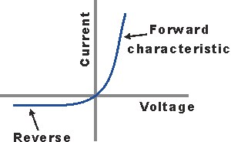

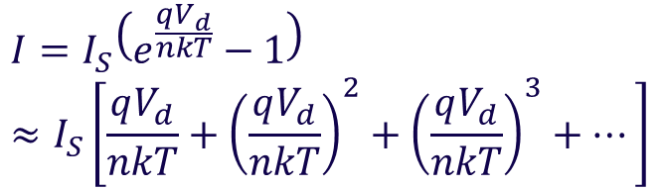


Mixing by Non-linear Circuit
Simple diode mixer
Diodes typically exhibit exponential I-V characteristics, which, at small signals, can be expanded to a polynomial
Schottky diodes are predominant in mixer applications, particularly at millimeter-wave frequencies, because of their fast transition time
$$V_{IF}$$
$$V_{RF}$$
$$V_{LO}$$
Non-linear region for mixer applications
$$I=I_{S}\left(e^{\frac{qV_{d}}{nkT}}−1\right) \\ ≈I_{S}\left[\frac{qV_{d}}{nkT}+{\left(\frac{qV_{d}}{nkT}\right)}^{2}+{\left(\frac{qV_{d}}{nkT}\right)}^{3}+…\right]$$
Mixing

Slide 10
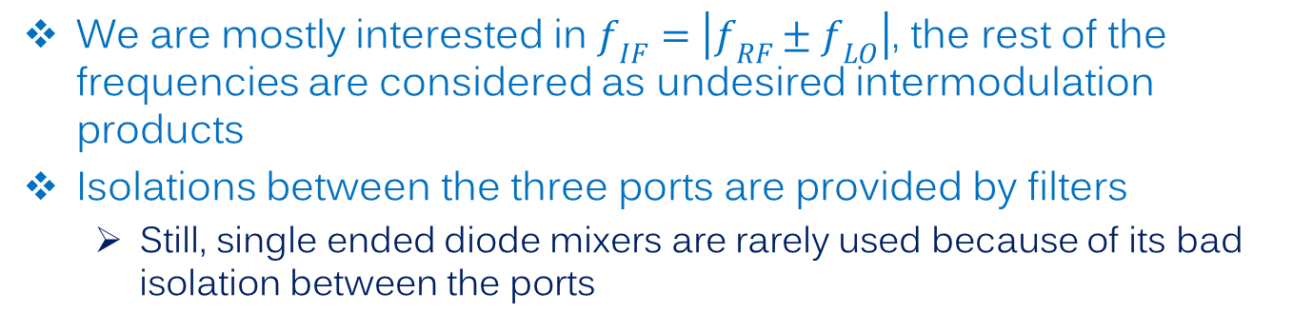



Diode Mixer
Mixing by non-linear circuit tend to generate a lot of spurious signals
Output frequency spectrum is now more complex than a simple ideal multiplier
$$V_{IF}$$
BPF
$$V_{RF}$$
LPF
BPF
$$V_{LO}$$
$$f_{IF}=±m⋅f_{RF}±n⋅f_{LO},$$
$$m=0, 1, 2, 3, …$$
$$n=0, 1, 2, 3, …$$
We are mostly interested in $f_{IF}=\left|f_{RF}±f_{LO}\right|$, the rest of the frequencies are considered as undesired intermodulation products
Isolations between the three ports are provided by filters
Still, single ended diode mixers are rarely used because of its bad isolation between the ports

Slide 11
Mixing by Other Forms of Non-linearities
Use transistor non-linearities
VDC
L1
RF
BPF
C1
IF
LO
Q1
BPF
R1

Slide 12





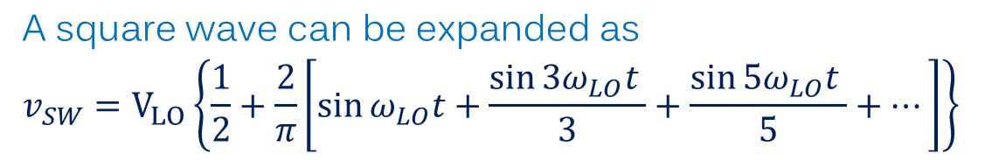

Mixing by Linear Time Varying Circuit
A simple time-variant circuit consisting of a switch controlled by the LO signal
$$v_{RF}$$
$$v_{RF}$$
$$R_{L}$$
$$R_{L}$$
$$v_{LO}$$
$$v_{LO}$$
A square wave can be expanded as
$$v_{SW}=V_{LO}\left\{\frac{1}{2}+\frac{2}{π}\left[\sin{ω_{LO}t}+\frac{\sin{{3ω}_{LO}t }}{3}+\frac{\sin{{5ω}_{LO}t }}{5}+…\right]\right\}$$
$$v_{o}=V_{RF}\cos{ω_{RF}t}⋅V_{LO}\left\{\frac{1}{2}+2/π\left[\sin{ω_{LO}t}+\frac{\sin{{3ω}_{LO}t }}{3}+\frac{\sin{{5ω}_{LO}t }}{5}+…\right]\right\}$$
Notes:
Add source impedance

Slide 13
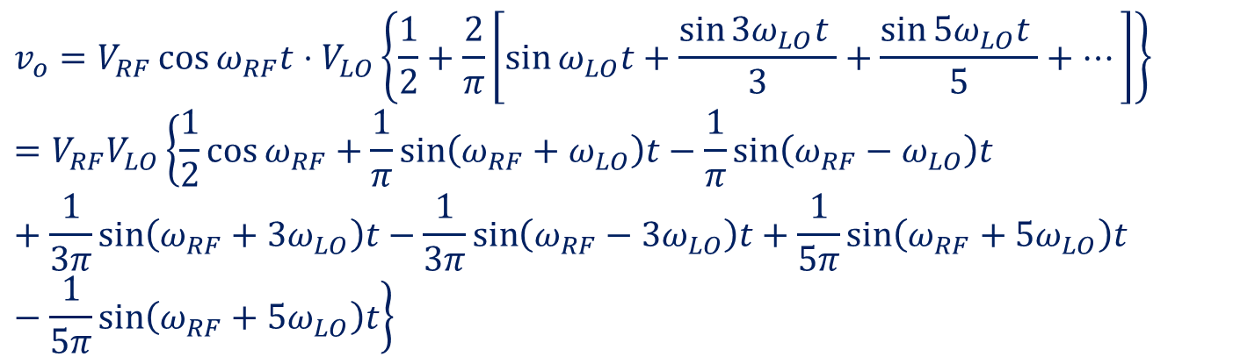
Mixing by Linear Time Varying Circuit
A simple time-variant circuit consisting of a switch controlled by the LO signal
$$v_{RF}$$
$$v_{RF}$$
$$R_{L}$$
$$R_{L}$$
$$v_{LO}$$
$$v_{LO}$$
Mixing products
RF Feed-through
$$v_{o}=V_{RF}\cos{ω_{RF}t}⋅V_{LO}\left\{\frac{1}{2}+\frac{2}{π}\left[\sin{ω_{LO}t}+\frac{\sin{{3ω}_{LO}t }}{3}+\frac{\sin{{5ω}_{LO}t }}{5}+…\right]\right\} \\ =V_{RF}V_{LO}\left\{\frac{1}{2}\cos{ω_{RF}}+\frac{1}{π}\sin\left(ω_{RF}+ω_{LO}\right)t−\frac{1}{π}\sin\left(ω_{RF}−ω_{LO}\right)t+\frac{1}{3π}\sin\left(ω_{RF}+{3ω}_{LO}\right)t−\frac{1}{3π}\sin\left(ω_{RF}−{3ω}_{LO}\right)t+\frac{1}{5π}\sin\left(ω_{RF}+{5ω}_{LO}\right)t−\frac{1}{5π}\sin\left(ω_{RF}+{5ω}_{LO}\right)t\right\}$$
Spurs; but not with even order harmonics of the LO

Slide 14






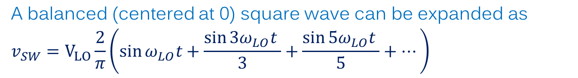
Mixing by Linear Time Varying Circuit
A balanced LO drive can reduce RF feed-through
A=1
A=1
$$v_{RF}$$
$$R_{L}$$
$$v_{RF}$$
$$R_{L}$$
A=-1
A=-1
$$v_{LO}$$
$$v_{LO}$$
A balanced (centered at 0) square wave can be expanded as
$$v_{SW}=V_{LO}\frac{2}{π}\left(\sin{ω_{LO}t}+\frac{\sin{{3ω}_{LO}t }}{3}+\frac{\sin{{5ω}_{LO}t }}{5}+…\right)$$
$$v_{o}=V_{RF}V_{LO}\left(\cos{ω_{RF}t}\sin{ω_{LO}t}+\cos{ω_{RF}t}\frac{\sin{{3ω}_{LO}t }}{3}+\cos{ω_{RF}t}\frac{\sin{{5ω}_{LO}t }}{5}+…\right)$$
Mixing products
Spurs

Slide 15
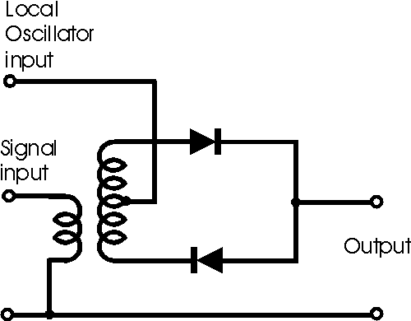
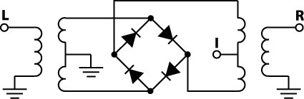
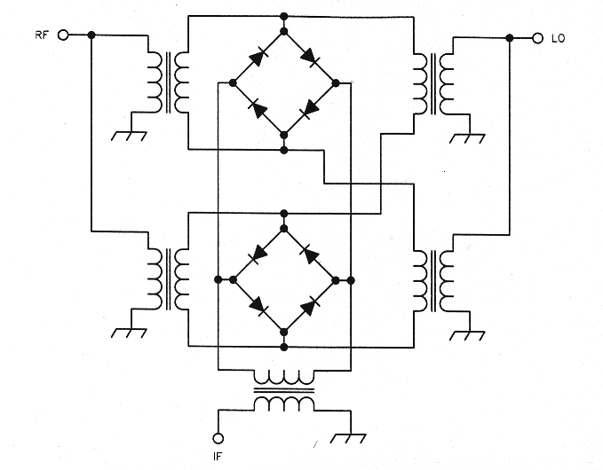
Balanced Mixer Designs
Single balanced
2 diodes for flipping the sign of the RF signal
Double balanced
A ring of 4 diodes
Double Double-balanced
Double ring of 8 diodes
http://www.radio-electronics.com/info/circuits/diode_single_balanced_mixer/diode_single_balanced_mixer.php
http://www.minicircuits.com/pages/SIM_Upcon_U712H_int1.htm
http://www.robkalmeijer.nl/techniek/electronica/radiotechniek/hambladen/qst/1993/12/page32/

Slide 16



Realizing a Switching based Mixer
Diode as a switch
Use a large (typically 20-dB larger than RF) LO to turn the diode on and off
Circuit would be identical to a non-linear diode mixer, but much less spurs
$$V_{IF}$$
$$V_{RF}$$
$$V_{LO}$$
LO Drive

Slide 17
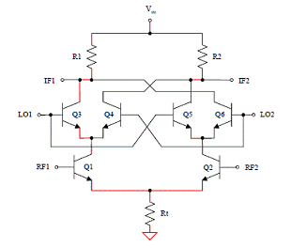
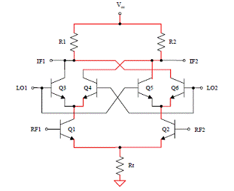
Circuit Implementation of a Multiplier
Gilbert Cell
A general 4-quadrand multiplier
Active circuit, so it give gain to the RF signal
Double balanced
When used as an RF-mixer, LO signal needs to be large in amplitude so that they can switch the transistors fast
http://www.bessernet.com/articles/mixernoise/mixerNoise6.htm

Slide 18
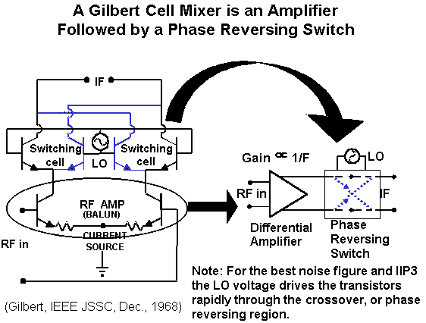
Circuit Implementation of a Multiplier
http://www.bessernet.com/articles/mixernoise/mixerNoise6.htm

Slide 19
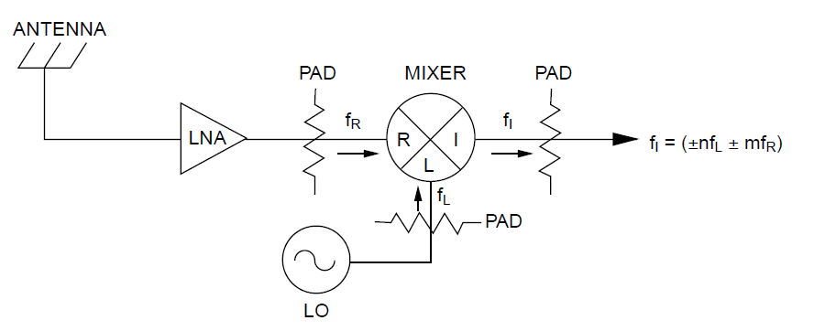
Mixer Specifications – Impedance Matching
The need for impedance matching doesn’t need further explanation
However, for switching based mixers, impedance matching can be difficult of the time-varying nature of the circuit
Impedance matching is really a LTI concept
Pay attention to the VSWR or return loss specs of mixers!
A=1
$$v_{RF}$$
$$R_{L}$$
A=-1
$$v_{LO}$$
Attenuators or isolator/circulators may be needed to improve matching

Slide 20
Attenuator (Pad) as Matching Network
Attenuators can indeed work as a matching network, and in fact a very wideband one
Albeit with a lot of signal loss!
10 dB Atten
300 Ω

Slide 21











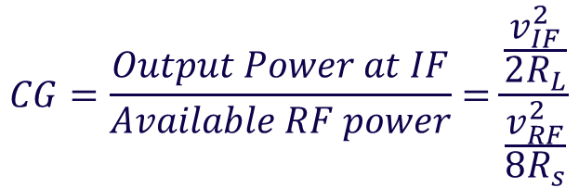
Mixer Specifications – Conversion Gain (Loss)
Conversion Gain (Loss): energy conversion efficiency from RF to IF
$$R_{S}$$
$$v_{IF}$$
$$v_{RF}$$
+
$$v_{in}$$
$$R_{L}$$
$$ConvGain(CG)=\frac{v_{IF}}{v_{in}}$$
-
$$v_{LO}$$
Or
$$CG=\frac{Output Power at IF}{Available RF power}=\frac{\frac{v_{IF}^{2}}{2R_{L}}}{\frac{v_{RF}^{2}}{8R_{s}}}$$
$$f_{LO}$$
$$f_{RF}$$
$$f_{IF}=f_{LO}−f_{RF}$$
$$f_{IF}=f_{LO}+f_{RF}$$
Note that because two mixing products (sum and difference) are generated, there is an automatic 3-dB loss
Active mixers may give gain; while passive mixers (e.g. diode mixers) give loss

Slide 22
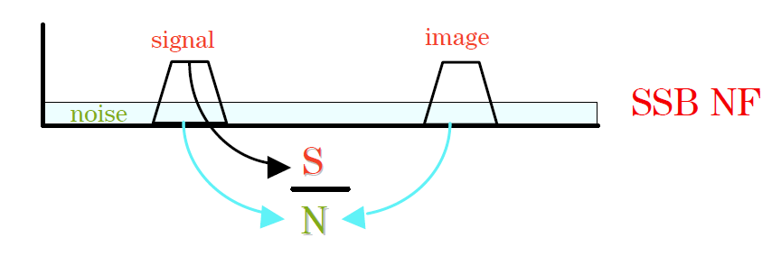
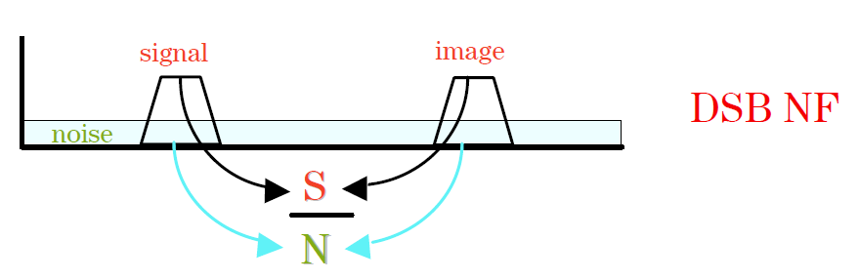
Mixer Specifications – Noise
Single-sideband noise: takes signal from one sideband but noise from both
Double-sideband noise: takes signals and noise from both sidebands
DSB NF would usually be 3-dB less than the SSB NF
For passive mixers, the NF is usually equal to the conversion gain (under the assumption that the mixer is well matched at the RF and IF ports)

Slide 23
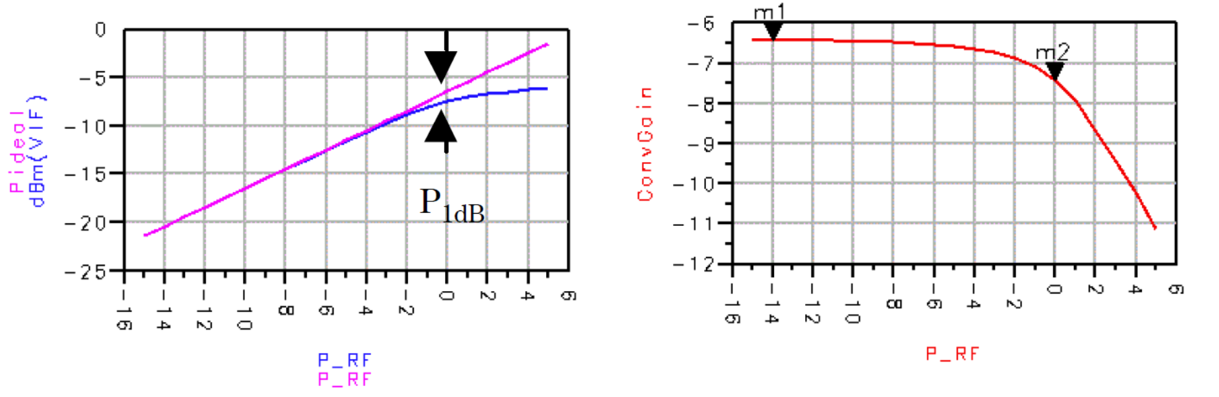
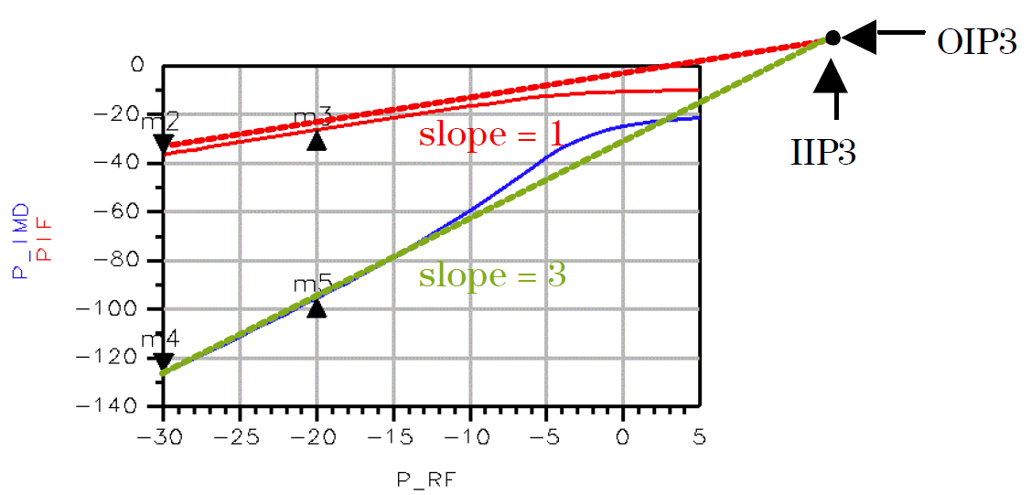
Mixer Specifications – Power Handling
The concept of nonlinearity metrics such as P1dB and IP3 are the same as in amplifiers we studied before
Gain compression – P1dB
Intermodulation – IP3

Slide 24
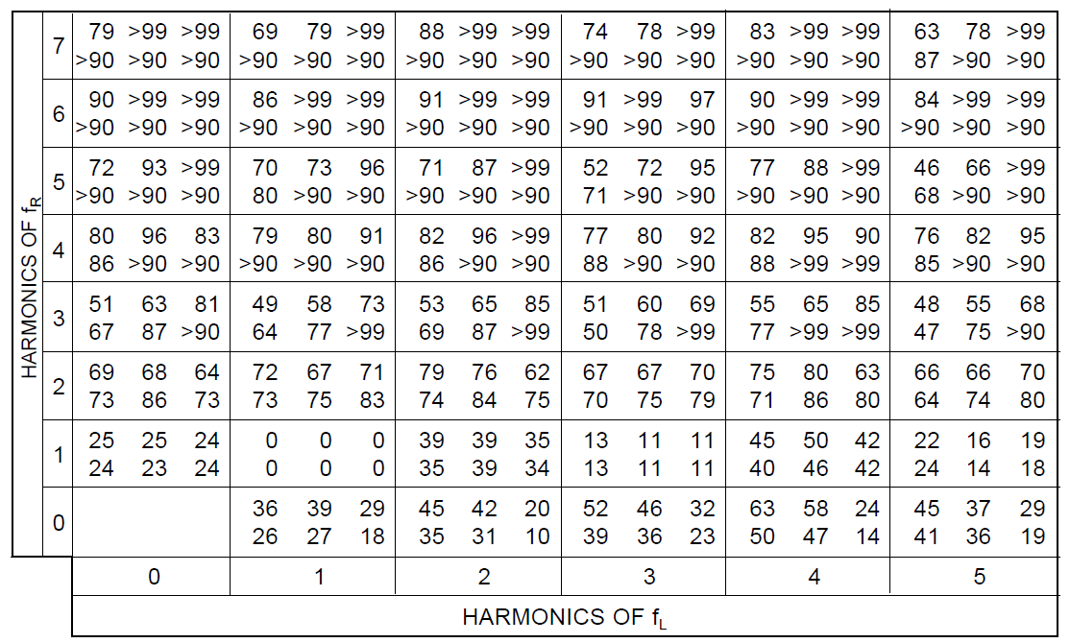
Mixer Specifications – Intermodulation
At the IF output, you may have a lot of intermodulation products
Some vendors provide tables of these intermod products (often specified relative to the IF output power)

Slide 25
Mixer Specifications -- Isolation
Isolation (feed-through): insertion loss between ports (at the same frequency)
Important ones: LO->RF feed-through, LO->IF feed-through
Not so important ones:
RF->IF: typically too small compared with the IF signals
IF->RF: typically too small compared with the LO->RF feed-through
IF->LO and RF->LO: typically too small to interfere with the LO circuit
RF
IF
LO-RF feed-through may radiate through the antenna
LO-IF feed-through may interfere with weak IF signals
LO

Slide 26
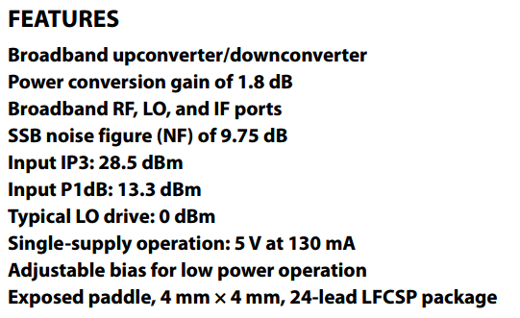
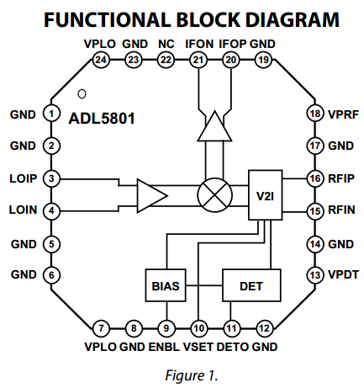
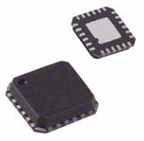
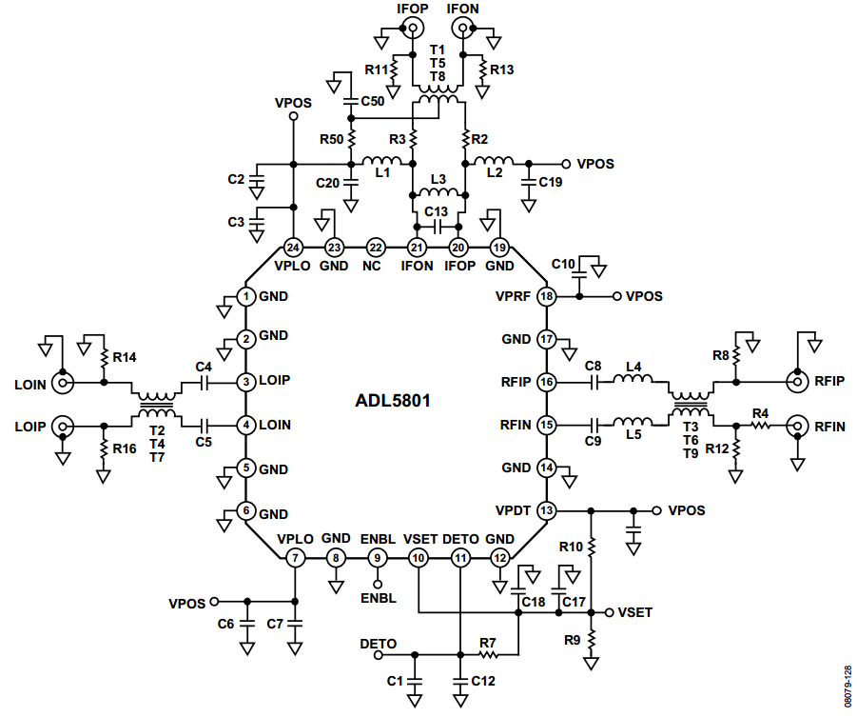
Mixer Example: Analog Devices ADL5801
Internal LO amplifier allows a small LO input
All ports are differential

Slide 27
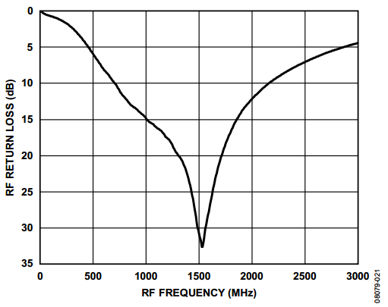
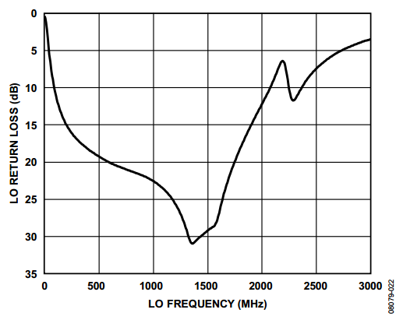
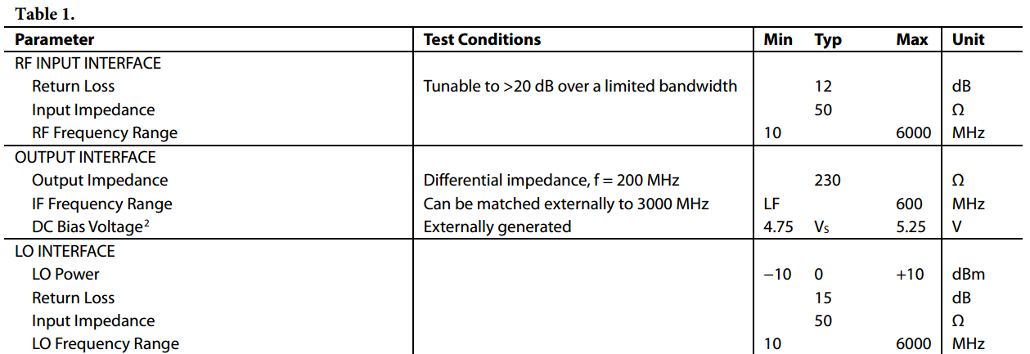
ADL5801 – Impedance Matching

Slide 28
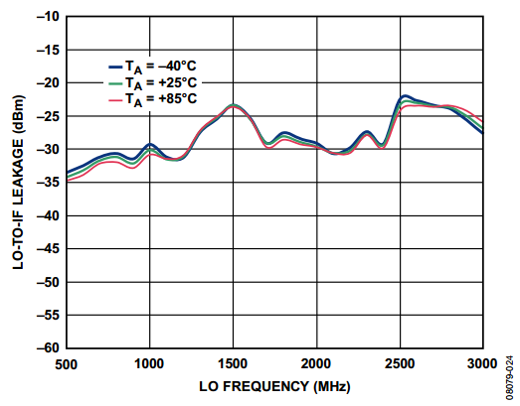
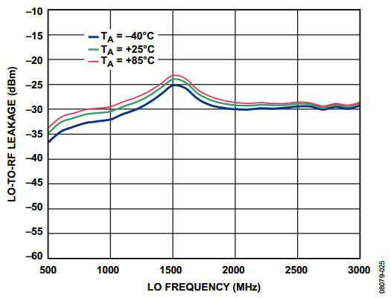
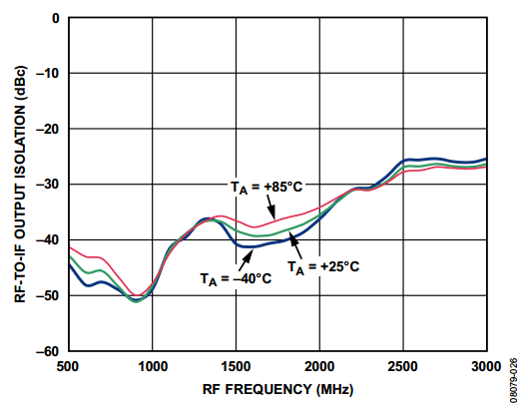
ADL5801 – Isolation

Slide 29
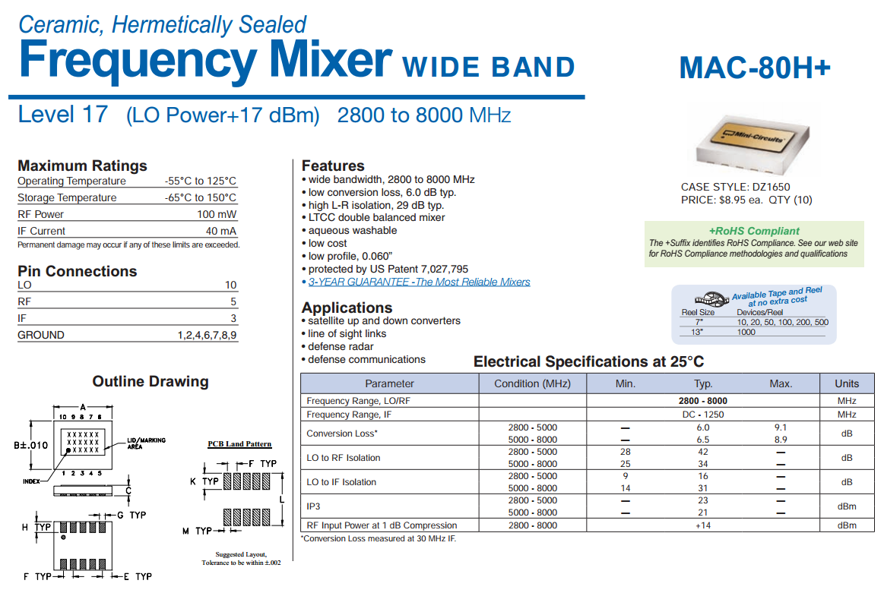
Mixer Example – MiniCircuits MAC-80H+
The level of a mixer is basically the required LO signal level

Slide 30
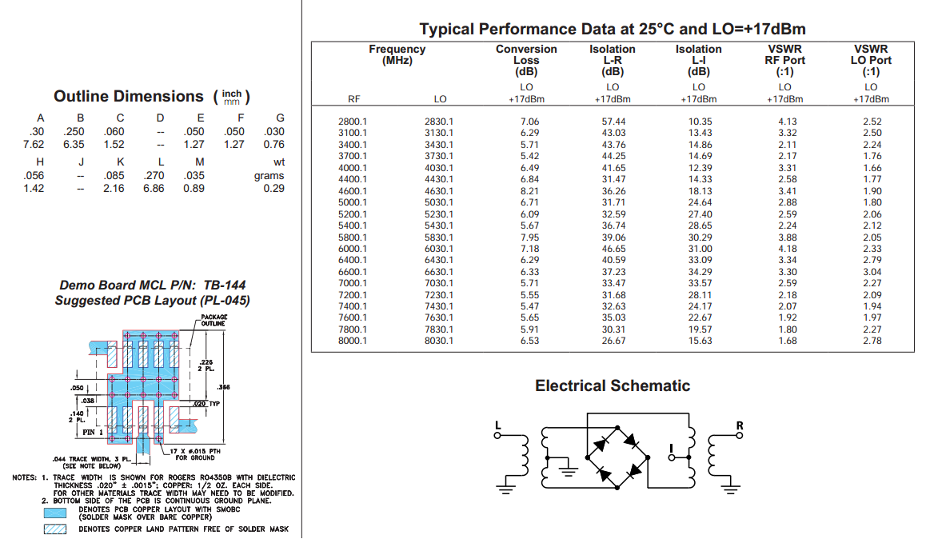
Mixer Example – MiniCircuits MAC-80H+
Read the fine prints:
Landing pad dimensions may be dependent on the substrate type and thickness

