Slide 1
Design of RF & Microwave Systems
EEC 134 A&B
Lecture 9: System Concepts
– Receiver Architecture
Xiaoguang “Leo” Liu
Assistant Professor
School of Electrical and Computer Engineering
Tel: 530-289-6367
lxgliu@ucdavis.edu
http://ucdart.net

Slide 2
RF System Design Topics
From this lecture on, we will discuss several topics related to RF/microwave system designs
Transmitter and receiver architectures
Design and estimation of system gain, noise, and non-linearity
Link budget calculation
Radar systems
Wireless communications systems
Test and measurement instrument

Slide 3
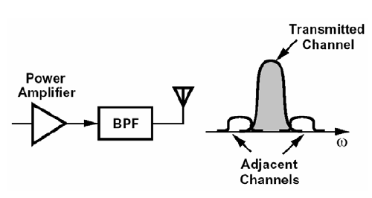
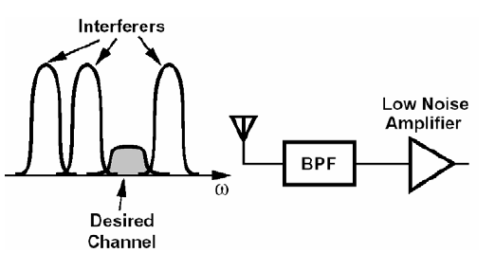
General Considerations of RF Systems Design
Transmitter
Output power
Spurious emission
Linearity
Efficiency
Complexity
Receiver
Sensitivity (noise)
Gain
Linearity
Selectivity (Immunity to Interference)
Complexity
Transmitter
Receiver
Notes:
What is needed in the receiver front-end?
• Amplification to compensate for transmission losses
• Selectivity to separate the desired signal from others
• Tunability to select the desired signal
• Conversion to digital domain

Slide 4
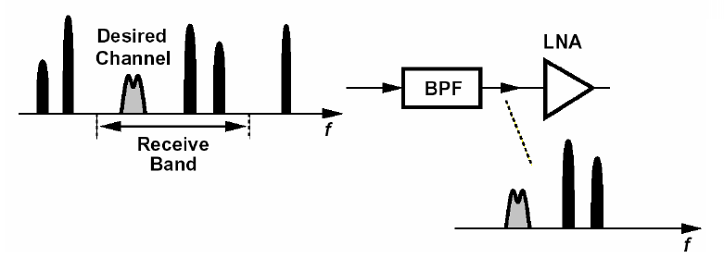
Interference

Slide 5

Interference
Interference: unwanted out-of-band or in-band signals
In practical RF system designs, interference may become the limiting factor in system performance. They must be taken into account in the design phase
LightSquared is a company that tries to develop a wholesale 4G wireless network integrated with satellite coverage across the United States.
In 2004, LightSquared acquired authorization from FCC to use the 1525 – 1559 MHz spectrum for its broadband 4G network. The Global Positioning System (GPS) uses the 1559 – 1610 MHz, which is really close
After LightSquared started deploying some of its base-stations, people noticed strong interference to some existing GPS receivers. The GPS community has since opposed the deployment of LightSquared networks. Interestingly, only those GPS receivers without a front-end filter were affected.
In 2012, FCC moved to bar LightSquared’s network because interference issues
In May 2012, LightSquared filed for bankruptcy. LightSquared has since lost $ 1.6 Billion and the figure is still rising…
Read more: http://en.wikipedia.org/wiki/LightSquared

Slide 6
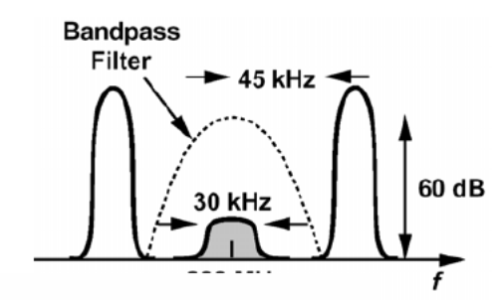
Front-end Filtering May NOT be Enough
Sometimes interferers are too close to the desired signal that the front-end filter cannot be completely eliminate the interferer.
The required filter may be too narrow-band that its loss can not be tolerated by the receiver
The front-end filter usually selects a band of frequency around the desired signal, allowing some interferers to pass through
Any receiver components must be linear enough to accommodate the interferer alongside the desired signal
Recall the non-linearity discussion in the RF Amplifiers lectures; strong interferers may desensitize or saturate the first receiver amplifier
B. Razavi, UCAL EE215C Lecture notes

Slide 7
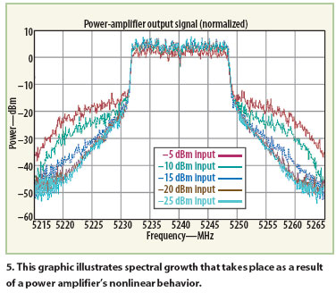
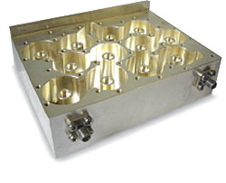
Transmitter Spurious Emission
The non-linearity of the transmitter power amplifier may cause out-of-band emission and must be well controlled
The sideband of a modulated signal rise significantly as the power amplifier enters compression and saturation region
The power amplifier must be sufficiently linearized
Or a strong filter will need to be used before the signal is transmitted to the antenna
A very low-loss output filter for base stations
B. Razavi, UCAL EE215C Lecture notes
http://mwrf.com/test-and-measurement/wireless-laboratory-aids-students-and-research

Slide 8
Receiver Arechitecture
Superheterodyne vs. Direct Conversion

Slide 9
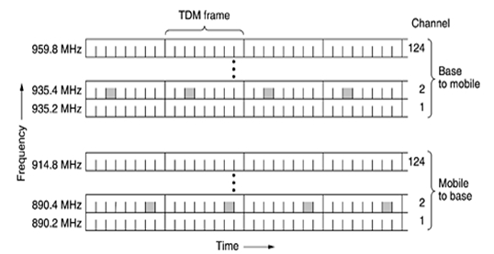
Band Selection and Channel Selection
Example: Global System for Mobile Communications (GSM) – 2G cellular standard
A GSM system has 124 pairs of simplex (meaning only transmit or only receive) channels, each of 200-kHz wide.
Selecting a channel (0.2 MHz) at the RF frequency (~900 MHz) is very difficult, if not impossible
B. Razavi, UCAL EE215C Lecture notes
http://www.thatstechnology.com/what-is-gsm-global-system-for-mobile-communications/

Slide 10
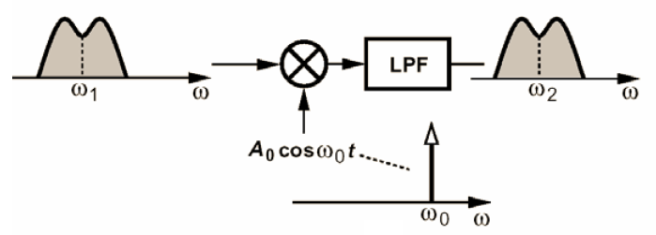
Superheterodyne Receiver
Moves RF frequency to an intermediate frequency (IF) before further processing
Easier to amplify the signals at lower frequency
Can distribute system gain at different frequencies to prevent oscillation
Selecting the channel is easier at lower frequency
A common architecture is to sweep the LO frequency to accommodate a band of RF signals
Note that it is possible to use an LO frequency higher than the RF

Slide 11
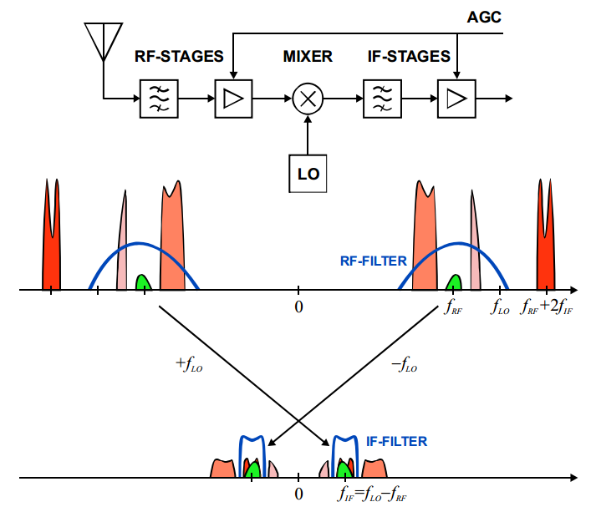
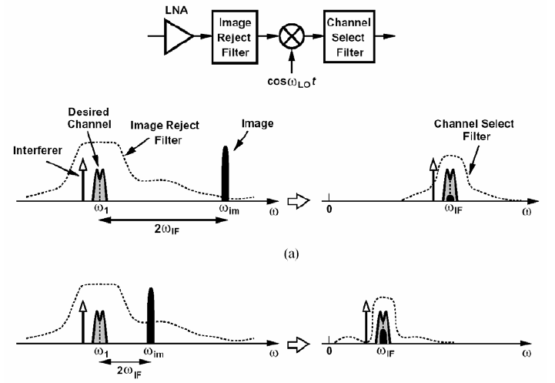
SuperHet
RF filter is only capable for band selection
Generally fixed in frequency (tunable RF filters with sufficient high Q is extremely, if not impossible, to make)
Channel selection happens at the IF frequency, where very narrowband filter are possible
Consider the following: 1 MHz bandwidth is 0.1% at 1 GHz but 10% at 10 MHz
Components have much higher Q at lower frequencies
Generally a low IF makes it easier to do channel selection; but a low IF also make the image very close to the actual signal; making it hard to filter

Slide 12
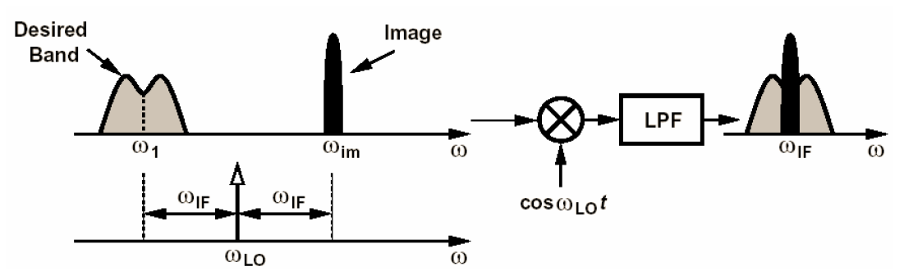
SuperHet – Image Problem
Image reject mixer will help to a certain extent
Common image reject mixers have image rejection ratio of 25-40 dB; may not be enough for a high power (> 60 dBc) interferer at the image frequency
Front-end filter (before the LNA) or an image reject filter (after the LNA, could be low pass or bandpass) may be needed
B. Razavi, UCAL EE215C Lecture notes

Slide 13
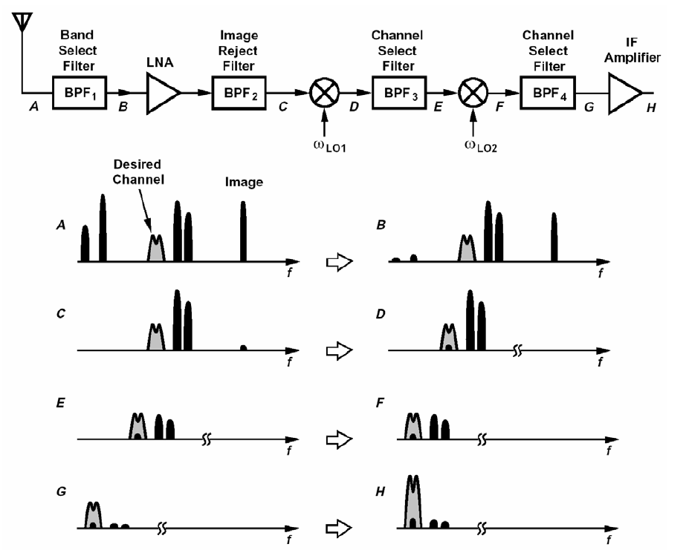
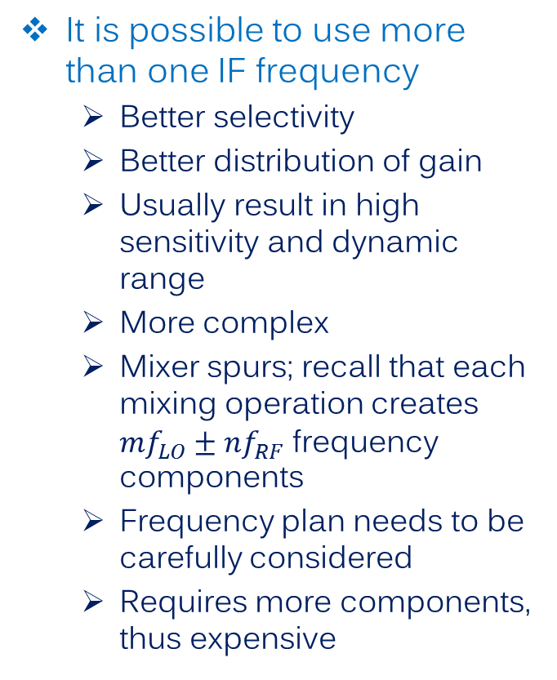
SuperHet – Dual Downconversion
It is possible to use more than one IF frequency
Better selectivity
Better distribution of gain
Usually result in high sensitivity and dynamic range
More complex
Mixer spurs; recall that each mixing operation creates $mf_{LO}±nf_{RF}$ frequency components
Frequency plan needs to be carefully considered
Requires more components, thus expensive
B. Razavi, UCAL EE215C Lecture notes

Slide 14








Up-Conversion SuperHet
It is also possible to use an IF higher than the RF
Seems counterintuitive: isn’t circuit design easier at low frequencies?
Image problem is greatly alleviated!!
Usually only the first stage is up-conversion
Low IF
$$f_{LO}=2.35 GHz$$
$$f_{image}=2.3 GHz$$
$$f_{RF}=2.4 GHz$$
$$f_{IF}=50 MHz$$
Image Reject Filter
High IF
$$f_{LO}=2.35 GHz$$
$$f_{RF}=2.4 GHz$$
$$f_{image}=7.10 GHz$$
$$f_{IF}=4.75 GHz$$
Image Reject Filter

Slide 15
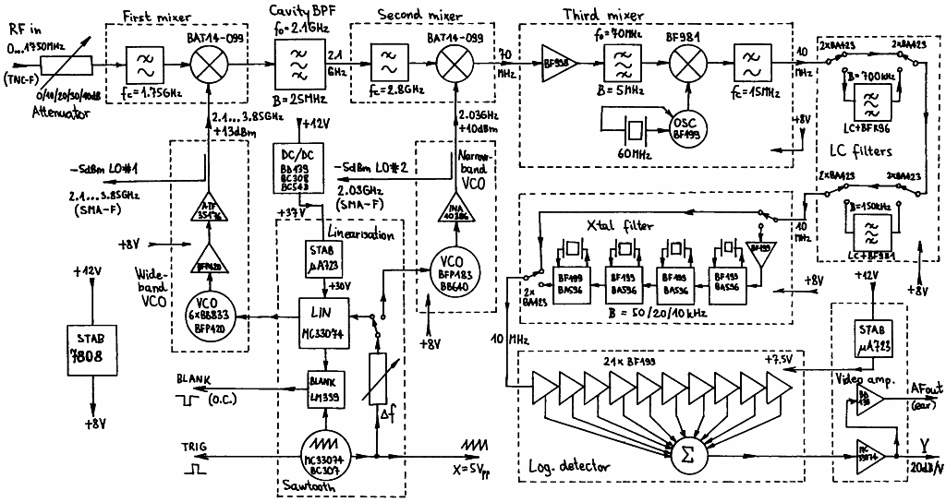
Example: A Spectrum Analyzer
Many spectrum analyzers use a high IF for their first stage
RF:
0 – 1.75 GHz
First IF:
2.1 GHz
Second IF:
70 MHz
Third IF:
10 MHz
Third LO:
60 MHz
First LO:
2.1 – 3.85 GHz
Second LO:
2.03 GHz
http://lea.hamradio.si/~s53mv/spectana/vco.html

Slide 16
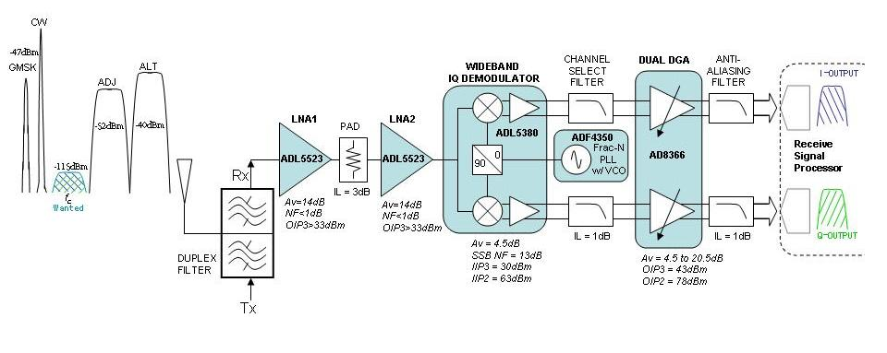
Direct Conversion Receiver
What if we set the IF to be 0? i.e. directly convert RF to baseband?
Entirely possible! We call such a receiver zero-IF or direct conversion receiver; another name for it is homodyne (which in fact has a slightly different meaning)
There is no image frequency! Image reject filters are not needed anymore
System complexity reduces significantly; very amenable to IC design
LNA does not have to drive 50 Ω; can now use a current mode LNA to improve linearity
Tuning the LO tunes the RF; easier to design a tunable RF receiver
Channel selection is performed by a fixed low pass filter
http://www.eetimes.com/document.asp?doc_id=1276400

Slide 17
Direct Conversion Receiver – Problems
No free lunch! Direct conversion receivers have their own problems
LO Leakage
DC Offset
I/Q Mismatch
Even-order distortion
Flicker Noise
Direct conversion receiver was invented in the 1930s, but the above technical issues prevented it from being used until recently
The development in large scale integrated circuits and a need to have very tunable and re-programmable RF system (software defined radio) have revived it

Slide 18
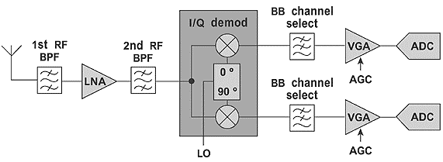
LO Leakage
Since LO and RF are of the same frequency, the LO signal can pass through all the front-end filters and the antenna
Leakage of the LO may radiate from the receiving antenna, causing interference to other users. You are transmitting on a receive frequency!
Leakage can happen through substrate coupling, an insufficient LO-RF isolation in the de-modulator/mixer, and an insufficient reverse isolation in the LNA
http://mwrf.com/components/quad-demodulators-arm-direct-conversion-receivers

Slide 19
DC Offset
When the leakage LO comes back to the de-modulator/mixer, it will mix with the actual LO to create a dc component at the baseband
LO leakage may reflect at the component boundaries where there is a mismatch
The radiated LO leakage may reflect off a nearby object to come back through the antenna
http://mwrf.com/components/quad-demodulators-arm-direct-conversion-receivers

Slide 20
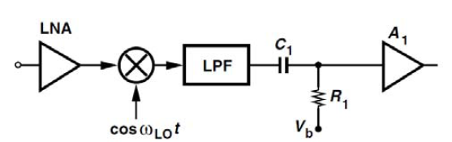
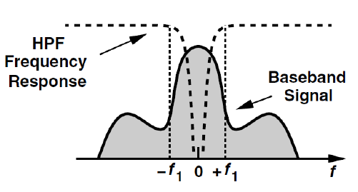
DC Offset
Since the offset occurs at dc, we can use a dc-blocking capacitor to eliminate it
The capacitor would have to be fairly large; may occupy a large chip area if the circuit is to be implemented with IC technology
Charging of the capacitor also takes time, making it hard to accommodate fast data rates
Dc-blocking won’t work for signals whose baseband spectrum has a dc component itself
B. Razavi, UCAL EE215C Lecture notes

Slide 21
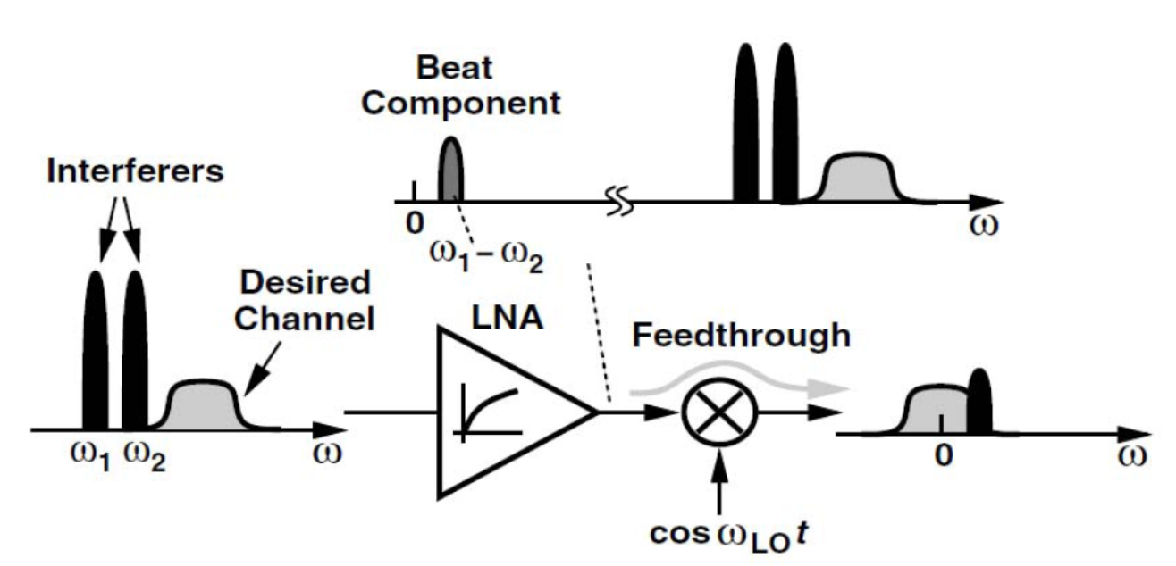
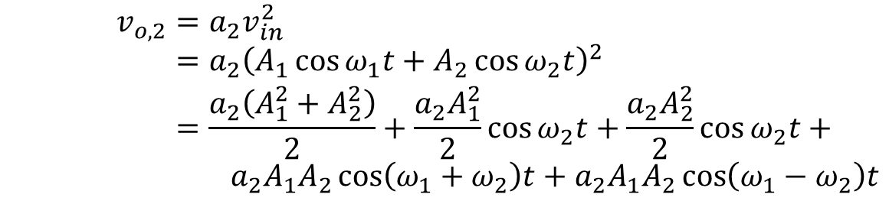
Even Order Distortion
We learned about non-linearity in the RF Amplifiers lecture and know that third-order non-linearity lead to inter-modulations products that are very close to desired signal
In a direction conversion receiver, there is one more non-linear distortion mechanism: even-order non-linearity
Consider the second order term in the amplifier non-linear input-output relationship
A
$$v_{o}=a_{0}+a_{1}v_{in}+a_{2}v_{in}^{2}+a_{3}v_{in}^{3}+…$$
With two interferers close to the desired signal frequency
$$v_{o,2}=a_{2}v_{in}^{2} \\ =a_{2}{\left(A_{1}\cos{ω_{1}t}+A_{2}\cos{ω_{2}t}\right)}^{2} \\ =\frac{a_{2}\left(A_{1}^{2}+A_{2}^{2}\right)}{2}+\frac{a_{2}A_{1}^{2}}{2}\cos{ω_{2}t}+\frac{a_{2}A_{2}^{2}}{2}\cos{ω_{2}t}+$$ $a_{2}A_{1}A_{2}\cos\left(ω_{1}+ω_{2}\right)t+a_{2}A_{1}A_{2}\cos\left(ω_{1}−ω_{2}\right)t$
Beat frequency is close to baseband!
B. Razavi, UCAL EE215C Lecture notes

Slide 22
Even Order Distortion
Beat frequency due to the second-order non-linearity term can pass through the receiver chain if the RF-IF leakage is not well controlled
Because the beat frequency is close to dc, it may corrupt the desired signal
B. Razavi, UCAL EE215C Lecture notes

Slide 23
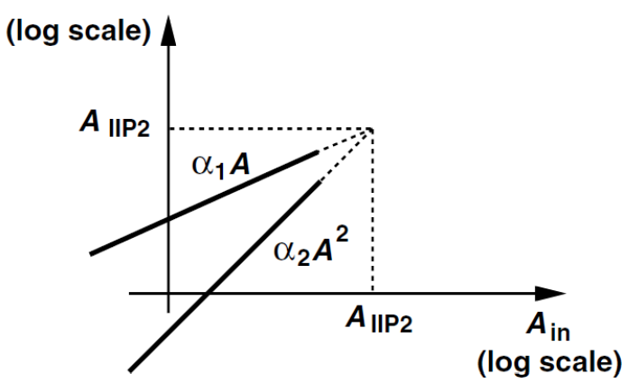
Second-Order Intercept Point
Similar to the concept of IP3, we define a second-order intercept point (IP2) for the receiver
In general, all even-order non-linearities create the low-frequency beat signals; the second-order term is usually the strongest of them
IP2 defined as the point when the second-order inter-modulation products have the same power as the fundamental term
B. Razavi, UCAL EE215C Lecture notes

Slide 24
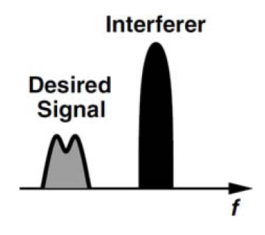
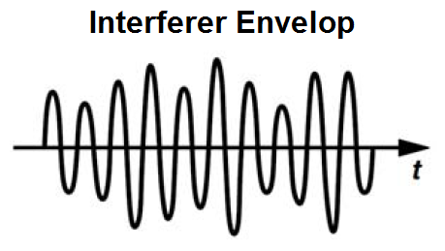
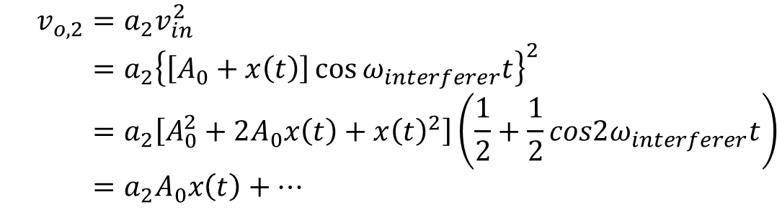
Even Order Distortion
Even-order distortion will also cause a low frequency output if the interferer has amplitude variations
The second-order term essentially works as a square-law detector
One interferer is enough to cause trouble to your baseband signal
A
The envelop singal will pass through the baseband LPF
$$v_{o,2}=a_{2}v_{in}^{2} \\ =a_{2}{\left\{\left[A_{0}+x\left(t\right)\right]\cos{ω_{interferer}t}\right\}}^{2} \\ =a_{2}\left[A_{0}^{2}+2A_{0}x\left(t\right)+x{\left(t\right)}^{2}\right]\left(\frac{1}{2}+\frac{1}{2}cos2ω_{interferer}t\right) \\ =a_{2}A_{0}x\left(t\right)+…$$
B. Razavi, UCAL EE215C Lecture notes

Slide 25
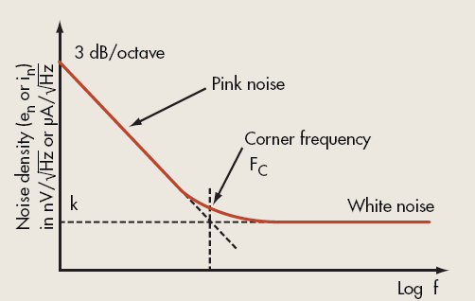
Flicker Noise
Flicker noise is a type of frequency dependent noise (compare with thermal noise, which is frequency independent for practical applications)
Flicker noise shows up as a low-frequency variation in the current or voltage in an electronic device
Flicker noise in an electronic device is always associated with a dc current
Also know as 1/f noise, as the slope of noise power follows a 1/f relationship; or pink noise, as apposed to white noise
Flicker noise is usually characterized by its corner frequency f_{c}
MOSFETs (such as CMOS transistors) have a higher fc (0.1 – 1 MHz) than JFET or bipolar transistors (could be as low as 2 kHz)
http://mwrf.com/test-and-measurement/integrated-system-tests-device-flicker-noise

Slide 26
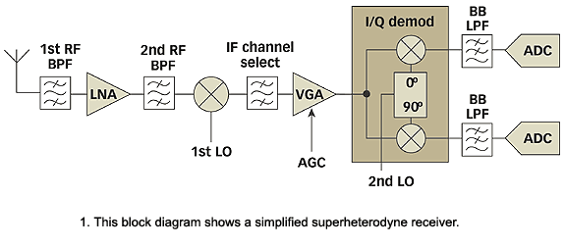
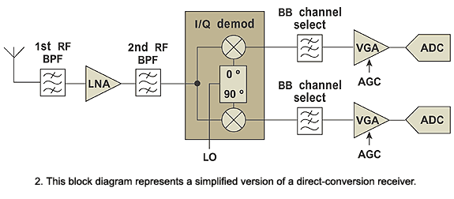
Flicker Noise in a Direction Conversion System
Since RF signal is de-modulated into basedband directly, they suffer from flicker noise in the baseband amplifier
http://mwrf.com/components/quad-demodulators-arm-direct-conversion-receivers

Slide 27
Superheterodyne vs. Direct Conversion
Superheterodyne
Superior performance in terms of sensitivity and dynamic range
Complex system design and frequency planning
Requires more components, especially high-Q filters that may be difficult to integrate into IC
Difficult to tune to a wide frequency range
Direct conversion
Flexibility in RF frequency
Fewer components, especially filters
Lower cost
Suffer from a few issues that need to be carefully taken care of
DC offset
IQ imbalance
LO leakage
Flicker noise

Slide 28
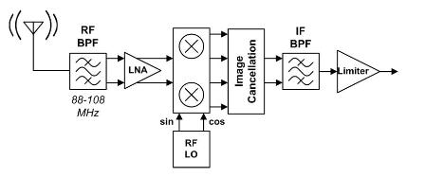
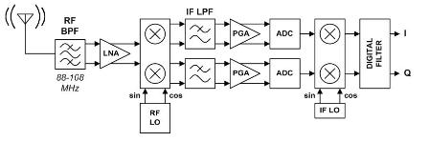
Low IF Receiver
Low IF: IF in the range of a few MHz or several hundred kHz
Advantages:
Great channel selection capability
Very much like direct conversion receiver, but without the problems of DC offset and flicker noise.
May require less components
Disadvantages:
Image frequency is very close to the RF frequency; may need a very high-Q filter; image reject mixer not be sufficient
This can be alleviated if we know for sure that there will not be interferers at the image frequency
Low-IF receivers are very popular in modern miniature FM receivers
Interferers are well known; no stronger transmitting signal in vicinity
Analog low-IF FM receiver
Digital low-IF FM receiver
http://www.edom.com.tw/en/index.jsp?lang=en&m=techview&cal=9&id=1383

