Slide 1

Autonomous Collision Avoidance for
Small Unmanned Aerial Vehicles
Comprehensive Exam
May 27th, 2015
Supervisor: Professor Liu Xiaoguang
Committee member: Professor Kent Wilken, Professor Soheil Ghiasi
Minjie Zhu, Samuel Cheung
Electrical and Computer Engineering, University of California, Davis

Slide 2
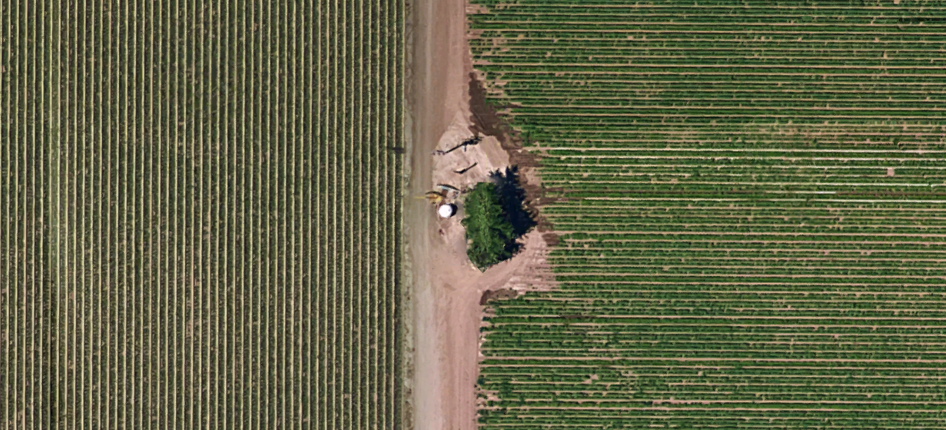
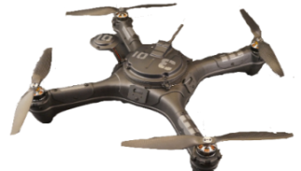
Introduction
Hardware in our project includes the quadcopter frame, the flight controller, Lidar-Lite distance sensor and radio communication tools.
The flight controller – Pixhawk, processes the data from the sensors, including barometer, accelerometer, gyroscope, compass, etc., and feeds proper current to the motors for attitude balance and frame movement .
By programming the flight controller, we can add our own algorithms and applications based on the existing ardupilot firmware codes.
Main goal of our project is to implement Autonomous Collision Avoidance feature in the new firmware

Slide 3
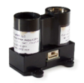
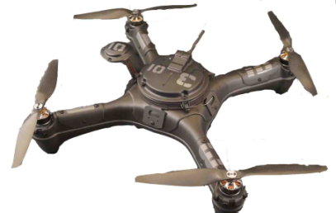
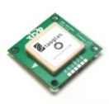


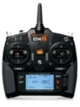
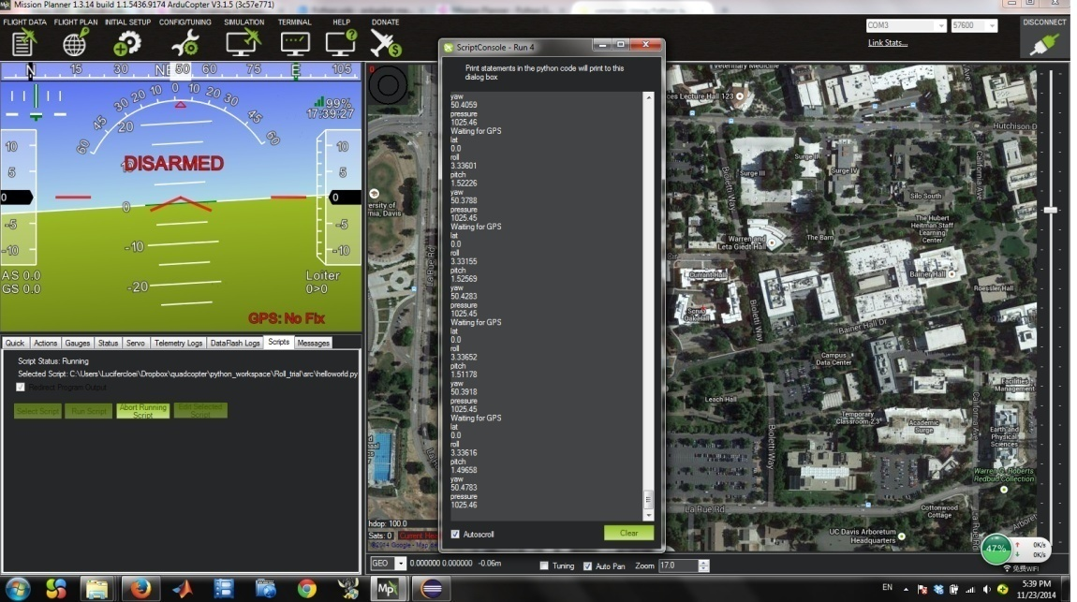

LIDAR-Lite interfaced by I2C, used for distance measurement
Quadcopter System
The system incorporates all the parts together in order to achieve the basic functionalities of flight and communicates with Mission Planner for real time monitoring of sensor data.
Pixhawk flight controller with onboard accelerometer, gyroscope and barometer
3DR uBlox GPS with compass
Aerotestra quadcopter frame
Dx6i transmits on the 2.4 GHz band for manual control of the quadcopter
3DR Radio set that communicates at 915MHz to transfer information to and from the laptop
Laptop running Mission Planner for a live feed of the sensor data and status of the quadcopter
Wireless connection
Wired connection

Slide 4
Code Hierarchy
High
Scheduler
Acts as a main()
Real time operating system – assign each thread with corresponding call frequency, priority and maximum time
New tasks can be assigned into existing fix-frequency schedules(1Hz, 10Hz, etc)
Flight Mode controller
When started, the quadcopter always enters a flight mode, such as land/loiter/etc.
Fight mode can be switched according to RC input channel 5
In each flight mode, the quadcopter can perform certain actions with/without RC input channel 1~4
Movement controller
Altitude controller - controls z-axis acceleration and adjusts altitude
Attitude controller - controls self-rotation and balances the quadcopter
Position controller - controls x,y-axis acceleration and adjust horizontal position
Waypoint controller - commands the quadcopter to move according to preset waypoint files
Library files
Onboard sensor data processing
Motor controller - converts higher level commands to the actual motor outputs
Mavlink communication with PC terminal
HAL layer
Hardware abstraction layer for digital/analog input and output
Low

Slide 5
LIDAR-Lite Sensor
Specs:
Communication protocol: I2C
Detection range: 0.2 meter to 40 meters
Beam angle: 1.5 degrees
Linear resolution: 1 cm
Issues:
I2C slave address cannot be changed. Multiple instances of LIDAR-Lite is not allowed, at least for this version.
Distance reading stagnates when the actual distance is beyond the detection range.
Power consumption is high. Flight controller cannot provide sufficient current, requiring separate battery pack.

Slide 6
LIDAR-Lite Sensor – additonal processing to fix stagnant reading
#define ACA_LIDAR_STAG_THR 100 //lidar stagnates within THR, considered as blocked,
// else considered infinite
#define ACA_LIDAR_STAG_BLOCKED 1 //return of lidar when in BLOCKED state
#define ACA_LIDAR_STAG_INIFINITE 9999 //return of lidar when in INIFINITE state
void
ACA_AI::update_lidar(int sonar_distance_cm)
{ lidar_curr = sonar_distance_cm;
if (lidar_curr == lidar_prev){lidar_stag_ct++;}
else{lidar_stag_ct = 0;}
//Lidar return value keeps the same for 1 sec, considered stagnant
if(lidar_stag_ct > ACA_LIDAR_STAG_CT)
{
if(lidar_curr >ACA_LIDAR_STAG_THR)
{lidar_cm = ACA_LIDAR_STAG_INIFINITE;}
else
{lidar_cm = ACA_LIDAR_STAG_BLOCKED;}
}
else//Lidar return value not considered stagnant
{lidar_cm = lidar_curr;}
lidar_prev = lidar_curr;
}

Slide 7
The AI class – an independent object
To implement the ACA feature, we created a new C++ class called ACA_AI. Any add on features to the original source code regarding ACA is implemented and processed in this object.
To maximize system simplicity and easiness in debugging, we embed the ACA_AI class as a thread that runs independently. The ACA_AI class will not call any function or write any variables in the other classes. The processed variables will be utilized in the modified auto flight mode.
ACA_AI.cpp
void update_lidar(int sonar_distance_cm);
void update_ten_hz(int milliseconds);
void update_state();
void apply_avoid();
void update_rc();
int wp_speed ACA_state
int rc1_input ACA_direction
int rc2_input
int rc3_input
…
Control_auto.pde
wp_nav.set_speed_xy(wp_speed);
wp_nav.set_pilot_desired_acceleration(ai.rc1_input, ai.rc2_input);
target_climb_rate = get_pilot_desired_climb_rate
(ai.rc3_input);
Arducopter.pde
sonar_distance_cm
milliseconds
Reference
Apply
Process

Slide 8
The ACA AI class – state transition diagram
lidar_cm > ACA_LIDAR_ALARM_THR
lidar_cm – variable recording distance measured by lidar
ACA_time_elapse2 – time elapsed after entering a new state
avoid_done – Boolean flag for quitting Avoid state
#define ACA_LIDAR_ALARM_THR 750
#define ACA_LIDAR_AVOID_THR 350
#define ACA_****_MIN 3000
Sleep
lidar_cm < ACA_LIDAR_AVOID_THR
ACA_time_elapse2 < ACA_HALT2SLOW_MIN
lidar_cm > ACA_LIDAR_ALARM_THR
&&
ACA_time_elapse2 > ACA_SLOW2SLEEP_MIN
Halt
lidar_cm < ACA_LIDAR_ALARM_THR
lidar_cm < ACA_LIDAR_AVOID_THR
&&
ACA_time_elapse2 > ACA_HALT2AVOID_MIN
lidar_cm < ACA_LIDAR_AVOID_THR
avoid_done == 1
Avoid
lidar_cm > ACA_LIDAR_AVOID_THR
&&
ACA_time_elapse2 > ACA_HALT2SLOW_MIN
Slow
ACA_LIDAR_AVOID_THR < lidar_cm < ACA_LIDAR_ALARM_THR
or
ACA_time_elapse2 < ACA_SLOW2SLEEP_MIN
avoid_done == 0

Slide 9
Avoid state transition diagram
fail ==1 or ACA_time_elapse < ACA_AVOID_STAY_MIN
lidar_cm – variable recording distance measured by lidar
ACA_time_elapse – time elapsed after changing direction
avoid_done – boolean flag for quiting Avoid state
#define ACA_LIDAR_AVOID_THR 350
#define ACA_AVOID_STAY_MIN 500
#define ACA_AVOID_HOR_MAX 5000
#define ACA_AVOID_HOR_MIN 3000
#define ACA_AVOID_UP_MAX 5000
ACA_time_elapse> ACA_AVOID_STAY_MIN
ACA_time_elapse < ACA_AVOID_HOR_MAX
Lidar_cm <= ACA_LIDAR_AVOID_THR
Stay
Left
Avoid_done = 1
Forward
Lidar_cm > ACA_LIDAR_AVOID_THR
&&
ACA_time_elapse > ACA_AVOID_FOR_MIN
lidar_cm > ACA_LIDAR_AVOID_THR
&&
ACA_time_elapse > ACA_AVOID_HOR_MIN
ACA_time_elapse> ACA_AVOID_UP_MAX
/ fail == 1
ACA_time_elapse > ACA_AVOID_HOR_MAX
ACA_time_elapse < ACA_AVOID_FOR_MIN
Up
Right
lidar_cm < ACA_LIDAR_AVOID_THR
or
ACA_time_elapse < ACA_AVOID_HOR_MIN
ACA_time_elapse >
2 * ACA_AVOID_HOR_MAX
ACA_time_elapse <
2 * ACA_AVOID_HOR_MAX
ACA_time_elapse < ACA_AVOID_UP_MAX

Slide 10

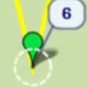
Video demonstrating successful collision avoidance (board example)
Real time recording of quadcopter
From the video, the quadcopter is running a mission across the Hutchison Field. A board holding by a moving person simulates a object with large scale. During the mission, the quadcopter attempts to avoid this object by a leftward movement first, followed by a rightward movement, finally an upward movement. The quadcopter continues its mission when it sensed that the object is bypassed successfully.
screen capture of MP
(2 Sec advance)
Legend
Way points
Desired path
Actual path

Slide 11
Video demonstrating successful collision avoidance (tree example)
Real time recording of quadcopter
Instead of a simulated object, this time the quadcopter runs into a real object – a tree in between two waypoints. The quadcopter successfully finds a way to bypass it and reaches the schedule next waypoint.
screen capture of MP
(1 Sec advance)
Legend
Way points
Desired path
Actual path

Slide 12
Extra modifications
- New flight mode – test mode
An additional flight mode is created and added to the existing 16 flight modes. The extra flight mode can be used to test whatever features created without interfering the original firmware codes, and in case of emergencies, can be switched back to loiter or land mode.
The current content in the test mode is a camera guided flight mode in collaboration with the EEC181 group. The flight controller will monitor the LIDAR sensor and write HIGH/LOW via digital I/O pins to the FPGA board. The FPGA board interprets the camera data and uses the LIDAR sensor data to send commands back to the flight controller as a master-slave configuration.
- Force landing
An additional safety feature is added. Originally, the flight controller trusts the barometer reading for altitude and will not disarm the motors if the barometer reading is above 2.5 meters. However, the barometer readings are sometimes inaccurate and a manually overridable ‘Kill switch’ is needed.
‘Force land’ is triggered whenever the RC channel inputs satisfies the following condition:
rc_4.control_in <-4000 && rc_3.control_in <5 && flight_mode == land
It enable the user to trigger motor disarm at any time, especially in the case of barometer malfunction.

Slide 13
Acknowledgement
Professor Liu, the proposer and supervisor of our project
Aerotestra, hardware provider, the Hugo quadcopter
Ardupilot, provides PC software - Mission planner, open source code and online instruction
Pixhawk, the flight controller provider
Lidar-Lite, the lidar sensor provider
Thank you!

Slide 14
Video list
 | Real time recording | Screen capture of MP
Trial1(left) | https://youtu.be/dMN22gbEJ8I
Trial2(left right) | https://youtu.be/I3Bkfkz2en8
Trial3(left right) with emergency backward | https://youtu.be/HYo1Ptd2_cM
Trial4 (tree success) | https://youtu.be/QOxHUZJT4BE | https://youtu.be/kbls5MK9pUU
Trial5 (tree failure) | https://youtu.be/HtnenL2vYqw | https://youtu.be/KqYvyc3Dg_o
Trial6 (left right up) | https://youtu.be/by2NV3cgJnc | https://youtu.be/sbxltKb1jWo

