Slide 1
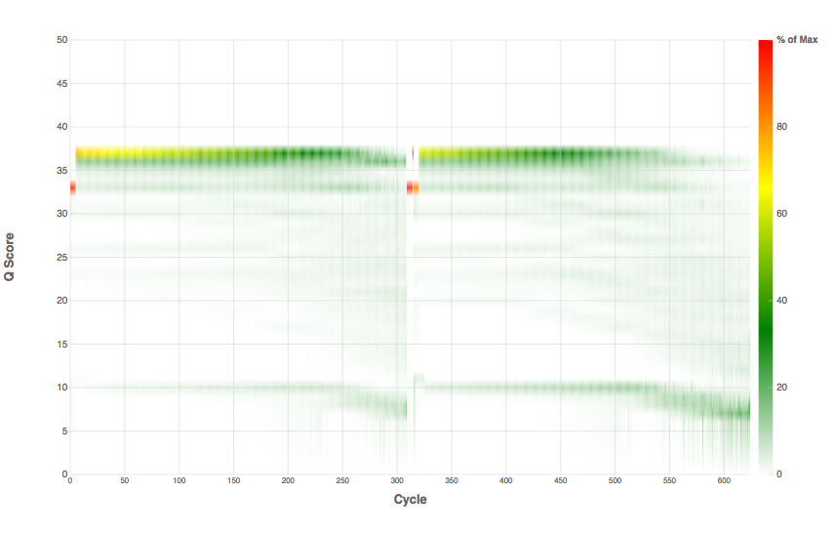
Original Sample (RNA/DNA)
[may also contain contamination,
polyA tails, etc.]
Library Preparation
[Includes fragmentation, adapter ligation]
PCR Enrichment
[not always]
Final Library
QA/QC traces
Inclusion of PhiX
By sequencing center
For QA purposes
Final Sequencing Stats
(characteristics and quality)

