Slide 1
So you want to do a: RNAseq Experiment Differential Expression Analysis
Genome Center Bioinformatics Core
University of California, Davis
bioinformatics.core@ucdavis.edu

Slide 2
Disclaimer
This talk/workshop is full of opinion, there are as many different way to perform analysis as there are Bioinformaticians.
My opinion is based on over a decade of experience and spending a considerable amount of time to understand data, how its created and how it relates to the biological questions of interest.
Each experiment is unique, this lecture is a starting place and should be adapted to the specific characteristics of your experiment.

Slide 3
What is Differential Expression
Differential expression analysis means taking normalized sequencing fragment count data and performing statistical analysis to discover quantitative changes in expression levels between experimental groups.
For example, we use statistical testing to decide whether, for a given gene, an observed difference in fragment counts between group A and group B is significant, that is, whether it is greater than what would be expected just due to natural random variation.

Slide 4
Goals
Focus on differential gene expression studies
Discussion of considerations from sample collection through analysis and analysis output.

Slide 5
Treating Bioinformatics as a Data Science
Seven stages to data science
Define the question of interest
Get the data
Clean the data
Explore the data
Fit statistical models
Communicate the results
Make your analysis reproducible
Data science done well looks easy and that’s a big problem for data scientists
simplystatistics.org
March 3, 2015 by Jeff Leek

Slide 6
Designing Experiments
Beginning with the question of interest ( and work backwards )
The final step of a DE analysis is the application of a statistical model to each gene in your dataset.
Traditional statistical considerations and basic principals of statistical design of experiments apply.
Control for effects of outside variables, avoid/consider possible biases, avoid confounding variables in sample preparation.
Randomization of samples, plots, etc.
Replication is essential (triplicates are THE minimum)
You should know your final (DE) model and comparison contrasts before beginning your experiment.

Slide 7
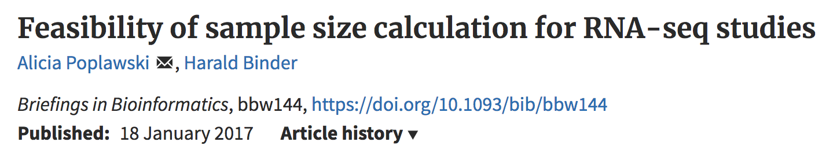
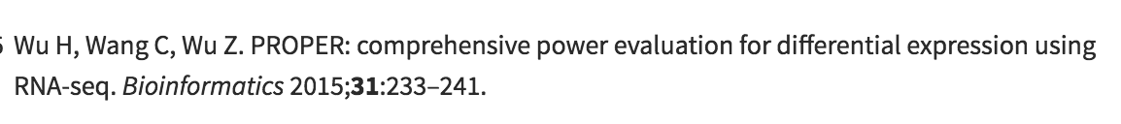
Power Analysis
A systematic search resulted in six open source tools for sample size calculation for RNA-seq differential expression analysis. As of Jan 2017
Exemplary sample size estimation performed by the remaining six tools using real mouse and human data as input files led to widely different results.
Tool evaluation using simulations showed that most tools estimate the sample sizes incorrect in particular for low true effects and large dispersion.
The use of pilot data is recommended.

Slide 8
Three outcomes Goldilocks and the three bears
Technical and/or biological variation exceeds that of experimental variation, results in 0 differentially expressed genes
Experiment induces a significant phenotype with cascading effects and/or little to no biological variation between replicates (ala cell lines), results in 1000s of DE genes. Some of which are directly due to experiment; however, most due to cascading effects.
Technical artifacts are controlled. Biological variation is induced in the experiment, and cascading effects are controlled, or accounted for, results in 100s of DE genes directly applicable to the question of interest.

Slide 9
General rules for preparing and experiment/ samples
Prepare more samples then you are going to need, i.e. expect some will be of poor quality, or fail
Preparation stages should occur across all samples at the same time (or as close as possible) and by the same person
Spend time practicing a new technique to produce the highest quality product you can, reliably
Quality should be established using Fragment analysis traces (pseudo-gel images, RNA RIN > 7.0)
DNA/RNA should not be degraded
260/280 ratios for RNA should be approximately 2.0 and 260/230 should be between 2.0 and 2.2. Values over 1.8 are acceptable
Quantity should be determined with a Fluorometer, such as a Qubit.

Slide 10
Sample preparation
In high throughput biological work (Microarrays, Sequencing, HT Genotyping, etc.), what may seem like small technical details introduced during sample extraction/preparation can lead to large changes, or technical bias, in the data.
Not to say this doesn’t occur with smaller scale analysis such as Sanger sequencing or qRT-PCR, but they do become more apparent (seen on a global scale) and may cause significant issues during analysis.

Slide 11
Be Consistent
BE CONSISTENT ACROSS ALL SAMPLES!!!

Slide 12
Generating RNA-seq libraries
Considerations
QA/QC of RNA samples
What is the RNA of interest
Library Preparation
Stranded Vs. Unstranded
Whole transcript Vs. 3-prime biased
Size Selection/Cleanup
Final QA

Slide 13
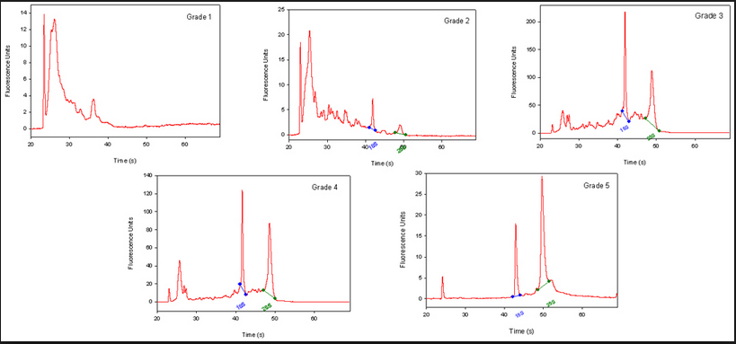
QA/QC of RNA samples
RNA Quality and RIN (RQN on AATI Fragment Analyzer)
RNA sequencing begins with high-quality total RNA, only an Agilant BioAnalyzer (or equivalent) can adequately determine the quality of total RNA samples. RIN values between 7 and 10 are desirable.
BE CONSISTANT!!!

Slide 14
RNA of interest
From “total RNA” we extract “RNA of interest”. Primary goal is to NOT sequence 90% (or more) ribosomal RNAs, which are the most abundant RNAs in the typical sample. there are two main strategies for enriching your sample for “RNA of interest”.
polyA selection. Enrich mRNA (those with polyA tails) from the sample by oligo dT affinity.
rRNA depletion. rRNA knockdown using RiboZero (or Ribominus) is mainly used when your experiment calls for sequencing non-polyA RNA transcripts and non-coding RNA (ncRNA) populations. This method is also usually more costly.
rRNA depletion will result in a much larger proportion of reads which align to intergenic and intronic regions of the genome.

Slide 15
Library Preparation
Some library prep methods first require you to generate cDNA, in order to ligate on the Illumina barcodes and adapters.
cDNA generation using oligo dT (3’ biased transcripts)
cDNA generation using random hexomers (less biased)
full-length cDNAs using SMART cDNA synthesis method
Also, can generate strand specific libraries, which means you only sequence the strand that was transcribed.
This is most commonly performed using dUDP rather than dNTPs in cDNA generation and digesting the “rna” strand.
Can also use a RNA ligase to attach adapters and then PCR the second strand and remainder of adapters.

Slide 16
Library Preparation – whole transcript/3’ biased

Slide 17
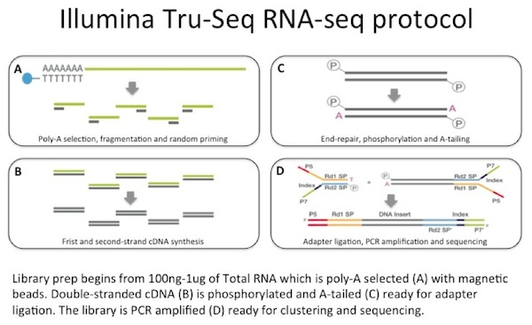
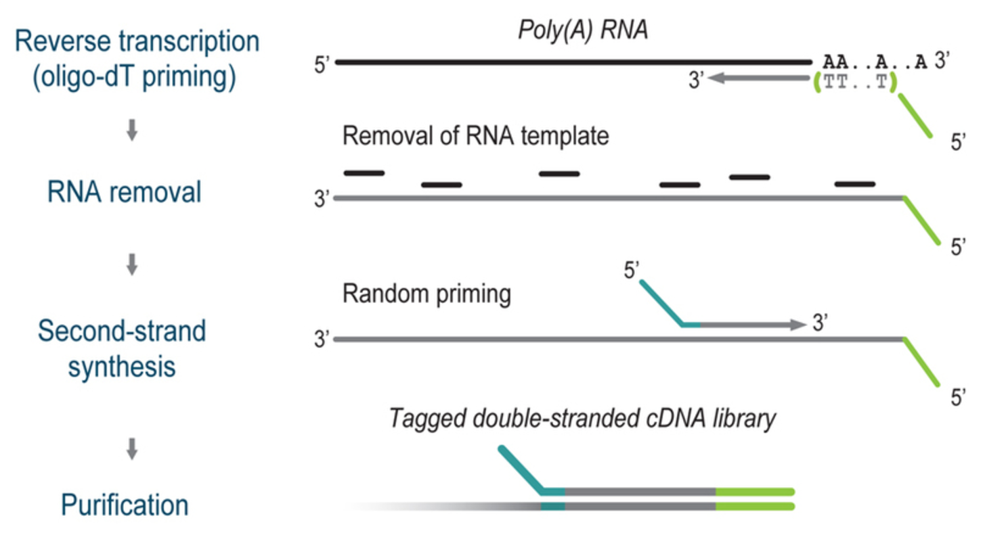
Protocol – whole transcript vs 3-prime biased
Lexogen Quantseq protocol

Slide 18
3-prime differences from whole transcript
Low input and low quality samples (say as low as 100ng), BUT protocol is a (a bit) more sensitive to chemical contaminants (spin column cleaned RNA samples are recommended)
Significant cost saving through faster library preparation protocol and multiplexing [need less sequencing per sample] comparable to microarrays.
Best suited for gene counting as data does not contain transcript splicing information on the whole transcript.
Requires (sort of) a reference genome with good annotation (plus known UTRs)
Only applicable to Eukaryotic samples (requires polyA)
Strand specific
Single read sequencing is sufficient

Slide 19
Size Selection/Cleanup/QA
Final insert size optimal for DE are ~ 150bp (or kit suggestion)
Very important to be consistent across all samples in an experiment on how you size select your final libraries. You can size select by:
Fragmenting your RNA, prior to cDNA generation.
Chemically heat w/magnesium
Mechanically (ex. ultra-sonicator)
Cleanup/Size select after library generation using SPRI beads or (gel cut)
QA the samples using an electrophoretic method (Bioanalyzer) and quantify with qPCR.
Most important thing is to be consistent!!!

Slide 20
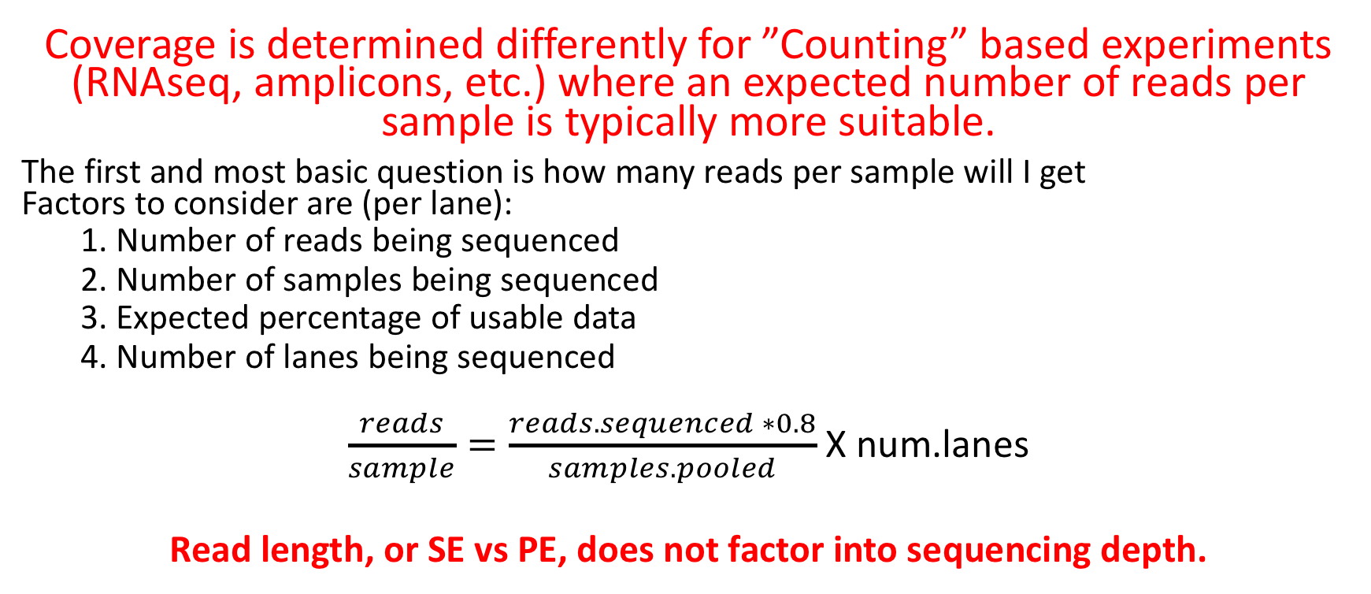
Sequencing Depth
Coverage is determined differently for ”Counting” based experiments (RNAseq, amplicons, etc.) where an expected number of reads per sample is typically more suitable.
The first and most basic question is how many reads per sample will I get Factors to consider are (per lane):
1. Number of reads being sequenced
2. Number of samples being sequenced
3. Expected percentage of usable data
4. Number of lanes being sequenced
$\frac{reads}{sample}=\frac{reads.sequenced ∗0.8}{samples.pooled}$X num.lanes
Read length, or SE vs PE, does not factor into sequencing depth.

Slide 21
Sequencing
Characterization of transcripts, or differential gene expression
Factors to consider are:
Read length needed depends on likelihood of mapping uniqueness, but generally longer is better and paired-end is better than single-end.
Interest in measuring genes expressed at low levels ( << level, the >> the depth and necessary complexity of library)
The fold change you want to be able to detect ( < fold change more replicates, more depth)
Detection of novel transcripts, or quantification of isoforms requires >> sequencing depth
The amount of sequencing needed for a given sample/experiment is determined by the goals of the experiment and the nature of the RNA sample.

Slide 22
Barcodes and Pooling samples for sequencing
Best to have as many barcodes as there are samples
Can purchase barcodes from vendor, generate them yourself and purchase from IDTdna (example), or consult with the sequencing core.
Best to pool all samples into one large pool, then sequence multiple lanes
IF you cannot generate enough barcodes, or pool into one large pool, RANDOMIZE samples into pools.
Bioinformatics core can produce a randomization scheme for you.
This must be considered/determined PRIOR to library preparation

Slide 23
[SUMMARY] Generating RNA-seq libraries
Considerations
QA/QC of RNA samples [Consistency across samples is most important.]
What is the RNA of interest [polyA extraction is recommended.]
Library Preparation
Stranded Vs. Unstranded [Standard stranded library kits]
Whole transcript vs 3-prime biased [IF DE only, 3-prime biased]
Size Selection/Cleanup [Target mean 150bp or kit recommendation]
Final QA [Consistency across samples is most important.]

Slide 24
Cost Estimation
RNA extraction and QA/QC (Per sample)
Enrichment of RNA of interest + library preparation (Per sample)
Library QA/QC (Bioanalyzer and Qubit)
Pooling [If you generate your own libraries]
Sequencing (Number of lanes)
Bioinformatics (General rule is to estimate the same amount as data generation, i.e. double your budget)
http://dnatech.genomecenter.ucdavis.edu/prices/
https://bioinformatics.sf.ucdavis.edu/rates

Slide 25
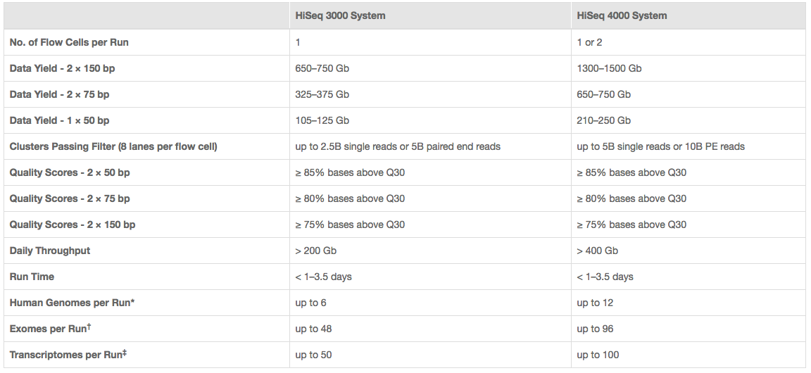
Illumina sequencing costs
I use 350M fragments per lane
http://www.illumina.com/systems/hiseq-3000-4000/specifications.html

Slide 26
Cost Estimation
48 Samples, QA/QC and Library Prep (Poly-A)
QA Bioanalyzer
Library Preparation (Poly-A Enrichment)
Sequencing, targeting 30M reads per sample (Illumina HiSeq 4000)
USE 2.1 - 2.5 Billion reads per run / 8 lanes = Approximately 350M reads per lane
Bioinformatics
Double your budget
What is the total experiment cost?
What is the cost per sample?
http://dnatech.genomecenter.ucdavis.edu/prices/
https://bioinformatics.sf.ucdavis.edu/rates

