Slide 1
So you want to do a: Peak based study
Matthew L. Settles
Genome Center Bioinformatics Core
University of California, Davis
settles@ucdavis.edu; bioinformatics.core@ucdavis.edu

Slide 2
Disclaimer
This talk/workshop is full of opinion, there are as many different way to perform analysis as there are Bioinformaticians.
My opinion is based on over a decade of experience and spending a considerable amount of time to understand data, how its created and how it relates to the biological questions of interest.
Each experiment is unique, this lecture is a starting place and should be adapted to the specific characteristics of your experiment.

Slide 3
Treating Bioinformatics as a Data Science
Seven stages to data science
Define the question of interest
Get the data
Clean the data
Explore the data
Fit statistical models
Communicate the results
Make your analysis reproducible
Data science done well looks easy and that’s a big problem for data scientists
simplystatistics.org
March 3, 2015 by Jeff Leek

Slide 4
Designing Experiments
Beginning with the question of interest ( and work backwards )
The final step of a DE analysis is the application of a statistical model to each gene in your dataset.
Traditional statistical considerations and basic principals of statistical design of experiments apply.
Control for effects of outside variables, avoid/consider possible biases, avoid confounding variables in sample preparation.
Randomization of samples, plots, etc.
Replication is essential (triplicates are THE minimum)
You should know your final (DE) model and comparison contrasts before beginning your experiment.

Slide 5
General rules for preparing and experiment/ samples
Prepare more samples then you are going to need, i.e. expect some will be of poor quality, or fail
Preparation stages should occur across all samples at the same time (or as close as possible) and by the same person
Spend time practicing a new technique to produce the highest quality product you can, reliably
Quality should be established using Fragment analysis traces (pseudo-gel images, RNA RIN > 7.0)
DNA/RNA should not be degraded
260/280 ratios should be approximately 2.0 and 260/230 should be between 2.0 and 2.2. Values over 1.8 are acceptable
Quantity should be determined with a Fluorometer, such as a Qubit.

Slide 6
Be Consistent
BE CONSISTENT ACROSS ALL SAMPLES!!!

Slide 7
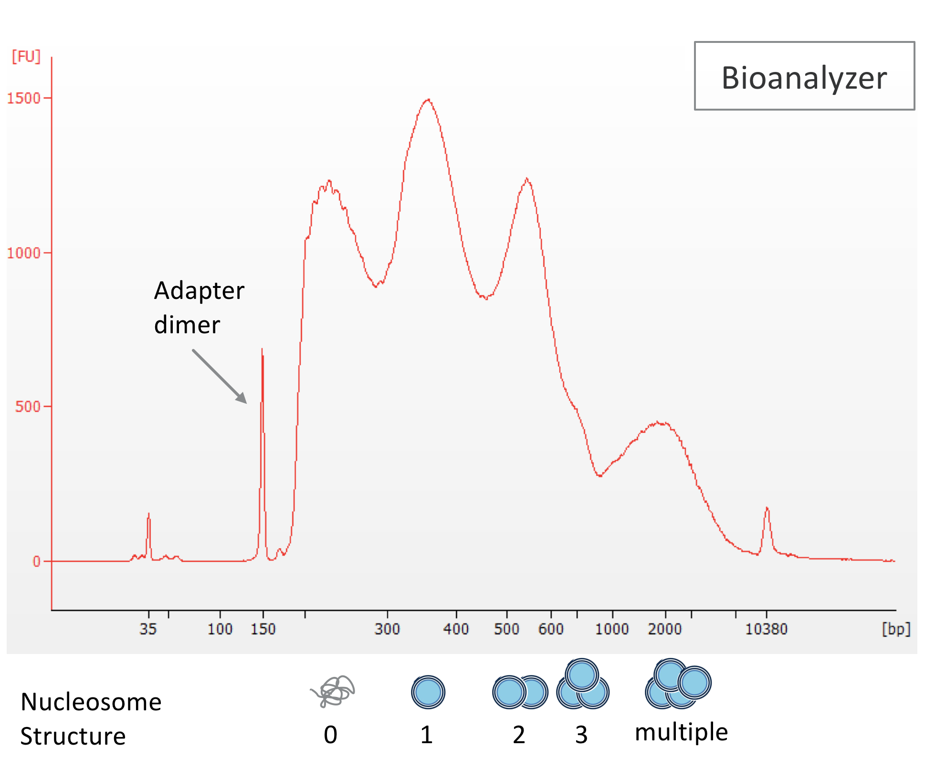
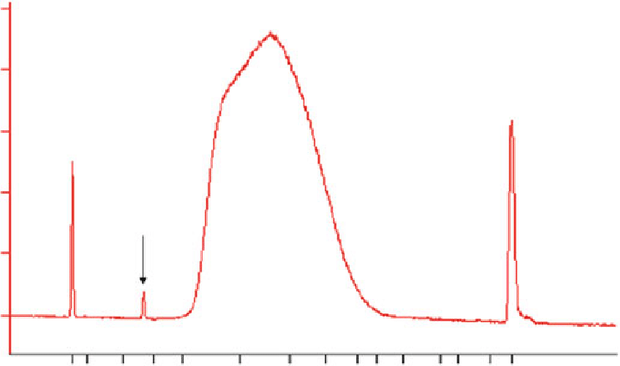
QA/QC traces
BE CONSISTANT!!!

Slide 8
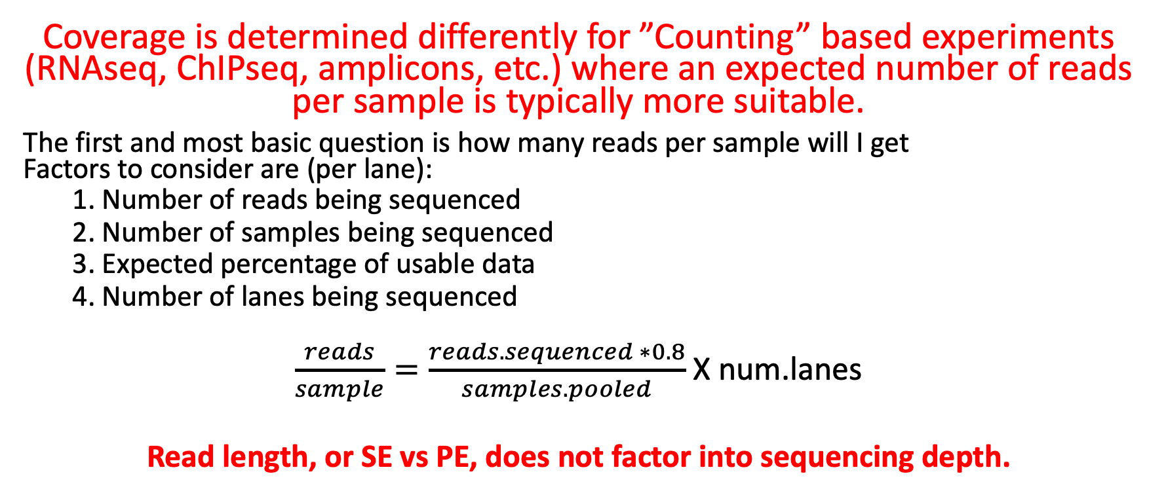
Sequencing Depth
Coverage is determined differently for ”Counting” based experiments (RNAseq, ChIPseq, amplicons, etc.) where an expected number of reads per sample is typically more suitable.
The first and most basic question is how many reads per sample will I get Factors to consider are (per lane):
1. Number of reads being sequenced
2. Number of samples being sequenced
3. Expected percentage of usable data
4. Number of lanes being sequenced
$\frac{reads}{sample}=\frac{reads.sequenced ∗0.8}{samples.pooled}$X num.lanes
Read length, or SE vs PE, does not factor into sequencing depth.

Slide 9
Sequencing
Characterization of peaks
Factors to consider are:
Read length needed depends on likelihood of mapping uniqueness, but generally longer is better and paired-end is better than single-end. (2 x >75bp is best)
Interest in measuring peaks expressed at low levels ( << level, the >> the depth and necessary complexity of library)
The change you want to be able to detect ( < fold change more replicates, more depth)
Paired end allows you to better define the start and end region of the peak.
The amount of sequencing needed for a given sample/experiment is determined by the goals of the experiment and the nature of the sample.

Slide 10
Barcodes and Pooling samples for sequencing
Best to have as many barcodes as there are samples
Can purchase barcodes from vendor, generate them yourself and purchase from IDTdna (example), or consult with the sequencing core.
Best to pool all samples into one large pool, then sequence multiple lanes
IF you cannot generate enough barcodes, or pool into one large pool, RANDOMIZE samples into pools.
Bioinformatics core can produce a randomization scheme for you.
This must be considered/determined PRIOR to library preparation

Slide 11
Cost Estimation
QA/QC (Per sample)
Enrichment of DNA of interest + library preparation (Per sample)
Library QA/QC (Bioanalyzer and Qubit)
Pooling [If you generate your own libraries]
Sequencing (Number of lanes)
Bioinformatics (General rule is to estimate the same amount as data generation, i.e. double your budget)
http://dnatech.genomecenter.ucdavis.edu/prices/
https://bioinformatics.sf.ucdavis.edu/rates

Slide 12
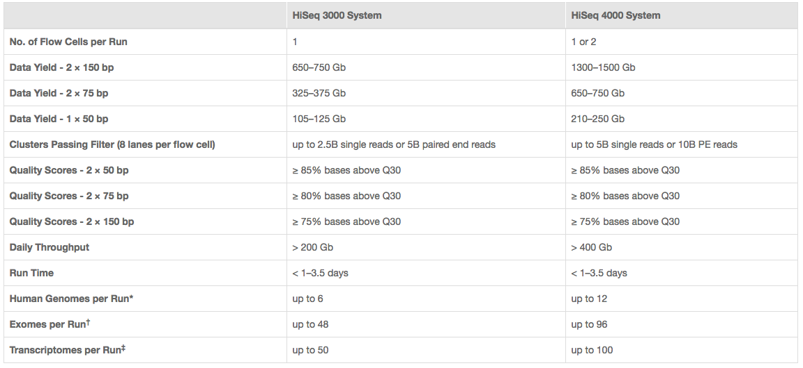
Illumina sequencing costs
I use 350M fragments per lane
http://www.illumina.com/systems/hiseq-3000-4000/specifications.html

