Slide 1




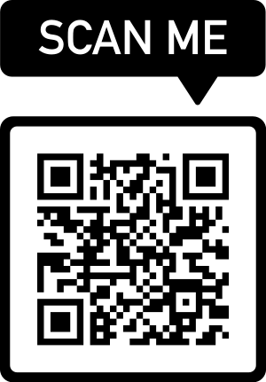
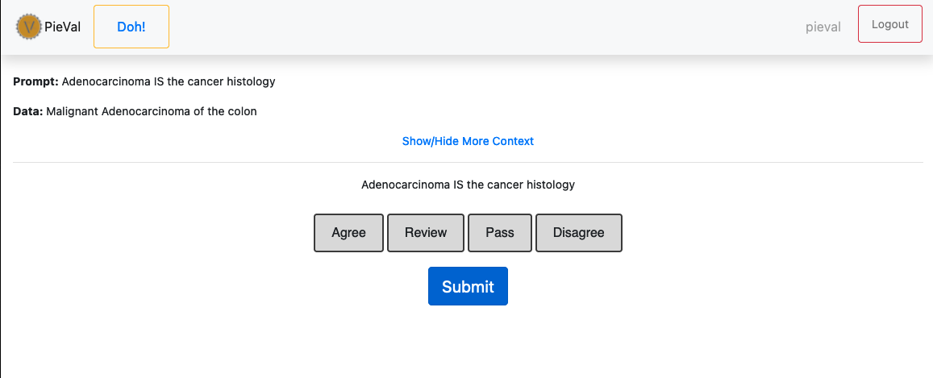
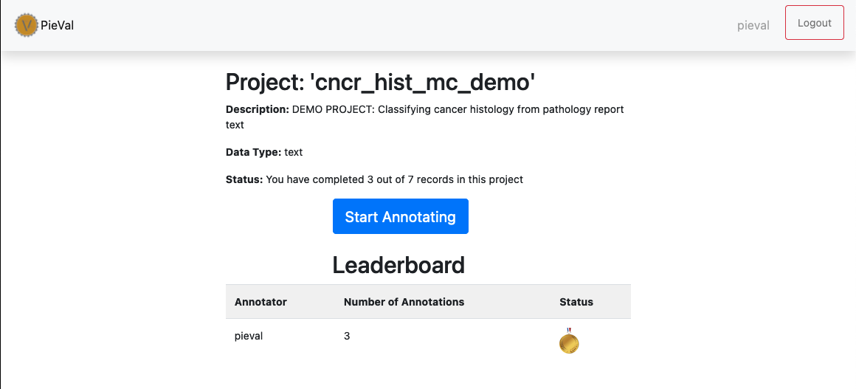
PieVal: an Open-Source, Efficient, Secure, Gamified, Rapid Document Classification Annotation Tool
Albert William Riedl, MS¹; Aaron Seth Rosenberg, MD¹; JP Graff, DO¹; Matthew S Renquist¹; Joseph M Cawood¹;
Nicholas R Anderson, PhD ¹
¹ University of California at Davis, Sacramento CA
Introduction
As much as 83% of biomedical information is contained within clinical notes [1]
Advancing Natural Language Processing (NLP) tools can address this challenge.
NLP is bottlenecked by the need for annotated datasets for model training and evaluation
Annotated data is expensive due to the need for highly trained personnel and the time required for annotation.
Expertise is required but inefficient annotation tools are not
We developed PieVal, a web-based, secure, high-throughput document classification annotation tool
Document level annotations in less than 30 seconds per document, based on 20K annotations captured to-date
Check us out on GitHub for:
- More extensive Documentation
- Implementation Instructions
On Ramp
- Problem formulation
- Exploratory Data Analysis
- Data Pre-Processing steps defined
- Labels and Prompts are defined and linked
Model Training/Rehearsal
Or
Algorithm Derivation/Updates
UN-labled
Documents
PieVal
Label Capture For training/derivation
Label Evaluation for Rehearsal/Updates
Deployment
Built for continuous improvement
The key to this integration is the relationship between labels and prompts
Labels are a machine learning concept
Prompts are human readable ‘label’ used in PieVal
PieVal tests the assertion that a prompt (aka label) and some data are concordant – thus creating labels that can be used to train machine learning models
After you have a deployed model, you can feed the machine generated lables back into PieVal for validation and to monitor drift over time
Monitoring
Feed Model predictions or Algorithmic outputs into PieVal as ‘Prompts’
Labled
Documents
Random Sample
Use-Cases
Bone Marrow Biopsy Reports
300 documents annotated
ANN learner trained with output achieves 96% accuracy
Blast %
N documents annotated
Expert system derived (regex plus rules) to extract 3 different blast percentages from various pathology reports
Bone Marrow Markers (cd34, cd117)
N documents annotated
Expert system derived (regex plus rules) to extract 2 different bone marrow markers from various pathology reports
Annotations as assertion tests
Asking about agreement allows for a consistent User Interface not matter what data OR the number of classes
Users presented with Prompt and Data and asked if the prompt applies to the data
Agree – yes, it does
Review – Unclear, and I have enough expertise to help clarify
Pass – Unclear, and I don’t have enough expertise to clarify
Disagree – No, it does not
Multi-class annotations include a ‘correction’ workflow when disagreement is selected
Data Enrichment
Data is encouraged to be populated with ‘enriched’ text
Enriched text is the result of pre-processing that pulls text more likely to answer a question out of a larger document
This is done purely for operational efficiency
The less text to review, the faster annotations can be captured
There is risk – pre-processing strategies can be flawed and sometimes eliminate the wrong text!
PieVal includes a hidden Extended Data field that should contain the full orginal text
It is accessible by clicking ‘show/hide more context’
Annotators can always review the original document if the enriched text leaves room for uncertainty
Full document views are tracked, which helps gather data about when an enrichment strategy may be failing
Future Directions
Continue to grow community support for a thriving Open-Source future
Add Image and table data annotation workflows
Include helpful pre-processors and post-processors
Build in data quality metrics as well as operator agreement scores
Gamefied – Leaderboard with Gold, Silver Bronze Medals
Use friendly competition to incentivize annotation adherence
References
1. Murdoch TB, Detsky AS. The Inevitable Application of Big Data to Health Care. JAMA2013;309:1351--

