Slide 1
Cryptocurrency

Slide 2
Cryptocurrency
What is it?
What problems does it solve?
What problems does it introduce?

Slide 3


Slide 4
Concepts
Digital Signature (Public Key Cryptography)
Mining (Proof of work)
Blockchain (Double-spend problem)

Slide 5
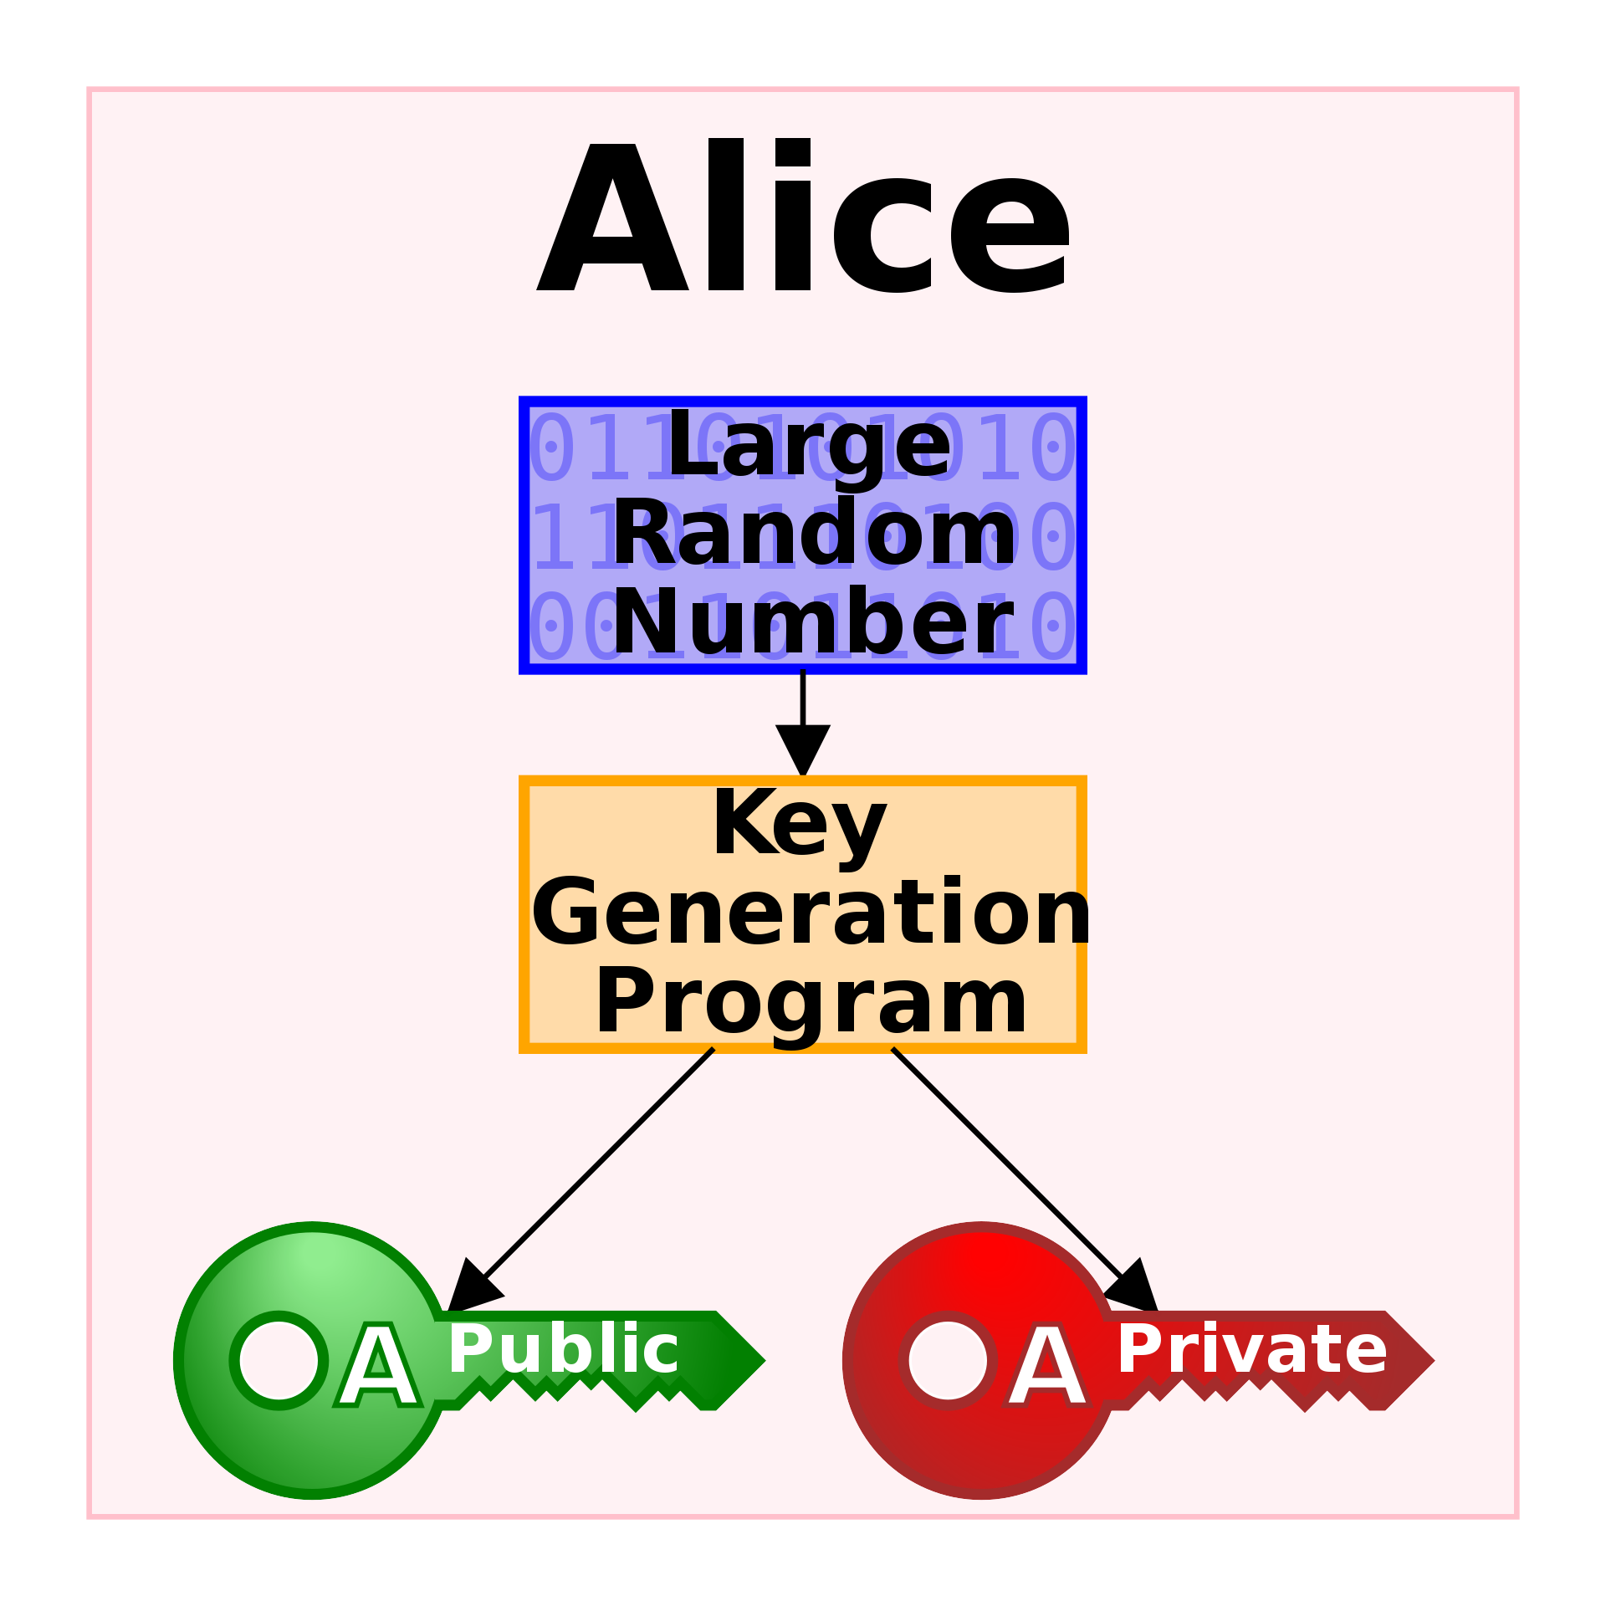
Public/Private Key Cryptography
KohanX [Public domain]

Slide 6
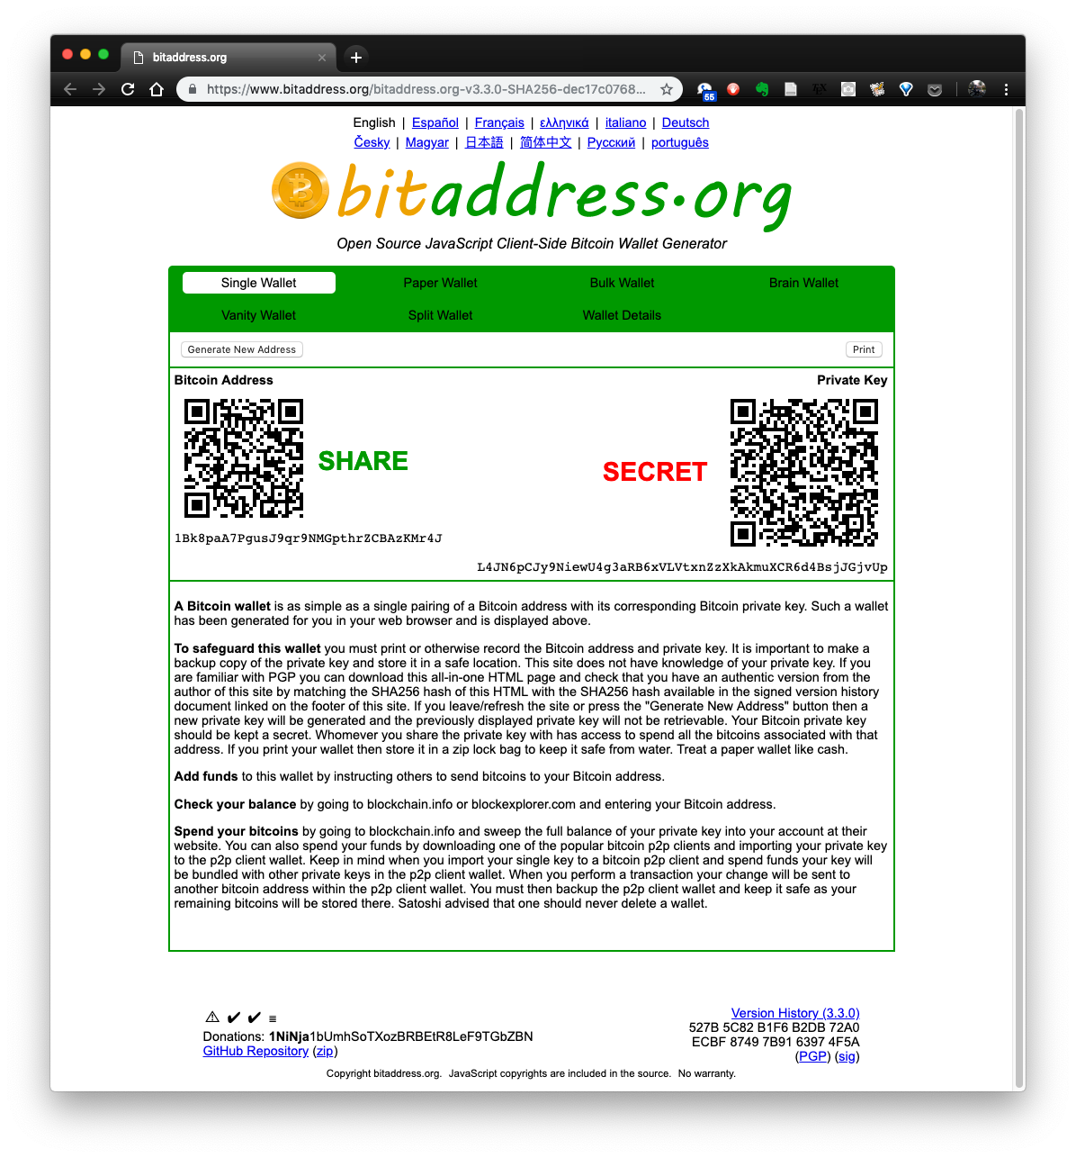
Bitcoin Wallet
Notes:
You could make a public/private keypair for every transaction, so that transactions could not be grouped and tracked to the same address.

Slide 7
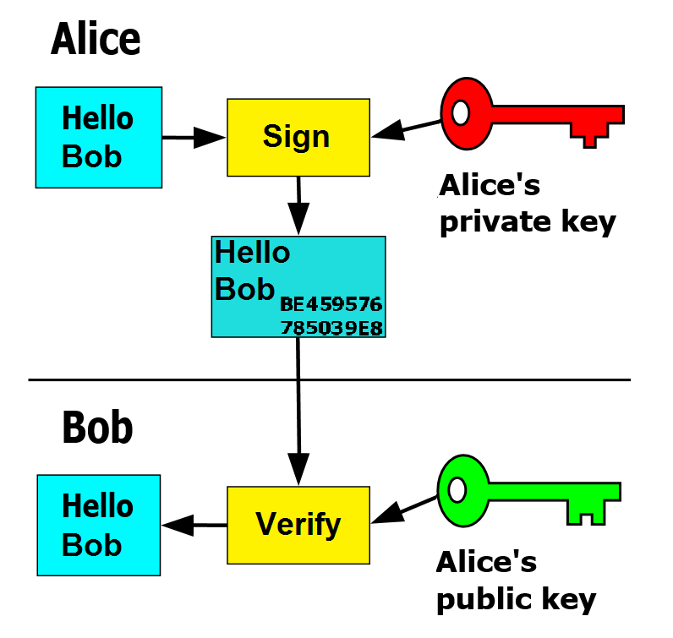
Hello Bob, I want to buy your book for 0.01XBT.
FlippyFlink [Public domain]
Notes:
$38.00

Slide 8
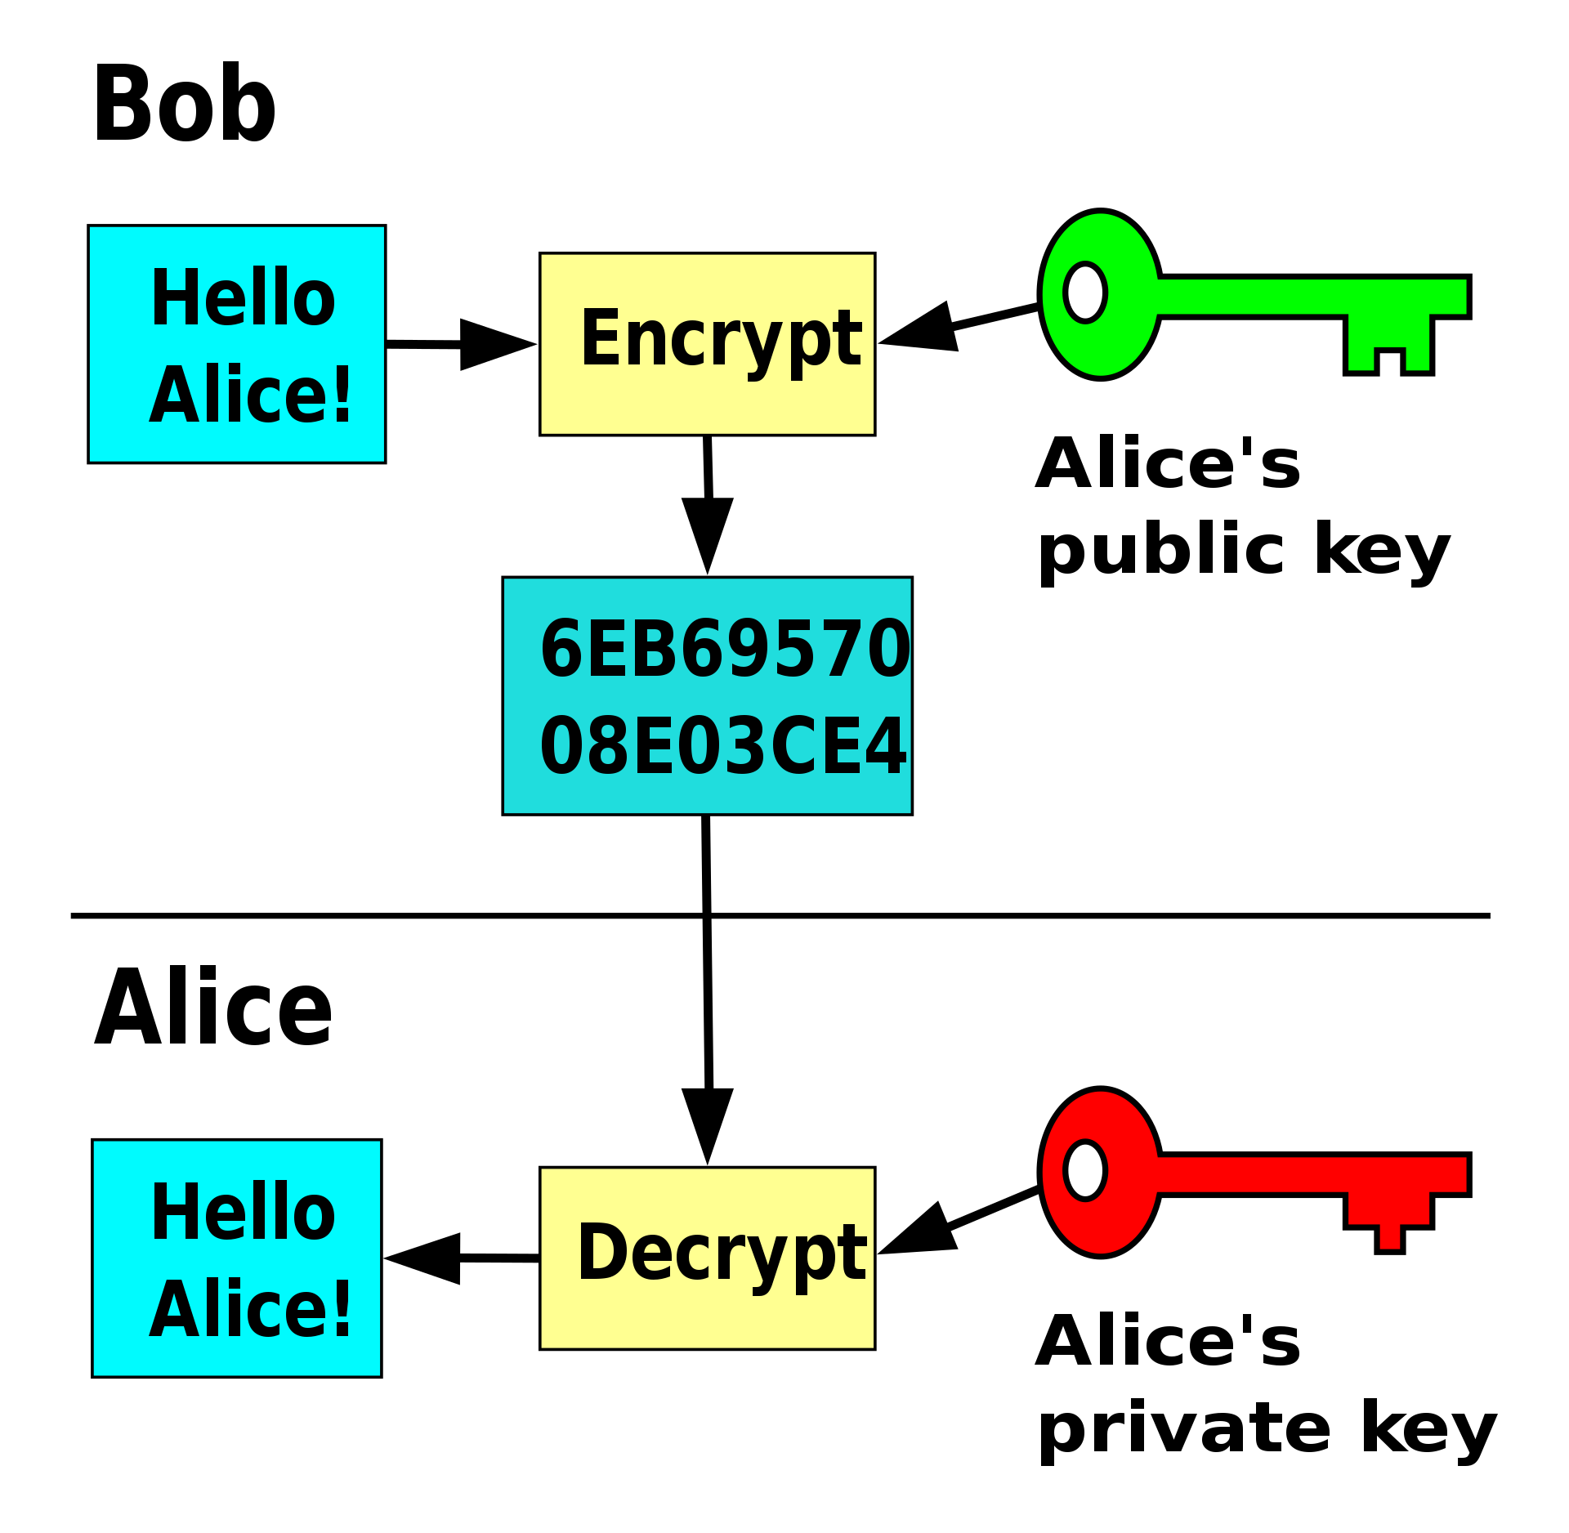
Hello Alice, here’s the book.
David Gothberg [Public domain]

Slide 9
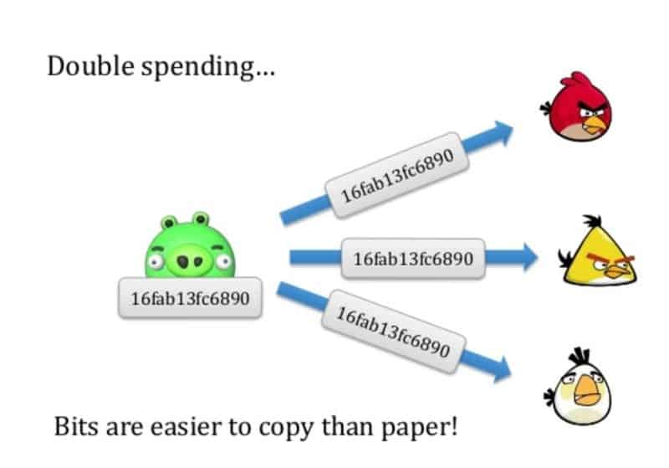
Double-Spend
https://coinsutra.com/bitcoin-double-spending/

Slide 10

Mining

Slide 11
Hash
SHA256:
“The quick brown fox jumps over the lazy dog.”
ef537f25c895bfa782526529a9b63d97aa631564d5d789c2b765448c8635fb6c
“The quick brown fox, jumps over the lazy dog.”
392bfd94c083e025e46d0be3ff9258c8bfc33bcd3296156f76c722f339a98dfb
The text of “War and Peace”
1feba561bf9106f3cbf6d78dd0c6056eef6ab59f15a30e64530ea6aea91d4e07
http://www.gutenberg.org/files/2600/2600-0.txt
Notes:
32-bit word

Slide 12
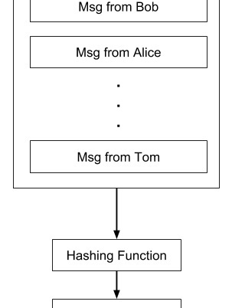
Mining Process - 12.5 XBT per block
https://www.tutorialspoint.com/blockchain/bitcoin_mining.htm
Notes:
Almost $50K.

Slide 13
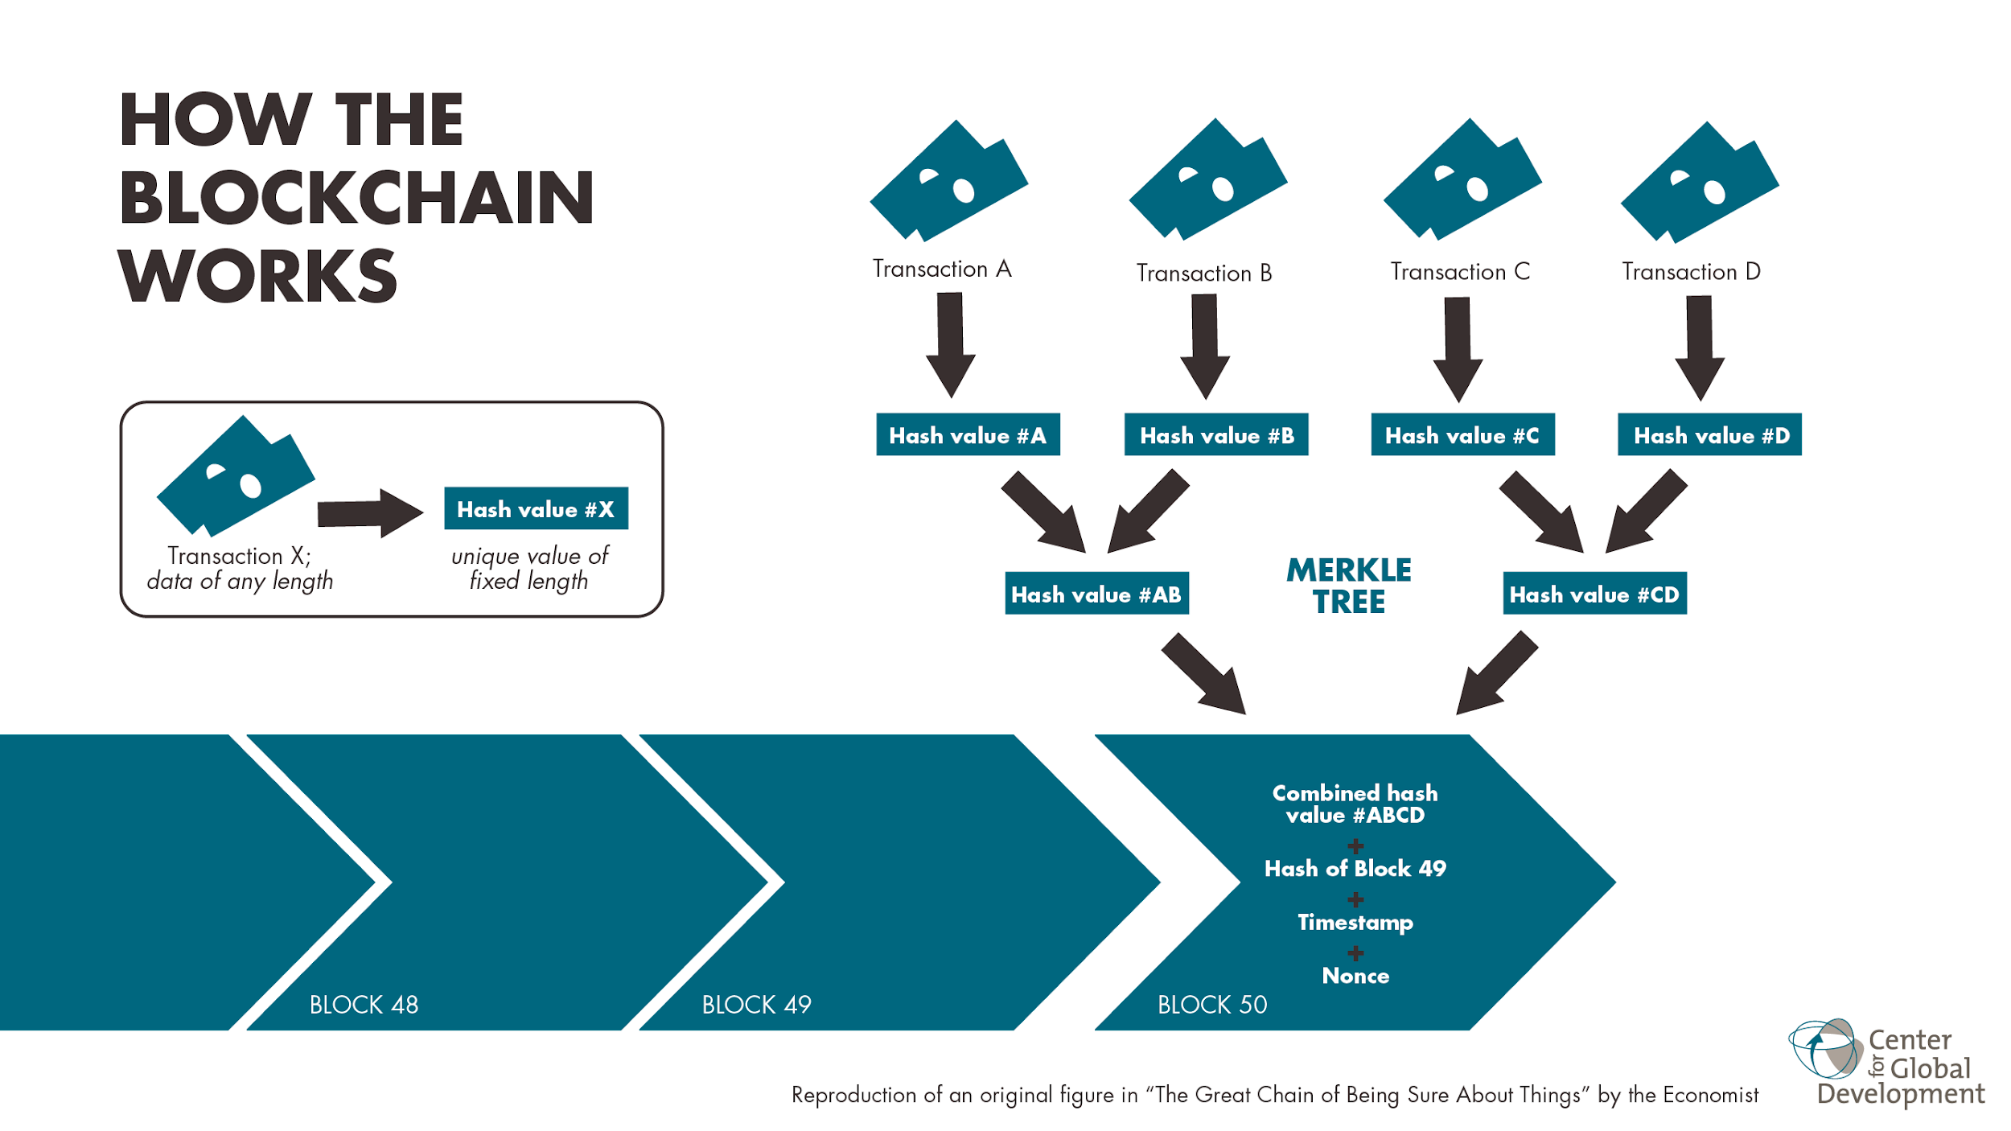
Blockchain

Slide 14
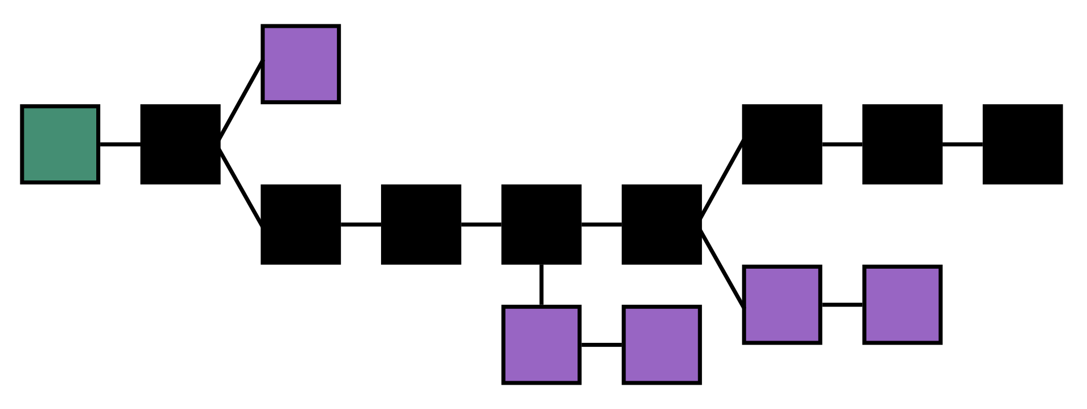
Longest Chain wins
By original file: Theymos from Bitcoin wikivectorization: User:Razorblissrotation: Own work - File:Blockchain.svg, CC BY 3.0, https://commons.wikimedia.org/w/index.php?curid=66599857
Notes:
You can pay miners incentives to include your transactions sooner
You should wait for a certain number of blocks to be added before trusting a transaction is valid

Slide 15
What problems does it introduce?
Irreversible
Hackable
Not really anonymous
Not really decentralized

Slide 16
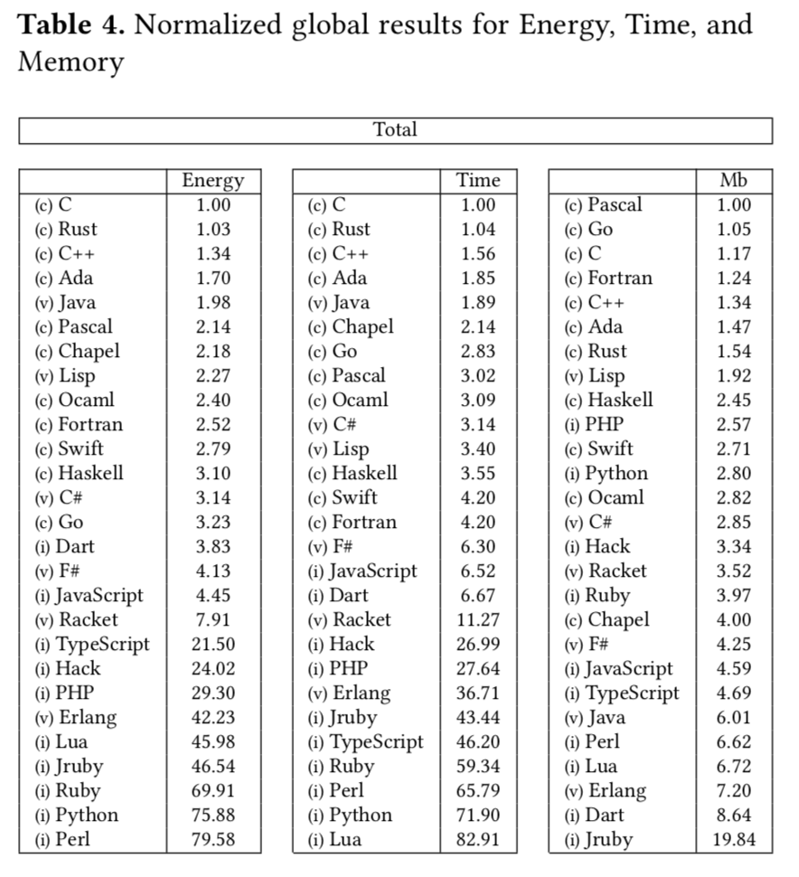
"Energy Efficiency across Programming Languages: How does Energy, Time and Memory Relate?", Rui Pereira, Marco Couto, Francisco Ribeiro, Rui Rua, Jácome Cunha, João Paulo Fernandes, and João Saraiva. In Proceedings of the 10th International Conference on Software Language Engineering (SLE '17)
https://github.com/greensoftwarelab/Energy-Languages#energy-efficiency-in-programming-languages

Slide 17
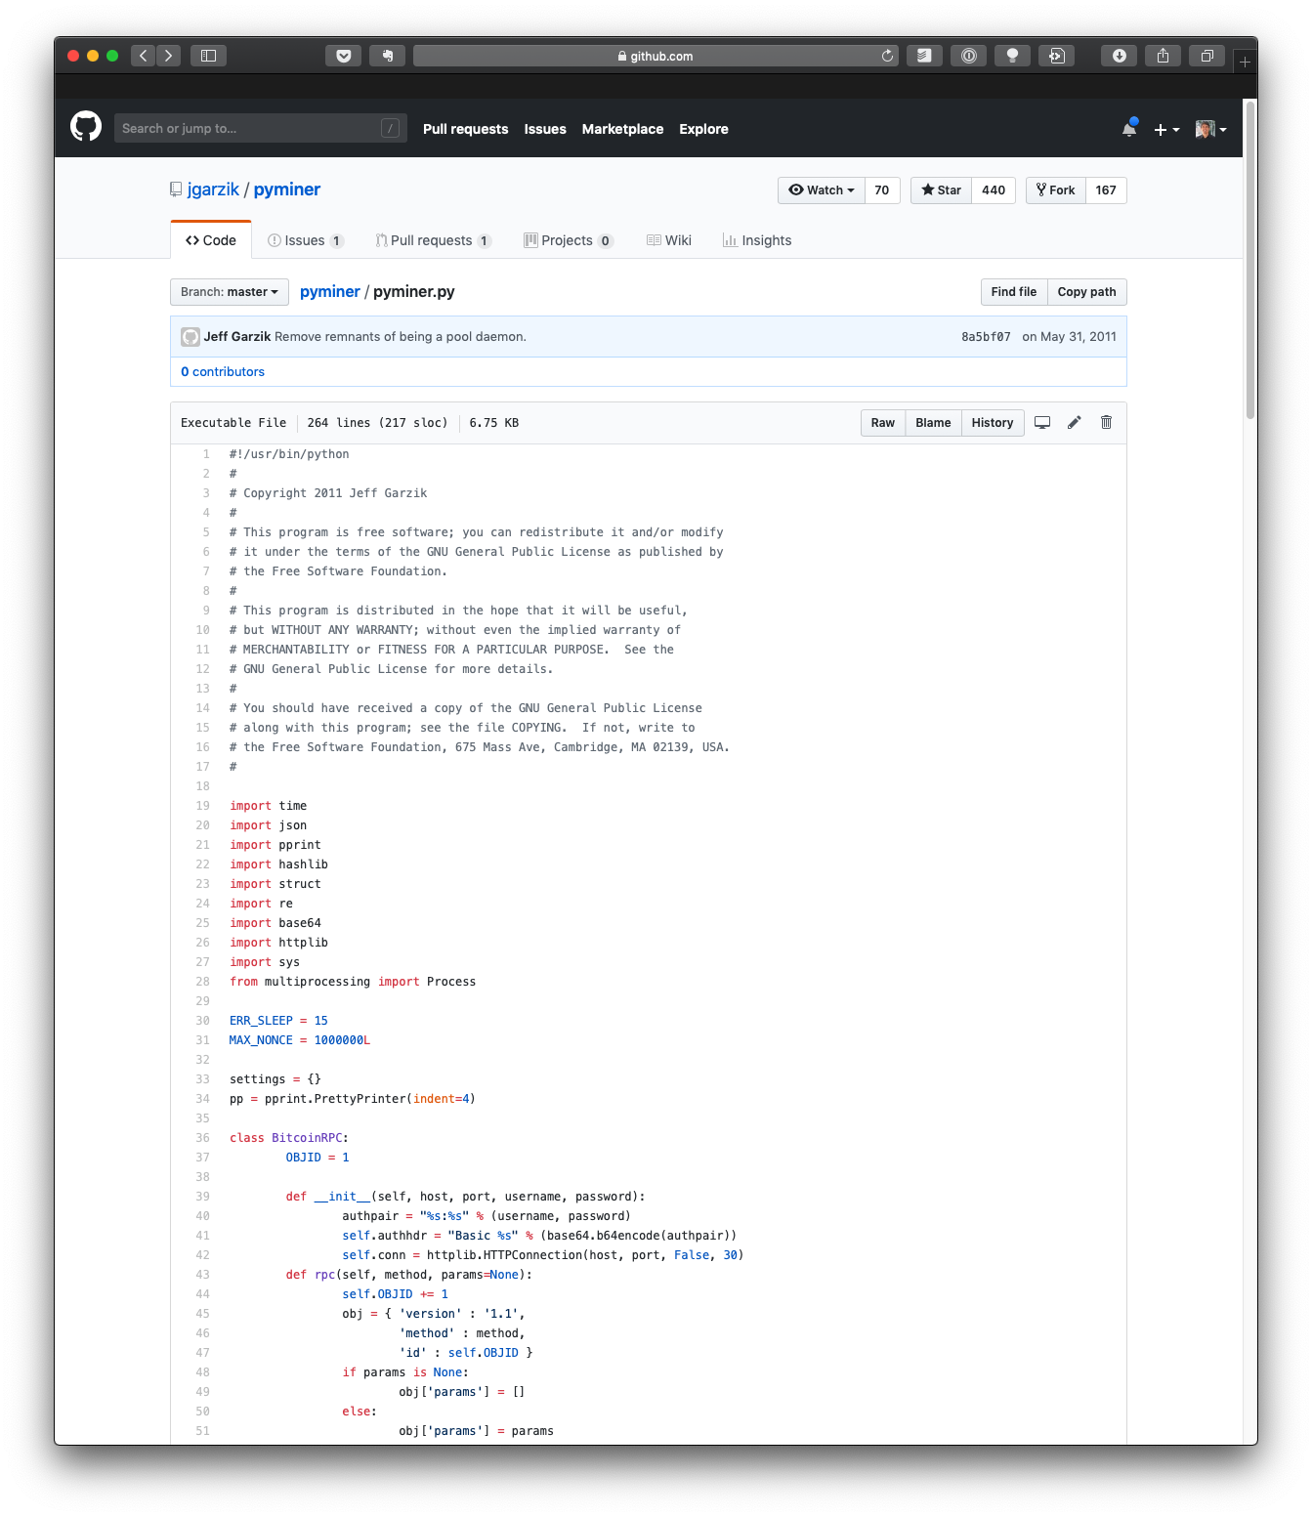

Slide 18
