Slide 1
Developing with uConnect

Slide 2
What is uConnect?
Microsoft Active Directory (Directory Services)
Microsoft Exchange (email and smtp routing)
Domain Name System (DNS)
Used to authorize and authenticate users and computers
Utilizes Lightweight Directory Access Protocol (LDAP)

Slide 3
AD Forest Configuration
Parent domain: ad3.ucdavis.edu
Child domains:
ou.ad3.ucdavis.edu
ex.ad3.ucdavis.edu
Trust with Microsoft Office365

Slide 4
AD Servers
AD Directory Services servers are called domain controllers (dc)
Each uConnect domain has domain controllers
Most uConnect DCs also function as Global Catalog servers
Global Catalog server stores its own full, writable domain replica (all objects and all attributes) plus a partial, read-only replica of every other domain in the forest.

Slide 5
AD Object Types
Organization Unit (OU)
Group
Computer
User
Contact

Slide 6
AD Search Components
AD Server
Search Base
Scope
Filter
Attributes

Slide 7
Search Base
The location in AD from which the LDAP search begins
Distinguished Name format
Examples:
OU=ucdUsers,DC=ad3,DC=ucdavis,DC=edu
OU=COE,OU=Departments,DC=ou,DC=ad3,DC=ucdavis,DC=edu
DC=ad3,DC=ucdavis,DC=edu
DC=ou,DC=ad3,DC=ucdavis,DC=edu

Slide 8
Important uConnect OUs
Campus members accounts are in AD3
OU=ucdUsers,DC=ad3,DC=ucdavis,DC=edu
PPS Department Groups
OU=ucdDepts,DC=ad3,DC=ucdavis,DC=edu
Departments
OU=COE,OU=Departments,DC=ou,DC=ad3,DC=ucdavis,DC=edu

Slide 9
Search Scope
Sets how deep to search within the search base
Base: search of the base object only
One Level: search of the immediately subordinate objects to the base. Does not include the base object
Subtree: search of the base object and the entire subtree

Slide 10
Search Filter
Selects which AD object(s) to return
Examples:
(&(objectClass=user)(sAMAccountName=dbunn))
(&(objectclass=computer)(|(name=coe-w10)(sAMAccountName=coe-w10$)))
(&(objectClass=group)(mail=* ))
(&(objectClass=group)(whenChanged>=20161011083000.0Z))
(&(objectclass=group)(|(groupType=8)(groupType=-2147483640))(extensionAttribute3=UCDBoxSync))

Slide 11
Search Attributes
The desired AD object properties to view
Pulling all attributes make large searches slower
Vary depending upon AD object type
Special handling is required for groups with over 1,500 members
Names in camel case
userPrincipalName, distinguishedName, proxyAddresses, displayName

Slide 12
Searching for Unique Objects
cn values unique only at the OU level
objectSid and sAMAccount values are only unique at the domain level
distinguishedName values are unique across AD forest but easily changed by moving AD object
objectGuid and userPrincipalName unique across the AD forest
objectGuid never changes and stored in little endian format

Slide 13
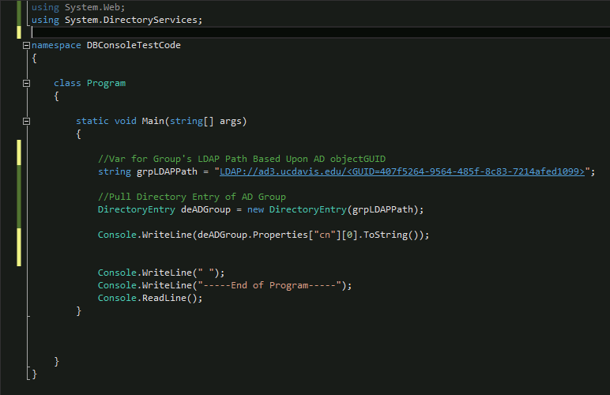
Pulling AD Group by objectGuid via C# .NET

Slide 14
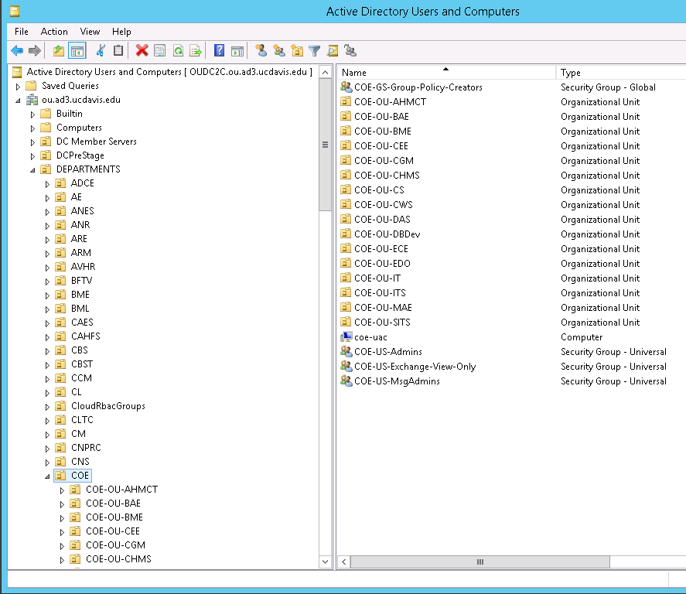

Slide 15
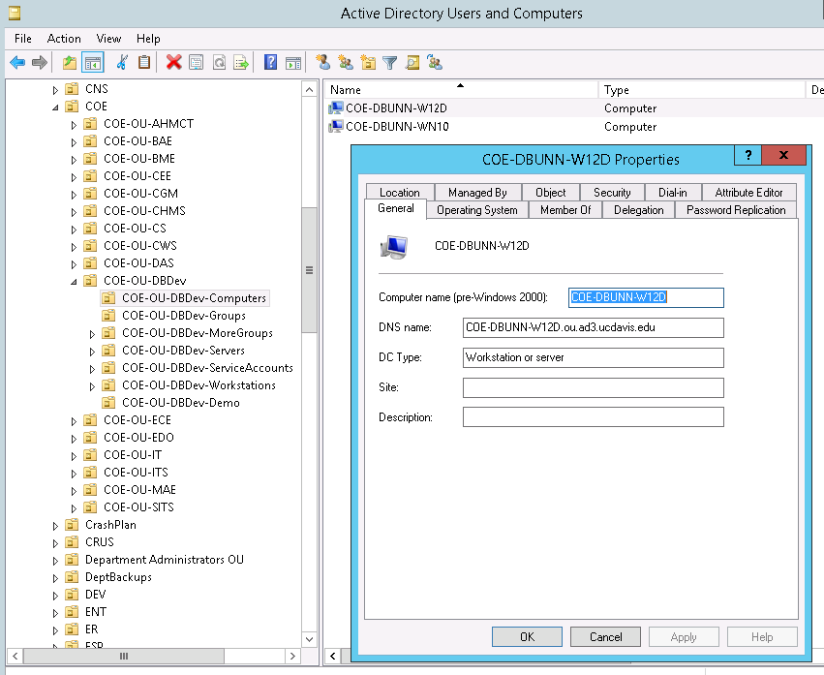

Slide 16
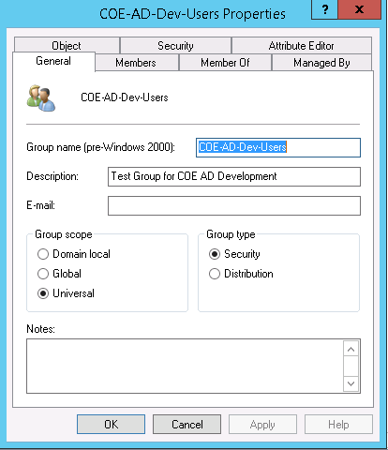

Slide 17
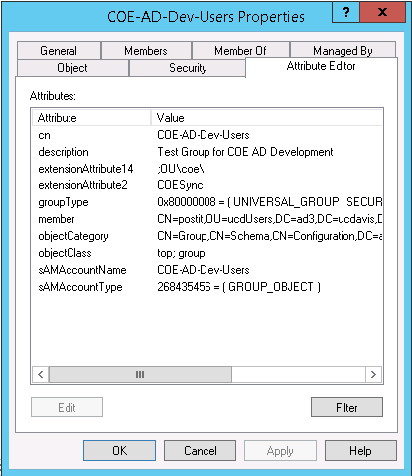

Slide 18
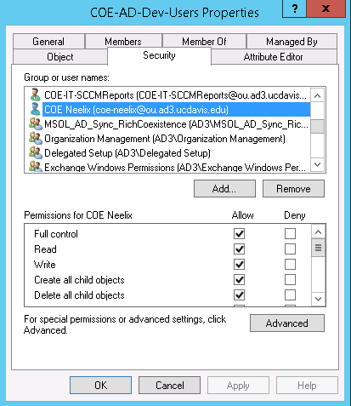

Slide 19
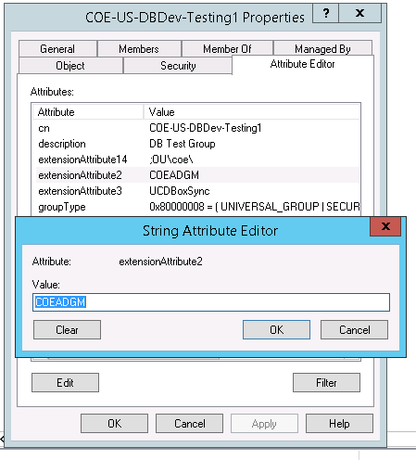

Slide 20
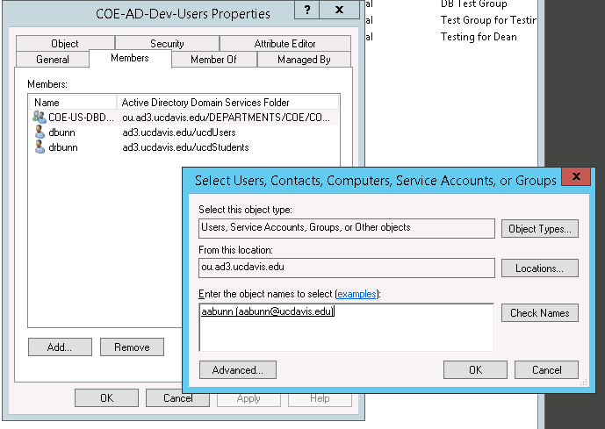

Slide 21
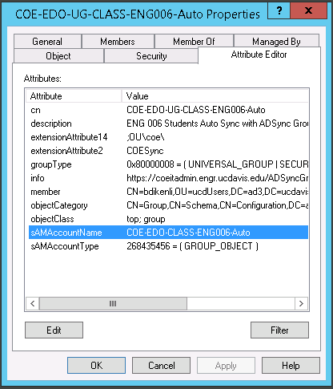
Please remember a group's “cn” can lie

Slide 22
Group Membership Changes
When modifying a group, use a domain controller in the same domain
Pull the distinguishedName of the user to be added or removed
When syncing with Campus data sources make sure nested groups and OU domain accounts are not removed

Slide 23
Code Demo

