Slide 1
Release Version of the GOOD Model Package
May 8, 2025

Slide 2
GOOD Philosophy
GOOD is a maximally modular and minimally determined package for power system optimal dispatch and capacity expansion.
GOOD object structure is minimal and intuitive.
GOOD core packages provide minimal functionality.
GOOD relies on a minimal set of package dependencies.
GOOD package dependenies are to well established and maintained packages.

Slide 3
GOOD Ecosystem
The GOOD Ecosystem will consist of three components, each of which will be packaged separately
1. GOOD Model: Tightly scoped mathematical model built in Python using Numpy, NetworkX, and Pyomo. GOOD Model will contain all mathematical operations such as clustering.
2. GOOD Datasets: Code for pulling datasets from Zenodo (or equivalent) data repository and processing them for running with GOOD Model.
3. GOOD Visualizations: Code for producing standard and stylized visualizations of model inputs and outputs.
Expansion of datasets and visualizations is encouraged. Expansion of GOOD Model is not.

Slide 4
Style Guide
We follow the style guidance of PEP-8
This will be enforced through pre-commit hooks
All Graph iterables are dictionaries (no lists, arrays etc.)
So we will cange the assets list to and assets dict and the policies list to a policies dict
This is because our basic form is a NetworkX graph which operates like a nested dictionary and we want all levels of nesting to operate consistently.
Convention on naming Pyomo objects:
We name pyomo objects in such a manner that overlap in handles is not possible.
Convention is “{object handle}::{name}” for nodal objects
Since no two Nodes or edges can have the same name this will be guaranteed

Slide 5
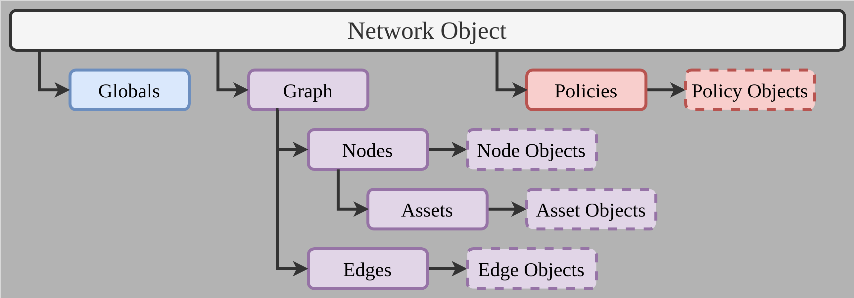
Network

