Slide 1
Formative user study
Group 6
Nina Marie Wahl Carl Emil Hattestad Armelle Rivière Aleksi O’Connor Anna Bellika Kjæmpenes

Slide 2
User research methodology
Think aloud The user thinks out loud while reading the storyboards
Hiding parts of the scenario and make users guess
Questions
Ideas for improvement
Ideas for suggestions

Slide 3
Script
Introduce our idea using the stop motion video
Story 1
Without text
The user thinks aloud- What are people thinking?
Story 2
Text in the two first squares
What will happen next?
Is this a good way to remind people to validate their tickets?

Slide 4
Script
Story 3
Text missing for one square
The user has to find out what the character is thinking/feeling
Story 4
Full story
We ask the user his/her opinion about this issue , ideas to solve it ?

Slide 5
Narrative storyboards

Slide 6
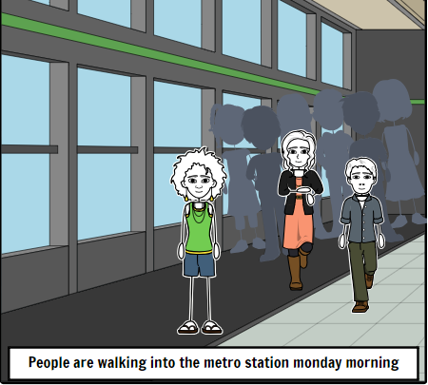
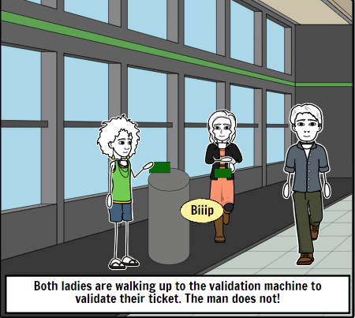
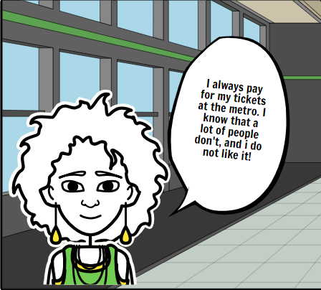
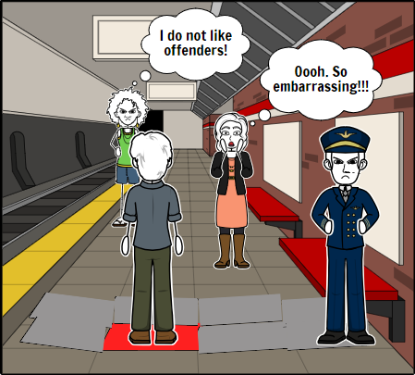
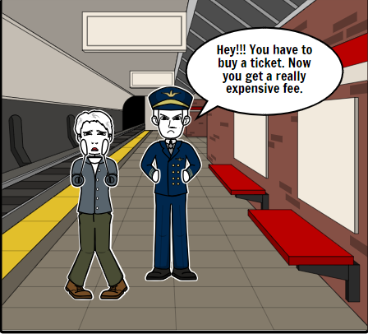

Slide 7
Story 1: Results
Goal: Test the concept from a general perspective
4 of the users thought the same as the “solution”
1 user though the girl on the right did not pay for her ticket, and did not think anything special of the guy standing on the red floor

Slide 8
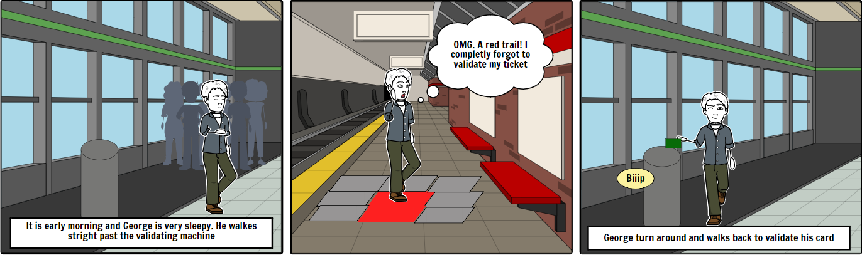
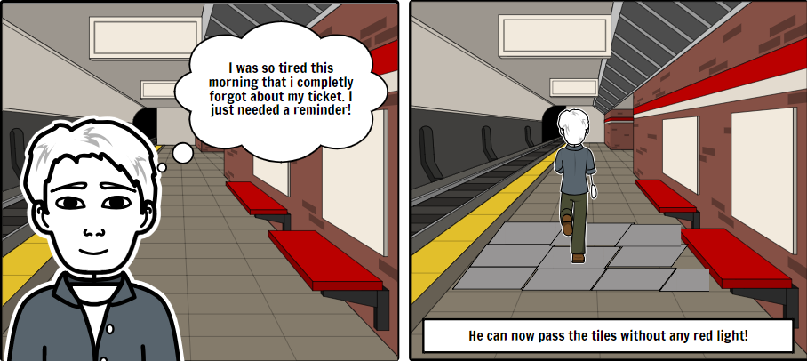

Slide 9
Story 2: Results
Goal: Is this a sufficient reminder for the users to validate the ticket?
Every user thinks that this is a good way to remind the user to validate the ticket
4 out of 5 also thinks that if there is not a security guard the guy could just ignore the signal

Slide 10
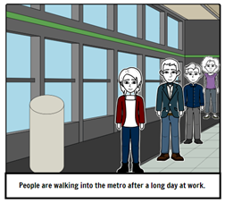
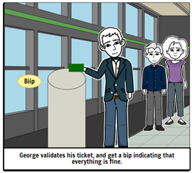
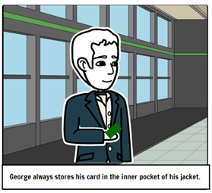
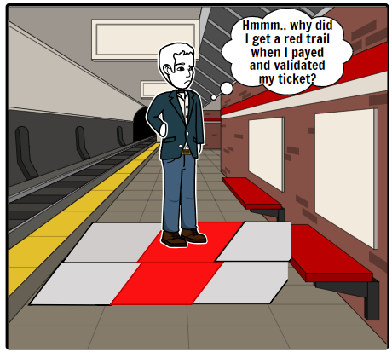
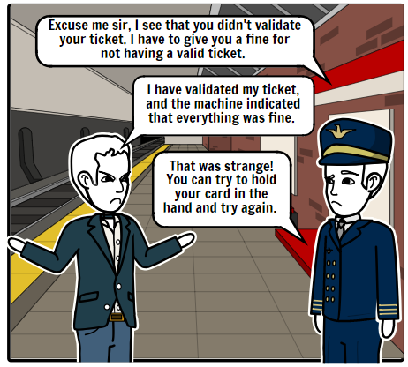

Slide 11
Story 3: Results
Goal: How do people react to false negatives?
Angry, embarrassed, annoyed, frustrated and confused
Ok if it is a rare occurrence, NOT ok if it happens regularly

Slide 12
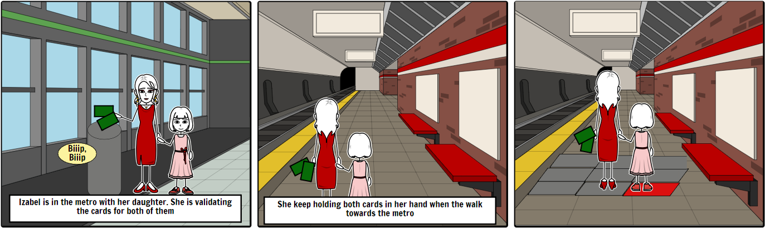
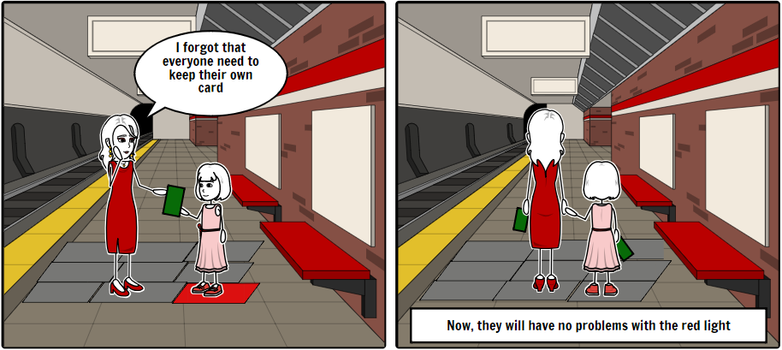

Slide 13
Results
Goal: How to handle validation process for children?
Not a good solution for the problem, easy for children to lose their tickets
1 user was very clear that there should not be any red light for children!
2 users showed concern about people with special needs, handicapped people, that need assistance

Slide 14
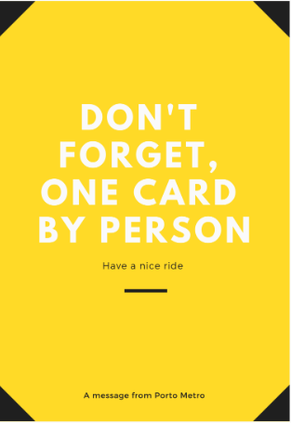
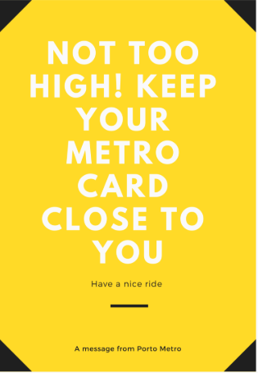
Ideas for improvement
The next process:
Redesign our idea to match the results from the formative user study
E.g: Informativ signs telling how to avoid false positive

