Slide 1
Personas and scenarios
Group 6
Nina Marie Wahl Carl Emil Hattestad Armelle Rivière Aleksi O’Connor Anna Bellika Kjæmpenes

Slide 2
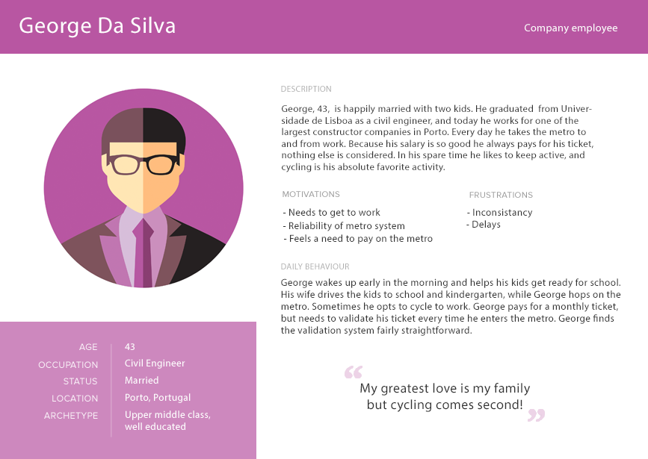

Slide 3
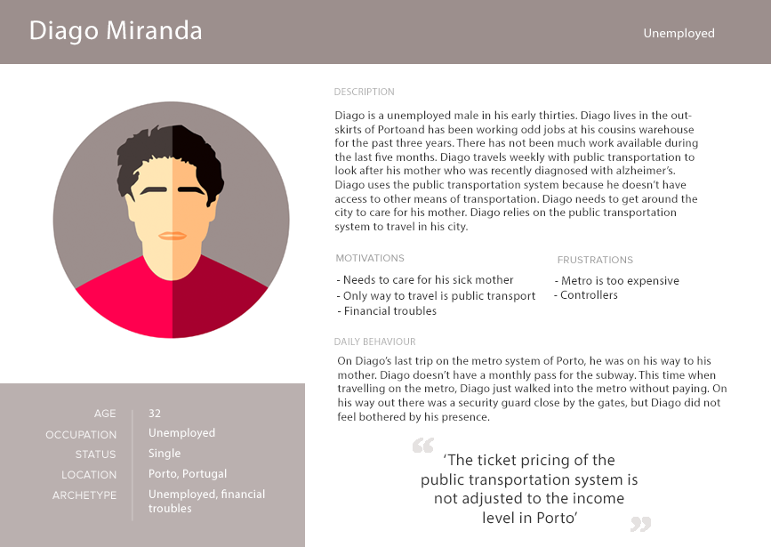

Slide 4
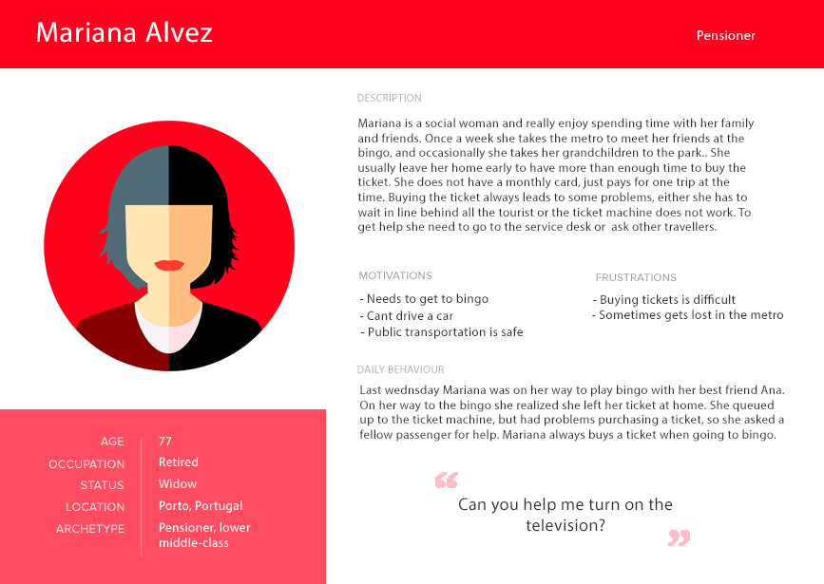

Slide 5
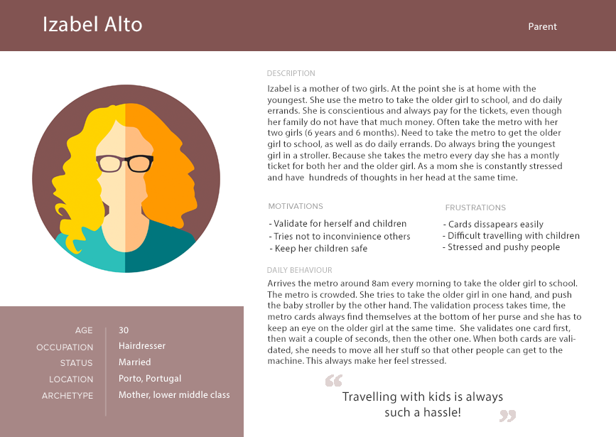

Slide 6
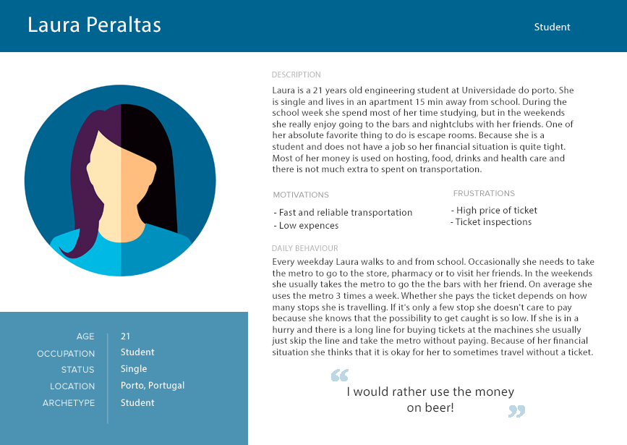

Slide 7
Scenarios

Slide 8
Scenario 1: Ticket line
“We are at the metro station São Bento in the middle of rush hour. The line to buy tickets is long”
Laura Peraltas- student
Mariana Alvez- old lady

Slide 9
Scenario 2: Security guard
“We are in the middle of rush hour, and another security guard just stepped in near the validation machines. ”
Laura Peraltas- student
Diago Miranda- unemployed

Slide 10
Scenario 3: Late night at the metro
“It’s late night, and just one hour until the metro closes. ”
Laura Peraltas- student
Diago Miranda- unemployed

Slide 11
Scenario 4: Validating and storing card
“It is early tuesday morning and a lot of people are heading of to work., the validation machines are running hot”
George da Silva - Company employee
Izabel Alto - Mother with two children

Slide 12
Development
Scenario 1+2: Implement glass floor
Glass floor
Pressure plates
RFID Sensor
Light
Scenario 3: Nothing, but shows weakness
Scenario 4: Camera function + Fun
Tracking
Connection to glass floor
Funny plate for children

Slide 13
Prioritized list
Glass floor
Pressure plates
RFID Sensor
Light 14th November
Camera
Tracking
Fun plates for children 26th November
Finalize prototype for testing 3ed December Finalize prototype 10th December

