Slide 1
Usability testing - Prototype
Group 6
Nina Marie Wahl Carl Emil Hattestad Armelle Rivière Aleksi O’Connor Anna Bellika Kjæmpenes

Slide 2
Research Questions
How will this solution have an impact on the already existing system?
Is the shame factor big enough?
Is the prototype realistic enough?

Slide 3
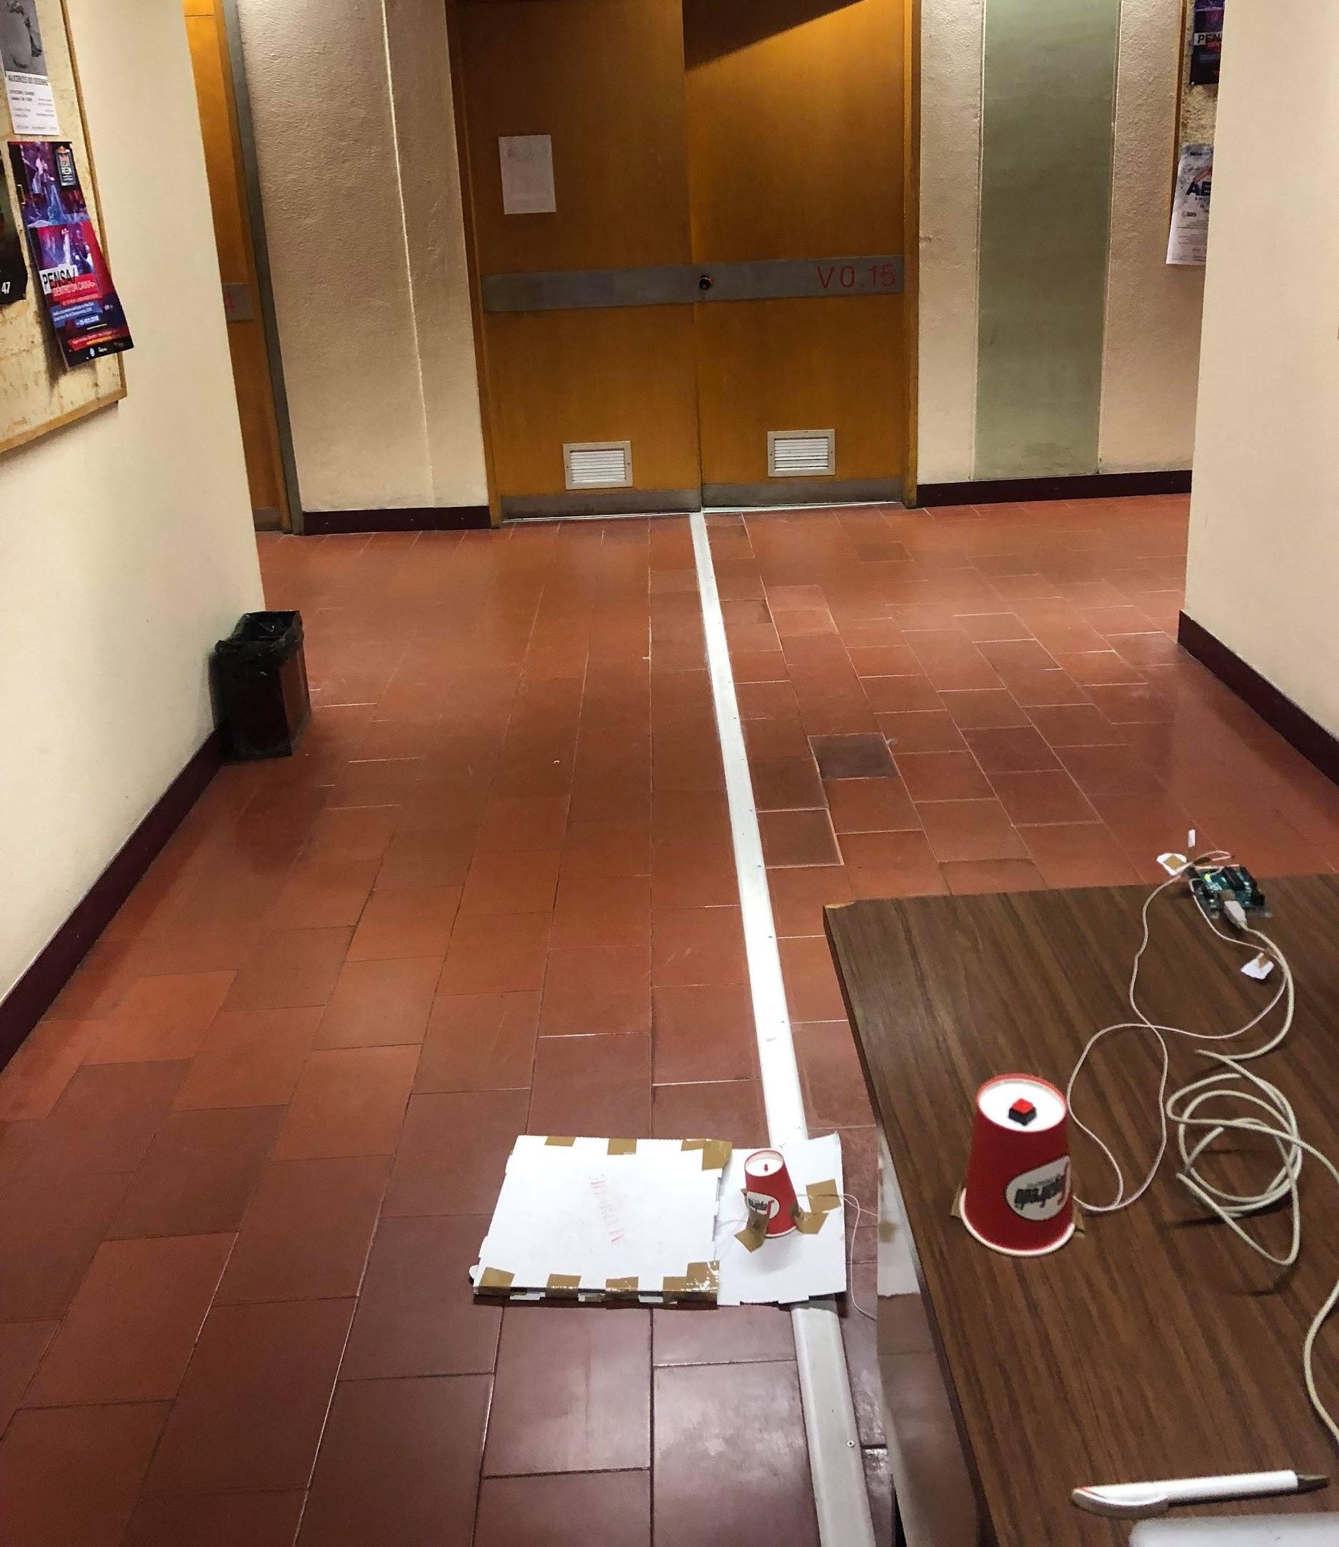
The testing
Civil building
5 users- all students
Direct observation- usability testing
Setting up prototype in the hallway- “lab”
Using the same script for all users

Slide 4
Script
Explain the scenario- not the concept
Walk over the plate
What do you think the red light represent?
Give the user more information, validate and walk over
What do you think the red light represent now?
What would you feel about a sound in addition to the red light?
Would you like to get some kind of feedback that everything is ok when you validate your ticket?
Explain the current system in porto: How will the new system impact the users compared to the current?
Test again- sneak into the metro
What do you feel about the shame factor?

Slide 5
Results
No one understood the concept the first time
They all focused on walking on the plate and not the red light.
All understood the red light after using the validation button.
When the users saw the light (second time), they all agreed that it will increase the shame factor
“Do it larger and more noticeable”
“Sound would be better”

Slide 6
Results 2
Validation process should be more realistic - have I validated or not?
Suggestions: Green light, good/bad sound when stepping on first plate
Sneak into the metro easy- just jump/walk over the plate
Need to make sure the floor is big enough - will be that in the real environment, but also in the prototype
The users are splitted between if more people will pay because of the shaming factor
The ones that think shaming is not enough, think it will help for the security
Conclusion: more people will end up paying
All think this will not have a negative impact on the existing system

Slide 7
Research Questions - result
How will this solution have an impact on the already existing system?
Help security
Social pressure→ people pay for the tickets
Is the shame factor big enough?
No
Is the prototype realistic enough?
No

Slide 8
Design implications
The environment should be more realistic
Green light when ticket is validated - in the metro you get a beep
More cardboard plates and duct tape simulating a bigger floor
Information posters on the floor and walls
Add sound for the shaming factor - one high beep on the first red square
Video Camera
Already a part of the development plan
Also for increasing the shaming factor
Fun plates for children
Low priority

