Slide 1
Impact on agents post launch of HDB Resale Portal
Utkarsh Chaturvedi
(Case Study for GovTech)

Slide 2
Some assumptions for the analysis
A house transaction can have multiple “buyer” and/or “seller” agents
Numbers of transactions in agent data is more than 2x transactions seen in resale data in 2017
Resale values are NOT impacted whether an agent sells the house or not
If house-prices are impacted by agents or vice-versa, impact on agent business could be under-valued or over-valued since the relationship between prices and agent popularity becomes interdependent

Slide 3
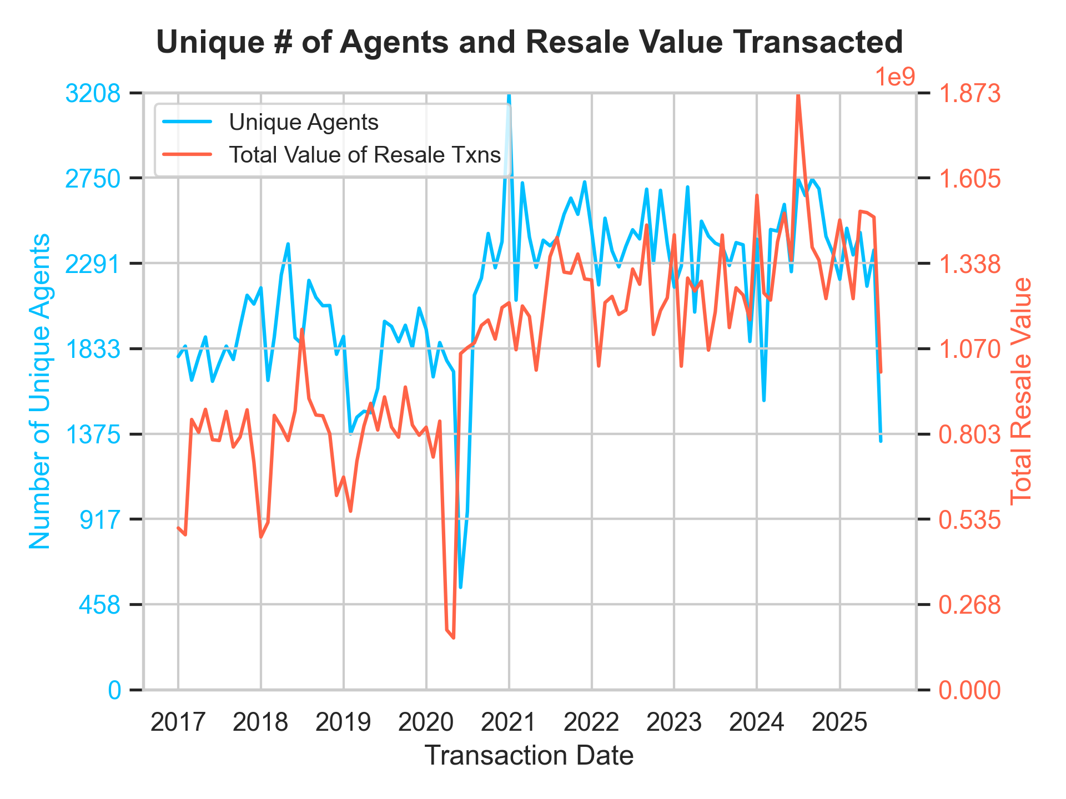
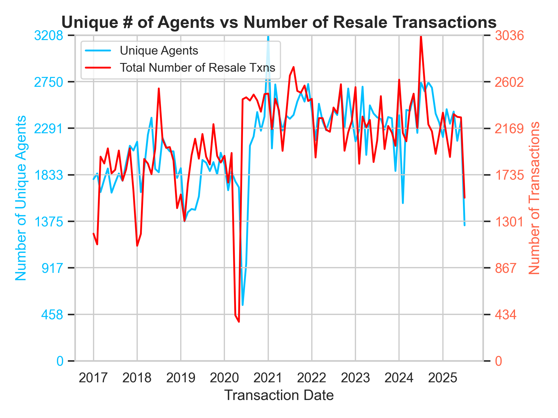
Pre and Post Portal Launch Market: Number of agents have adjusted to increased resale transactions post-Covid but stagnating resale value might start to drive margins downward
~ 25% increase in number of agents (who successfully made a resale transaction) pre-2020 to 2024-2025 along with an identical increase in # of resale properties
Resale Portal launch in 2018 correlates with some upward movement of # of agents in early-2018 but a downward trend later from Q4 2018 into 2019. Market appears to have a major role in these swings

Slide 4
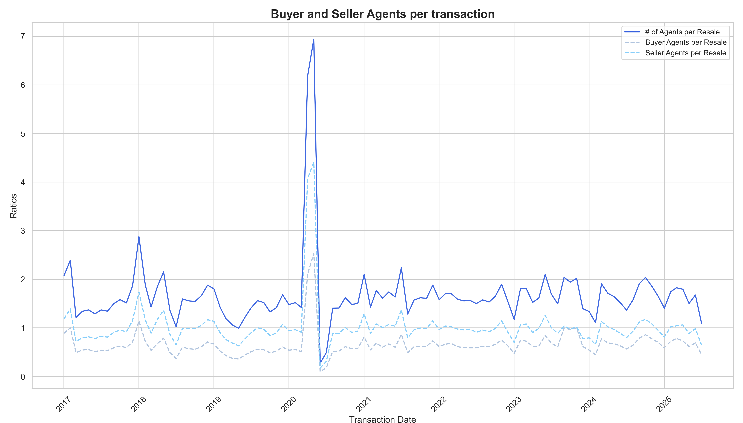
Buyer vs Seller agents Traditionally, sellers appear to have more agents or use agents more consistently, compared to buyers
Pre-Covid, ~1 seller agent would be attached to a resale but only 2 buyer agents would be attached for every 3-4 resales
On the buyer side, we see a downward trend in agents being used after Portal launch with ~10-15% reduction observed in number of buyer agents per resale
At 1% buyer commission*, this would translate to ~$100-150k/year impact on agents and savings for buyers (in 2019)
Covid appears to have disrupted any underlying patters, but 2019 trends appear to hold steady till ~2023
Post 2023, buyer agents appear to be back in demand
Peaks in number of agents/resale correlate to seasonal downturns in demands
* https://www.propertyguru.com.sg/property-guides/property-owners-dilemma-how-much-should-i-pay-my-estate-agent-9798

Slide 5
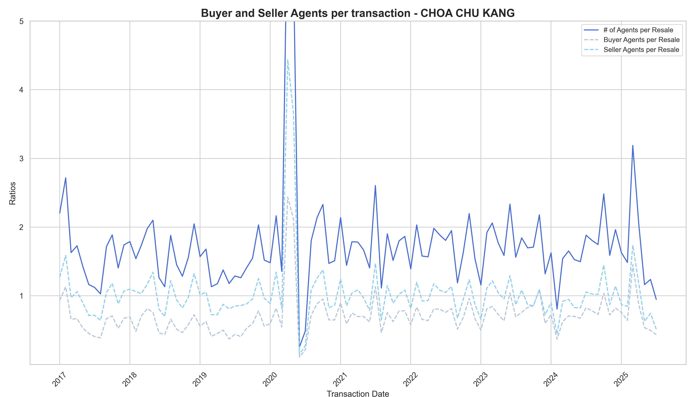
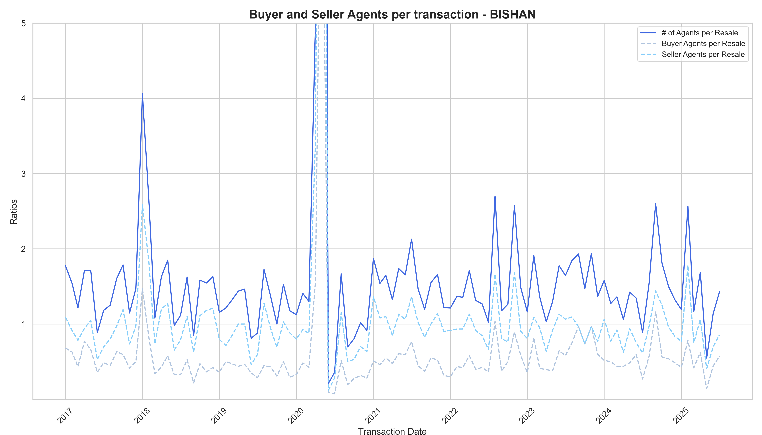
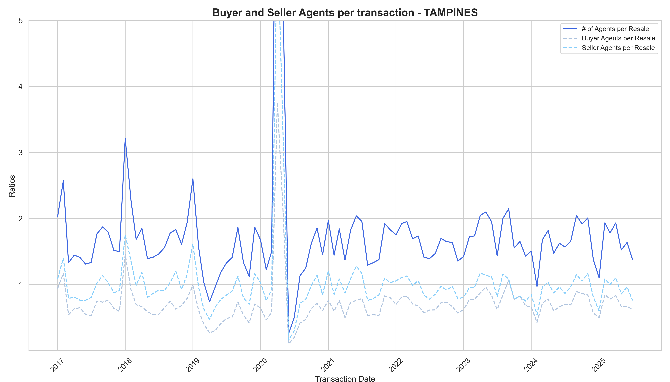
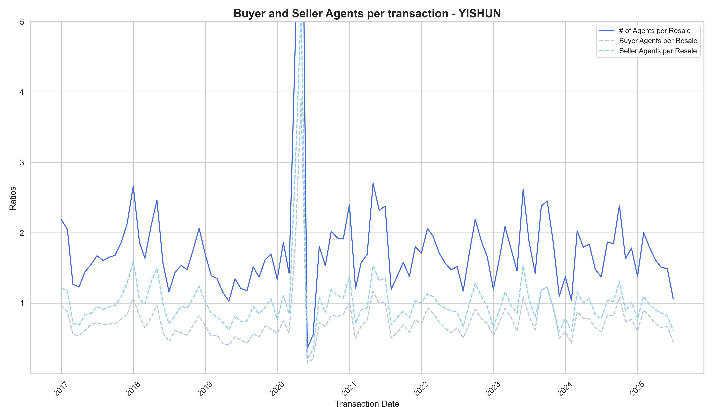
Portal impact depends on towns Popularity and demand in towns might impact people’s willingness to use agents
Choa Chu Kang, Bishan: Pre-Covid, an increasing gap between buyer and seller agents with widened separation from 2017-19. Gap has eroded after 2023 through (higher demand maybe due to new construction/development etc.)
Tampines, Yishun: Some towns appear to exhibit almost no impact in seller or buyer agent difference. They show reduced # total agents/transaction in 2019 but since both buyer and seller agents reduce, it is difficult to isolate the impact of Portal launch vs. market

Slide 6
Conclusions and Next Steps
The impact of Portal Launch might have been felt on the buyer’s willingness for an agent, but no discernable difference is observed on seller’s willingness to hire an agent
Covid appears to be the big disruptor, resetting people’s expectations and changing behaviour
Willingness to hire an agent by a buyer is also dependent on popularity of the area due to new developments, constructions etc. and on a long-term basis, it become critical to control for these factors before trying to discern the impact of the Portal
Impact of Portal launch could be qualitative in nature along with quantitative, and surveys are needed to understand when/how people use the Portal –
More data might increase both buyer and seller confidence in prices, and could help spur further resale transactions
The portal could track whether buyers and/or sellers completed the transaction without an agent, thus providing more granular data on portal success

