Slide 1
Predict COE prices across all vehicle categories
Utkarsh Chaturvedi
(Case Study for GovTech)

Slide 2
Some assumptions for the analysis/model
Monthly “quota” for each “bidding number” is known by LTA, so we will not forecast it for to get to future values of premium
Since bidding exercise happens every month, we assume that LTA is not looking for “predictive” premiums in short-term but rather medium-term in the future. We assume this to be 6 months.
Model variables, such as bids, which are unknowns in future can be considered with a 6-month lag

Slide 3












Model: Multiple Drivers and Explanatory variables used to understand COE prices
Raw Data Drivers
Derived Drivers
6 and 12-month lagged Premium
Quota
COE Premium
Log transformed (and) 10-year cumulative sum of quota
(proxy for current vehicle population)
Vehicle Category
Bidding Number of month
Bids Received/Bids Successful (Lagged)
(proxy for vehicle demand)
Seasonality and Temporal Drivers

Slide 4
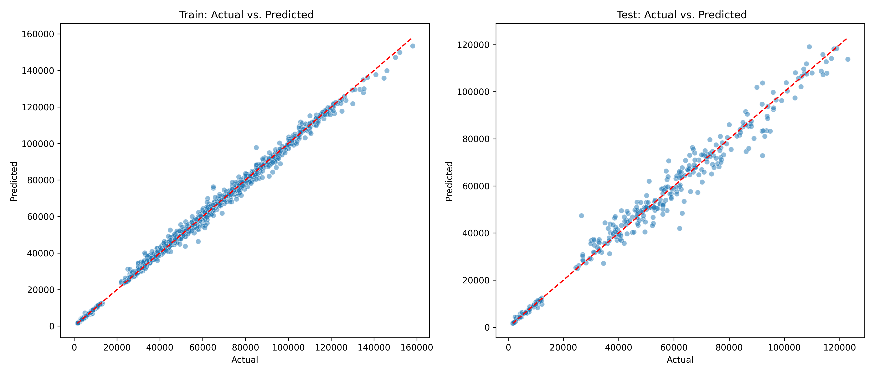
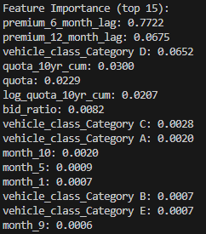
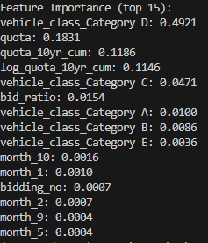
Model: Regression and Tree-based models with k-fold Cross-Validation
Model Performance with all Explanatory Variables
Feature Importance
With Lagged “Premium”
WITHOUT Lagged “Premium”
R^2 = ~0.98
R^2 = ~0.97
Past premium values are the biggest contributors to current values
While this relationship is expected, does this point to a deeper relationship between expectations of current prices based on past prices by the consumers?
The model performance remains robust even if we remove “lagged premium” as features. Beyond vehicle category,
COE quota is the 2nd most important variable here followed by “cumulative” quota. Modifying quota practices along with vehicle categories could help control COE prices

