Slide 1
Forecast 5-year preschool requirements
Utkarsh Chaturvedi
(Case Study for GovTech)

Slide 2
Some assumptions for the analysis
Population data available till 2020; forecast pre-school requirements from 2021 till 2025
Use HDB data (available from 2018) as a driver for training and planned completion years from 2021 for forecast
A static proportion of HDB housing (planned) split as 75% Chinese, 15% Malays and 10% Indians is assumed. This is used with relevant fertility rates to estimate new-born population, which acts a leading indicator for pre-school requirement.
Fertility rates from 2020 are used to calculate pre-school population from new HDB completions in 2021-2025
Pre-school center data does NOT have planning area or sub-zones. A path to extract planning areas from OneMap API (https://www.onemap.gov.sg/apidocs/search) has been provided in the codes as a pathway to finish this data
Newly created subzones in 2019 have very less data-points for prediction; they are being ignored in the current model build but need to be incorporated in full model as they are being carved out from other zones

Slide 3
Data Pre-processing Steps
Population Data
Combine different Excel sheets, clean and pivot data
Filter and aggregate data to get pre-school population for every subzone yearly
BTO Mapping
Filter data for necessary years (Training: 2018-20, Forecast: 2020-25)
Estimate new BTO population from static ethnicity quota(s) and fertility rates
Annual Birth And Fertility
Clean data to only focus on racial fertility rates preschool population from new BTOs might be influenced
PreSchool Center Data
Use Onemap API to map the Postal Code to Planning Areas finishing the dataset with above sources of data
New fields can help with visualization in the dashboard and capacity planning per subzone

Slide 4

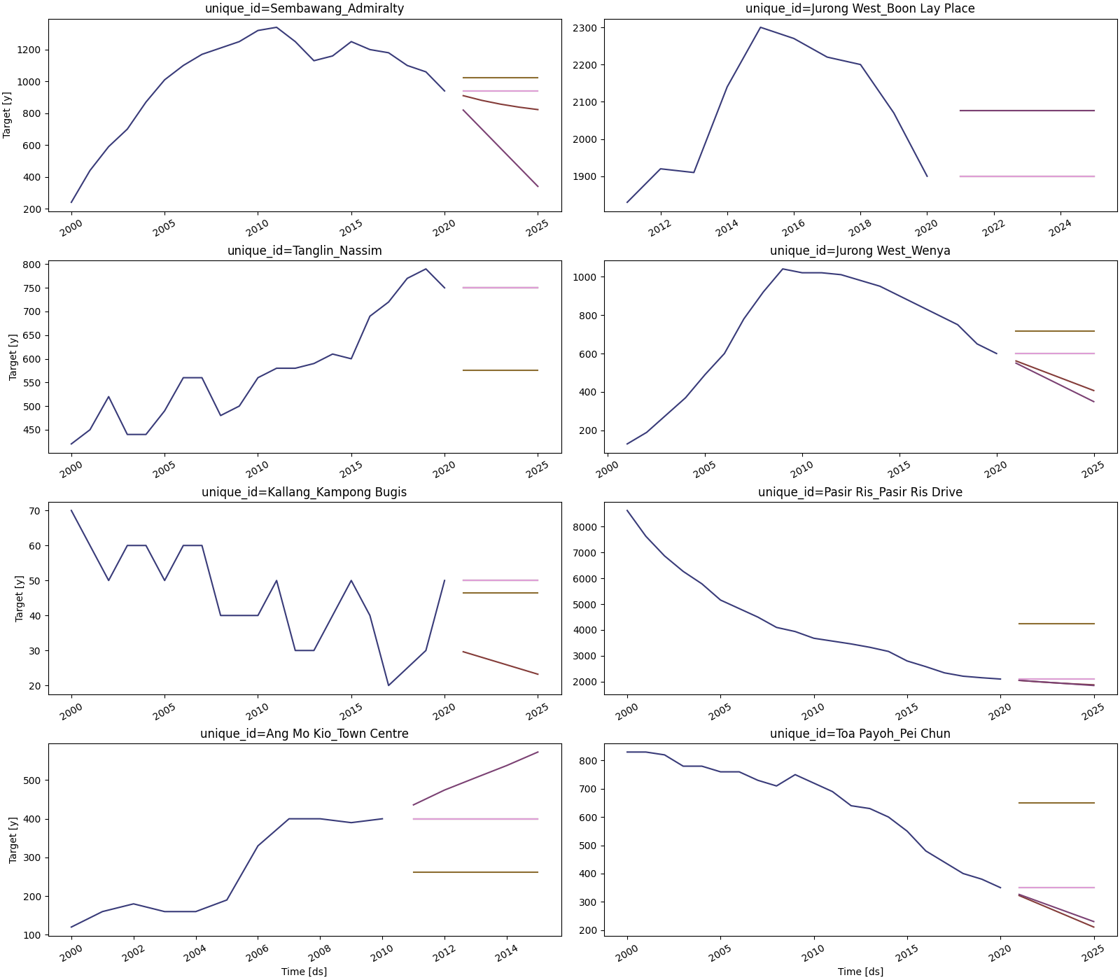


Time-Series model with # BTO houses and estimated preschool population as drivers
1
Validation using Back-Testing
Validation Windows
Time-series model, which analyses historical patterns of preschool population across all planning subzones
2010
2018
2019
2010
2019
2020
Best Models Used For Forecast
+
Sample forecasts for different Subzones
(process auto-selects the best model based on back-testing)
2
Drivers/Explanatory Variables:
# of HDB flats launched in a subzone in any year
Expected population of preschool from new launch based on ethnicity-mix and fertility ratio of said ethnicities

Slide 5
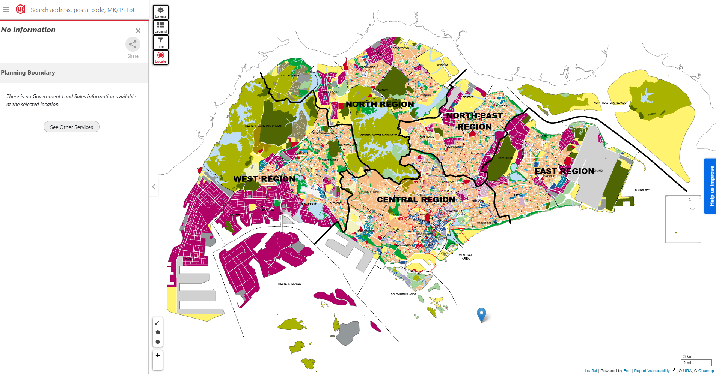

Visualization | Page 1: PowerBI or Tableau
Key Information to be presented on landing page:
Planning zones with green, amber and red colours to indicate sufficient, nearing or stressed capacity
Headline metrics -
Highest Stressed Planning Area (by # of waiting list vs capacity)
Highest Stressed Subzone (by # of waiting list vs capacity)
# of zones with capacity
# of zones nearing capacity
# of zones exceeding capacity
Top 5 “high” stress zones after 5 years (based on population forecast)
Tooltip (hover over a planning district) –
Current Capacity
# Number of preschools in subzone
5 Year preschool eligible population (forecast)
Stressed Subzone
# of subzone in capacity
# nearing capacity
# exceeding capacity
Stressed Planning Area
Top 5 forecast “stressed” zones next year
Current Capacity: 300
# of pre-schools : 4
5-year preschool eligible population: 900
Map snippet from Onemap

Slide 6
Visualization | Page 2: Future View
Key Information to be presented on this page:
Planning zones with green, amber and red colours to indicate sufficient, nearing or stressed capacity AFTER 5 years
Headline -
# of zones with capacity
# of zones nearing capacity
# of zones exceeding capacity
Expected capacity vs. population for each planning year
Tooltip (hover over a planning district) –
Number of pre-schools (current and planned) in subzone
Number of preschool students (current and 5 years later) in subzone
Year | Pre-school population | Expected Capacity
2021 | 5,000 | 7,500
… | … | …
… | … | …
# of subzone in capacity
# nearing capacity
# exceeding capacity
Caution Subzone : Nearing Capacity in 5 years
Good Subzone : Sufficient Capacity in 5 years
Insufficient Capacity: 2025
Insufficient Capacity: 2021
Good Subzone : Sufficient Capacity in 5 years
Good Subzone : Sufficient Capacity in 5 years
Caution Subzone : Nearing Capacity in 5 years
Insufficient Capacity: 2024
Caution Subzone : Nearing Capacity in 5 years
Good Subzone : Sufficient Capacity in 5 years
Insufficient Capacity: 2024
Insufficient Capacity: 2021
Map snippet from Onemap

Slide 7









Deployment using AWS Sagemaker and Lambda
Model deployed to AWS SageMaker AI
Model Artifact
Training*
Inference
AWS Lambda: New run triggers upload to BI tool
Live Dashboard
(Run-metrics and forecast also stored in S3)
Data from different Sources
Model-Input Data (Preprocessing on Lambda or Sagemaker depending on load)
User-triggered run
Upload triggers event
Source all data to S3 bucket
AWS Lambda is triggered for preprocessing
Non-model data required by BI tool
*Model Training can be manually or automatically triggered if input data-distribution changes beyond a certain threshold

Slide 8
Next Steps and Future Improvements
Implement the “completeness” for pre-school center data by bringing in planning zones for each center
Implement process logging and model logging to ensure consistent distribution of model inputs and results
Preschool population will be dependent on multiple factors requiring additional sources of data such as:
Redevelopment of area
Existing number of pre-schools and perceived quality
Fluctuating fertility rates, which itself will be a function of income, standard of living, closeness to family etc.
Explore and survey Preschool centers to get more data around factors influencing stressed subzones and what has gone right with high-capacity zones

