Slide 1
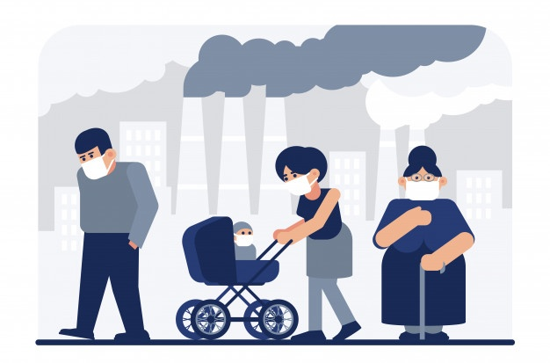
Pollution

Slide 2
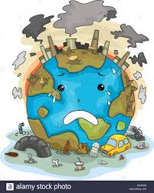
Pollution is the introduction of harmful materials into the enviroment.
Pollution can be natural such as volcanic ash.
It can also be created by human activity such as trash or runoff produced by factories.
Pollution damages the quality of air, water and land.

Slide 3
Air pollution
Air pollution is mostly invisible but sometimes it can be visible,
for example you can see dark smoke coming from pipes of large trucks or factories.
Polluted air is dangerous it can increase the risk of lung cancer.
Natural dissasters can also cause air pollution for example volcanoes eject ash and gases into the atmosphere.
The greenhouse gases are another source of air pollution.
Cars and companies produce pollutants including nitrogen oxide, sulfur dioxide and hydrocarbons, which react with sunlight and produce smog-a thick fog of air pollution, which can make breathing difficult.
When certain air pollutants mix with moisture they can turn to acids, which othen fall back to earth as acid rain.Acid rain can kill all the trees in a forest,devastate lakes and other waterways. When water becomes acid, fish can’t survive.

Slide 4
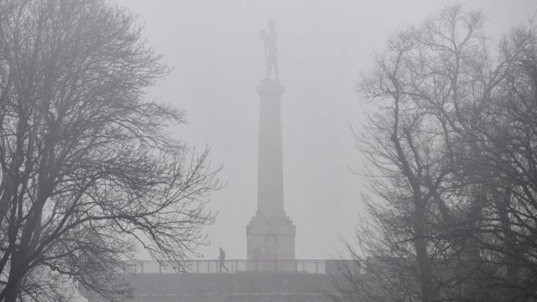
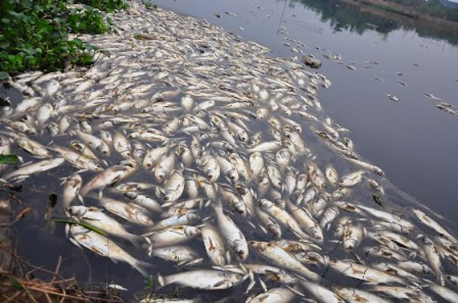
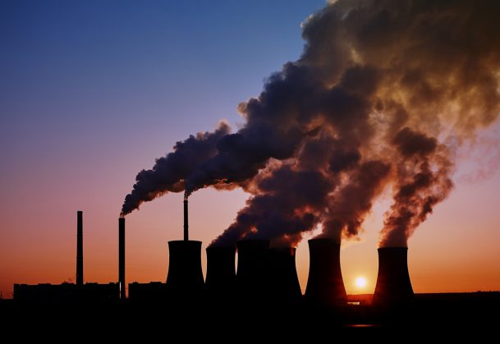
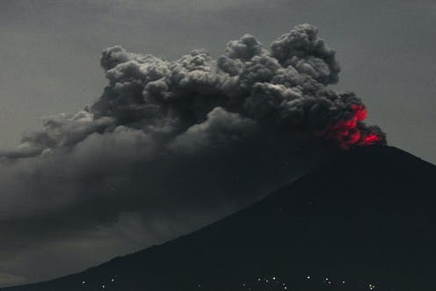

Slide 5
Water pollution
Some polluted water looks muddy and smells bad, and some looks clean but is filled with harmful chemicals.
Drinking polluted water is very dangerous, the UN estimates that 4,000 children die every day from drinking polluted water.
The fish that live in polluted water are unsafe to eating it can lead to sickness.
Chemicals and oils from factories are dumped into waterways, they can create a fertile environment for blue-green algae, which create a harmful algal bloom that prevent plants and fish from living in the ocean.
Mining and drilling can also contribute to water pollution.
Another source of water pollution are oil spills, buried chemical waste, fertilizers used in agriculture and sewage that has not been properly treated.
Heat, for example heat produced by power plants and simple garbage are also major causes of water pollution.

Slide 6
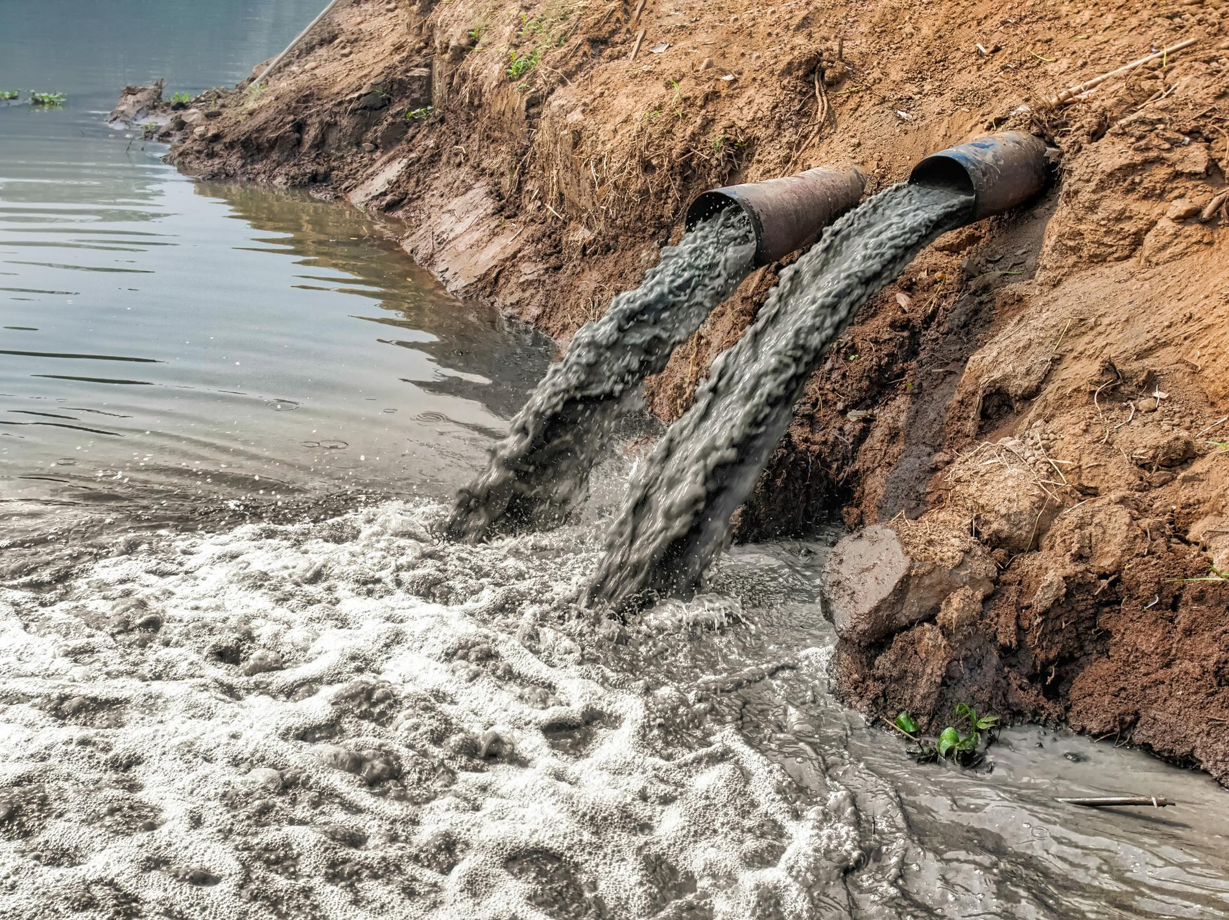
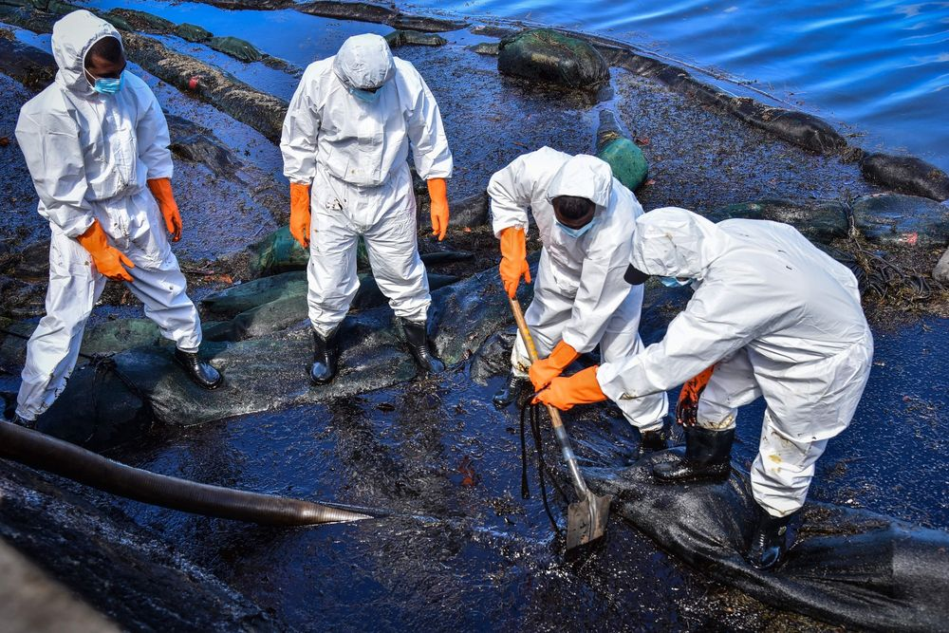
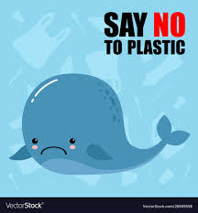
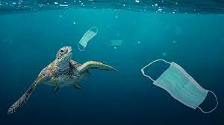
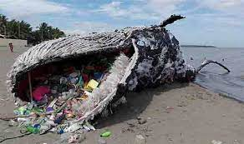

Slide 7

Reducing pollution
Recycling

Slide 8
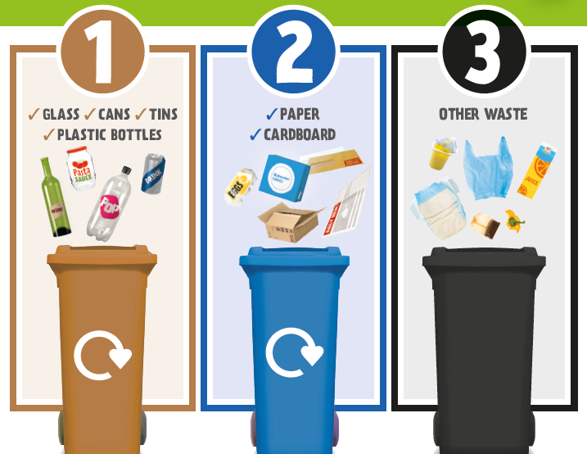
Recycling is the process of collecting and processing materials that would otherwise be thrown away as trash and turning them into new products.
Recycling creates jobs, raises environmental consciousness and there is an overall environmental benefit from it.
Recycling plastic takes 88% less energy than making it from raw materials.
Recycling reduces pollution, saves energy and protects the environment which is why more people should be doing it.

Slide 9
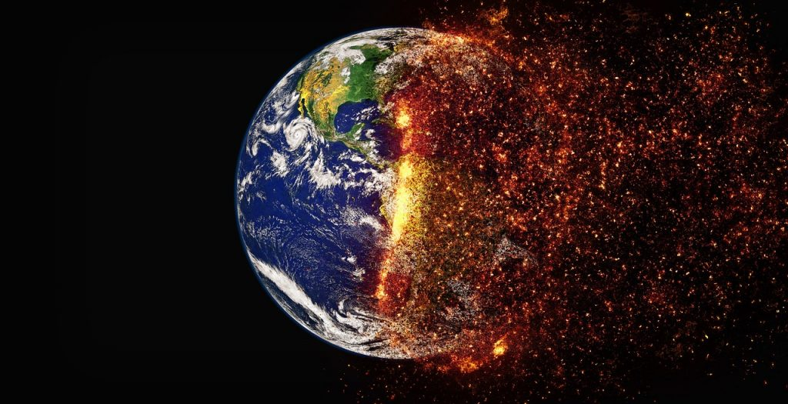
Global Warming

Slide 10
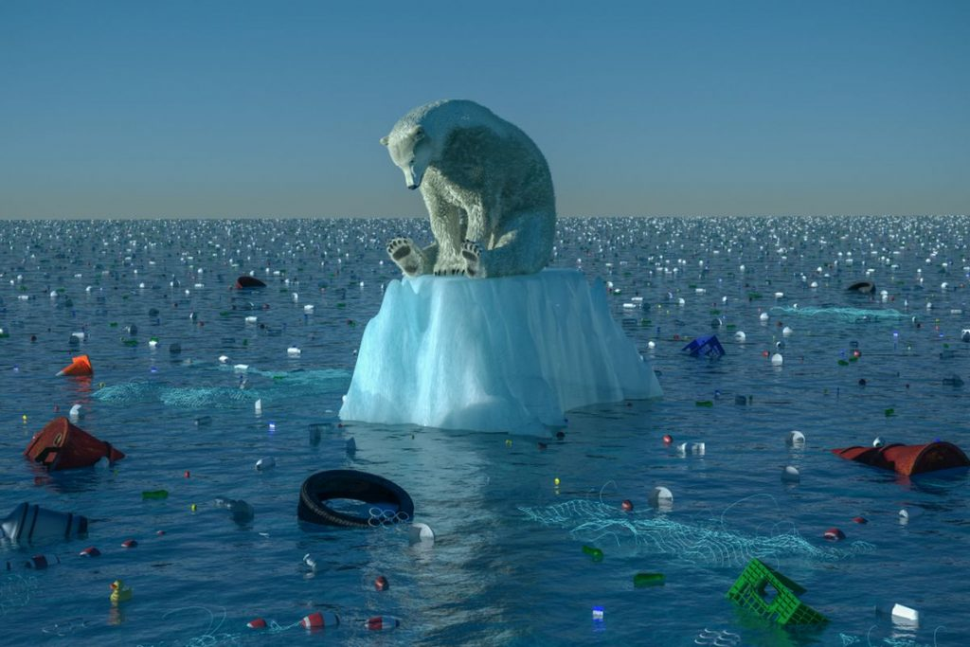
Global warming is the long-term heating of Earth’s climate system due to human activities, primarily fossil fuel burning, which increases heat-tapping greenhouse gas levels in Earth’s atmosphere.
Increased heat, drought and insect outbreaks have increased wildfires.
Declining water supplies, reduced agricultural yields, health impacts and flooding and erosion in coastal areas are big concerns.
Due to effects of climate change some species are at risk of becoming extinct.

Slide 11
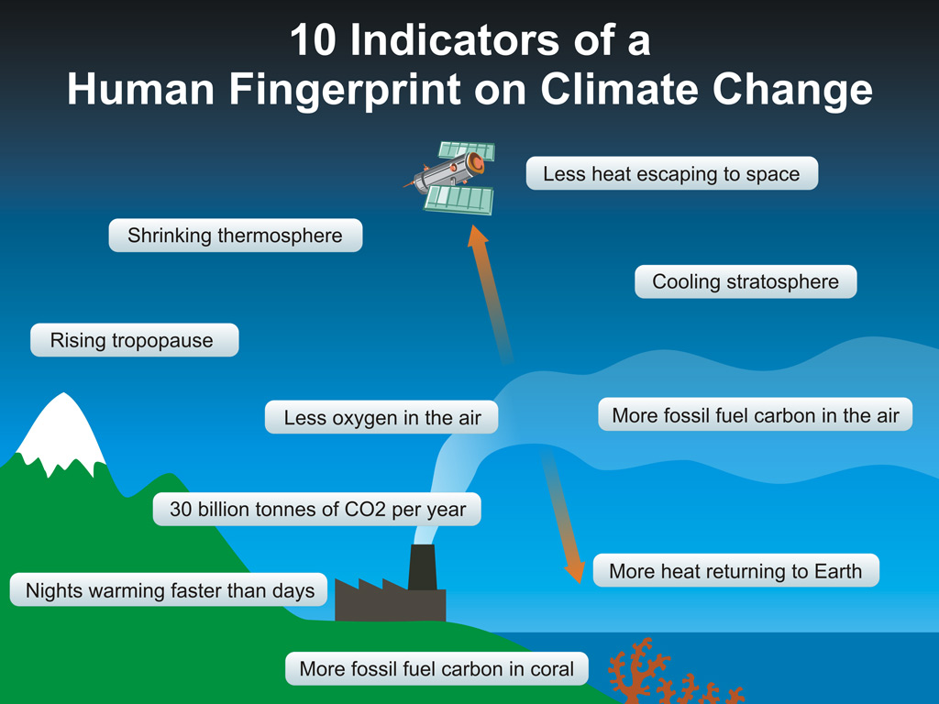
Solutions
We should:
Speak more openly about climate change.
Use renewable energy.
Reduce water waste.
Drive fuel-efficient vehicles.
Plant more trees.
Urge governments to take climate action now.
Listen to Greta:
https://www.youtube.com/watch?v=u9KxE4Kv9A8

Slide 12
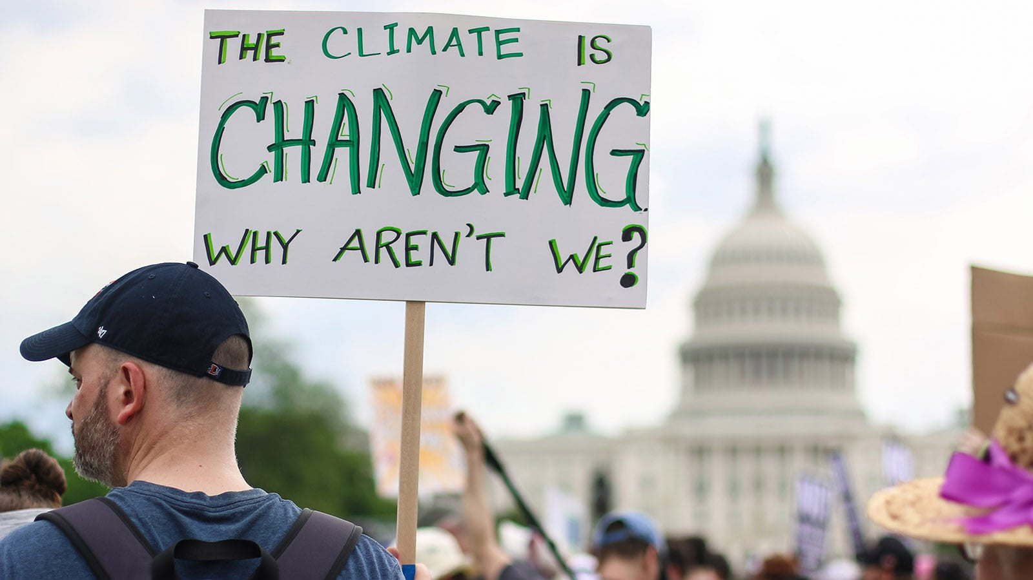

Slide 13
Presentation by
Lidija Ilić
IV-1

