Slide 1
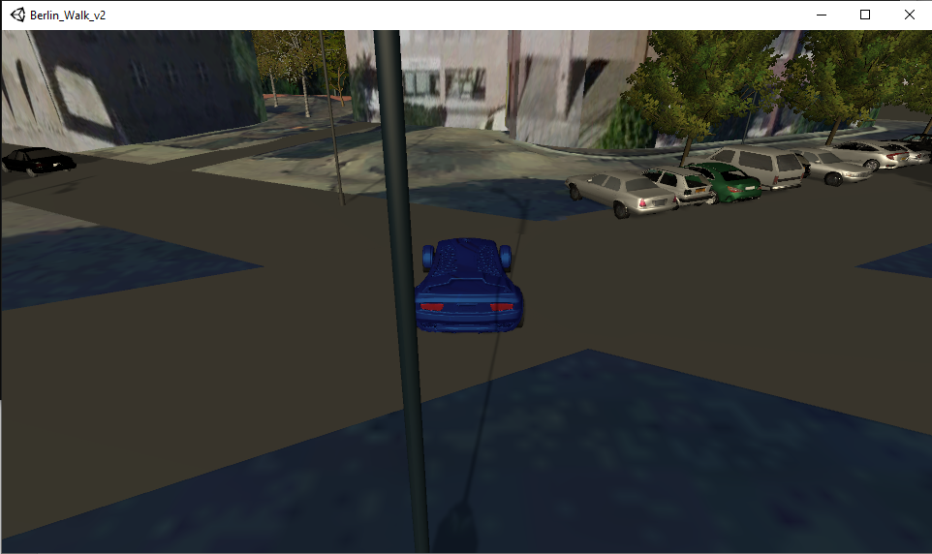
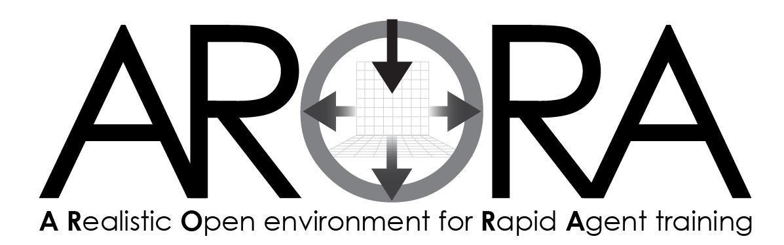
AAR
After Action Review
QUICKSTART GUIDE

Slide 2
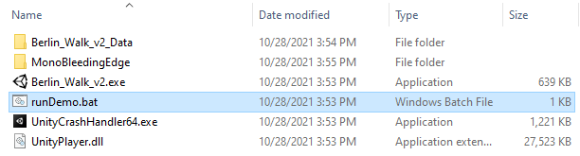
1
If Needed, Extract the zip file onto your hard drive.
On Windows, (Right-click over the .7z file name and select “Extract All” to a location of your choice on the hard drive.)
Linux – issue the bash command: tar xzvf AroraXXX.tgz
2
On Linux: Run ARORA AAR from bash: runDemo.sh (found in the folder you have unarchived).
cd /work/ARORA/demo_iitsec_linux_20211027
./run_demo.sh
On Windows Run ARORA AAR: double-click on runDemo.bat (found in the folder you unzipped).
(If double-clicking does not run the file, use the Command window to run the runDemo.bat file.)

Slide 3
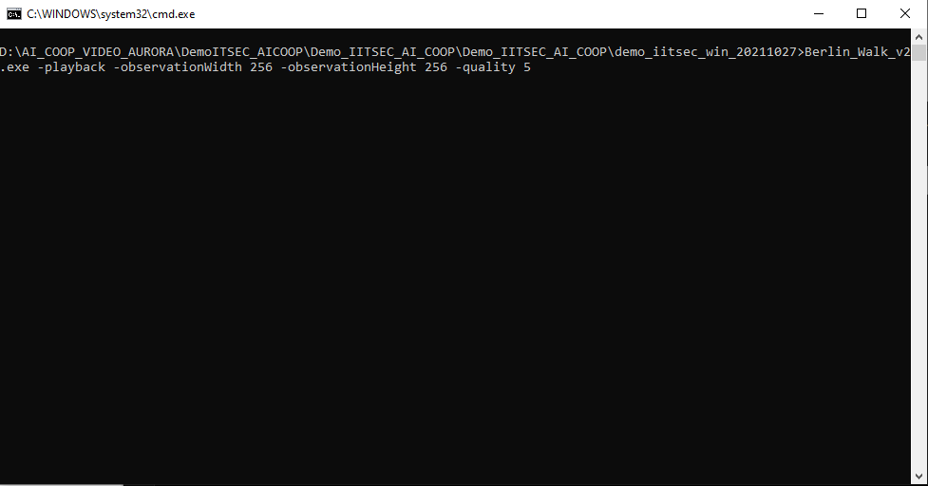
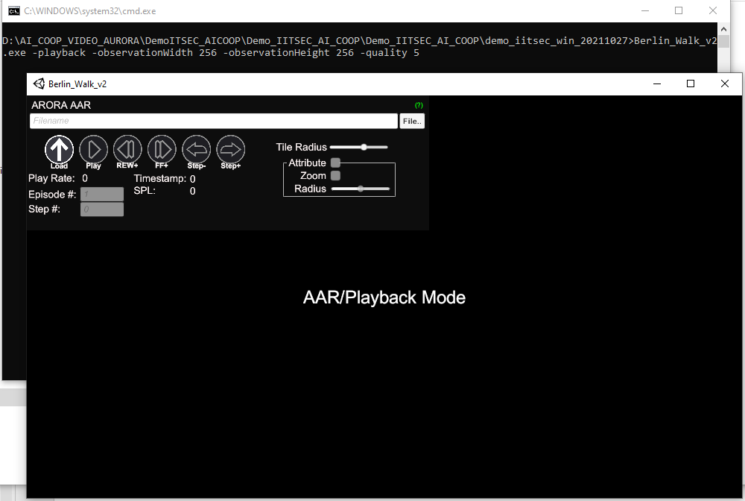
3
This screen appears.
Then this screen appears.
This is the ARORA AAR Interface.

Slide 4
4
Within the AAR Interface, there is a control panel.
This is the AAR Control Panel.

Slide 5
5
Next, click the “File..” button to browse (or find) the file you want to load into the window.
(The “File..” Button opens a window called “Open Vector Observation File” so you can locate and open the AAR file.)

Slide 6
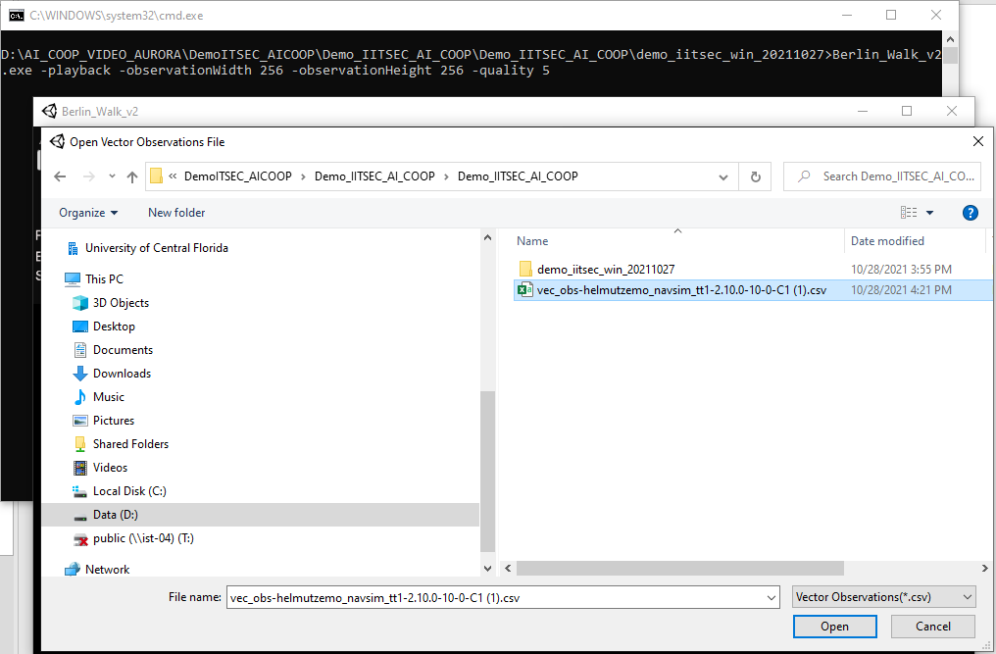
6
In the “Open Vector Observations File” window, look for the folder you unzipped the .7z file to earlier.
Inside that folder there is a .csv file.
Select the .csv file. (In this example, it is the vec_obs-helmutzemo_navsim_tt1-2.10.0-10-0-C1 (1).csv file that is highlighted in blue.)
Click Open.

Slide 7
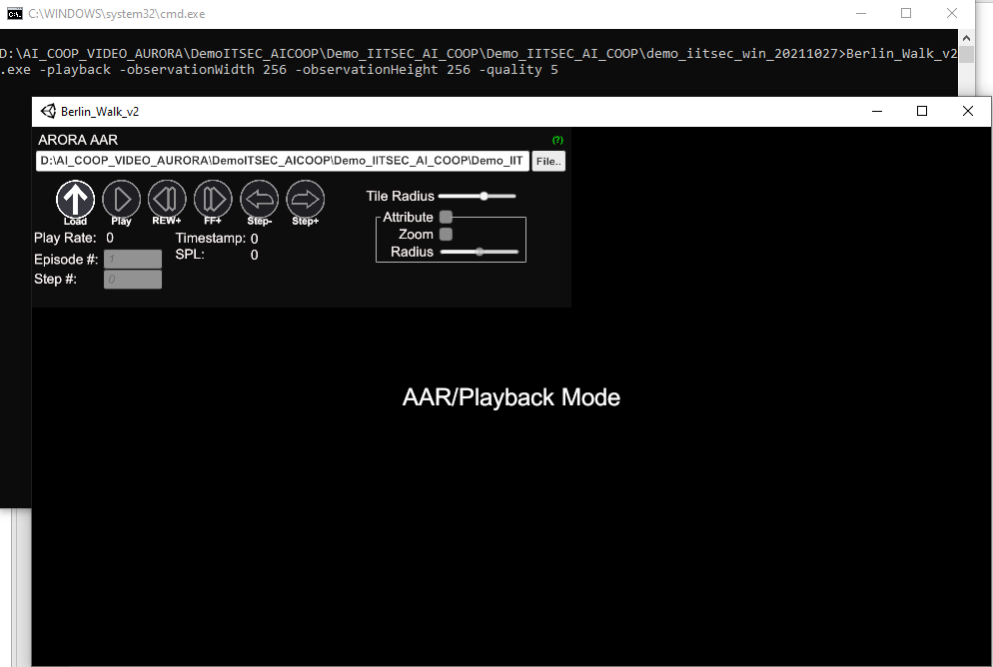
7
You should see that the .csv file is acknowledged and is loaded onto the file location line.
Now select the “Load” button by clicking on it.

Slide 8
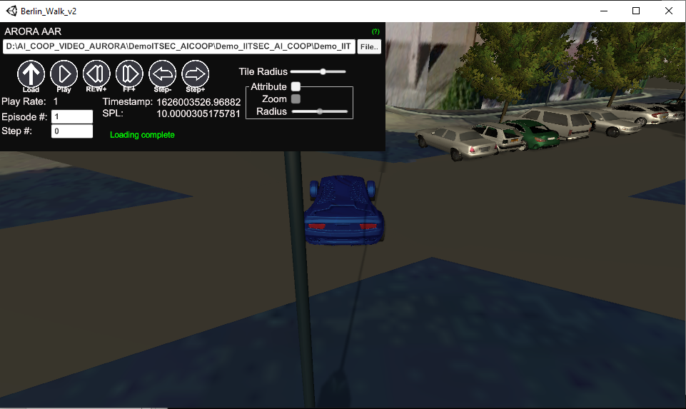
8
The .csv file should load into the window as shown here.
Load status should read “Loading complete.”
Now we will explore the different buttons in the AAR Control Panel.

Slide 9
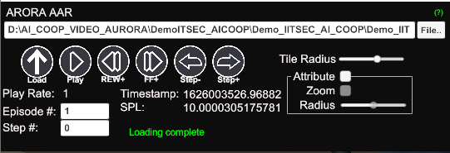
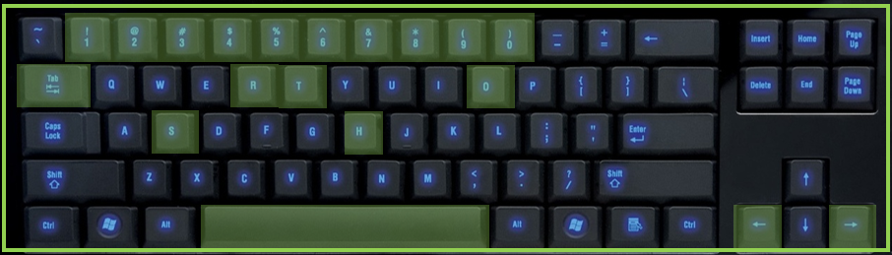
9
Explore the ARORA AAR Control Panel
Mouseover the (?) symbol found in the upper right-hand corner of the Control Panel
This pop up appears with helpful keys that control playback and hides/shows interface features.

Slide 10

10
Key Commands Available:
H or TAB
Toggle the UI AAR Control Panel on/off by hitting the letter H on the keyboard (or by hitting the Tab button).
Toggled ON
Toggled OFF
Both H or Tab may be used to perform this same operation.

Slide 11
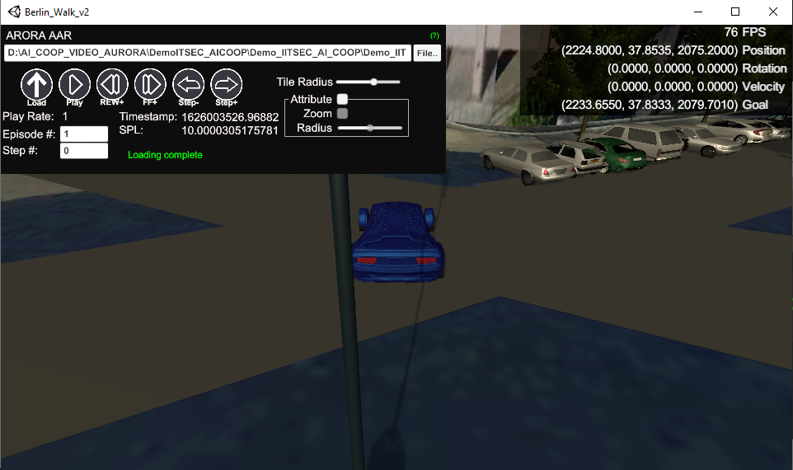
10
Key Commands Available:
S
Toggle the Debug by hitting the letter S on the keyboard.
Toggled OFF
Toggled ON

Slide 12
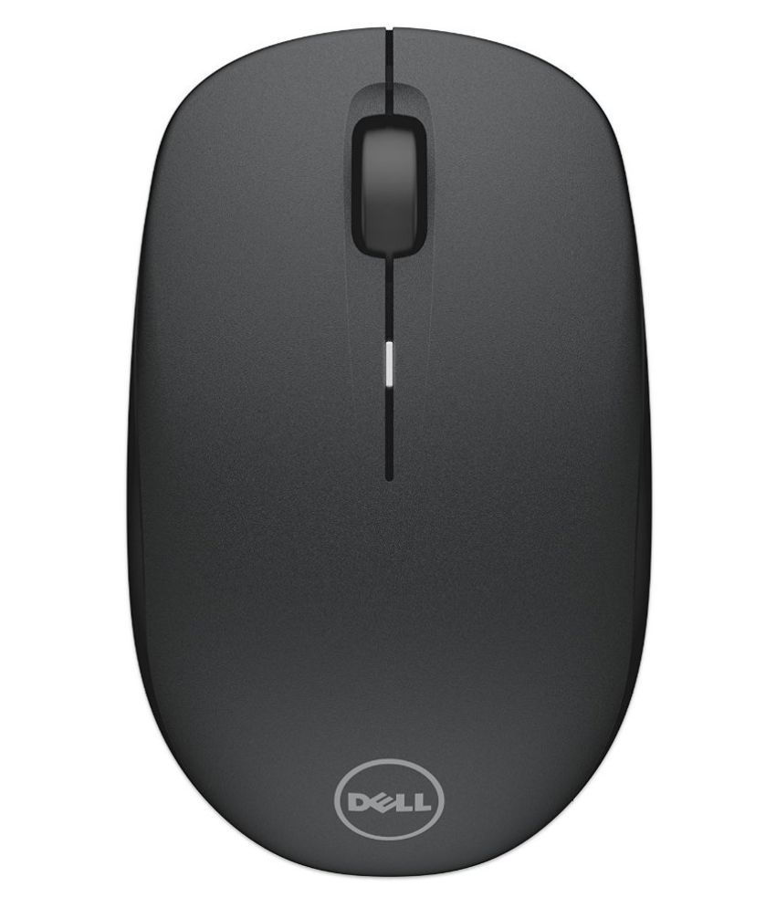
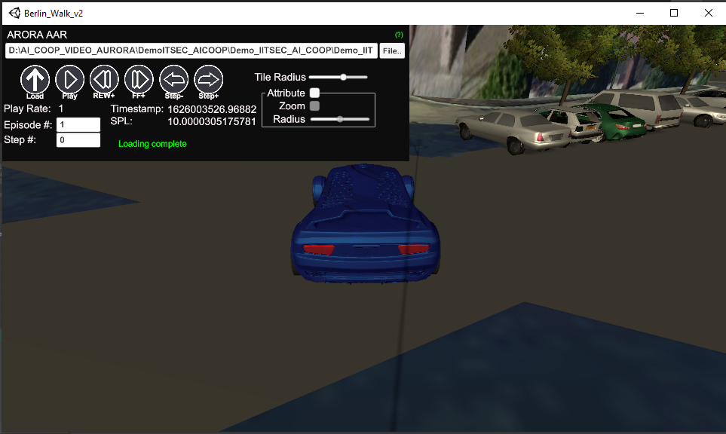

10
Key Commands Available:
T
Use the mouse to zoom in/out by moving the mouse forward and backward.
Toggle the Camera Control by hitting the letter T on the keyboard.
Camera Control OFF
Camera Control ON
The mouse cursor is visible when Camera Control is set to OFF.
The mouse cursor disappears when T is pressed. If you then move the mouse, the camera will move around.
The set camera focal point in the scene is at the center of the agent. This means you may rotate about the agent. The camera is tied to the center of the agent.

Slide 13

10
Key Commands Available:
R
Reset the camera by hitting the letter R on the keyboard.
Camera Before Reset
Camera After Reset

Slide 14
10
Key Commands Available:
Left and Right Arrows
Move through the playback by hitting the Left and Right Arrows on the keyboard.
Play forward with Right Arrow key
Play backward with Left Arrow key

Slide 15
10
Key Commands Available:
Spacebar
Play or Pause the playback by hitting the Spacebar on the keyboard.
Use the keys instead of the panel buttons to control the AAR playback.
Play/Pause AAR using the Spacebar

Slide 16
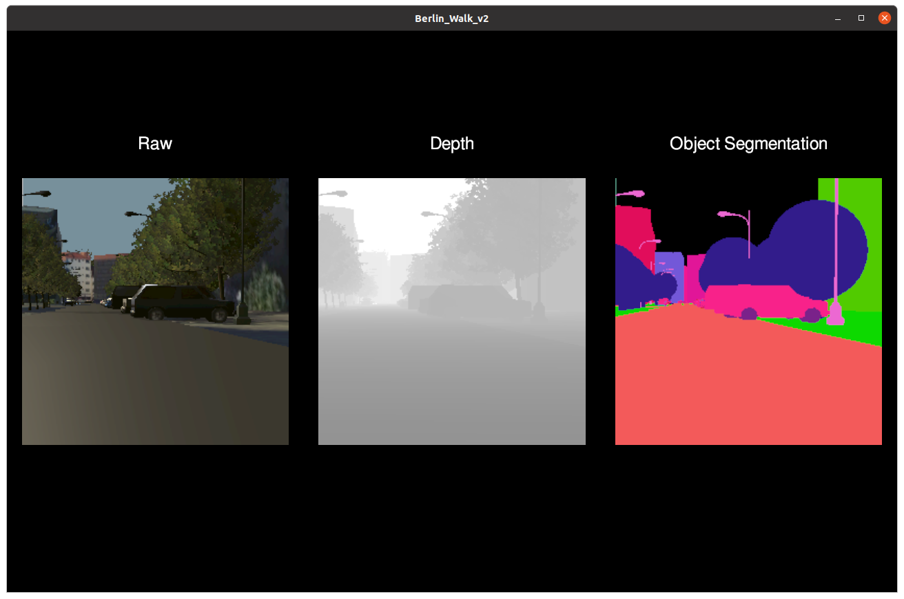
10
Key Commands Available:
O
Change to the Sensor views during playback by hitting the O key on the keyboard.
Hit O Key & return to main view
Hit O Key to switch to Sensors view
There are 3 sensor views: Raw, Depth, and Object Segmentation. The agent can use these sensors while exploring the space in order to achieve training.

Slide 17
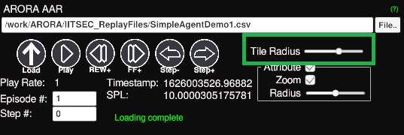
11
UI Tile Radius Widget:
Use: Demonstrates the dynamic terrain loading on the fly
How To: Use the slider to influence the distance bias, which can cause terrain sections to load/unload
Note: This is for demonstration, it can be set via an API call at the start of training

Slide 18
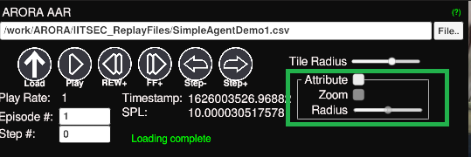
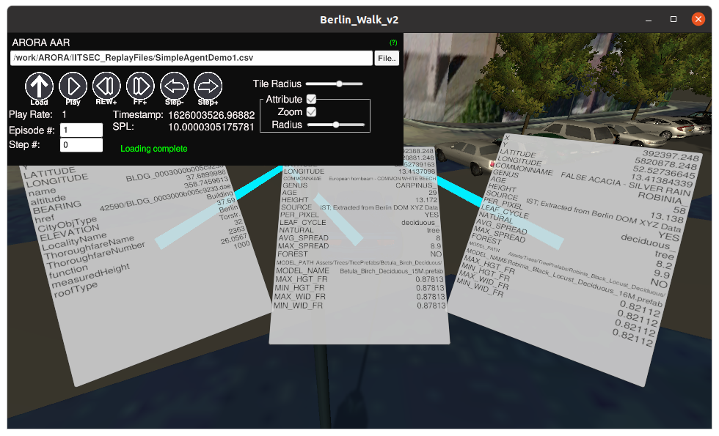
12
UI Attributes Widget:
Use: Demonstrates the attribution of environmental objects/elements
How To: Click the Attribute checkbox
Zoom – causes closest 3 element attribution cards to be zoomed
Radius – influence the distance at which attribution cards are rendered
Note: The attribution cards are for demonstration purposes – the attributions are provided during training time via an API.

