Slide 1
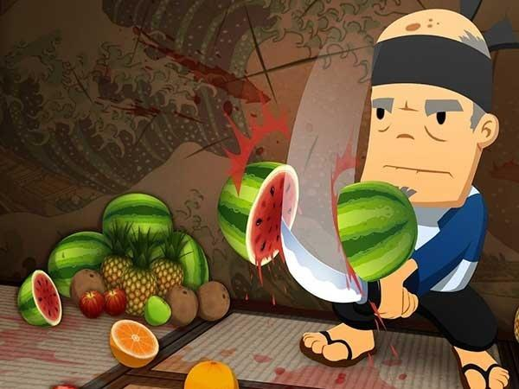
Fruit Detection

Slide 2
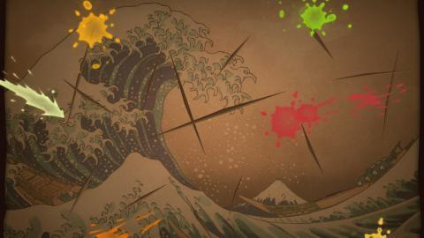
structure
Data preprocessing
Data preprocessing
Collect Data
Build model
Visualisation

Slide 3
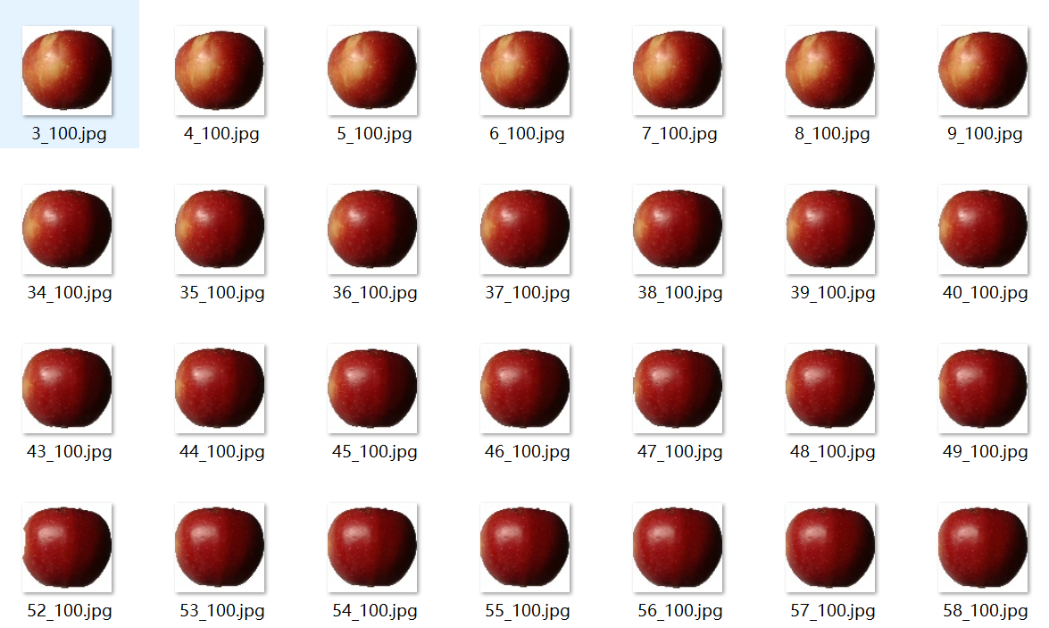
Collect Data
Fruit-360

Slide 4
Data Prossing
Cut image
Color to gray

Slide 5
Bulid Modle
CNN LeNet-5

Slide 6
VISUalisation
Opencv+camera

Slide 7
Code

