Slide 1
Paraview Workshop

Slide 2
Aim
Brief introduction to Paraview
  Simple examples
  Hands on
    Better way to learn
    All examples on github

Slide 3
Requirements
Paraview
  Any version
Git
  https://github.com/ucgmsim/paraview-workshop
  If account clone it
  If no account, download a ZIP file

Slide 4
Basics
Open file
  Can open almost any format
  Open --> select file(s) --> apply
  Go to paraview-workshop/simple_example
  Open sample.vti
    Ignore warning

Slide 5
Basics
We can:
  Select different views for the original domain
    Outline, surface, …
    The color to use for the domain
  Select planes on the domain
  Clip the domain
  Threshold
  Set camera
  Etc.

Slide 6
Basics
Filters
  Change/represent your input data differently
    Select “Stream tracer” filter
    Apply it
    Delete it
    Select “Glyph” filter
    Select “Arrow”
    Apply it
    Re-scale arrows with velocity

Slide 7
Manipulation of CSV
Simple file format
  Easy to produce
Paraview accepts CSV
  Open CSV file
  Need to map columns to points/cells

Slide 8
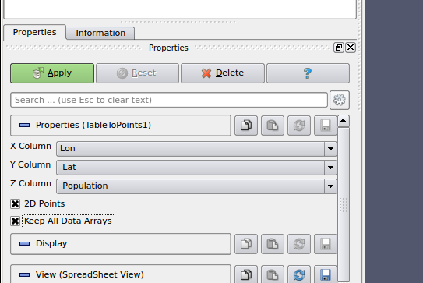
NZ population example
Families per region
  Region represented by centroid (longitude, latitude)
Go to paraview-workshop/nz-population/
Open population_grid.csv
Apply filter as per image

Slide 9
NZ population example
Select only North Island
  Clip filter
Apply threshold
  Select places with a given population
Apply glyph
  Spheres with radius proportional to population

Slide 10
NZ population example
Convert population to height on Z
Vector (lat,lon,population)
  Use “calculator filter”
  Can create new scalars and vectors
  Simple notation
    Vector : xComponent*iHat + yComponent*jHat + zComponent*kHat
  In our case zComponent = 0.0001*Population

Slide 11
Animation example
OpenSees simulation of load on a 3D domain (Chris Mcgann)
  TCL script on github
  Uses PVD recorder to create paraview data
  ¼ of the whole domain simulated (we will complete it)
  Runs quickly on 1 core

Slide 12
Animation example
Go to paraview-workshop/opensees
Decompress 3Dexample.tar.gz
  Command: tar xvfz 3Dexample.tar.gz
Open 3Dexample.pvd
  XML format specifying data to load
Apply
  This will load whole simulation data
Select surface view
  Color by “displacement”
Click play

Slide 13
Animation example
Complete domain
  Reload the same pvd a second time
  Apply “transformation” filter
    Parameters:
      Translate 60 units on x
      Rotate -90 degrees on y
  Apply “group datasets”
    Now we have 1 single domain with all data

Slide 14
Some general tips
Save/load state
  Repeat complex manipulations on dataset
Trace
  Tools –> Start Trace
  (Almost) Every interaction with paraview = python call
  Possible to generate trace of all interactions
  Useful to automatize (batch processing)

Slide 15
The End
Questions?
Thank you!

