Slide 1




Tips for creating a successful presentation in English
Dr Katie Patterson
Departamento de Filologías Inglesa y Alemana
University of Granada
kpatterson@ugr.es

Slide 2
A clear research presentation usually answers five questions:
If the audience understands these five points,
your presentation has succeeded.

Slide 3
Outline
Why presentations matter
Audience
3 elements of a good presentation
Structure and design
Delivery
Language
Mistakes
Questions

Slide 4
Quick question
Think about the last academic presentation you attended...
What made it good?
What made it difficult to follow?
Think about structure, slides, delivery...

Slide 5
Why presentations matter
Research is communicated orally for a number of reasons:
through conference talks,
seminars,
thesis defences
job talks
A clear presentation helps audiences understand and remember your research
Strong presentations can influence how research is received

Slide 6
Three elements of a good presentation
Structure
Language
Delivery
Effective talks balance all three elements

Slide 7

Audience
Notes:
setting, physical environment,

Slide 8


Funding presentation
vs
Conference presentation
Notes:
how would they differ in terms of audience and what the audience want to see?

Slide 9
Funding presentation
vs
Conference presentation
non-specialist
specialist
outcome/applications
theory/scientific method
doing something innovative
adding to established field

Slide 10
A presentation is NOT a paper
Common mistake: trying to include everything
A presentation should highlight the main idea
Focus on key findings
Tell a clear research story
Notes:
work in progress
before the project has begun
preliminary findings

Slide 11
I. Structure

Slide 12
Basic structure
Background or context
Research question(s)
Method / data
Main findings / discussion
Conclusion

Slide 13
The 20‑minute conference rule
Introduction about 3 minutes
Literature review about 3 minutes
Method about 3 minutes
Findings about 8 minutes
Conclusion about 3 minutes

Slide 14
Designing effective slides
Keep slides simple
Use minimal text
Use large readable fonts
Use visuals when useful

Slide 15
Example of an overloaded slide
Long paragraphs
Too many bullet points
Small text
Audience reads instead of listening

Slide 16
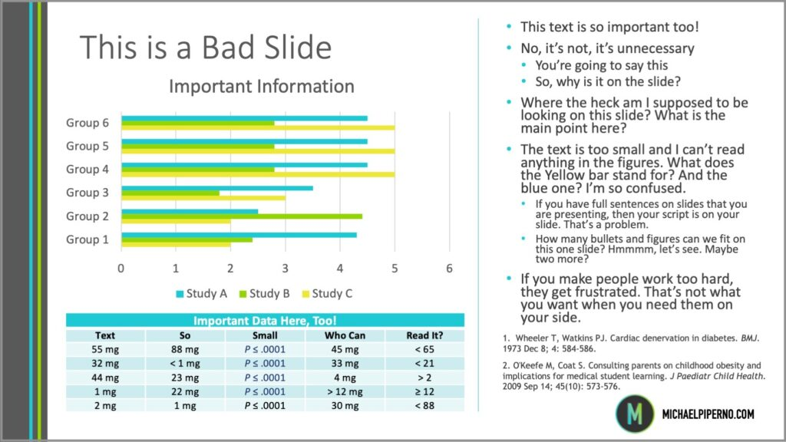

Slide 17
Better slide design
Clear title
One idea per slide
Keywords instead of sentences
Notes:
be brave
less liekly to rely on reading from a slide

Slide 18
II. Language

Slide 19

Signposting
First I will briefly introduce…
Now I would like to turn to…
Let me move to the next point
To sum up…
Notes:
forwards and backwards

Slide 20
Bad vs Good Opening
Today I will present my research about migration.
Vs
My research examines how these metaphors shape public perceptions of migration in European media.
My thesis has five chapters
Vs
First I will talk about the literature review and then the methodology...

Slide 21
Written vs spoken academic language
Written: This study aims to investigate the discursive construction of migration
Spoken: For this study I examine how migration is discussed
Spoken academic English should be:
slightly simpler
shorter
easier to follow

Slide 22
Explaining research to non-specialists
Academic audiences are often not experts in your specific field.
Good presenters:
avoid unnecessary jargon
explain key concepts briefly
focus on the main idea
give simple examples
think about rapport

Slide 23
Specialist version
This research analyses metaphorical framing in higher-education crisis discourse.
Clearer version
My research examines how universities are described using crisis metaphors in public debate.

Slide 24
Exercise
Explain your research to a non-specialist in two sentences
Sentence 1: My research examines…
Sentence 2: Specifically I investigate…

Slide 25
III. Delivery

Slide 26
Starting a presentation
Today I would like to talk about…
Hiya, I’m gonna tell you about my research
This presentation examines…
My research focuses on…
The aim of this study is to…
Good morning, my name’s Katie and I’d like to talk to you about....

Slide 27
Starting a presentation
Today I would like to talk about…
Hiya, I’m gonna tell you about my research
This presentation examines…
My research focuses on…
The aim of this study is to…
Good morning, my name’s Katie and I’d like to talk to you about....

Slide 28
Delivery
Speak clearly and slightly slower than normal conversation
Pause between ideas
Emphasise key points
Avoid reading slides
Practice makes perfect!
Try recording yourself

Slide 29
Typical mistakes speakers make
Reading slides word for word
Speaking too quickly when nervous
Using very long sentences
Lack of signposting language
Direct translation from Spanish structures

Slide 30
What about the feared questions?
Usually and extra 10 minutes given over to questions
This is the part of a presentation we can’t entirely control and is the most feared
Notes:
what are your thoughts or fears at this time?

Slide 31
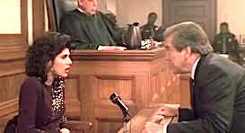
What if I don’t understand the question?
What if I just don’t know the answer?
What if they try to trip me up?

Slide 32
What if I don’t understand the question?
No shame in asking for the question to be repeated, rephrased, reformulated, explained more clearly.
“If I understand correctly, you’re asking about…”
“Do you mean in relation to…?”
“Let me think about that for a moment.”
Focus on willingness and honesty
Notes:
lets deal with these one by one
This actually turns it around and implies that they may not have done a clear job in asking it in the first place
Repeating gives you more time to think
- shows you are taking them seriously and want to answer them but also that you care about saying the right thing

Slide 33
What if I just don’t know the answer?
“That’s a good question; I want to look into that further"
“That’s a good point, and it highlights a limitation of this study.”
"I want to give you an accurate answer, so I’d like to check my notes/the data first”
“This is something that would need further research.”
"That is not within my area of expertise, but I can connect you with someone who knows more".
"I don't have the complete answer now, but here is what I know so far...”
Notes:
Use it
as a bridge to what you do know.
Show confidence in not knowing

Slide 34
What if they try to trip me up?

Slide 35
Conclusions and final advice
Focus on the main message
Guide the audience through your talk
Keep slides simple
Clarity is more important than complexity
Prepare, prepare, prepare!

Slide 36
A clear research presentation usually answers five questions:
If the audience understands these five points,
your presentation has succeeded.

Slide 37
A clear research presentation usually answers five questions:
What is the problem or topic?
Why is it important?
What did you do?
What did you find?
Why do the findings matter?
If the audience understands these five points,
your presentation has succeeded.

