Slide 1
Mask Wearing vs Covid Development Per Region
David Alade & Uchenna Aduaka

Slide 2
Background
Coronavirus disease (COVID-19) is an infectious disease that has ravaged the world over the past year
Scientists have since been studying ways to slow down and prevent the spread of COVID-19
Scientists have recommended that social distancing of at least up to 6 feet and mask wearing as ways to

Slide 3
THE problem
Many countries have implemented strict COVID-19 restrictions while many others have had very relaxed COVID-19 restrictions
We wanted to answer what is the correlation of regions who have high compliance to COVID-19 restrictions vs those who do not
We were given access to the data that was provided and we proceeded to answer the questions

Slide 4
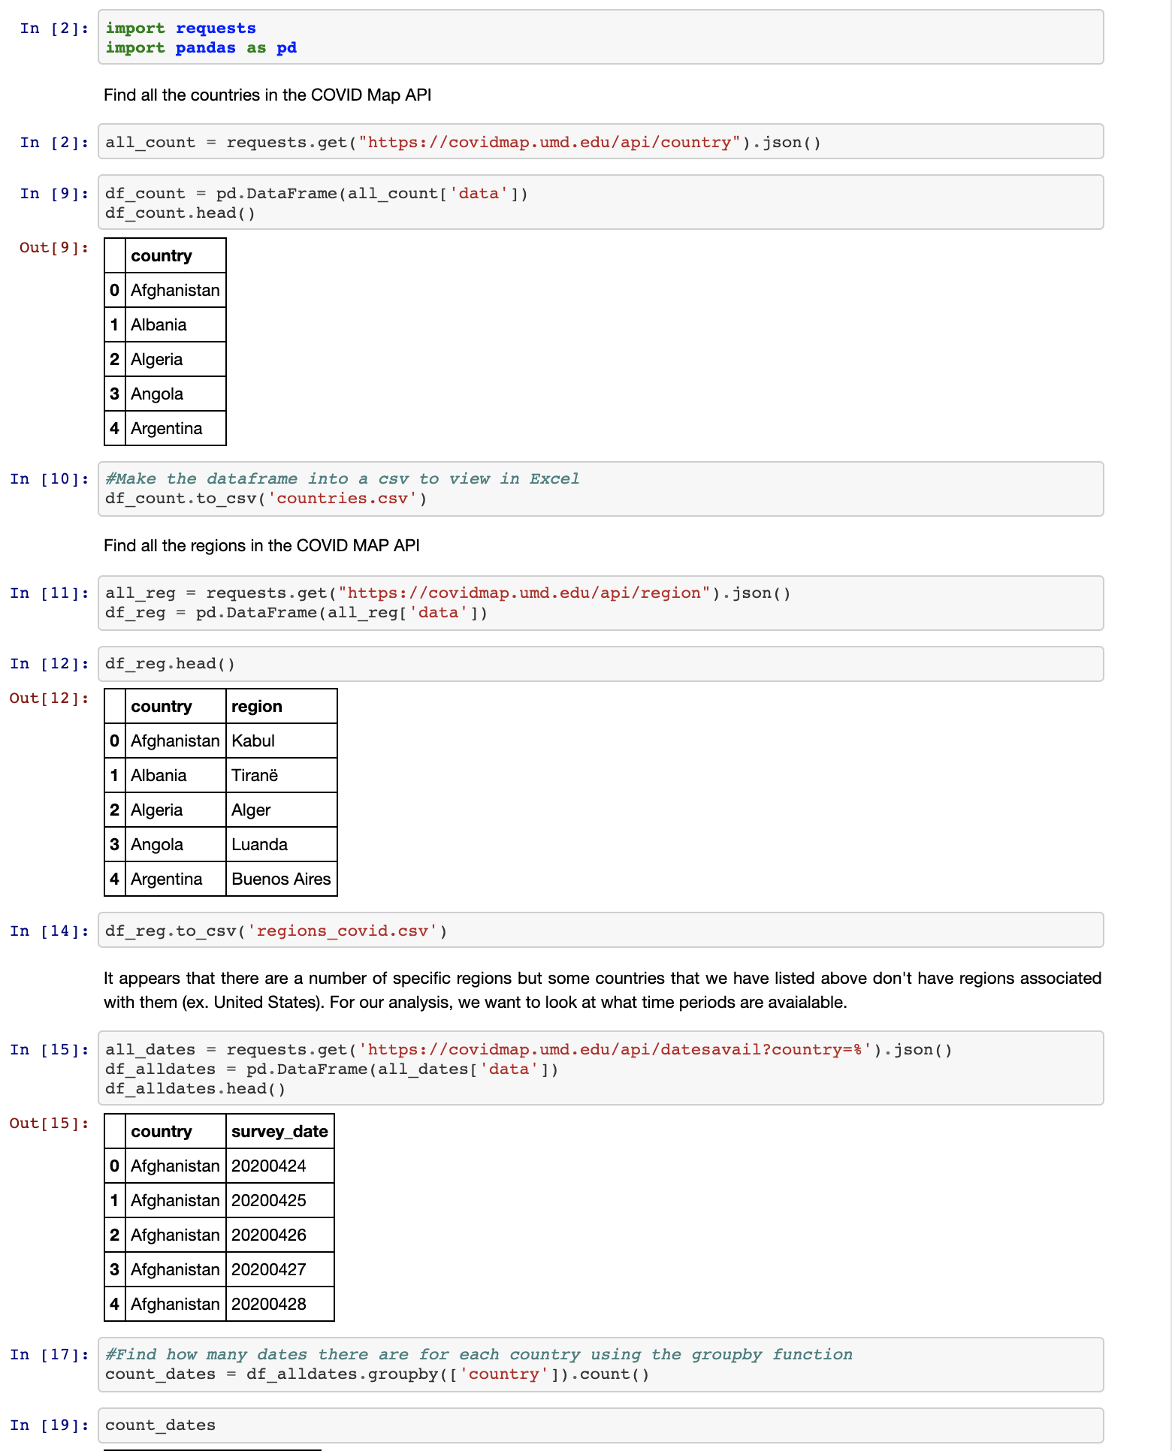
Methodology/Approach
We utilized the pandas' libraries exclusively for the data analysis portion of the project
We looked at 4 different regions and we proceeded to extract data from the API. From there we then mapped out two important variables
We extracted the percent of mask compliance to represent COVID-19 restrictions and we then checked the percent of COVID-19 cases in those same regions

Slide 5
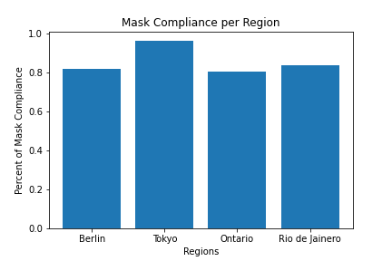
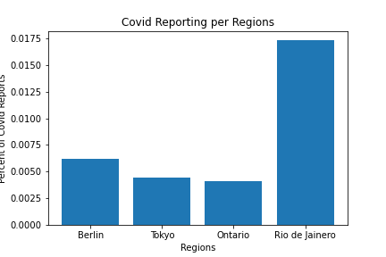
Results/fINDINGDS
After analyzing the data, we then constructed bar graphs to highlight the percentage of mask compliance and then another to highlight the infection rate/percentage of reported COVID-19 cases.
We found that in regions that had at least 80% of mask compliance, the infection rate never reached past 2%.
We utilized the bar graphs because we believed it would help make a clear distinction in regions and also answer the question we asked earlier

Slide 6
outlook
To concur, we did find that a high percentage of COVID-19 restriction compliance correlated to low infection rates
We also found that the recommendations scientists have given to slow the spread of COVID-19 were verified and they should be continued to be followed
We wanted to make note that the data should be observed objectively.
This is because things such as new strains, environments, as well as current COVID-19 cases were not measurable data
Also, because those are external factors that can also influence the infection rate

