Slide 1


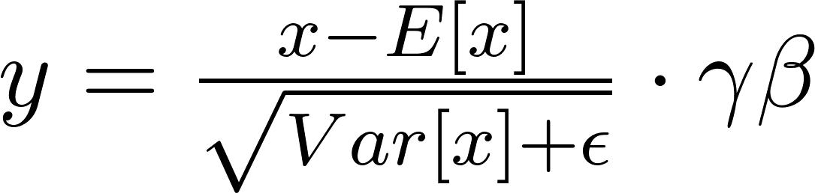
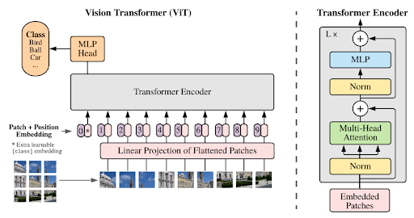
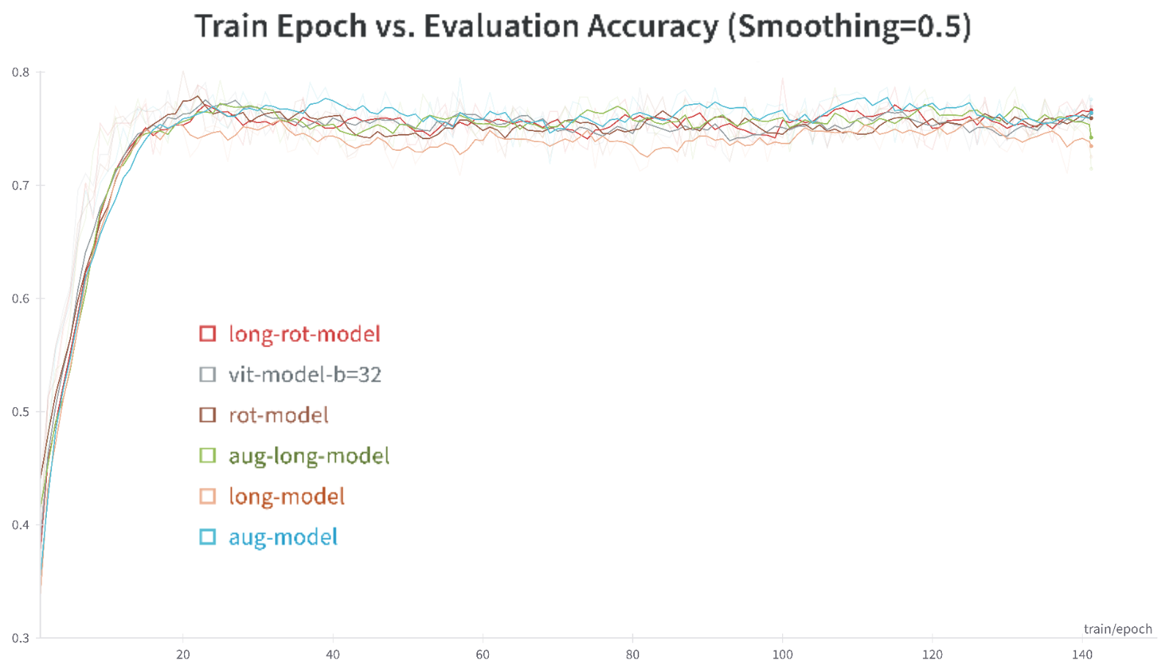
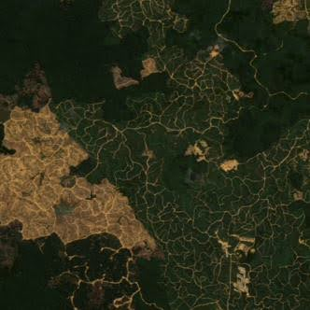
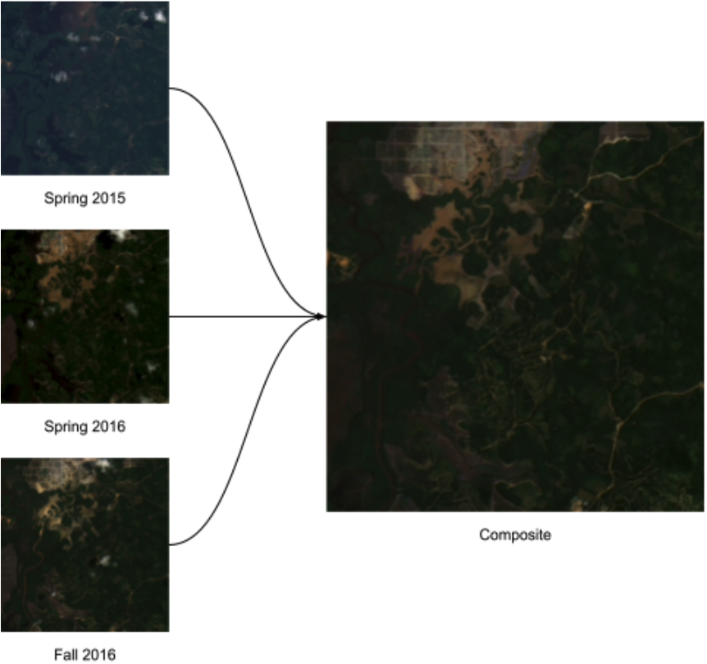
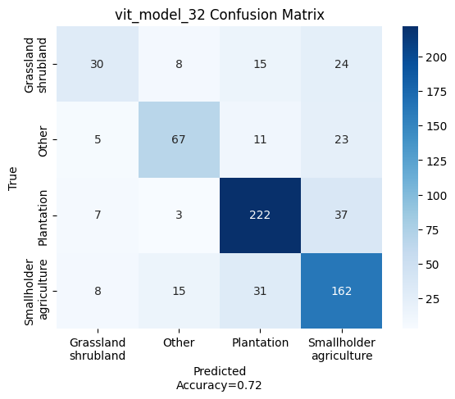
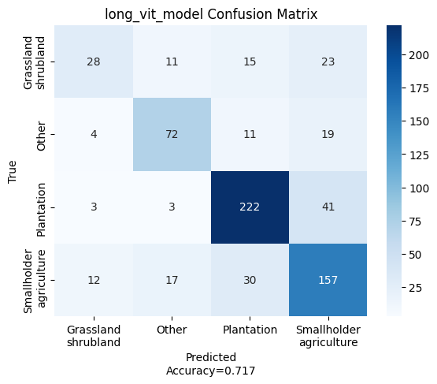
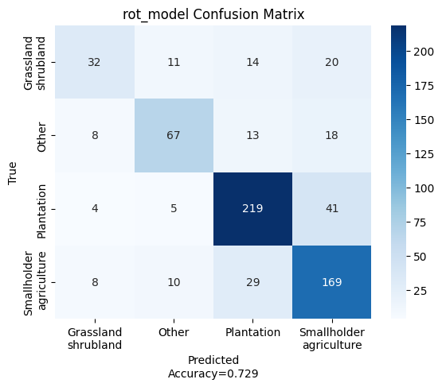
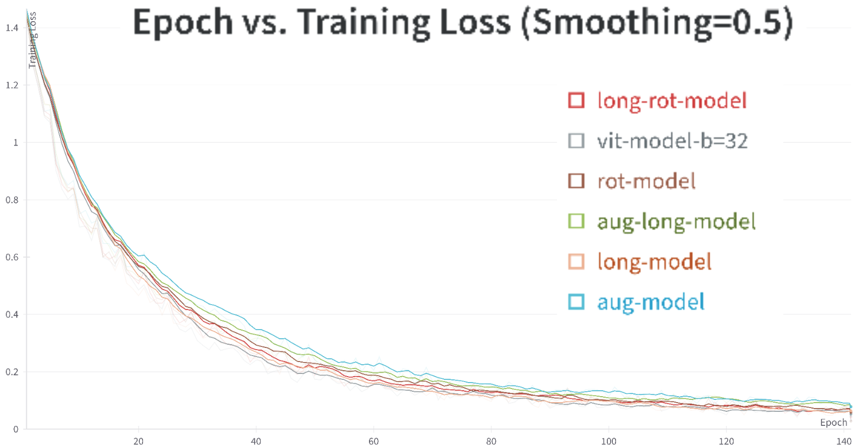
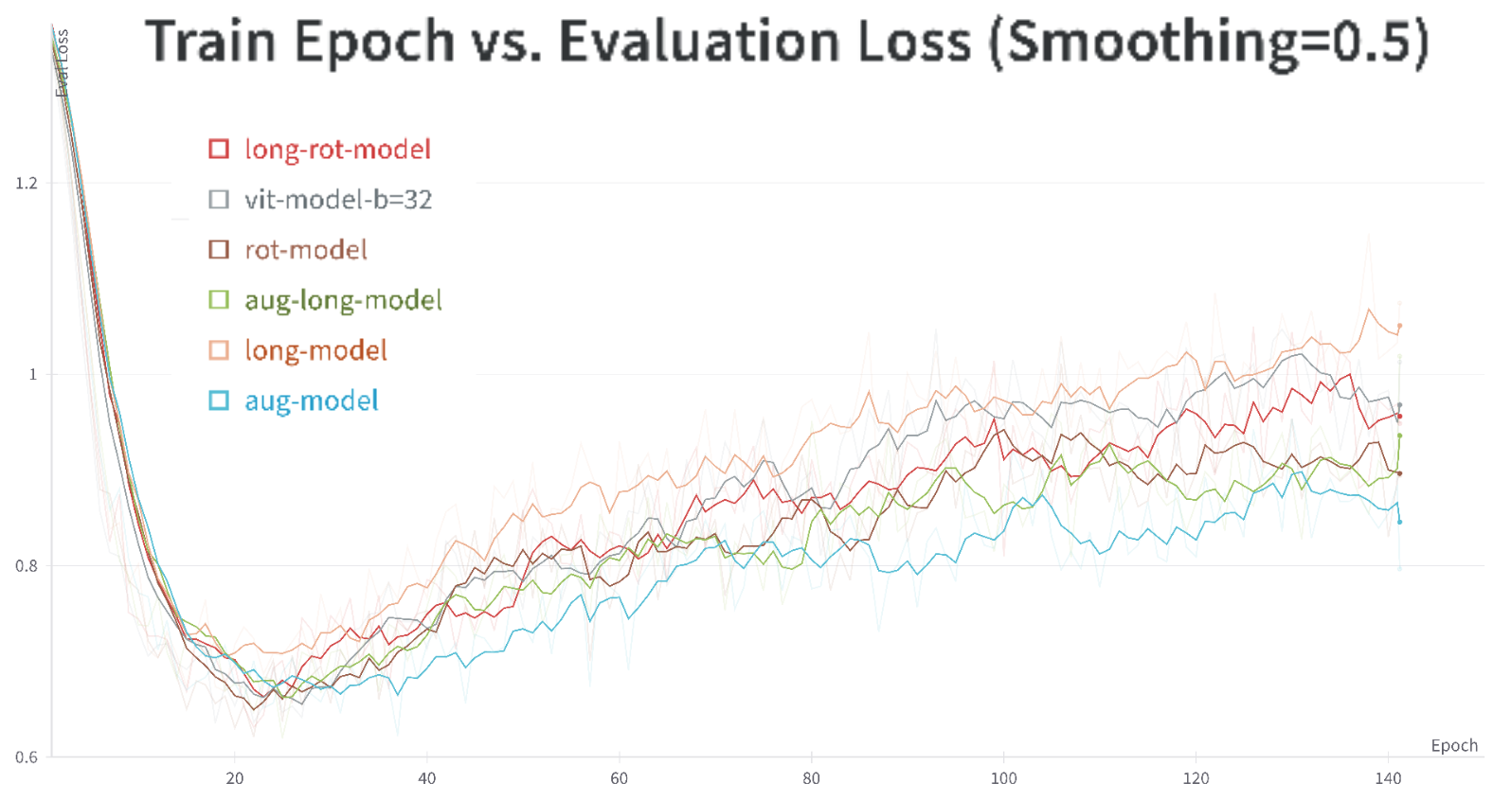
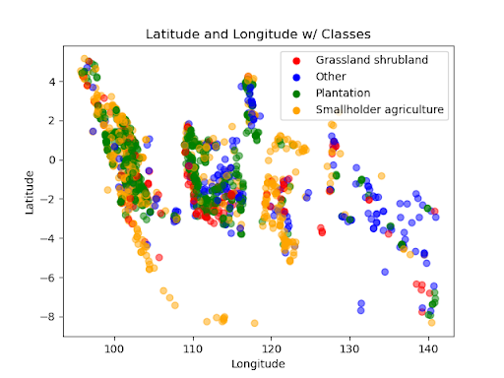
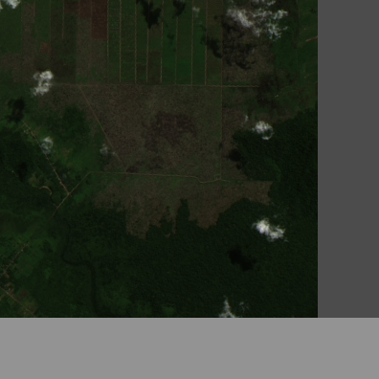
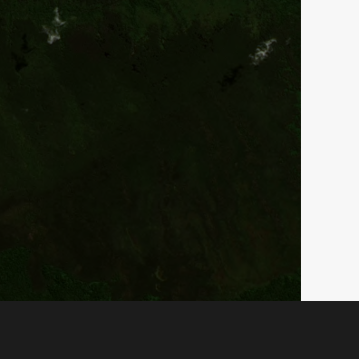
TreeFormers - An Exploration of Vision Transformers for Deforestation Driver Classification
Uche Ochuba¹
Department of Computer Science, Stanford University
Computer Science
Project Overview
Models
Results
Critical issue: Deforestation in Indonesian forests
Proposed approach: ViTs and machine learning for driver classification
Input: 332x332 satellite images
Method: Fine-tuned ViT on Stanford ML Group dataset
Data augmentation: Rotational techniques, Longitudinal data embedding
Results: 72.9% test accuracy (significant improvement)
This project employed a logistic regression with stochastic gradient descent and convolutional neural network baselines. The majority of exploration involved the employment of vision transformers (ViTs) with a variety of modifications, such as image flips/rotations (rotational); the former plus random color jitter, gaussian blur, grayscale, and perspective change (augmented); and a model trained with embedded longitudinal data with varying intensity for different longitudinal values. ViT architecture involves the creation of various “attention patches”, which are passed to an encoder which contains a liner projection layer, LayerNorm followed by a multi-head self-attention layer, another LayerNorm layer, then a multilayer perceptron (MLP) layer, which consists of individual processing units, termed "neurons," arranged hierarchically (Dosovitskiy et al., 2020).
Model | Accuracy (Val, n=473) | Accuracy (Test, n=668)
Naive LR Baseline | 35.0 | 33.3
UNET - CNN | 60.6 | 57.9
UNET - C8 Equivariant | 67.1 | 63.0
Custom ViT | 45.4 | 38.4
ViT | 79.1 | 72.0
Rotation ViT | 80.1 | 72.9
Augmented ViT | 79.5 | 72.9
Longitudinal ViT | 77.6 | 71.7
Longitudinal+Rotation ViT | 79.5 | 72.3
Longitudinal+Augmented ViT | 79.3 | 72.6
Some sample images from the dataset, a visualization of compositing of images.
Discussions & Future Research
Datasets & Features
Discussions:
ViTs Promise for Deforestation: Pre-trained ViTs with rotational data augmentation achieved 72.9% accuracy, surpassing past models reliant solely on image data. This highlights the effectiveness of ViTs' multi-layered encoding and augmented training.
Longitudinal Data's Limited Impact: Including longitudinal data in ViTs didn't improve accuracy, suggesting its lower predictive power than initially assumed.
Grassland-Shrubland Misclassification: Rotational ViTs struggled with this class due to limited training data, mirroring challenges noted in prior works; all ViTs tended to over-predict the larger "smallholder agriculture" class.
Cardinality and Feature Impact: The over-prediction of "smallholder agriculture" is likely due to its large training set size and distinct visual features compared to other classes.
Plantation Recognition Advantage: Large-scale plantations, occupying more space in images, were easier for ViTs to recognize due to their distinct features.
Future Research:
Future research would include further iterating on creating a custom MLP classification head to incorporate longitudinal data, or exploring using different pre-trained vision transformers, or potentially curating topological or demographic data to incorporate into predictions to improve accuracy. One might also look into artificially re-balancing the dataset, or changing the data split to increase the size of the training set.
Source: Stanford ML Group (Irvin et al., 2020)
Content: 2756 color satellite images of Indonesia (2001-2016)
Split: Train (59%), Validation (17%), Test (24%)
Features: Time-blended composites for locations with multiple images
Key augmentations: rotations/flips, color jitter, longitudinal data embedding with colored bars
Expert-labeled with one of four classes
Normalized for ViT model input
Transformer architecture and training losses and accuracies.
References
[1] Abdus Subhahan, D., & Vinoth Kumar, C. N. S. (2023). Classifying drivers of deforestation by using the deep learning based
poly-highway forest convolution network. Journal of Intelligent & Fuzzy Systems, Preprint(Preprint), 1–15. https://doi.org/10.
3233/JIFS-233534
[2] Austin, K. G., Schwantes, A., Gu, Y., & Kasibhatla, P. S. (2019). What causes deforestation in Indonesia? Environmental Research
Letters, 14(2), 024007. https://doi.org/10.1088/1748-9326/aaf6db
[3] Biewald, L. (2020). Experiment Tracking with Weights and Biases. https://www.wandb.com/
[4] Chen, K., Zhuang, D., & Chang, J. M. (2022). SuperCon: Supervised Contrastive Learning for Imbalanced Skin Lesion Classification (arXiv:2202.05685). arXiv. https://doi.org/10.48550/arXiv.2202.05685
[5] Clark, J. A. (n.d.). Pillow (PIL Fork) Documentation.
[6] Dosovitskiy, A., Beyer, L., Kolesnikov, A., Weissenborn, D., Zhai, X., Unterthiner, T., Dehghani, M., Minderer, M., Heigold,
G., Gelly, S., Uszkoreit, J., & Houlsby, N. (2021). An Image is Worth 16x16 Words: Transformers for Image Recognition at Scale
(arXiv:2010.11929). arXiv. https://doi.org/10.48550/arXiv.2010.11929
[7] Harris, C. R., Millman, K. J., van der Walt, S. J., Gommers, R., Virtanen, P., Cournapeau, D., Wieser, E., Taylor, J., Berg, S., Smith, N.
J., Kern, R., Picus, M., Hoyer, S., van Kerkwijk, M. H., Brett, M., Haldane, A., del Río, J. F., Wiebe, M., Peterson, P., . . . Oliphant, T. E.
(2020). Array programming with NumPy. Nature, 585(7825), Article 7825. https://doi.org/10.1038/s41586-020-2649-2
[8] Hartanti, B. S. I., Vito, V., Arymurthy, A. M., Krisnadhi, A. A., & Setiyoko, A. (2023). Multimodal SuperCon: Classifier for drivers of deforestation in Indonesia. Journal of Applied Remote Sensing, 17(3), 036502. https://doi.org/10.1117/1.JRS.17.036502
[9] Hunter, J. D. (2007). Matplotlib: A 2D Graphics Environment. Computing in Science & Engineering, 9(3), 90–95. https:
//doi.org/10.1109/MCSE.2007.55
[10] Irvin, J., Sheng, H., Ramachandran, N., Johnson-Yu, S., Zhou, S., Story, K., Rustowicz, R., Elsworth, C., Austin, K., & Ng, A. Y.
(2020). ForestNet: Classifying Drivers of Deforestation in Indonesia using Deep Learning on Satellite Imagery (arXiv:2011.05479). arXiv. https://doi.org/10.48550/arXiv.2011.05479
[11] Lhoest, Q., del Moral, A. V., Jernite, Y., Thakur, A., von Platen, P., Patil, S., Chaumond, J., Drame, M., Plu, J., Tunstall, L., Davison,
J., Šaško, M., Chhablani, G., Malik, B., Brandeis, S., Scao, T. L., Sanh, V., Xu, C., Patry, N., . . . Wolf, T. (2021). Datasets: A Community
Library for Natural Language Processing (arXiv:2109.02846). arXiv. https://doi.org/10.48550/arXiv.2109.02846
[12] Li, Y., Wu, C.-Y., Fan, H., Mangalam, K., Xiong, B., Malik, J., & Feichtenhofer, C. (2022). MViTv2: Improved Multiscale Vision
Transformers for Classification and Detection (arXiv:2112.01526). arXiv. https://doi.org/10.48550/arXiv.2112.01526
[13] Mitton, J., & Murray-Smith, R. (2021). Rotation Equivariant Deforestation Segmentation and Driver Classification (arXiv:2110.13097; Version 2). arXiv. http://arxiv.org/abs/2110.13097
[14] Paszke, A., Gross, S., Massa, F., Lerer, A., Bradbury, J., Chanan, G., Killeen, T., Lin, Z., Gimelshein, N., Antiga, L., Desmaison, A.,
Köpf, A., Yang, E., DeVito, Z., Raison, M., Tejani, A., Chilamkurthy, S., Steiner, B., Fang, L., . . . Chintala, S. (2019). PyTorch: An
Imperative Style, High-Performance Deep Learning Library (arXiv:1912.01703). arXiv. https://doi.org/10.48550/arXiv.1912.
01703
[15] Pedregosa, F., Varoquaux, G., Gramfort, A., Michel, V., Thirion, B., Grisel, O., Blondel, M., Müller, A., Nothman, J., Louppe, G.,
Prettenhofer, P., Weiss, R., Dubourg, V., Vanderplas, J., Passos, A., Cournapeau, D., Brucher, M., Perrot, M., & Duchesnay, É. (2018).
Scikit-learn: Machine Learning in Python (arXiv:1201.0490). arXiv. https://doi.org/10.48550/arXiv.1201.0490
[16] Pratiwi, N. K. C., Fu’adah, Y. N., & Edwar, E. (2021). Early Detection of Deforestation through Satellite Land Geospatial Images
based on CNN Architecture. JURNAL INFOTEL, 13(2), Article 2. https://doi.org/10.20895/infotel.v13i2.642
[17] Ridnik, T., Ben-Baruch, E., Noy, A., & Zelnik-Manor, L. (2021). ImageNet-21K Pretraining for the Masses (arXiv:2104.10972).
arXiv. https://doi.org/10.48550/arXiv.2104.10972
[18] Ronneberger, O., Fischer, P., & Brox, T. (2015). U-Net: Convolutional Networks for Biomedical Image Segmentation
(arXiv:1505.04597). arXiv. https://doi.org/10.48550/arXiv.1505.04597
[19] Steiner, A., Kolesnikov, A., Zhai, X., Wightman, R., Uszkoreit, J., & Beyer, L. (2022). How to train your ViT? Data, Augmentation,
and Regularization in Vision Transformers (arXiv:2106.10270). arXiv. https://doi.org/10.48550/arXiv.2106.10270
[20] team, T. pandas development. (2023). pandas-dev/pandas: Pandas (v2.1.4) [Computer software]. Zenodo. https://doi.org/10.
5281/zenodo.10304236
[21] van der Maaten, L. J. P., & Hinton, G. E. (2008). Visualizing High-Dimensional Data Using t-SNE. Journal of Machine Learning
Research, 9(nov), 2579–2605.
[22] Virtanen, P., Gommers, R., Oliphant, T. E., Haberland, M., Reddy, T., Cournapeau, D., Burovski, E., Peterson, P., Weckesser, W.,
Bright, J., van der Walt, S. J., Brett, M., Wilson, J., Millman, K. J., Mayorov, N., Nelson, A. R. J., Jones, E., Kern, R., Larson, E., . . .
6
van Mulbregt, P. (2020). SciPy 1.0: Fundamental algorithms for scientific computing in Python. Nature Methods, 17(3), Article 3.
https://doi.org/10.1038/s41592-019-0686-2
[23] Waskom, M. L. (2021). seaborn: Statistical data visualization. Journal of Open Source Software, 6(60), 3021. https://doi.org/
10.21105/joss.03021
[24] Wolf, T., Debut, L., Sanh, V., Chaumond, J., Delangue, C., Moi, A., Cistac, P., Rault, T., Louf, R., Funtowicz, M., Davison, J., Shleifer,
S., von Platen, P., Ma, C., Jernite, Y., Plu, J., Xu, C., Scao, T. L., Gugger, S., . . . Rush, A. M. (2020). HuggingFace’s Transformers:
State-of-the-art Natural Language Processing (arXiv:1910.03771). arXiv. https://doi.org/10.48550/arXiv.1910.03771
Plot of location of images, sample images embedded with longitudinal data.

