Slide 1
Image-guide Navigation for Robotics
Good Practices for Code Design
Rachel Sparks, Ph.D.
Rachel.sparks@kcl.ac.uk
Lecturer in Surgical & Interventional Engineering
School of Biomedical Engineering & Imaging Sciences

Slide 2
Code Design
Systematic approach to design & implementing code
There are many possible methods – Agile, Waterfall, Scrum, Lean, Extreme
Some differences, but we are going to focus on the similarities
Common trends
Decouple design (how code achieve aim) from implementation (specifics of what code does)

Slide 3
Code Design Cycle
Analyze
Define Problem
Test
Design
Implement
Notes:
Have them define the problem theoretically

Slide 4
Code Design Cycle
Define Problem
Why is our code being created?
Corresponds to theoretical definition
At this point don’t think about code, inputs or outputs
Use mathematics or English to define the main idea
Should be able to do in one sentence
In school this typically defines your assignment
Industry this is done by your boss/client
Analyze
Define Problem
Test
Design
Implement
Notes:
The “why” we are coding -> “why” is this code going to solve a real world problem/automate an important task etc.

Slide 5
Code Design Cycle
Design
Structure the <problem> into smaller tasks?
Corresponds to Pseudo-Code
At this point don’t think how to code
Imagine you have a friend that only uses FORTRAN how would you describe this problem?
Define inputs and outputs
Define information flow in the program
Analyze
Define Problem
Test
Design
Implement
Notes:
The “how” -> how are we going to solve the problem, does not need to be line by line but with enough granular detail we know which individual components we need and how they should be interacting

Slide 6
Code Design Cycle
Implement
Translate Pseudo-Code to actual code
Key here is to start small and build up
Start with what you know how to do
What (if any) code have we already created that might help
Analyze
Define Problem
Test
Design
Implement
Notes:
“What” -> once we know how we want to solve our problem we need to define exactly what the code will do to achieve our design.

Slide 7
Code Design Cycle
Test
Check does our code work as expected?
Early warning your code is not correct
Key is to keep it simple
Minimum working example
Easy to check – we already know the result(s)
Analyze
Define Problem
Test
Design
Implement
Notes:
Is it working -> always try to define a very simple test that you can easily check. For instance give the program one positive example (code should work as expected and give a known output), one negative example (code should fail or this is an edge case where the result should be a known, but invalid output), and a few nonsense examples (for instance an empty input, a datatype you are not expecting, etc.)

Slide 8
Code Design Cycle
Analyze
Have we have solved the problem?
Corresponds to Validation
Assess how the code works on real data
Define criteria of success – we may not always know the right answer
Allows us to define expected performance
Analyze
Define Problem
Test
Design
Implement
Notes:
This can be where we bring in edge cases – where the output is not known ahead of time but we want to see if the algorithm would work under a special scenario or on real world data (that might have noise or other “problems” not introduced during testing)

Slide 9
Code Design Cycle
Define Problem
Rescope if your analysis shows your implementation is not good enough
Move onto another interesting problem if you have solved it
Analyze
Define Problem
Test
Design
Implement

Slide 10
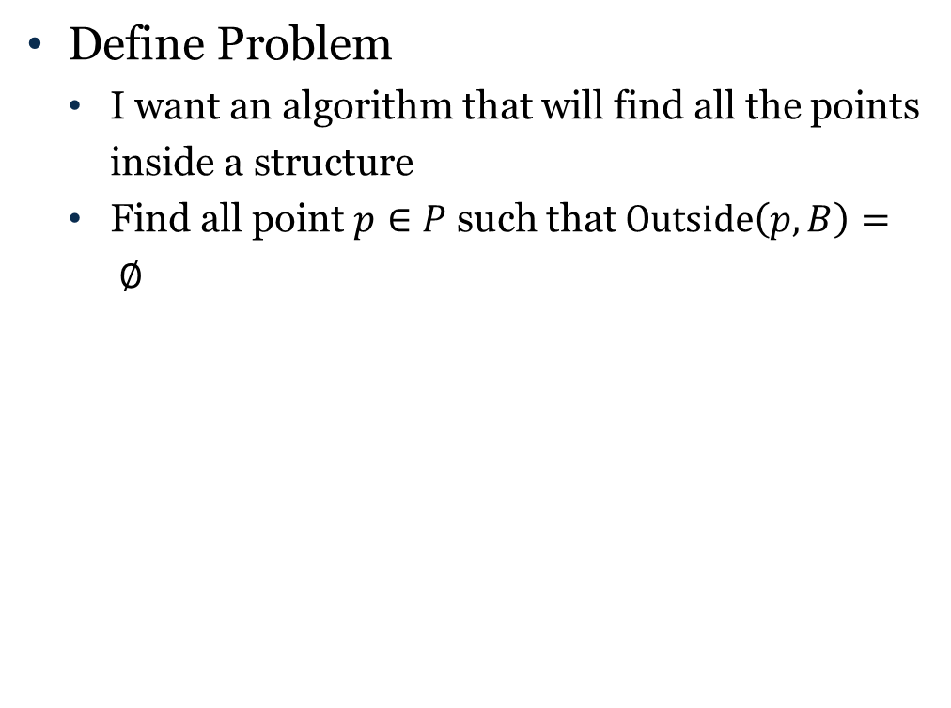
Code Design Cycle
Define Problem
I want an algorithm that will find all the points inside a structure
Find all point $p∈P$ such that $Outside\left(p,B\right)= ∅$
Analyze
Define Problem
Test
Design
Implement
Notes:
Have them define the problem theoretically

Slide 11
Code Design Cycle
Design
I want an algorithm that will find all the points inside a structure
Usually inputs/outputs are defined first
Analyze
Define Problem
Test
Design
Implement
Notes:
Have them define the problem theoretically

Slide 12
Code Design Cycle
Design
I want an algorithm that will find all the points inside a structure
Usually inputs/outputs are defined first
MY PROGRAM
List of points P_{o}
List of points P
Structure B (Image)
Structure B
Get a point
p in list Po
Find Pixel location for p
Check if Pixel is in B
Put p inside B into list
Notes:
What can we further define in the inputs
Think about the elements and how they need to be connected Does not have to be linear just think about the minimum step you can take for a specific input or desired output
Then think about how to line up the boxes– don’t worry about having to “add” boxes if you need to make a link!

Slide 13
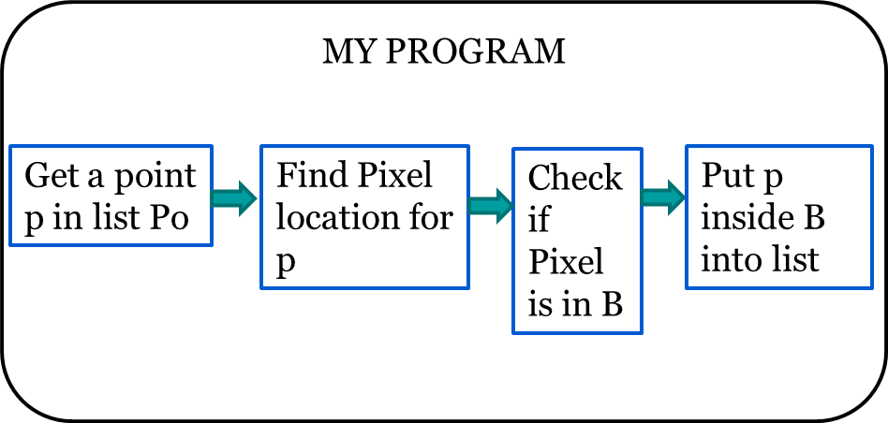
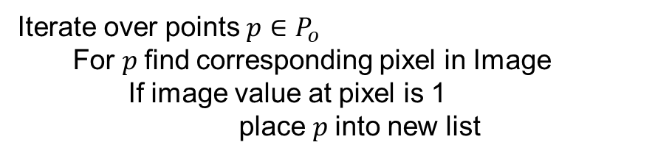

Code Design Cycle
Design
Take the elements you have designed and identified how to turn them into pseudo code
MY PROGRAM
List of points P_{o}
Iterate over points $p∈P_{o}$
For $p$find corresponding pixel in Image
If image value at pixel is 1
place $p$into new list
List of points P
Structure B (Image)
$p→P$
Notes:
What can we further define in the inputs

Slide 14
Code Design Cycle
Implement
Translate Pseudo-Code to actual code
Key here is to start small and build up
Start with what you know how to do
What (if any) code have we already created that might help
For now skip what we don’t know how to do
Analyze
Define Problem
Test
Design
Implement
Notes:
Have them define the problem theoretically

Slide 15

Code Design Cycle
Implement
Inputs and Outputs are probably defined by our code base
vtkMRMLMarkupsFiducialNode
MY PROGRAM
List of points P_{o}
vtkMRMLMarkupsFiducialNode
Iterate over points $p∈P_{o}$
For $p$find corresponding pixel in Image
If image value at pixel is 1
place $p$into new list
List of points P
Structure B (Image)
vtkImageData
$p→P$
Notes:
What can we further define in the inputs

Slide 16

Code Design Cycle
Implement
Inputs and Outputs are probably defined by our code base
What do you know how to do
We have done a fair amount of code – but haven’t tested if anything works yet
vtkMRMLMarkupsFiducialNode
MY PROGRAM
List of points
vtkMRMLMarkupsFiducialNode
For x in range (0, input.GetNumberOfFiducials()) :
pos = [0,0,0]
inputFiducials.GetNthFiducialPosition(x, pos)
Iterate over points $p∈P_{o}$
For $p$find corresponding pixel in Image
If image value at pixel is 1
$p→P$
List of points
Structure (Image)
vtkDataImage
# ignore
if (pixelValue == 1)
output.AddFiducial(pos)
Notes:
Start adding in simple things we know how to do ignoring those things we don’t know how to do

Slide 17
Code Design Cycle
Test
Check does our code work as expected?
Early warning your code is not correct
Your test should inform how to fix your implementation
Analyze
Define Problem
Test
Design
Implement
Notes:
What can we test and how?

Slide 18
Code Design Cycle
Test
Don’t need to finish to start testing
If we run incomplete it will complain pixelValue is not defined – so lets define it
vtkMRMLMarkupsFiducialNode
MY PROGRAM
List of points
vtkMRMLMarkupsFiducialNode
Iterate over points
For each point find corresponding point in image
Check if image value at point is correct
place point into new list
For x in range (0, input.GetNumberOfFiducials()) :
pos = [0,0,0]
inputFiducials.GetNthFiducialPosition(x, pos)
List of points
Structure (Image)
vtkImageData
pixelValue = 1
# ignore
if (pixelValue == 1)
output.AddFiducial(pos)
Notes:
Fill in misc values/variables that we don’t know how to properly complete yet for the purpose of testing

Slide 19
Code Design Cycle
Test
Don’t need to finish to start testing
If we run incomplete it will complain pixelValue is not defined – so lets define it
vtkMRMLMarkupsFiducialNode
MY PROGRAM
List of points
vtkMRMLMarkupsFiducialNode
Iterate over points
For each point find corresponding point in image
Check if image value at point is correct
place point into new list
For x in range (0, input.GetNumberOfFiducials()) :
pos = [0,0,0]
inputFiducials.GetNthFiducialPosition(x, pos)
List of points
Structure (Image)
vtkImageData
pixelValue = 1
# ignore
if (pixelValue == 1):
output.AddFiducial(pos[0], pos[1], pos[2])
Notes:
Fix any mistakes so that we return what we would expect

Slide 20
Code Design Cycle
Test
Don’t need to finish to start testing
If we run incomplete it will complain pixelValue is not defined – or a slightly better test
vtkMRMLMarkupsFiducialNode
MY PROGRAM
List of points
vtkMRMLMarkupsFiducialNode
Iterate over points
For each point find corresponding point in image
Check if image value at point is correct
place point into new list
For x in range (0, input.GetNumberOfFiducials()) :
pos = [0,0,0]
inputFiducials.GetNthFiducialPosition(x, pos)
List of points
Structure (Image)
vtkImageData
pixelValue = random.random()
# ignore
if (pixelValue == 1):
output.AddFiducial(pos[0], pos[1], pos[2])
Notes:
Maybe try creating a slightly better check – just to see that our if statement is working correctly.

Slide 21
Code Design Cycle
Implement
Translate Pseudo-Code to actual code
Key here is to start small and build up
Now we only have to finish up the things we don’t know how to do
Analyze
Define Problem
Test
Design
Implement
Notes:
Have them define the problem theoretically

Slide 22
Code Design Cycle
Implement
We need pixelValue from our vtkDataImage
vtkMRMLMarkupsFiducialNode
MY PROGRAM
List of points
vtkMRMLMarkupsFiducialNode
Iterate over points
For each point find corresponding point in image
Check if image value at point is correct
place point into new list
For x in range (0, input.GetNumberOfFiducials()) :
pos = [0,0,0]
inputFiducials.GetNthFiducialPosition(x, pos)
List of points
Structure (Image)
vtkImageData
pixelValue = random.random()
# ignore
if (pixelValue == 1):
output.AddFiducial(pos[0], pos[1], pos[2])
Notes:
Finally we can focus on filling in the line of code we have chosen to ignore.

Slide 23
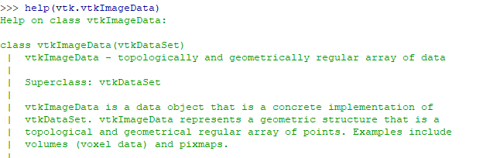
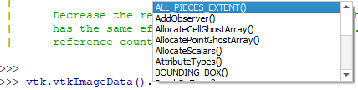
vtkImageData
There are many ways to do this
Documentation: https://vtk.org/doc/nightly/html/classvtkImageData.html
Inline help
Tab complete to list functions
Notes:
First determine where you should look to find the functions/calls

Slide 24
vtkImageData
There are many ways to do this
Documentation: https://vtk.org/doc/nightly/html/classvtkImageData.html
Inline help
Tab complete to list functions
Other online program forums: https://programtalk.com/python-examples/vtk.vtkImageData/; https://stackoverflow.com/questions/tagged/vtk
We are still going to need a bit of reasoning/trial and error
Find/Get usually retrieve things
Set usually sets things
Notes:
Use some knowledge/logic to help figure out where to start your investigation

Slide 25
vtkImageData
Read to identify likely candidates
>>> help(vtk.vtkImageData().FindPoint)
Help on built-in function FindPoint:
FindPoint(...)
V.FindPoint(float, float, float) -> int
C++: virtual vtkIdType FindPoint(double x, double y, double z)
V.FindPoint([float, float, float]) -> int
C++: vtkIdType FindPoint(double x[3]) override;
Standard vtkDataSet API methods. See vtkDataSet for more
information.
>>> help(vtk.vtkImageData().GetPoint)
Help on built-in function GetPoint:
GetPoint(...)
V.GetPoint(int) -> (float, float, float)
C++: double *GetPoint(vtkIdType ptId) override;
V.GetPoint(int, [float, float, float])
C++: void GetPoint(vtkIdType id, double x[3]) override;
Standard vtkDataSet API methods. See vtkDataSet for more
information.
Notes:
Help paired with your knowledge of how the code is named can help identify possible functions to use

Slide 26
Code Design Cycle
Implement
We need pixelValue from our vtkDataImage
ind = inputVolume.GetImageData().FindPoint(pos)
# a bit of math to transform the ind into i,j,k position
dim = inputVolume.GetImageData().GetDimensions()
xInd = ind % dim[0]
yInd = (ind % (dim[0] * dim[1]) ) / dim[0]
zInd = ind / (dim[0] * dim[1])
pixelValue = inputVolume.GetImageData().GetScalarComponentAsDouble (xInd,yInd,zInd,0)
vtkMRMLMarkupsFiducialNode
MY PROGRAM
List of points
vtkMRMLMarkupsFiducialNode
Iterate over points
For each point find corresponding point in image
Check if image value at point is correct
place point into new list
For x in range (0, input.GetNumberOfFiducials()) :
pos = [0,0,0]
inputFiducials.GetNthFiducialPosition(x, pos)
List of points
Structure (Image)
vtkImageData
pixelValue = random.random()
# ignore
if (pixelValue == 1)
output.AddFiducial(pos[0], pos[1], pos[2])
Notes:
After some trial and error we can figure out how to translate our point into a pixel

Slide 27
Class Design
In general define classes where possible to
More closely follow the pseudo code flow charts
Help isolate code logic into classes – when you reuse it you do not need to remember implementation details every time
Allows easier testing – test function not every single call
Remember to document the point of classes
Knowing how to break code into classes involves a bit of practice
If you find you are constantly creating new classes with minor variations consider trying to make the function more general
If you find multiple classes have the same documentation for many classes consider consolidating
If your class is only called once consider removing

Slide 28
Code Refactoring
Don’t be afraid to rewrite code.
Once you have implemented your entire algorithm you may realise there are unnecessary calls or multiple similar lines of code
Similar code may indicate you need to create a class
If after implementation you think you have a simpler way to achieve the same results try it
Fewer lines of code can be easier to debug
More readable code can be easier to use and debug later

