Slide 1
Image-guided Navigation for Robotics
Image Coordinate Frames
Rachel Sparks, Ph.D.
Rachel.sparks@kcl.ac.uk
Lecturer in Surgical & Interventional Engineering
School of Biomedical Engineering & Imaging Sciences

Slide 2
Image Coordinate Frames
Every image has its own coordinate frame
Software platforms use this coordinate frame to determine how to render images on screen
Transformations can be applied to alter an image coordinate frame or its rendering
Learning Objectives:
Understand image coordinates and how 3D Slicer uses this information to render images on screen
Understand how transformations can be used to alter image coordinates
Understand how transformations can be used to alter rendering in 3D Slicer

Slide 3
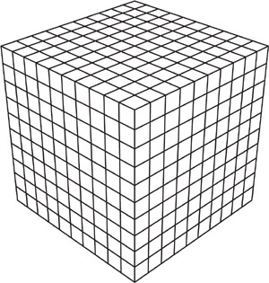
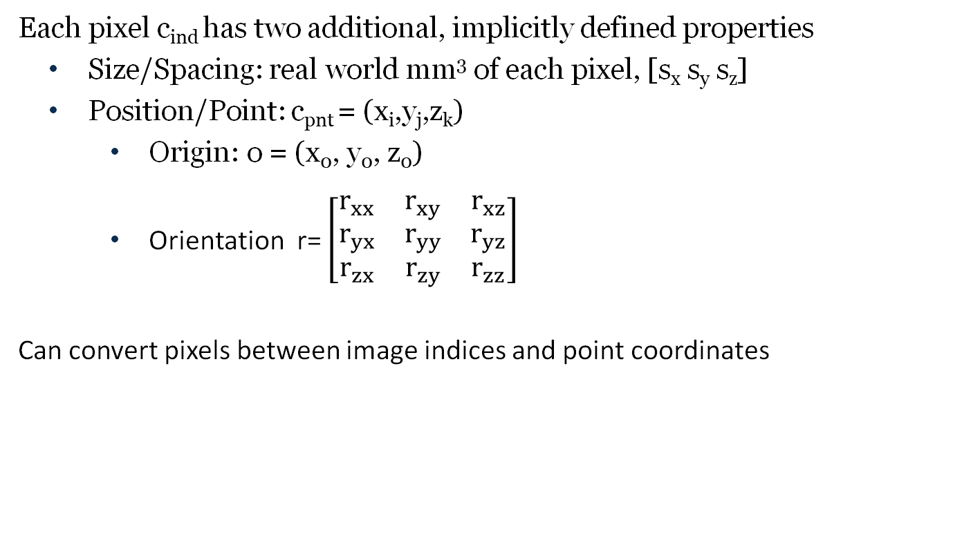
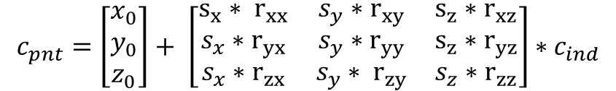
Image To “World Coordinates”
Each pixel c_{ind} has two additional, implicitly defined properties
Size/Spacing: real world mm³ of each pixel, [s_{x} s_{y} s_{z}]
Position/Point: c_{pnt} = (x_{i},y_{j},z_{k})
Origin: o = (x₀, y₀, z₀)
Orientation r= $\left[\begin{matrix}r_{xx} & r_{xy} & r_{xz} \\ r_{yx} & r_{yy} & r_{yz} \\ r_{zx} & r_{zy} & r_{zz}\end{matrix}\right]$
Can convert pixels between image indices and point coordinates
(0,0,0)
$$c_{pnt}=\left[\begin{matrix}x_{0} \\ y_{0} \\ z_{0}\end{matrix}\right]+ \left[\begin{matrix}{s_{x}∗ r}_{xx} & s_{y}∗r_{xy} & {s_{z}∗r}_{xz} \\ s_{x}∗r_{yx} & s_{y}∗r_{yy} & {s_{z}∗r}_{yz} \\ s_{x}∗r_{zx} & s_{y}∗ r_{zy} & s_{z}∗r_{zz}\end{matrix}\right]∗c_{ind}$$
Notes:
Specifically for 3D Slicer see the following for a description of the coordinate system: https://www.slicer.org/wiki/Coordinate_systems

Slide 4
Rendering Pipeline – Overview
Rendering aims to take N-Dimensional (ND) Data and Display it on a 2D Display screen
matplotlib.pyplot simply takes the raw pixel data and displays each pixel with a set size
This does not make use of any of the image specific information (size, origin, orientation)
Images of different sizes but similar resolutions appear differently
Images of similar sizes but different resolutions appear the same
Data
2D Screen

Slide 5
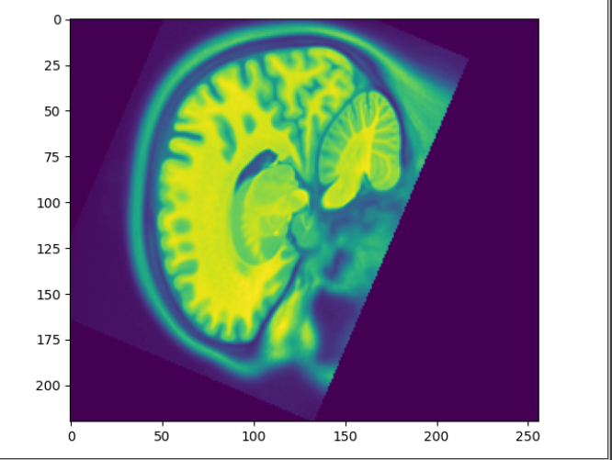
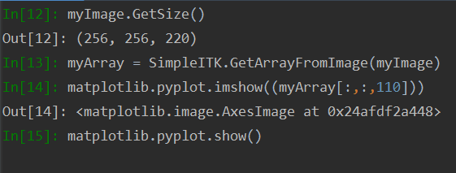
Rendering Pipeline – Overview
Rendering aims to take N-Dimensional (ND) Data and Display it on a 2D Display screen
matplotlib.pyplot simply takes the raw pixel data and displays each pixel with a set size
This does not make use of any of the image specific information (size, origin, orientation)
Images of different sizes but similar resolutions appear differently
Images of similar sizes but different resolutions appear the same.
Notes:
This is a low-level imaging platform which means you as the developer have to manually specific how items will appear and manually figure out the plane/orientation etc.

Slide 6
Rendering Pipeline – Slicer Overview
Rendering aims to take 3-Dimensional (3D) Data and Display it on a 2D Display screen
In Sicer3D we assume all data is in the same 3D world our “mrmlScene”
3D world gets projected to different 2D scenes (“Red”, “Yellow”, and “Green” Planes)
Data
3D World
2D Screen
vtkImage
vtkPolyData
mrmlScene
vtkMRML…Node
Red
Yellow
Green
Notes:
Data is our vtk objects
The 3D world is a mrmlScene that is a collection of nodes
And our 2D screen is a set of planes – in this example Red, Yellow, and Green corresponding to each of the 2D imaging planes we can select
Overall getting the system to work is a bit more complicated but once done you don’t need to redo for every new dataset!

Slide 7
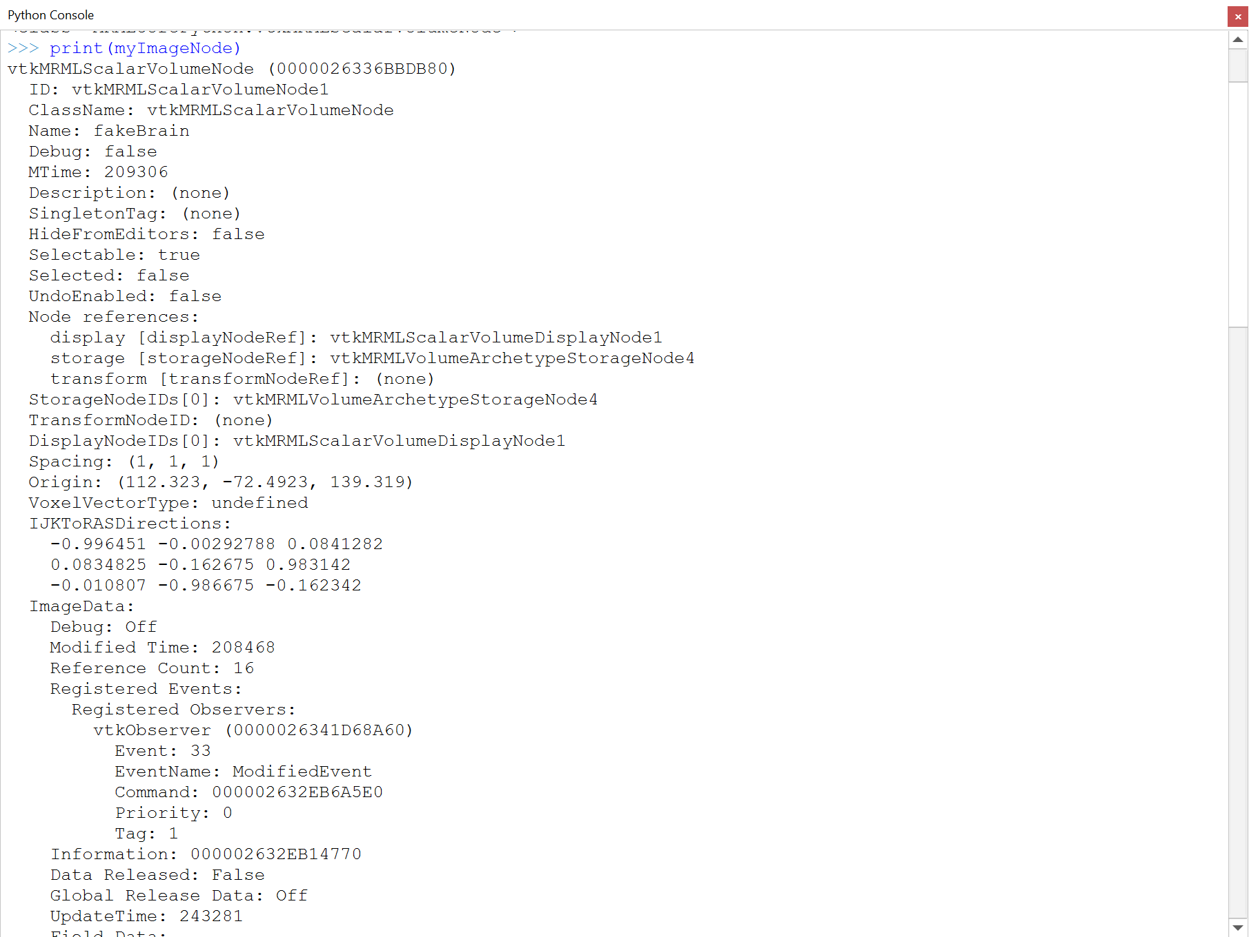
vtkMRML*Nodes
The nodes in 3D Slicer help to define how Data is projected into the 3D World
We have already seen each node has a name and a unique ID as well as data
It also stores information to move from
data to world space
“TransformNodeID”
For images we also always need:
Space
Origin
Transformation “IJKToRASDirections”

Slide 8
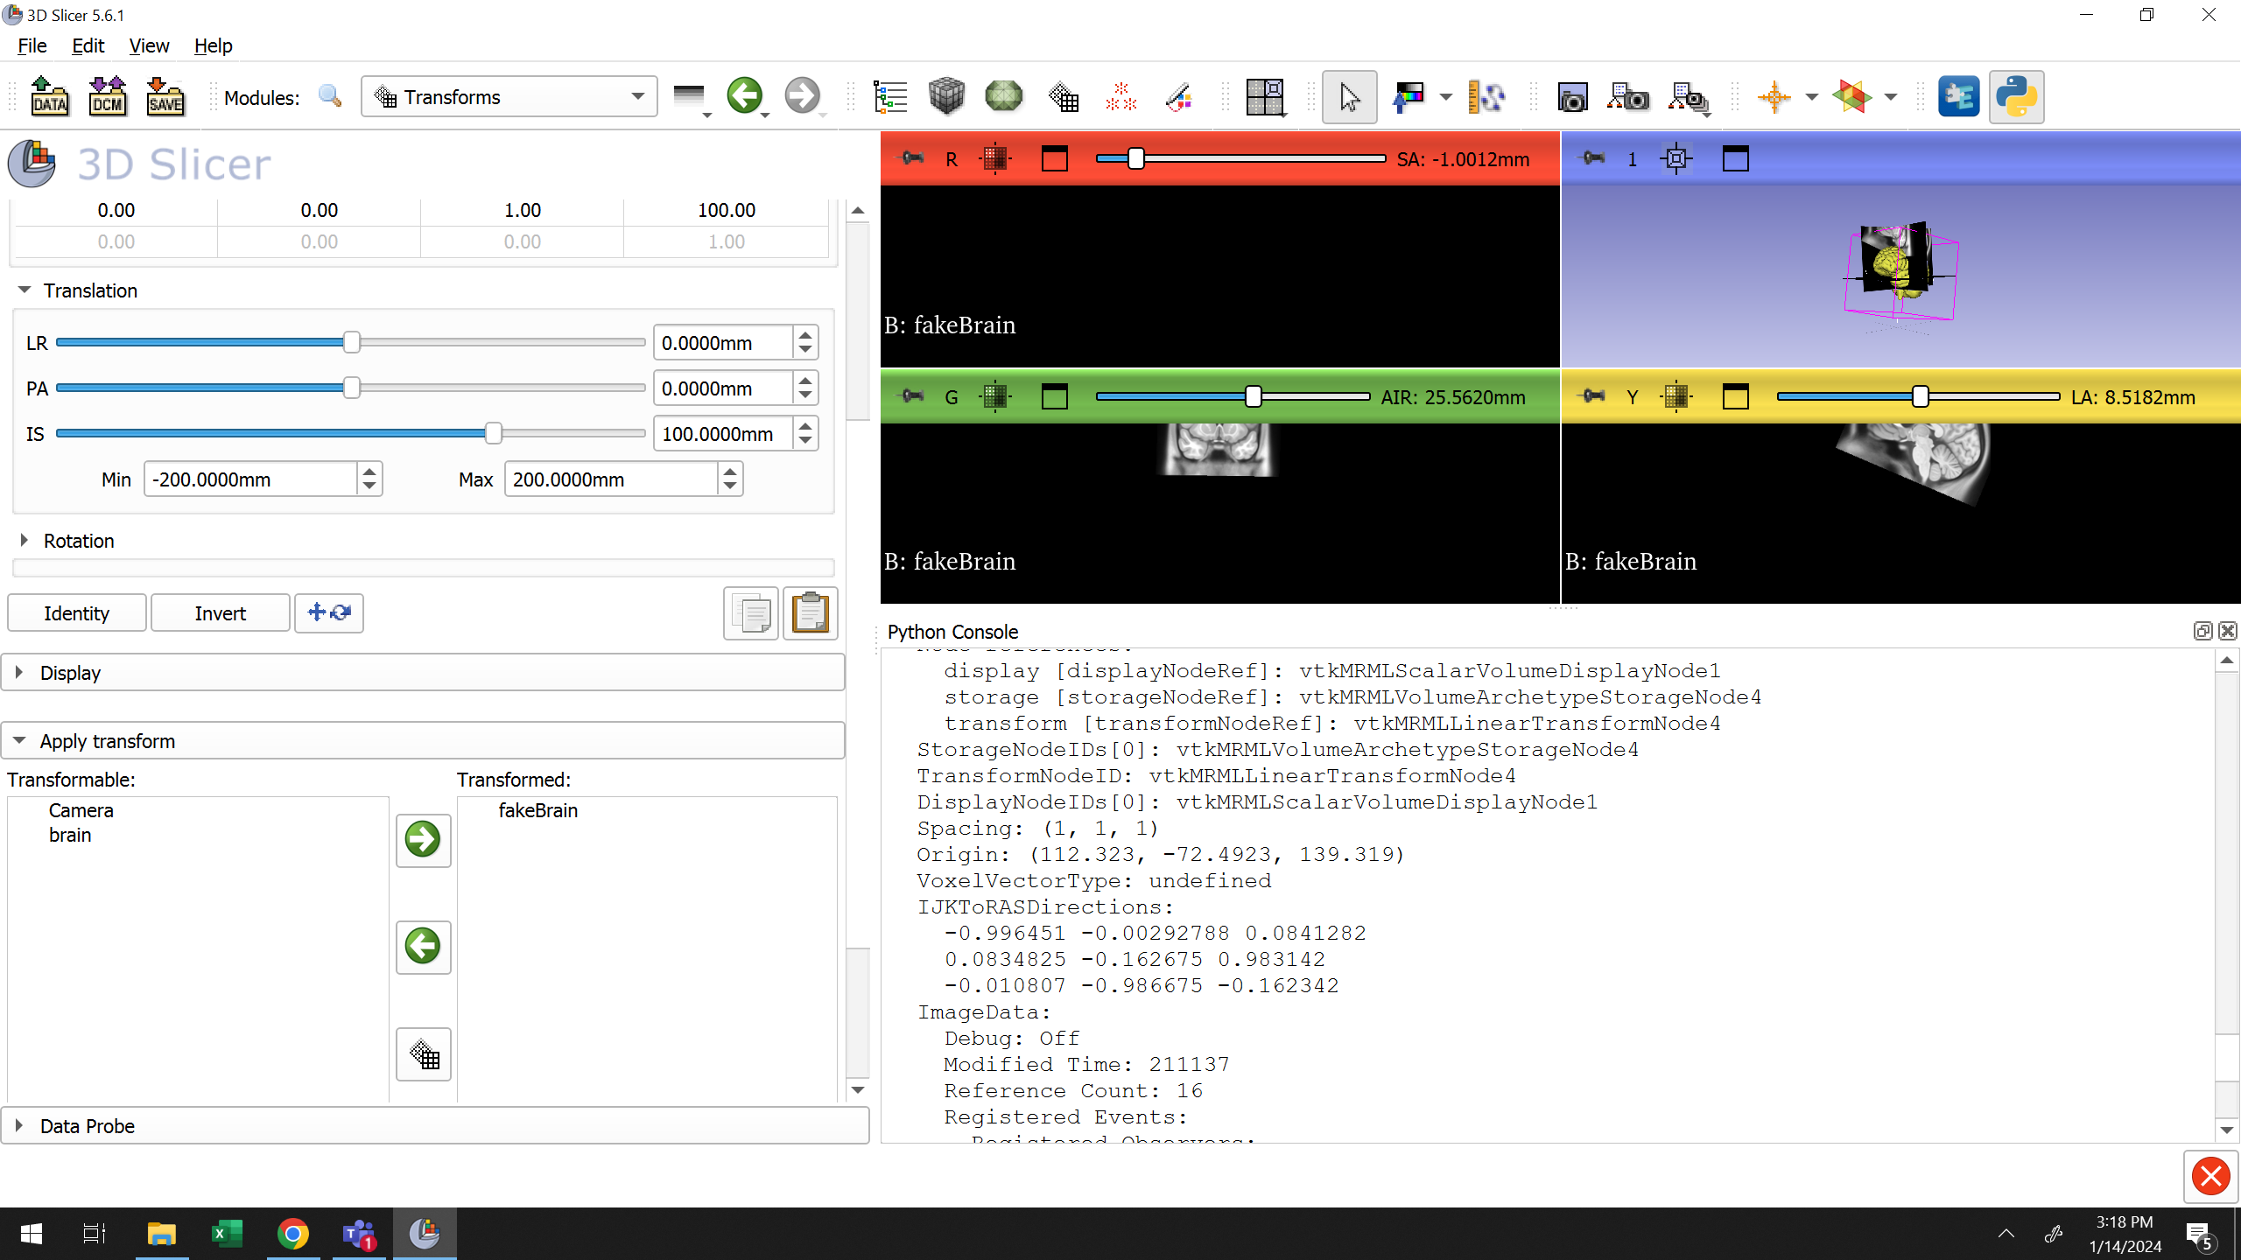
vtkMRML*Nodes
You can move the rendering location of objects using the ‘Transforms’ module
Note this only changes its appearance on screen not the underlying data!
We now have two transforms – on describing the underlying data and one describing the transformation applied to the node!
Notes:
Example of the brain being shifted up

Slide 9
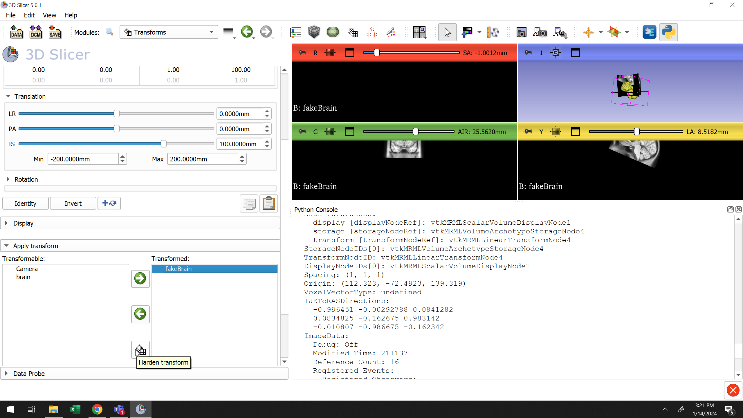

vtkMRML*Nodes
You can move the rendering location of objects using the ‘Transforms’ module
"Harden" will combine the two transformations into one by altering Origin, Spacing and ITKToRASDirections
Notes:
Example of the brain being shifted up

Slide 10
Different Image Coordinate Frames
Different software implementations implement coordinate frames differently
Be careful when converting between data types that you understand each coordinate system
Where possible use in-built tools to perform conversions
Always sense check coordinates to test your implementation

Slide 11
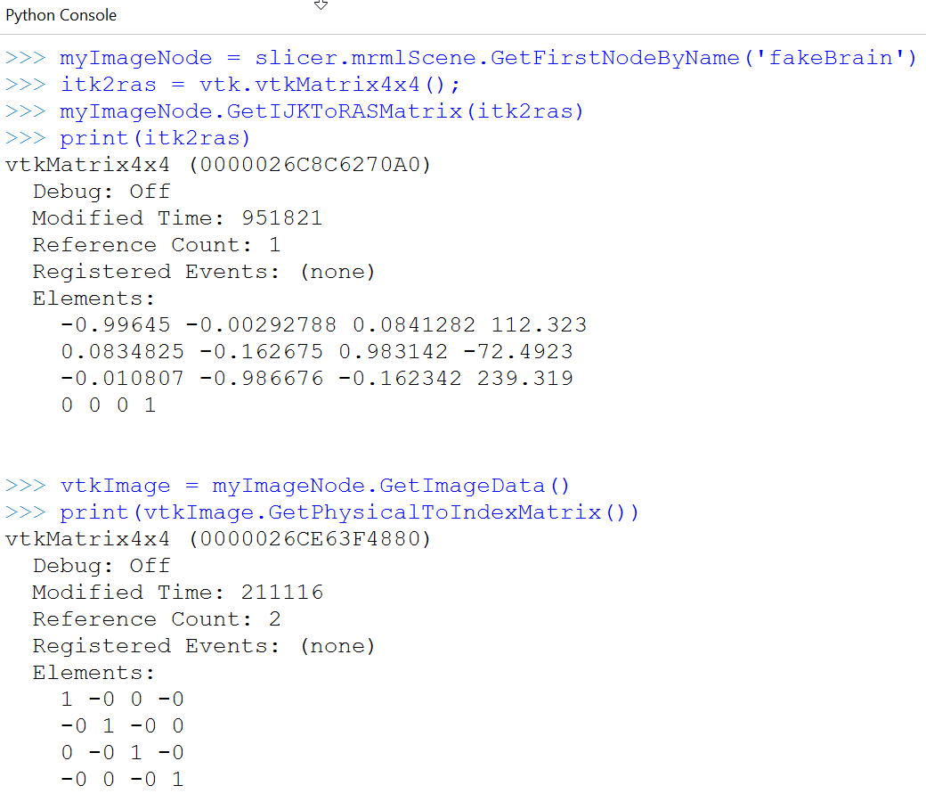
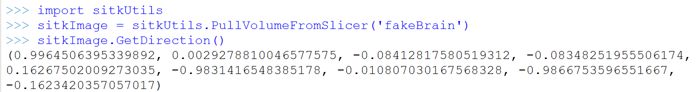
Different Image Coordinate Frames
vtkImage
When in 3D Slicer vtkImage does not store your origin, spacing, orientation the node does
Similar to how numpy array of image data does not store origin, spacing orientation
SimpleITK Image
Same purpose as a node – this stores origin, spacing, and orientation

Slide 12
Putting it all together
Images have a size (spacing), origin, and orientation (IJKToRASDirections)
Not all low lever rendering options (matplotlib) will use all of this information to display images
Image software that uses all parameters might make different display choices (e.g. what side of the screen is right/left, what axes the 2D imaging planes are shown, etc.)
Be aware of how coordinate systems might change during data conversions

