Slide 1
Image-guided Navigation for Robotics
Coordinate Systems
Rachel Sparks, Ph.D.
Rachel.sparks@kcl.ac.uk
Lecturer in Surgical & Interventional Engineering
School of Biomedical Engineering & Imaging Sciences

Slide 2
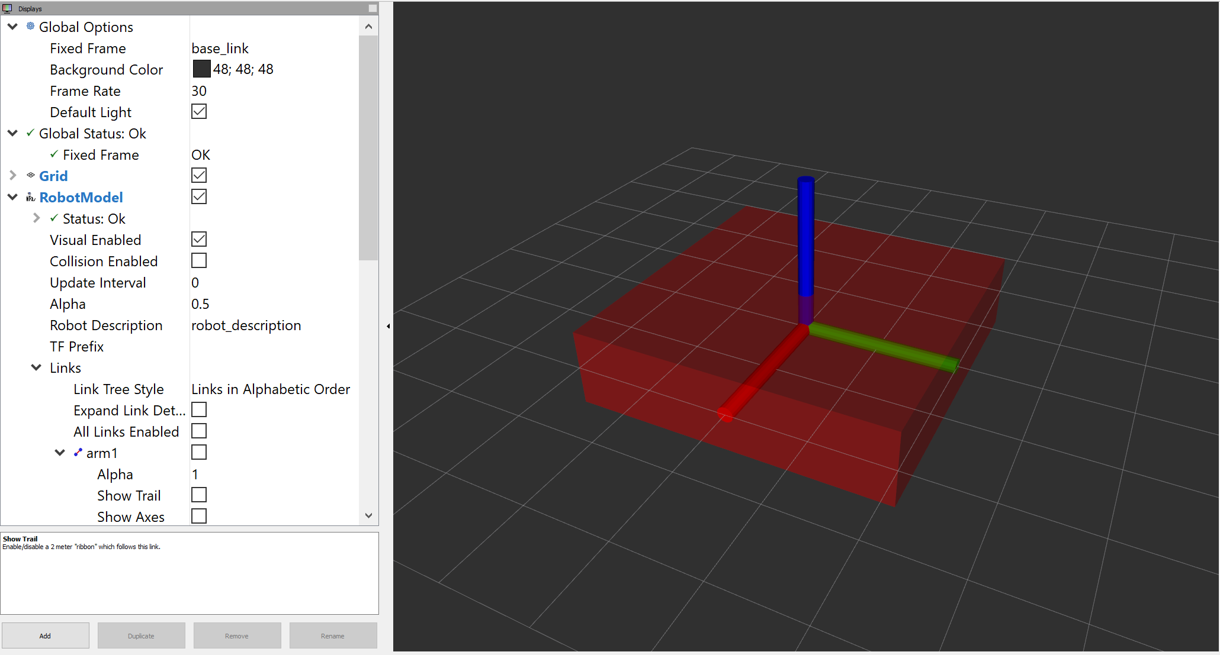
Coordinate System
Set of orthogonal axes attached to an object
Origin is where the axes meet (i.e. the 0,0,0 point of the coordinate frame)
Frames in ROS are always right-handed (x-axis forward, y-axis left, z-axis up)
z
y
x

Slide 3
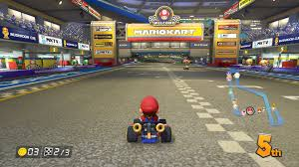
Coordinate System
Set of orthogonal axes attached to an object
Used to describe the positions of points relative to the object
Used to relate the relative orientation of different objects with respect to each other

Slide 4
Coordinate System
Coordinates systems are used everywhere
3D Slicer: Transform used to map an image to the “World” space (aka IJKToRASTransformationMatrix).
Each object is mapped to the World
The World is the global space
Applying different transformation moves your object in the World (and Display).
ROS: the origin of a joint is used to represent a link location
Each joint is mapped with respect to its parent
A base_link defines your location of the robot in the world and can be updated by odom
The position of all other links can be computed by chaining the transformations from the base_link through to its children links of your robot.
Notes:
Note in Slicer the concept is relatively easy. Everything is mapped to the World space – and then you apply different transformations to the object to move it in the space of the world. These are always global systems.
ROS is a local system that enables chain computations.

Slide 5
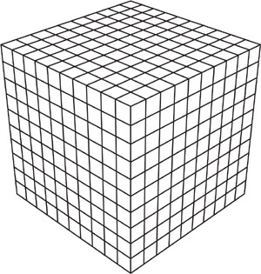
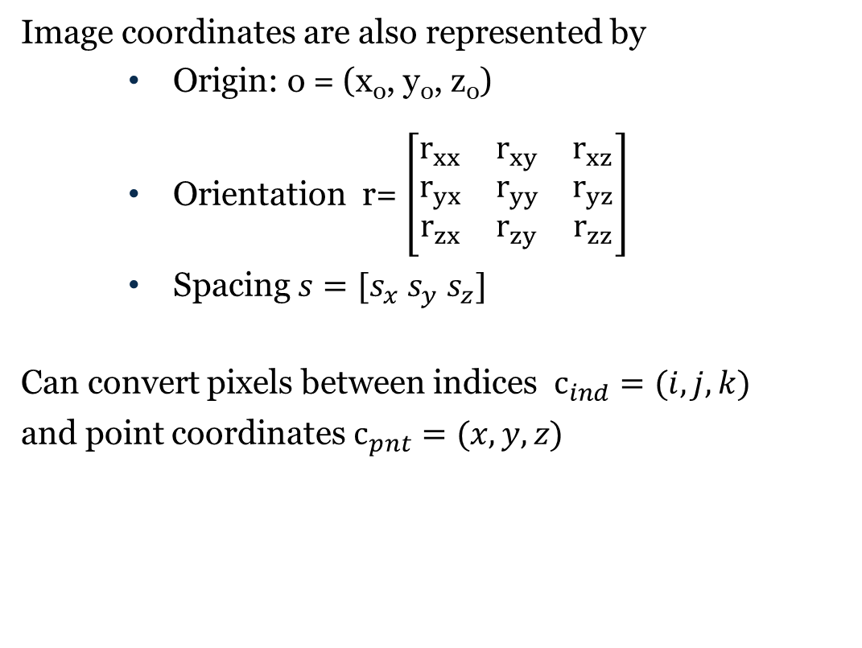
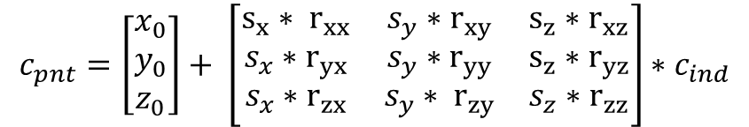
Coordinate System – Images
Image coordinates are also represented by
Origin: o = (x₀, y₀, z₀)
Orientation r= $\left[\begin{matrix}r_{xx} & r_{xy} & r_{xz} \\ r_{yx} & r_{yy} & r_{yz} \\ r_{zx} & r_{zy} & r_{zz}\end{matrix}\right]$
Spacing $s=[s_{x} s_{y} s_{z}]$
Can convert pixels between indices $c_{ind}=(i, j, k)$
and point coordinates $c_{pnt}=(x, y, z)$
$$c_{pnt}=\left[\begin{matrix}x_{0} \\ y_{0} \\ z_{0}\end{matrix}\right]+ \left[\begin{matrix}{s_{x}∗ r}_{xx} & s_{y}∗r_{xy} & {s_{z}∗r}_{xz} \\ s_{x}∗r_{yx} & s_{y}∗r_{yy} & {s_{z}∗r}_{yz} \\ s_{x}∗r_{zx} & s_{y}∗ r_{zy} & s_{z}∗r_{zz}\end{matrix}\right]∗c_{ind}$$
However this is just one way to represent coordinate spaces….

Slide 6
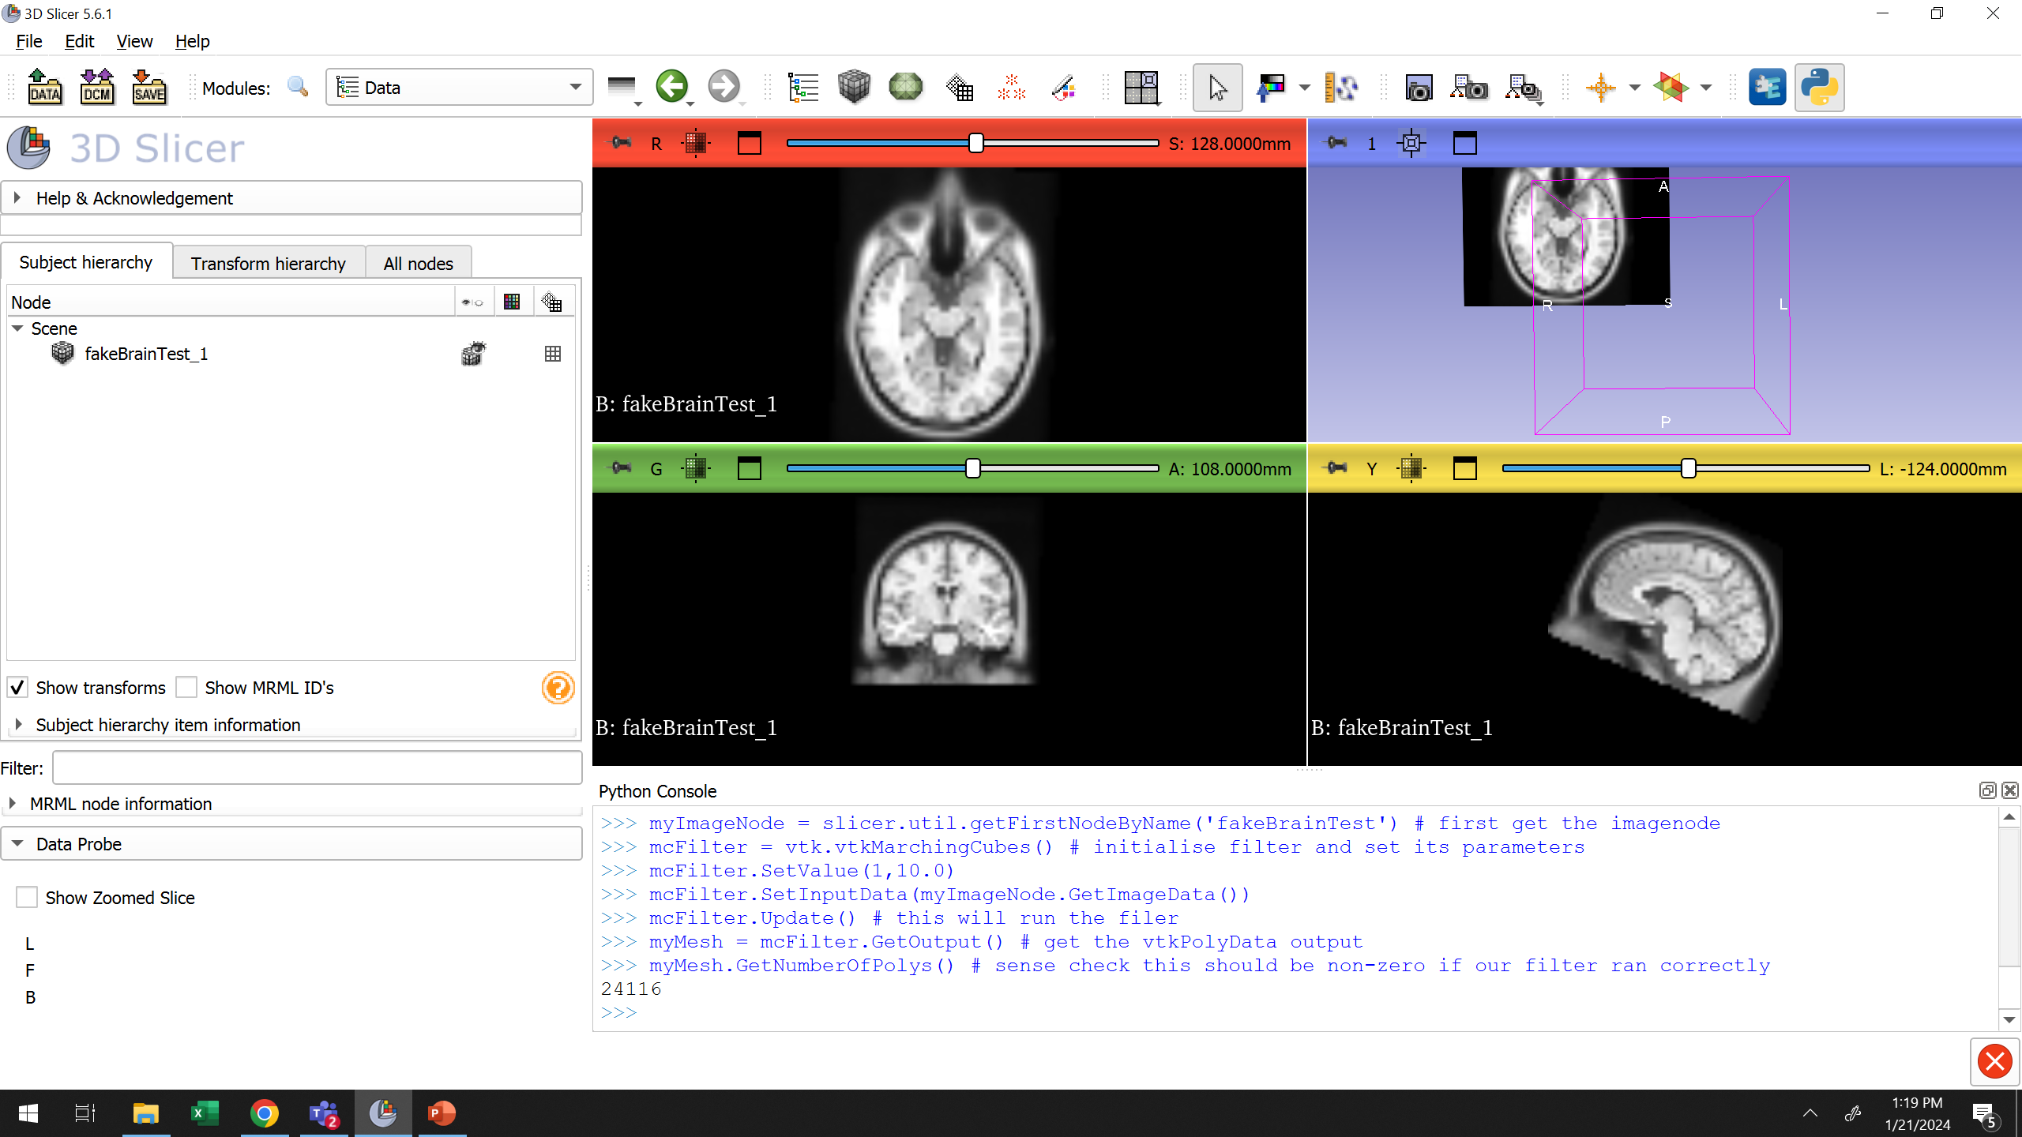
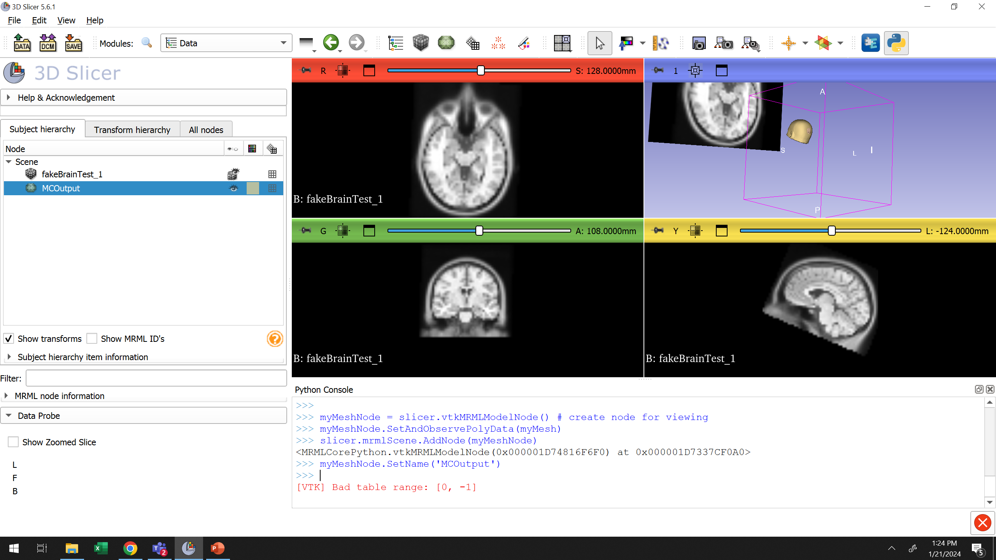
Coordinate System – vtkMarching Cubes Example from Week 2
Run the filter to get the poly data
Place data into node and adjust display
Notes:
Here the image and the mesh are not aligned why? Remember our transformation is stored at the node not data level so we have better transfer that over too!

Slide 7
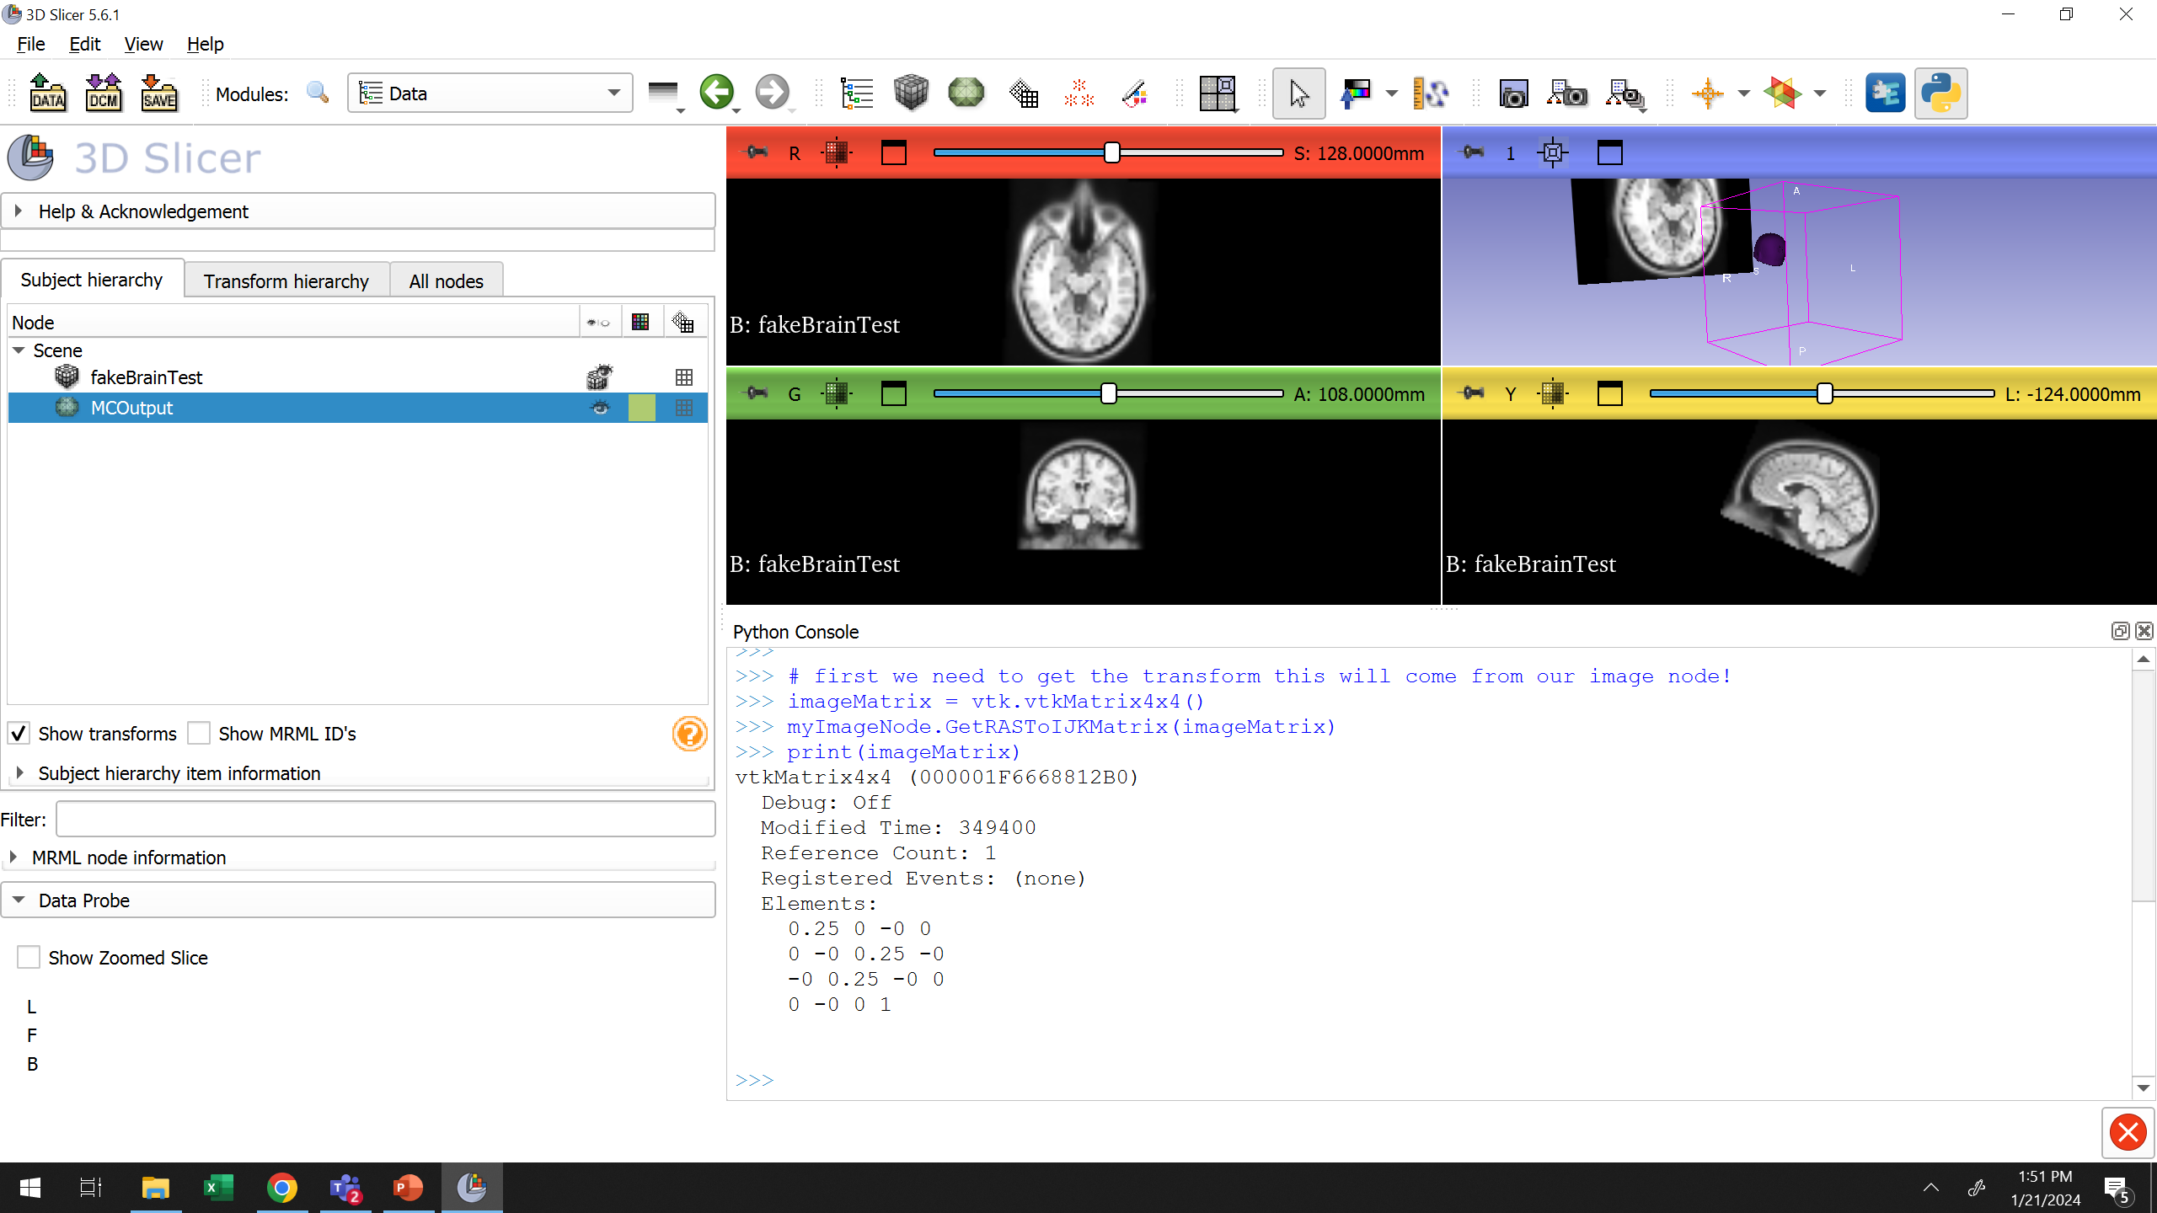
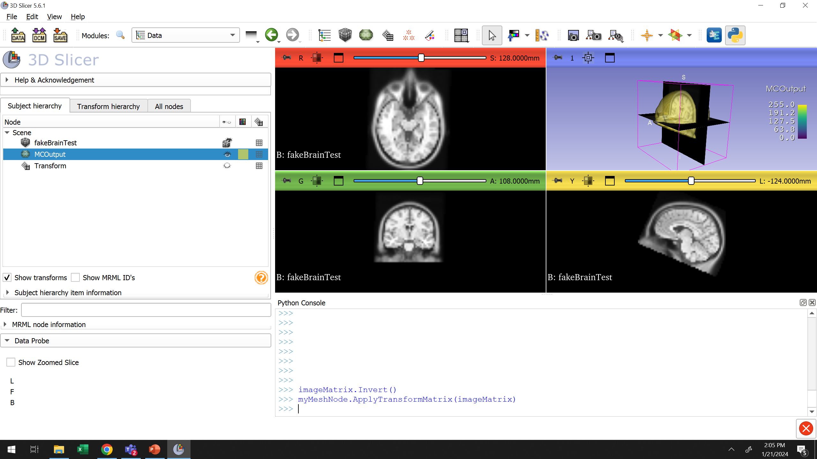
Coordinate System – vtkMarching Cubes Example from Week 2
Get Matrix – what space is this in?
Invert RASToIJKMatrix and Apply to Mesh node.
Notes:
RASToIJK does from the world to the image space– we want to do the opposite here so we invert.

Slide 8

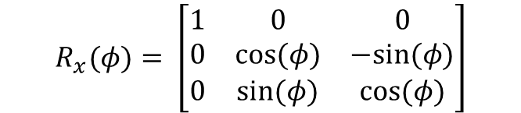
Coordinate System - RPY
Set of orthogonal axes attached to an object – origin is set at the center of mass
Rotations about each axis can be considered separately
“Roll”
$$R_{x}(φ)= \left[\begin{matrix}1 & 0 & 0 \\ 0 & cos⁡(φ) & −sin⁡(φ) \\ 0 & sin⁡(φ) & cos⁡(φ)\end{matrix}\right]$$
z
y
$$φ$$
x

Slide 9

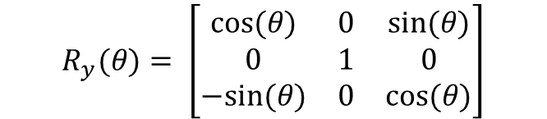
Coordinate System - RPY
Set of orthogonal axes attached to an object
Rotations about each axis can be considered separately
“Pitch”
$$R_{y}(θ)= \left[\begin{matrix}cos⁡(θ) & 0 & sin⁡(θ) \\ 0 & 1 & 0 \\ −sin⁡(θ) & 0 & cos⁡(θ)\end{matrix}\right]$$
z
$$θ$$
y
x

Slide 10

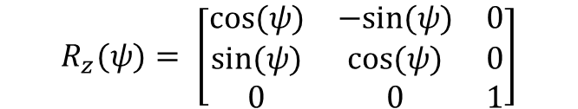
Coordinate System - RPY
Set of orthogonal axes attached to an object
Rotations about each axis can be considered separately
“Yaw”
$$R_{z}(ψ)= \left[\begin{matrix}cos⁡(ψ) & −sin⁡(ψ) & 0 \\ sin⁡(ψ) & cos⁡(ψ) & 0 \\ 0 & 0 & 1\end{matrix}\right]$$
$$ψ$$
z
y
x

Slide 11

Coordinate System
Set of orthogonal axes attached to an object
Rotations about each axis can be considered separately
Or combined
$R(φ,θ,ψ)=$ ${R_{z}(ψ)R}_{y}(θ$) $R_{x}\left(φ\right)$
z
y
x

Slide 12
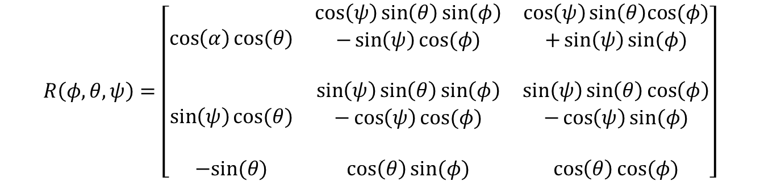
Coordinate System - RPY
Set of orthogonal axes attached to an object
Rotations about each axis can be considered separately
Or combined
$$R\left(φ,θ,ψ\right)=\left[\begin{matrix}\cos\left(α\right)cos⁡(θ) & \begin{aligned}\cos\left(ψ\right)\sin\left(θ\right)\sin\left(φ\right) \\ −\sin\left(ψ\right)cos⁡(φ) \\ \end{aligned} & \begin{aligned}\begin{aligned}\cos\left(ψ\right)\sin\left(θ\right)cos⁡(φ) \\ +\sin\left(ψ\right)sin⁡(φ)\end{aligned} \\ \end{aligned} \\ \sin\left(ψ\right)cos⁡(θ) & \begin{aligned}\sin\left(ψ\right)\sin\left(θ\right)\sin\left(φ\right) \\ −\cos\left(ψ\right)cos⁡(φ) \\ \end{aligned} & \begin{aligned}\begin{aligned}\sin\left(ψ\right)\sin\left(θ\right)\cos\left(φ\right) \\ −\cos\left(ψ\right)sin⁡(φ)\end{aligned} \\ \end{aligned} \\ −sin(θ) & \cos\left(θ\right)sin⁡(φ) & \cos\left(θ\right)cos⁡(φ)\end{matrix}\right]$$
z
y
x

Slide 13
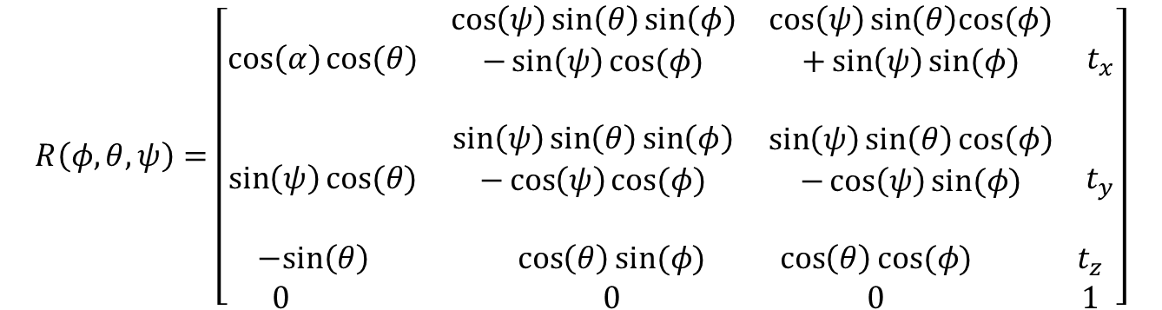
Coordinate System - RPY
z₀
To incorporate translation we use homogenous coordinates
y₀
x₀
$$R\left(φ,θ,ψ\right)=\left[\begin{matrix}\begin{matrix}\cos\left(α\right)cos⁡(θ) & \begin{aligned}\cos\left(ψ\right)\sin\left(θ\right)\sin\left(φ\right) \\ −\sin\left(ψ\right)cos⁡(φ) \\ \end{aligned} \\ \sin\left(ψ\right)cos⁡(θ) & \begin{aligned}\sin\left(ψ\right)\sin\left(θ\right)\sin\left(φ\right) \\ −\cos\left(ψ\right)cos⁡(φ) \\ \end{aligned}\end{matrix} & \begin{matrix}\begin{aligned}\begin{aligned}\cos\left(ψ\right)\sin\left(θ\right)cos⁡(φ) \\ +\sin\left(ψ\right)sin⁡(φ)\end{aligned} \\ \end{aligned} & t_{x} \\ \begin{aligned}\begin{aligned}\sin\left(ψ\right)\sin\left(θ\right)\cos\left(φ\right) \\ −\cos\left(ψ\right)sin⁡(φ)\end{aligned} \\ \end{aligned} & t_{y}\end{matrix} \\ \begin{matrix}−sin\left(θ\right) & \cos\left(θ\right)sin⁡(φ) \\ 0 & 0\end{matrix} & \begin{matrix}\cos\left(θ\right)cos⁡(φ) & { t}_{z} \\ 0 & 1\end{matrix}\end{matrix}\right]$$
(t_{x},t_{y},t_{z})
z_{w}
y_{w}
x_{w}

Slide 14
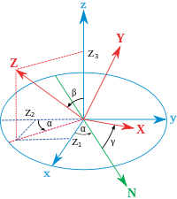
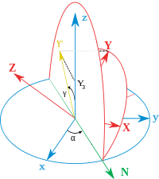
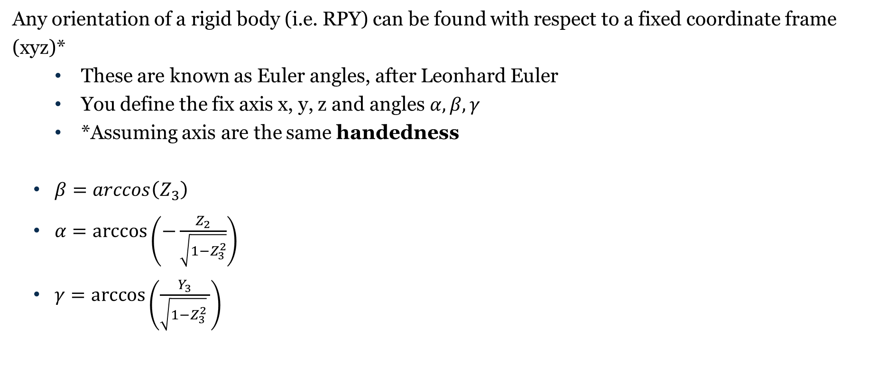
Conversion Between RPY and XYZ
Any orientation of a rigid body (i.e. RPY) can be found with respect to a fixed coordinate frame (xyz)*
These are known as Euler angles, after Leonhard Euler
You define the fix axis x, y, z and angles $α, β, γ$
*Assuming axis are the same handedness
$β=arccos\left(Z_{3}\right)$
$α=\arccos\left(−\frac{Z_{2}}{\sqrt{1−Z_{3}^{2}}}\right)$
$γ=\arccos\left(\frac{Y_{3}}{\sqrt{1−Z_{3}^{2}} }\right)$
*Note Slicer and ROS are not the same handedness so you need to mirror an axis
Notes:
https://en.wikipedia.org/wiki/Euler_angles for a more detailed description

Slide 15
Coordinate systems in ROS
Fixed frame is the object that does not move
Most commonly referred to as the reference frame – all other coordinate systems can be calculated from this object
So far we have defined the base link – i.e. the portion of the robot that does not move

Slide 16
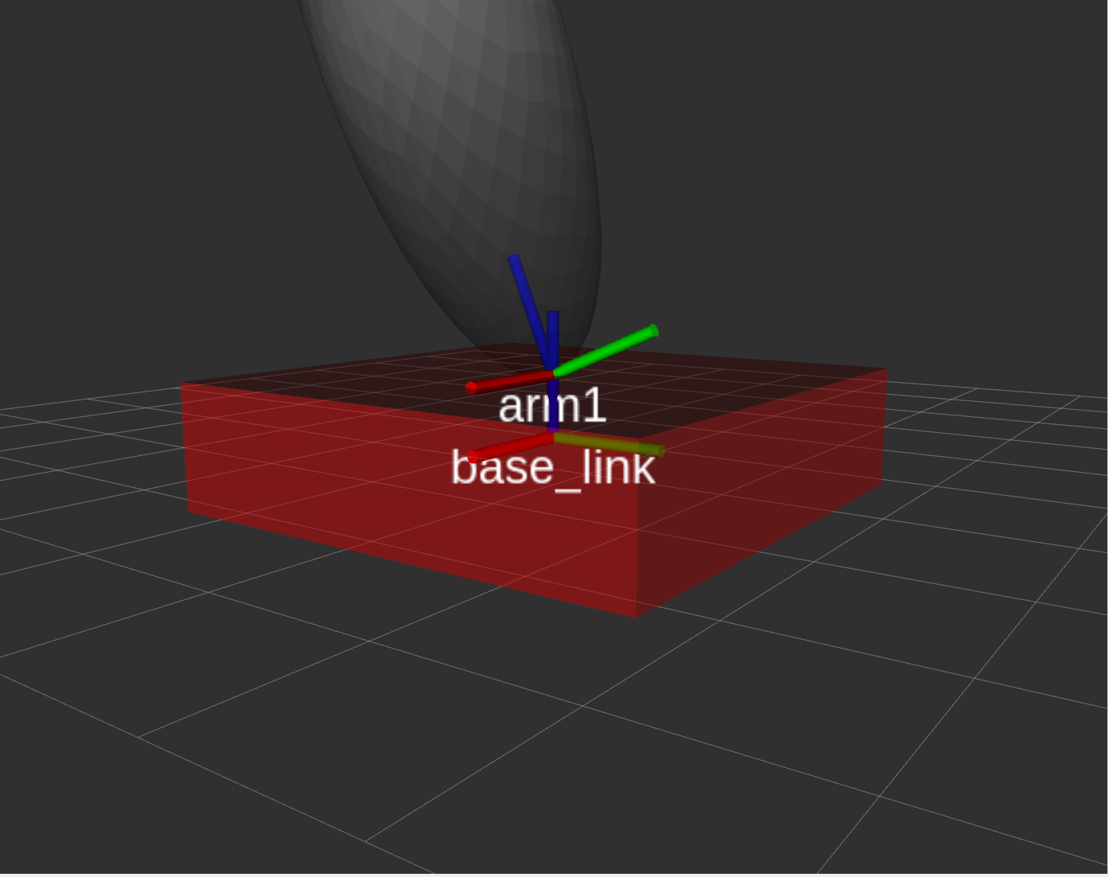
Coordinate systems in ROS
Fixed frame is the object that does not move
Most commonly referred to as the reference frame – all other coordinate systems can be calculated from this object
So far we have defined the base link – i.e. the portion of the robot that does not move
Each link in urdf has its own unique coordinate frame
Joints enable us to define the relative position of the
child link with respect to the parent link.

Slide 17
Coordinate systems in ROS
A practical note: when setting up urdf file
Be default the object origin is the center of mass
Both joints and objects are assumed to be centered at (0,0,0) and orientated (0,0,0)
Joints will rotate around their origins
You need to calculate both object offset and joint offset to ensure proper robotic manipulation

Slide 18
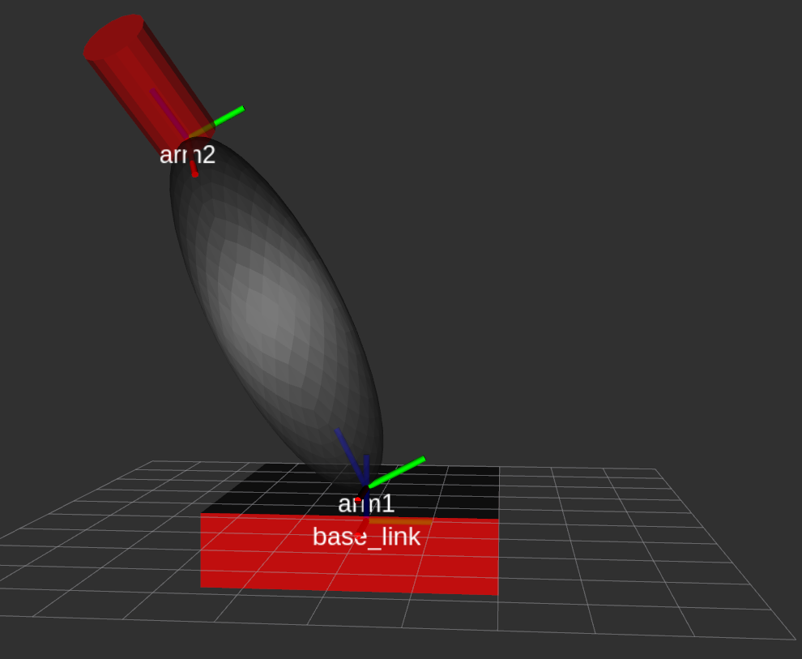
Coordinate systems in ROS
The relative position of each arm is calculated in a recursive fashion
Arm1 is calculated based on its position to base_link
Arm2 is calculated based on its position to Arm1
Etc.

Slide 19
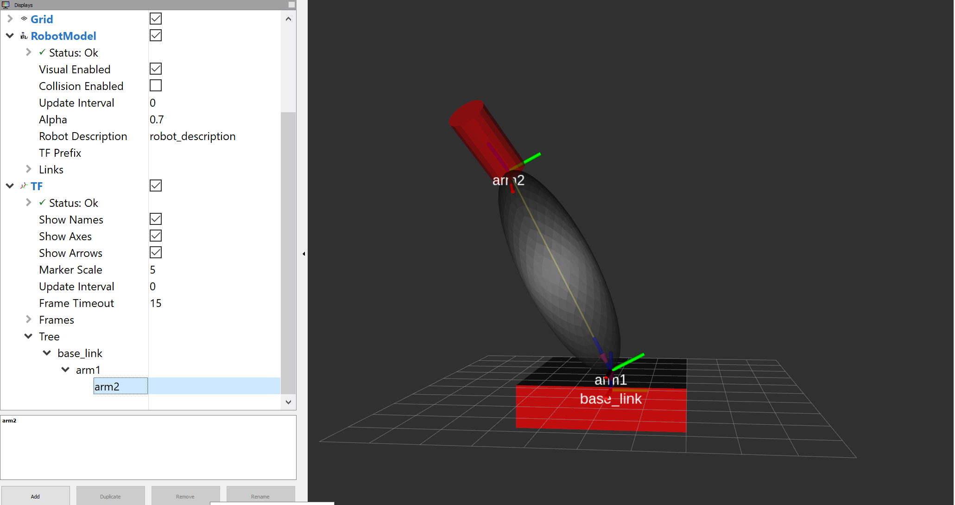
Coordinate systems in ROS
This is defined by a Tree object where relationships between joints are stored

Slide 20
Robot Building Example
Lets assume we have three links
By default center of rotation aka position of joint is considered to be in the center of mass
First identify where you want each joint to be relative to its link.
This offset is the link origin!
Note here a negative movement in the joint corresponds to a positive movement in the link – we are actually moving the link not the joint.
1
2
1
1
6
3
1
4
Notes:
Example found in MyJointedRobot.urdf

Slide 21
Robot Building Example
Lets assume we have three links
By default center of rotation aka position of joint is considered to be in the center of mass
First identify where you want each joint to be relative to its link.
Next consider the distance between the joints
These are the joint origins
You can also start your robot in a non-straight position by specifying rpy this will robot your link about the joint.
For rotational joints you can specify the axis it rotates about (1,0,0) is the default
1
2
1
1
6
3
1
4
Notes:
Example found in MyJointedRobot.urdf
The origin between base_to_arm1 is 0.5: half the size of the base_link
The origin between arm1_to_arm2 is 6: the size of the arm1 link.

Slide 22
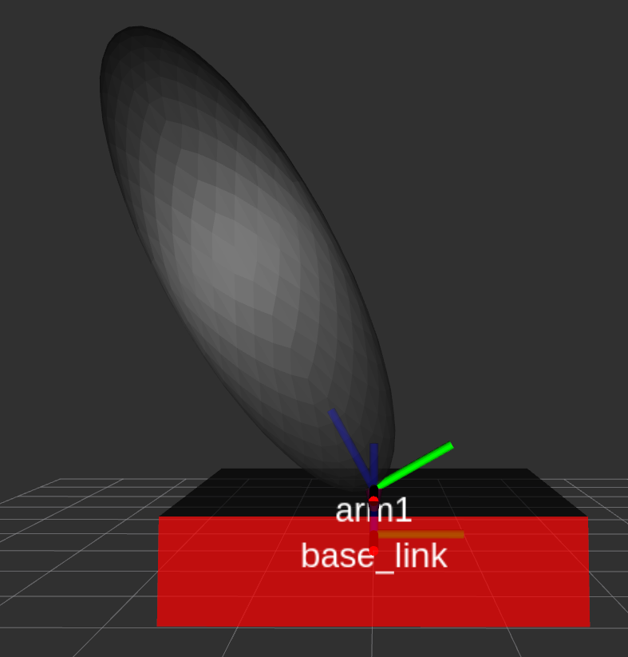
Kinematic Chains
The description of a rigid robot as a hierarchy of parts enables quick and easy calculation of the location of the end effector
From the base can build up chain of transformations to describe the relative position of each arm until the end effector position is calculated
When updating the overall robot position only new movements need to be taken into account
$Effector_{TF}=|X_{effector}|\left|Z_{arm1}\right| \left| X_{arm1}\right|$ $\left|Z_{base}\right|$

Slide 23




Kinematic Chains
The description of a rigid robot as a hierarchy of parts enables quick and easy calculation of the location of the end effector
From the base can build up chain of transformations to describe the relative position of each arm until the end effector position is calculated
When updating the overall robot position only new movements need to be taken into account
$Effector_{TF}=|X_{effector}|\left|Z_{arm1}\right| \left| X_{arm1}\right|$ $\left|Z_{base}\right|$
$$\left[\begin{matrix}\begin{matrix}1 & 0 \\ 0 & 1\end{matrix} & \begin{matrix}0 & 0 \\ 0 & 0\end{matrix} \\ \begin{matrix}0 & 0 \\ 0 & 0\end{matrix} & \begin{matrix}1 & 0 \\ 6 & 1\end{matrix}\end{matrix}\right]$$
$$\left[\begin{matrix}\begin{matrix}1 & 0 \\ 0 & cos⁡(θ)\end{matrix} & \begin{matrix}0 & 0 \\ −sin⁡(θ) & 0\end{matrix} \\ \begin{matrix}0 & sin⁡(θ) \\ 0 & 0\end{matrix} & \begin{matrix}cos⁡(θ) & 0 \\ 0 & 1\end{matrix}\end{matrix}\right]$$
$$\left[\begin{matrix}\begin{matrix}1 & 0 \\ 0 & 1\end{matrix} & \begin{matrix}0 & 0 \\ 0 & 0\end{matrix} \\ \begin{matrix}0 & 0 \\ 0 & 0\end{matrix} & \begin{matrix}1 & 0 \\ 0.5 & 1\end{matrix}\end{matrix}\right]$$
$$\left[\begin{matrix}\begin{matrix}1 & 0 \\ 0 & 1\end{matrix} & \begin{matrix}0 & 0 \\ 0 & 0\end{matrix} \\ \begin{matrix}0 & 0 \\ 0 & 0\end{matrix} & \begin{matrix}1 & 0 \\ 0 & 1\end{matrix}\end{matrix}\right]$$

Slide 24
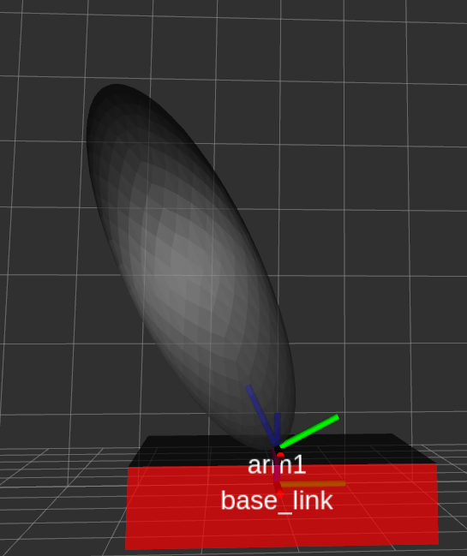





Kinematic Chains
The description of a rigid robot as a hierarchy of parts enables quick and easy calculation of the location of the end effector
From the base can build up chain of transformations to describe the relative position of each arm until the end effector position is calculated
When updating the overall robot position only new movements need to be taken into account
$$Effector_{TF}=T_{eff} ∗R_{arm1}∗ T_{joint1}∗R_{base}$$
$$\left[\begin{matrix}\begin{matrix}1 & 0 \\ 0 & 1\end{matrix} & \begin{matrix}0 & 0 \\ 0 & 0\end{matrix} \\ \begin{matrix}0 & 0 \\ 0 & 0\end{matrix} & \begin{matrix}1 & 0 \\ 6 & 1\end{matrix}\end{matrix}\right]$$
$$\left[\begin{matrix}\begin{matrix}1 & 0 \\ 0 & cos⁡(θ)\end{matrix} & \begin{matrix}0 & 0 \\ −sin⁡(θ) & 0\end{matrix} \\ \begin{matrix}0 & sin⁡(θ) \\ 0 & 0\end{matrix} & \begin{matrix}cos⁡(θ) & 0 \\ 0 & 1\end{matrix}\end{matrix}\right]$$
$$\left[\begin{matrix}\begin{matrix}1 & 0 \\ 0 & 1\end{matrix} & \begin{matrix}0 & 0 \\ 0 & 0\end{matrix} \\ \begin{matrix}0 & 0 \\ 0 & 0\end{matrix} & \begin{matrix}1 & 0 \\ 0.5 & 1\end{matrix}\end{matrix}\right]$$
$$\left[\begin{matrix}\begin{matrix}1 & 0 \\ 0 & 1\end{matrix} & \begin{matrix}0 & 0 \\ 0 & 0\end{matrix} \\ \begin{matrix}0 & 0 \\ 0 & 0\end{matrix} & \begin{matrix}1 & 0 \\ 0 & 1\end{matrix}\end{matrix}\right]$$
$$= \left[\begin{matrix}\begin{matrix}1 & 0 \\ 0 & 0.88\end{matrix} & \begin{matrix}0 & 0 \\ −.46 & 0\end{matrix} \\ \begin{matrix}0 & 0.46 \\ 0 & 2.77\end{matrix} & \begin{matrix}0.88 & 0 \\ 5.82 & 1\end{matrix}\end{matrix}\right]$$

Slide 25

Kinematic Chains -- Remote center of motion
The description of a rigid robot as a hierarchy of parts enables quick and easy calculation of the location of the end effector
You can model remote center of motion or more complex motions by adding virtual joints with appropriate offsets.
$Effector_{TF}$ will be updated with the additional elements
Example shows a way to add a 3DOF joint through virtual links
$$Effector_{TF}=T_{eff} {∗R}_{arm1_vir1}∗R_{arm1_vir2}∗R_{arm1}∗ T_{joint1}∗R_{base}$$

Slide 26
Kinematic Chains – Remote center of motion
In ROS this is as simple of offsetting the joint from the link
<?xml version="1.0"?>
<robot name="origins">
<link name="base_link">
<visual>
<geometry>
<cylinder length="0.6" radius="0.2"/>
</geometry>
</visual>
</link>
<link name="right_leg">
<visual>
<geometry>
<box size="0.6 0.1 0.2"/>
</geometry>
<origin rpy="0 1.57075 0" xyz="0 0 -0.3"/>
</visual>
</link>
<joint name="base_to_right_leg" type="fixed">
<parent link="base_link"/>
<child link="right_leg"/>
<origin xyz="0 -0.22 0.25"/>
</joint>
</robot>

Slide 27
Kinematic Chains in ROS
From a practical standpoint Kinematic Chains in ROS requires two packages
kdl_parser: Kinematics and Dynamic Library (KDL) Parser
From urdf or collada description construct the tree representation of robot joints
This builds up the relationship between links, joints, and positions/orientations
tree_kinematics: Forward and inverse kinematic solver
Uses joint position, velocity, and limits to calculate kinematics
Applies exponential smoothing to when all joints are at rest
Limited to serial robots

Slide 28
Coordinate System Conclusions
Coordinate frames are used to represent scenes and objects
Used to describe relationship between joints in ROS
Used to describe relationship in medical images
Coordinate frames can be transformed between by simple matrix multiplication and trigonometry
Homogenous coordinates
Each transformation is correctly computed
The order of transformations is applied correctly

