Slide 1
Image-Guided Navigation for Robotics
Communication Protocols: Pt. 1 API
aka what’s up with Qt?
Rachel Sparks, Ph.D.
Rachel.sparks@kcl.ac.uk
Lecturer in Surgical & Interventional Engineering
School of Biomedical Engineering & Imaging Sciences

Slide 2
Application Programming Interface (API)
A software intermediary that allows two pieces of software to communicate
Process1
Software 1
Class 1
Variable 1
Software 2
Class 2
Process2
Variable 2

Slide 3
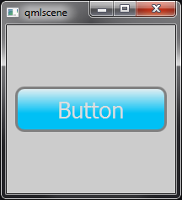
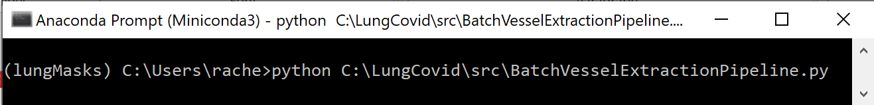
Application Programming Interface
A software intermediary that allows two pieces of software to communicate
Comes in many different flavours
Any command line input, user interface or program you have written or called
class MyAwesomeClass:
def run(self, var1, var2):
return output
USER INTERFACE
COMMAND
FUNCTION

Slide 4
Functions
We already know how to use API for functions and classes
import MyAwesomeClass
class HigherLevelClass:
def run(self):
…
x = MyAwesomeClass()
x.run(var1, var2)
…
class MyAwesomeClass:
def run(self, var1, var2):
return output
Need to know how to instantiate class
What function to call
How to call function

Slide 5
Functions
We already know how to use API for functions and classes
import MyAwesomeClass
Load symbols
class HigherLevelClass:
def run(self):
…
x = MyAwesomeClass()
x.run(var1, var2)
…
class MyAwesomeClass:
def run(self, var1, var2):
return output

Slide 6
Functions
We already know how to use API for functions and classes
import MyAwesomeClass
class HigherLevelClass:
def run(self):
…
x = MyAwesomeClass()
x.run(var1, var2)
…
class MyAwesomeClass:
def run(self, var1, var2):
return output
HigherLevelClass
….
MyAwesomeClass
….

Slide 7
Functions
Simple; easy to implement
Ensures a tight coupling and linear workflow
If we change MyAwesomeClass we may need to change HigherLevelClass
Need to rewrite HigherLevelClass to swap MyAwesomeClass with a new class
HigherLevelClass
….
MyAwesomeClass
….

Slide 8
Functions
Simple; easy to implement
Ensures a tight coupling and linear workflow
Difficult to swap functions
Even more difficult to expand HigherLevelClass to call multiple functions at once
Even more difficult to link actions elsewhere in the program to calling MyAwesomeClass
With out additional programming infrastructure we cannot instantiate multiple calls at the same time (one-to-one mapping)
HigherLevelClass
….
MyAwesomeClass
….

Slide 9
User Interface
We only want to call run of MyAwesomeClass when “Button” is pressed by the user
class MyAwesomeClass:
def run(self, var1, var2):
return output

Slide 10
User Interface
We only want to call run of MyAwesomeClass when “Button” is pressed
class MyUI():
def setup(self):
# Apply Button
button = qt.QPushButton(“Button")

Slide 11
User Interface
We only want to call run of MyAwesomeClass when “Button” is pressed
Once again tightly coupled → will need to rewrite MyUI to remove, change or add functions
Computationally will continue running unnecessarily due to while loop
class MyUI():
def setup(self):
# Apply Button
button = qt.QPushButton(“Button")
def run(self):
while true:
if (self.applyButton.pressed()):
x = MyAwesomeClass()
x.run(var1, var2)

Slide 12
User Interface
We only want to call run of MyAwesomeClass when “Button” is pressed
Once again tightly coupled → will need to rewrite MyUI to remove, change or add functions
Computationally will continue running unnecessarily due to while loop
class MyUI():
def setup(self):
# Apply Button
button = qt.QPushButton(“Button")
def run(self):
while true:
if (self.applyButton.pressed()):
x = MyAwesomeClass()
x.run(var1, var2)
MyUI
MyAwesomeClass

Slide 13
User Interface
We only want to call run of MyAwesomeClass when “Button” is pressed
Once again tightly coupled → will need to rewrite MyUI to remove, change or add functions
Computationally will continue running unnecessarily due to while loop
We only want to call run of MyAwesomeClass when “Button” is pressed
Once again tightly coupled → will need to rewrite MyUI to remove, change or add functions
Computationally will continue running unnecessarily due to while loop
class MyUI():
def setup(self):
# Apply Button
button = qt.QPushButton(“Button")
def OnPushButton(self):
while true:
if (self.applyButton.pressed()):
x = MyAwesomeClass()
x.run(var1, var2)

Slide 14
User Interface – Callbacks
We only want to call run of MyAwesomeClass when “Button” is pressed
Once again tightly coupled → will need to rewrite MyUI to remove, change or add functions
We only want to call run of MyAwesomeClass when “Button” is pressed
Once again tightly coupled → will need to rewrite MyUI to remove, change or add functions
Requires know what the type of myClass before UI design
class MyUI():
def setup(self):
# Apply Button
button = qt.QPushButton(“Button")
def OnPushButton(self, myClass):
x = MyAwesomeClass()
myClass.run(var1, var2)

Slide 15
User Interface – Callbacks
We only want to call run of MyAwesomeClass when “Button” is pressed
Once again tightly coupled → will need to rewrite MyUI to remove, change or add functions
We only want to call run of MyAwesomeClass when “Button” is pressed
Once again tightly coupled → will need to rewrite MyUI to remove, change or add functions
Requires know the type of myClass before UI design
Required all types of myClass be consistent
class MyUI():
def setup(self):
# Apply Button
button = qt.QPushButton(“Button")
def OnPushButton(self, myClass):
x = MyAwesomeClass()
myClass.run(var1, var2)
MyUI
MyAwesomeClass

Slide 16
User Interface – Signal/Slot Interface
We only want to call run of MyAwesomeClass when “Button” is pressed
Once again tightly coupled → will need to rewrite MyUI to remove, change or add functions
We only want to call run of MyAwesomeClass when “Button” is pressed
Once again tightly coupled → will need to rewrite MyUI to remove, change or add functions
class MyUI():
def setup(self):
# Apply Button
button = qt.QPushButton(“Button")
def OnPushButton(self):
emit Signal

Slide 17
User Interface – Signal/Slot Interface
We only want to call run of MyAwesomeClass when “Button” is pressed
Once again tightly coupled → will need to rewrite MyUI to remove, change or add functions
We only want to call run of MyAwesomeClass when “Button” is pressed
Now every time “Button” is pressed, we emit the clicked signal
class MyUI():
def setup(self):
# Apply Button
button = qt.QPushButton(“Button")
def OnPushButton(self):
self.clicked.emit(true)
def OnPushButton(self):
emit Signal

Slide 18
User Interface – Signal/Slot Interface
We only want to call run of MyAwesomeClass when “Button” is pressed
Once again tightly coupled → will need to rewrite MyUI to remove, change or add functions
We only want to call run of MyAwesomeClass when “Button” is pressed
Now every time “Button” is pressed, we emit the clicked signal
The signal must be connected to a slot to call a function
class MyUI():
def setup(self):
# Apply Button
button = qt.QPushButton(“Button")
self.button.connect('clicked(bool)’,self.runButton)
def OnPushButton(self):
self.clicked.emit(true)
MyUI
MyAwesomeClass

Slide 19
User Interface – Signal/Slot Interface
We only want to call run of MyAwesomeClass when “Button” is pressed
Once again tightly coupled → will need to rewrite MyUI to remove, change or add functions
We only want to call run of MyAwesomeClass when “Button” is pressed
Now every time “Button” is pressed, we emit the clicked signal
The signal must be connected to a slot to call the function
class NewClass():
def setup(self):
self.button = MyUI()
# Slots
self.button.connect('clicked(bool)', self.onApplyButton)
def onApplyButton(self):
x = MyAwesomeClass()
x.run(var1, var2)
Class containing emitter

Slide 20
User Interface – Signal/Slot Interface
We only want to call run of MyAwesomeClass when “Button” is pressed
Once again tightly coupled → will need to rewrite MyUI to remove, change or add functions
We only want to call run of MyAwesomeClass when “Button” is pressed
Now every time “Button” is pressed, we emit the clicked signal
The signal must be connected to a slot to call the function
class NewClass():
def setup(self):
self.applyButton = MyUI()
# Slots
self.applyButton.connect('clicked(bool)', self.onApplyButton)
def onApplyButton(self):
x = MyAwesomeClass()
x.run(var1, var2)
Setting up the slot i.e. what object will emit the signal

Slide 21
User Interface – Signal/Slot Interface
We only want to call run of MyAwesomeClass when “Button” is pressed
Once again tightly coupled → will need to rewrite MyUI to remove, change or add functions
We only want to call run of MyAwesomeClass when “Button” is pressed
Now every time “Button” is pressed, we emit the clicked signal
The signal must be connected to a slot to call the function
class NewClass():
def setup(self):
self.applyButton = MyUI()
# Slots
self.applyButton.connect('clicked(bool)', self.onApplyButton)
def onApplyButton(self):
x = MyAwesomeClass()
x.run(var1, var2)
What signal are we listening for

Slide 22
User Interface – Signal/Slot Interface
We only want to call run of MyAwesomeClass when “Button” is pressed
Once again tightly coupled → will need to rewrite MyUI to remove, change or add functions
We only want to call run of MyAwesomeClass when “Button” is pressed
Now every time “Button” is pressed, we emit the clicked signal
The signal must be connected to a slot to call the function
class NewClass():
def setup(self):
self.applyButton = MyUI()
# Slots
self.applyButton.connect('clicked(bool)', self.onApplyButton)
def onApplyButton(self):
x = MyAwesomeClass()
x.run(var1, var2)
What function to call when signal is sent

Slide 23
User Interface – Signal/Slot Interface
We only want to call run of MyAwesomeClass when “Button” is pressed
Once again tightly coupled → will need to rewrite MyUI to remove, change or add functions
We only want to call run of MyAwesomeClass when “Button” is pressed
Now every time “Button” is pressed, we emit the clicked signal
The signal must be connected to a slot to call the function
Can set up as many slots you like to any signal
Loose coupling – need only know about signal of class/object you want to listen to
class NewClass():
def setup(self):
self.applyButton = MyUI()
# Slots
self.applyButton.connect('clicked(bool)', self.onApplyButton)
def onApplyButton(self):
x = MyAwesomeClass()
x.run(var1, var2)

Slide 24
User Interface – Signal/Slot Interface
We only want to call run of MyAwesomeClass when “Button” is pressed
Once again tightly coupled → will need to rewrite MyUI to remove, change or add functions
We only want to call run of MyAwesomeClass when “Button” is pressed
Now every time “Button” is pressed, we emit the clicked signal
The signal must be connected to a slot to call the function
Can set up as many slots you like to any signal
Loose coupling – need only know about signal of classes you care about
Need to be careful when designing workflow to avoid circular referencing
class ButtonClass():
def setup(self):
self.applyCheckBox = CheckboxClass()
# Slots
self.applyCheckBox.connect(‘toggled(bool)’, self.onApplyButton)
def onApplyButton(self):
self.applyButton.clicked.emit(true)
class CheckboxClass():
def setup(self):
self.applyButton = ButtonClass()
# Slots
self. applyButton.connect(‘clicked(bool)’, self.onApplyCheckBox)
def onApplyCheckBox(self):
self.applyCheckBox.toggled.emit(true)

Slide 25
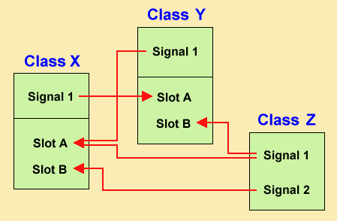
User Interface – Signal/Slot Interface
We only want to call run of MyAwesomeClass when “Button” is pressed
Once again tightly coupled → will need to rewrite MyUI to remove, change or add functions
We only want to call run of MyAwesomeClass when “Button” is pressed
Now every time “Button” is pressed, we emit the clicked signal
The signal must be connected to a slot to call the function
Can set up as many slots you like to any signal
Loose coupling – need only know about signal of classes you care about
Need to be careful when designing workflow
Typically slots only take actions from
signals
Signals only emit based on actions
Easy to end up with never ending loops if
you are not careful with code
Helpful for closed applications – but not easy to
scale

Slide 26
Qt User Interface – The Hard Way (i.e. coding)
class PathPlannerWidget(ScriptedLoadableModuleWidget):
def setup(self): ScriptedLoadableModuleWidget.setup(self)
# Parameters Area
parametersCollapsibleButton = ctk.ctkCollapsibleButton()
parametersCollapsibleButton.text = "Parameters"
self.layout.addWidget(parametersCollapsibleButton)
# Layout within the dummy collapsible button
parametersFormLayout =
qt.QFormLayout(parametersCollapsibleButton)
# input volume selector
self.inputImageSelector = slicer.qMRMLNodeComboBox()
self.inputImageSelector.nodeTypes =
["vtkMRMLLabelMapVolumeNode"]
self.inputImageSelector.selectNodeUponCreation = True
self.inputImageSelector.addEnabled = False
self.inputImageSelector.removeEnabled = False
self.inputImageSelector.noneEnabled = False
self.inputImageSelector.showHidden = False
self.inputImageSelector.showChildNodeTypes = False
self.inputImageSelector.setMRMLScene( slicer.mrmlScene )
self.inputImageSelector.setToolTip( "Pick the input to the
algorithm." )
parametersFormLayout.addRow("Input Label Volume: ",
self.inputImageSelector)
……
# Apply Button
self.applyButton = qt.QPushButton("Apply")
self.applyButton.toolTip = "Run the algorithm."
self.applyButton.enabled = False
parametersFormLayout.addRow(self.applyButton)
# connections
self.applyButton.connect('clicked(bool)', self.onApplyButton)
self.inputImageSelector.connect("currentNodeChanged(vtkMRML
Node* )", self.onSelect)
self.outputSelector.connect("currentNodeChanged(vtkMRMLNode*
)", self.onSelect)
Note when setting up a connection between your Widget and Logic class you must do it this way.

Slide 27
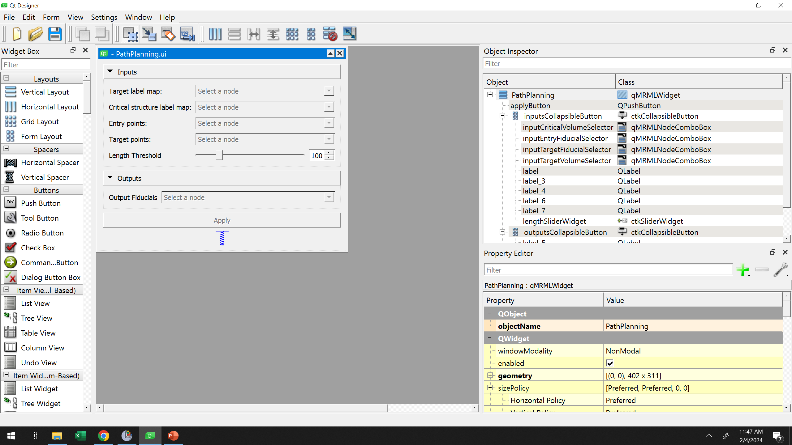
Qt User Interface – The “Easier” Way (i.e. Qt Designer)
Widget box, Object Inspector and Property Editor should already be familiar
Notes:
This are the objects we use to create new widgets, control their layout and properties like names, geometry,etc.

Slide 28
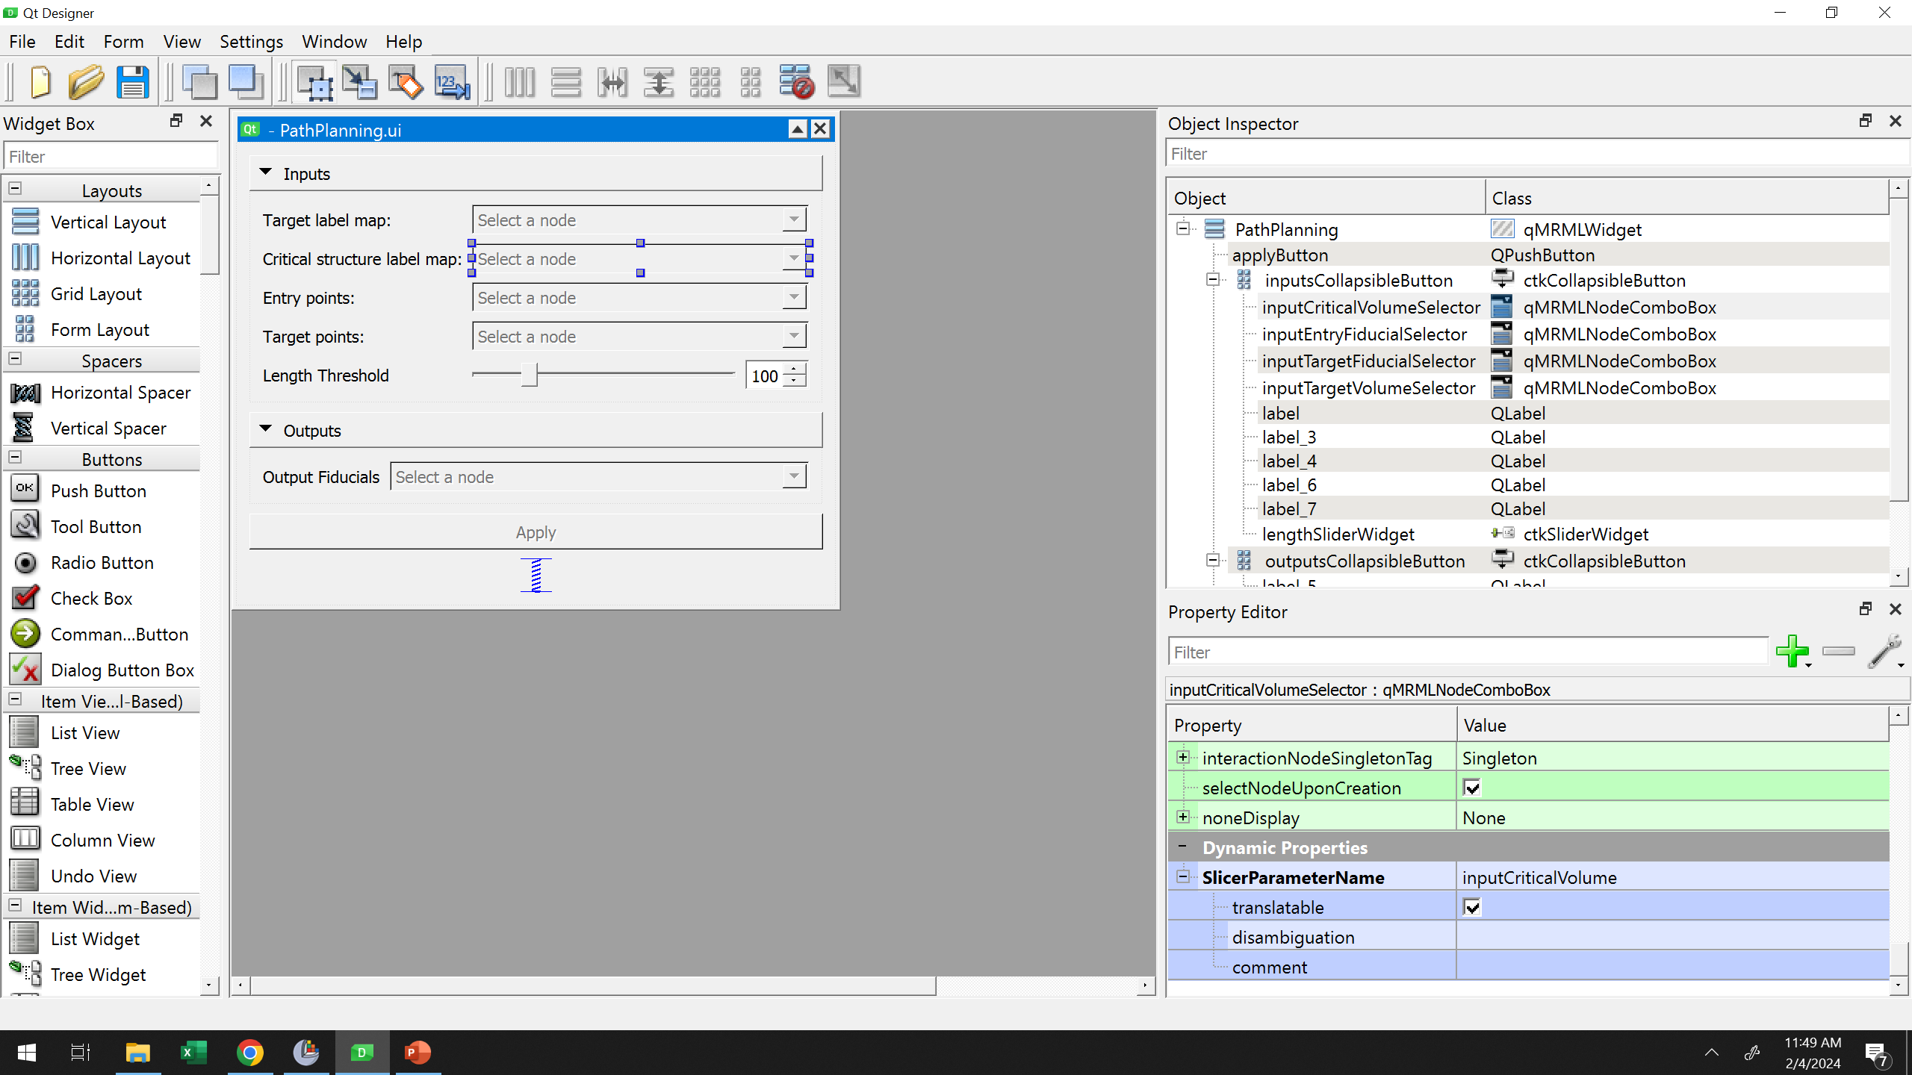
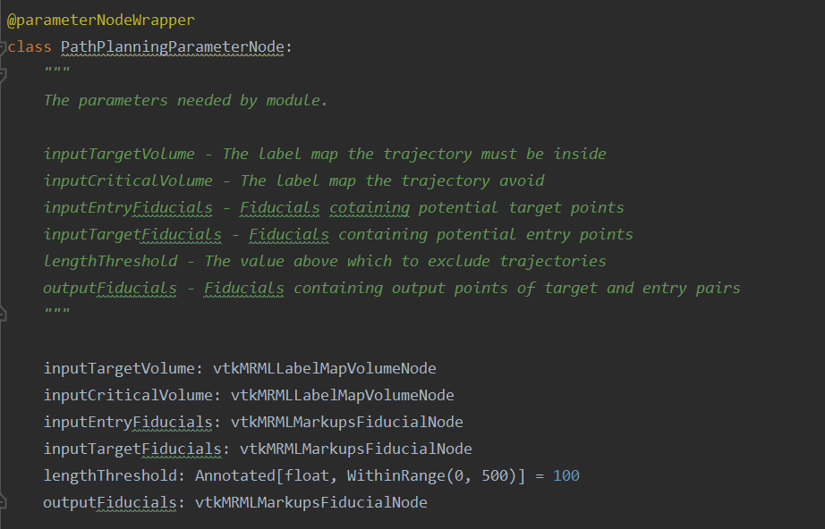
Qt User Interface – The “Easier” Way (i.e. Qt Designer)
Widget box, Object Inspector and Property Editor should already be familiar
SlicerParameterName linked to name in parameter list to associate qMRMLNodeComboBox with a parameter
Notes:
This are the objects we use to create new widgets, control their layout and properties like names, geometry, etc.

Slide 29
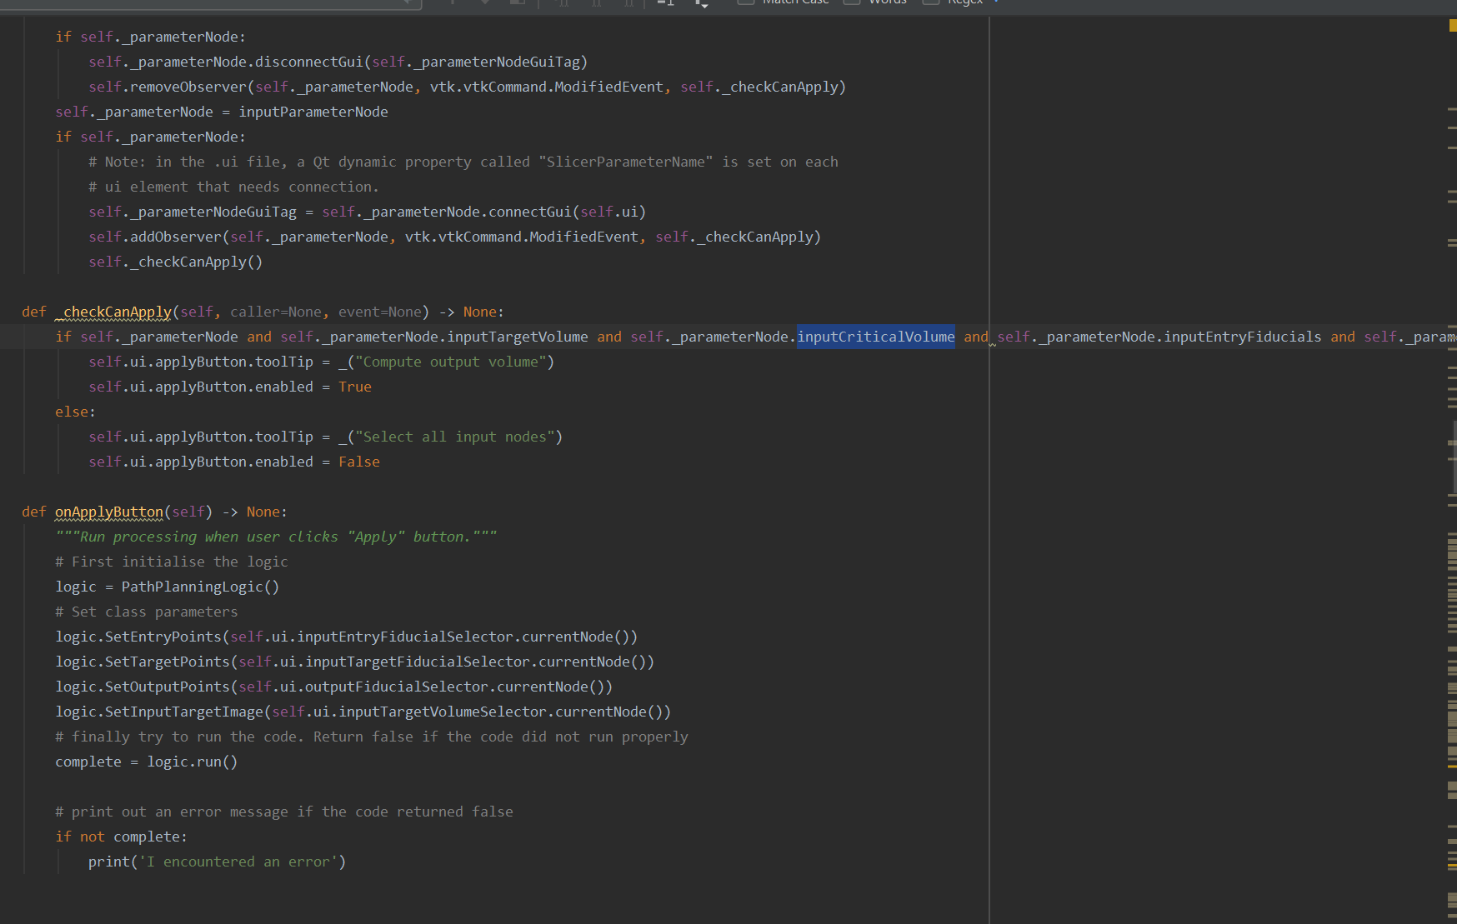
Qt User Interface – The “Easier” Way (i.e. Qt Designer)
Widget box, Object Inspector and Property Editor should already be familiar
SlicerParameterName linked to name in parameter list to associate qMRMLNodeComboBox with a parameter
Then can query self._parameterNode to reference the node in the Widget class.
Notes:
This are the objects we use to create new widgets, control their layout and properties like names, geometry, etc.

Slide 30
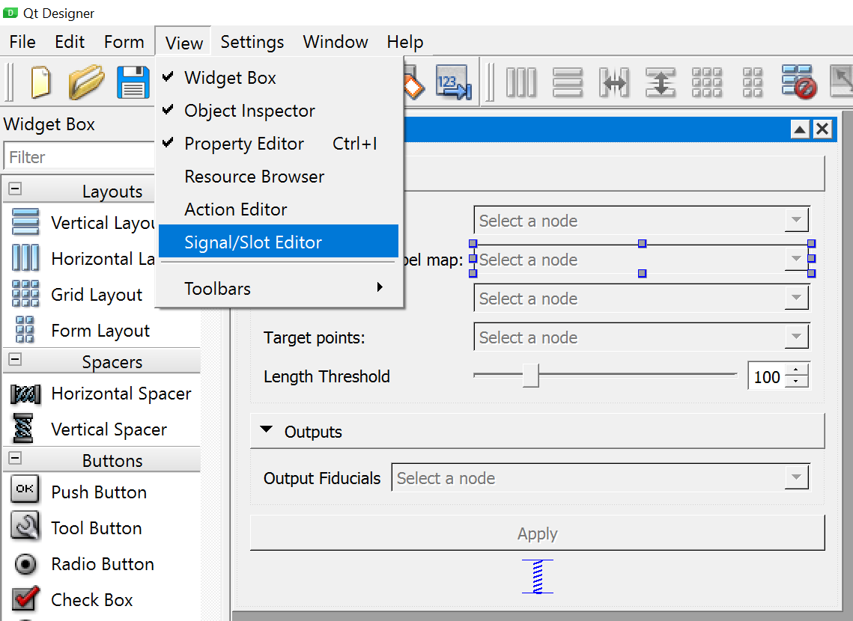
Qt User Interface – The “Easier” Way (i.e. Qt Designer)
Signals: open the Signal/Slot Editor
Notes:
This are the objects we use to create new widgets, control their layout and properties like names, geometry, etc.

Slide 31
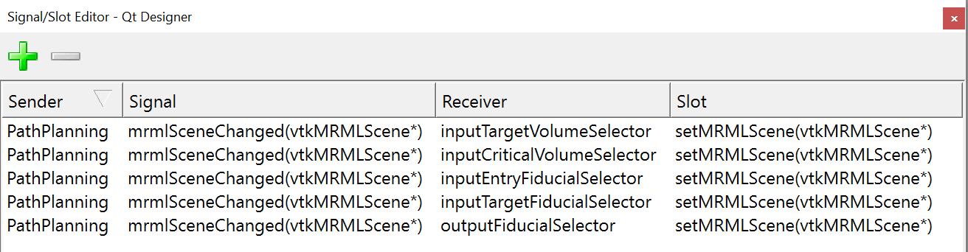
Qt User Interface – The “Easier” Way (i.e. Qt Designer)
Signals: open the Signal/Slot Editor
Can add slot with “+”, remove with “-”
Can change any object using drop down bars
Notes:
Sender -> the widget class
Signal whenever the scene is changed
Reciever: each of the dropdown nodes
Call setMRMLScene

Slide 32
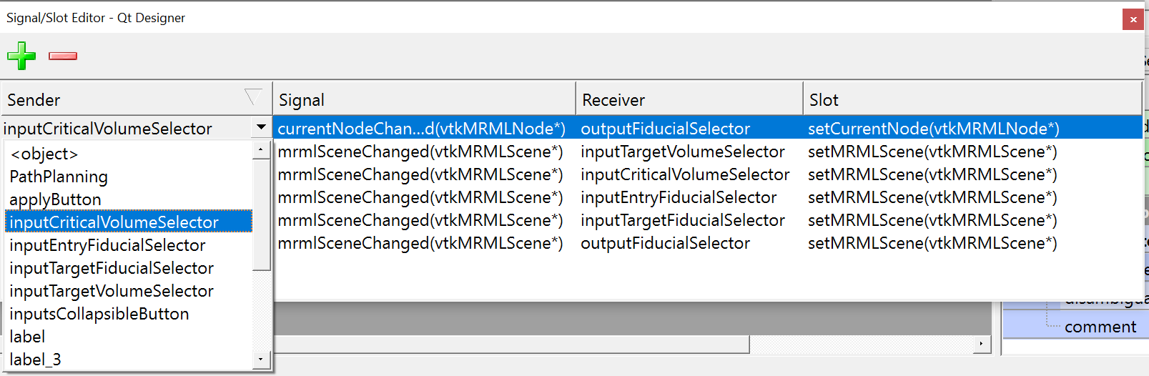
Qt User Interface – The “Easier” Way (i.e. Qt Designer)
Signals: open the Signal/Slot Editor
Can add slot with “+”, remove with “-”
Can change any object using drop down bars
Notes:
Here there is something missing?

Slide 33
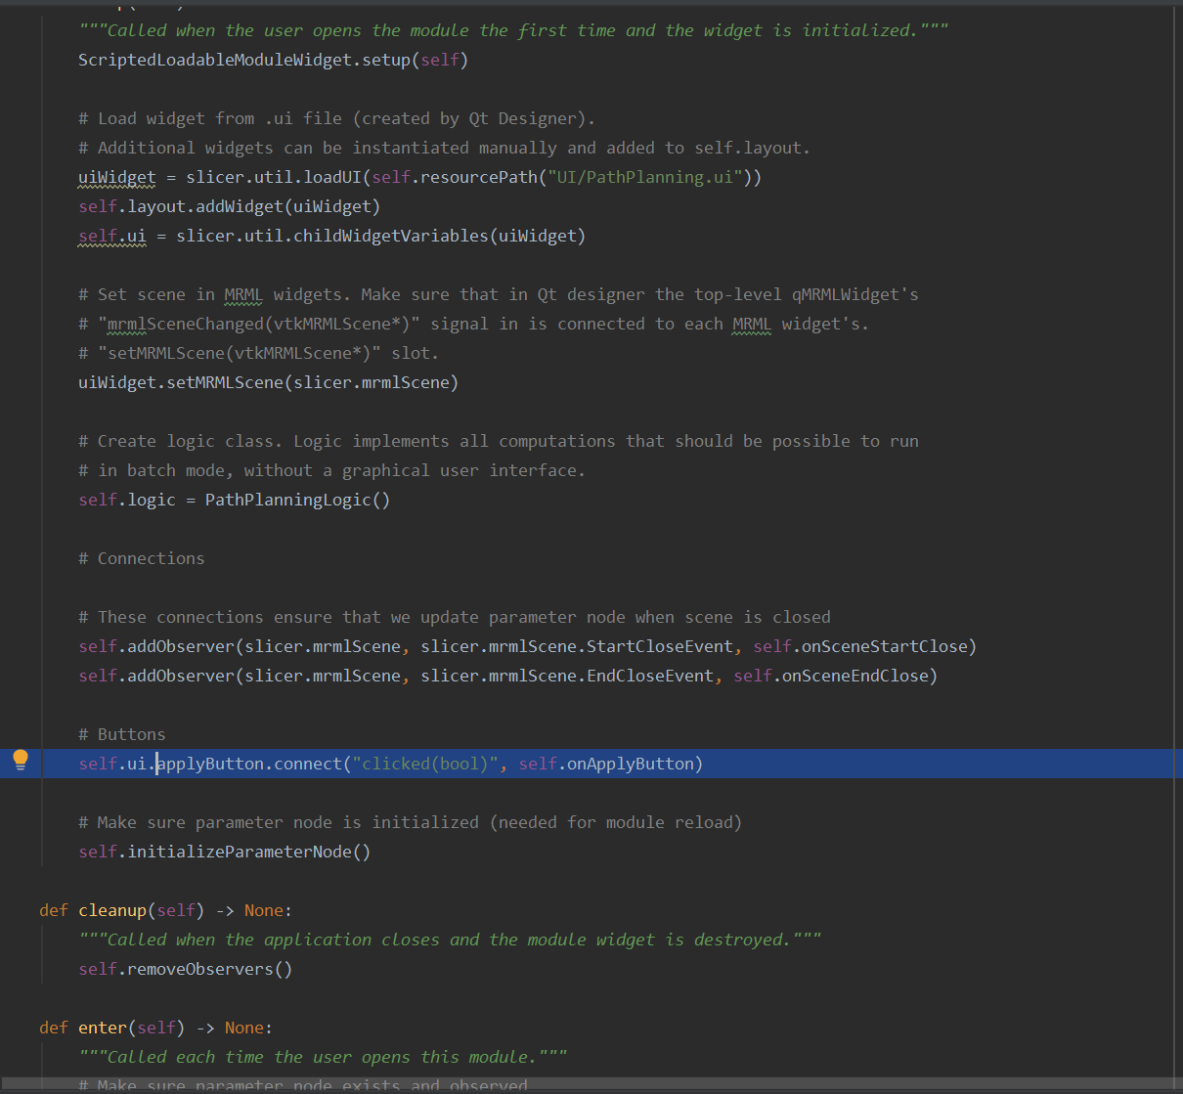
Qt User Interface – The “Easier” Way (i.e. Qt Designer)
The UI file does not know about our logic class even when using the Designer your call to your logic class/apply must be set via code
Notes:
Pause here open up the UI and .py files to describe items line by line getting students to answer questions/prompts.

Slide 34
Qt User Interface – The “Easier” Way (i.e. Qt Designer)
Three main points:
“ParameterNode” associates a Slicer Parameter Name (set in Qt Designer) with a type and a Qt qMRMLNodeComboBox. Used to manage node/parameter associations
Qt Designer Signals and Slots to update objects/functions defined entirely in the UI
Widget class to call Logic class and link signals/slots defined in the .py file

Slide 35
User Interface – Signal/Slot Interface
Qt calls this pattern Signal/Slot but there are other names
Emitter-> Listener
Transmitter->Receiver
Subject->Observer
It requires the observer/slot objects to continually query the state of the subject/signal and update accordingly
It requires direct loading of symbols (i.e. import) and recompilation of code
Has poor scaling behavior for
states with large data transmission
many subjects per observer
many observers per subject
Server -> Client model helps to deal with some of these limitations

Slide 36
Representational state transfer (REST) API
Representational state transfer (REST) API
A software architecture defining a set of constraints used for creating Web Services
Scalability
Simplicity
Modifiability
Visibility
Portability
Reliability
- able to support a large number of components
- uniform interface
- can change components will application runs
- components are knowable by all components
- able to move components with data across computers
- main function will not fail if a component does

Slide 37
Representational state transfer (REST) API
Representational state transfer (REST) API
A software architecture defining a set of constraints used for creating Web Services
Six general guidelines
Client-server framework
Statelessness
Cacheability
Layered system
Uniform interface
Code on demand (optional)

Slide 38

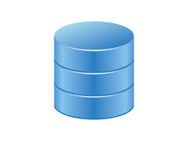

Client-Server Framework
Server provides some computational resource
Assume server is eternal – always available
Must balance requests from clients
Responds to client
Many clients can request computation resource(s)
Clients can be transient
Clients know nothing about each other
Example: Article look up on Wikipedia
Light weight queries to ensure the system is scalable
to many queries

Slide 39
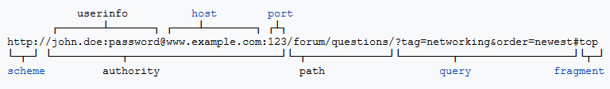
Stateless
No client contextual information is stored by the server
Each client message to server contains all necessary information to run algorithm
Each message can be treated independently
Examples
IP
HTTP

Slide 40
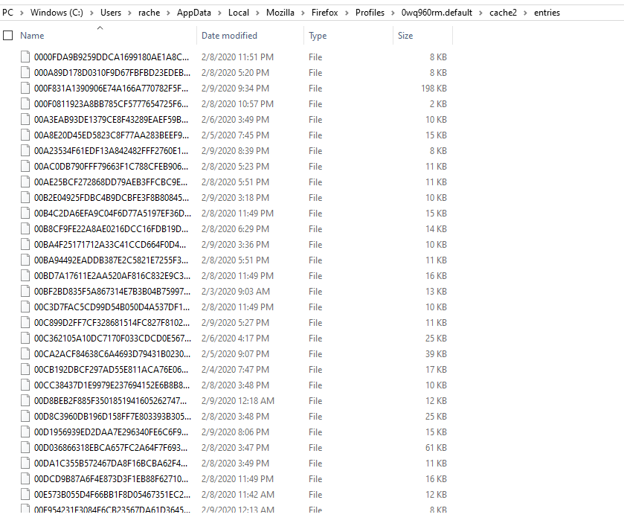
Cacheability
Enable temporary storying of information form server to increase speed and efficiency of queries
Evaluate cache correctness by
Freshness (date)
Validation (If Modified Since query)
Invalidation (PUSH, DELETE, etc)
This is why when you refresh email you
only have to download new emails

Slide 41
Layered System
Organize information flow in a hierarchical manner to reduce redundancy and limit data transfer
Client
Query
Gateway Cache
Load Balancer
Database Server
Computer
Web container
Database

Slide 42
Unified Interface
HTTP methods allow to query external webservices
HTTP GET
HTTP POST
HTTP PUT
HTTP DELETE
HTTP PATCH
Return code corresponding to error
200 Found
201 Created
404 Not Found
- Read
- Create
- Update
- Remove
- Partial Update
HTTP GET http://www.appdomain.com/users

