Slide 1
Image-guided Navigation for Robotics
Communication Protocols: Pt. 2 Non-API
Rachel Sparks, Ph.D.
Rachel.sparks@kcl.ac.uk
Lecturer in Surgical & Interventional Engineering
School of Biomedical Engineering & Imaging Sciences

Slide 2
Communication Protocols Part 1 Recap: API
A software intermediary that allows two pieces of software to communicate
Process1
Software 1
Class 1
Variable 1
Software 2
Class 2
Process2
Variable 2

Slide 3
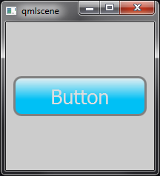
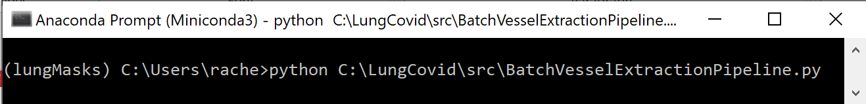
Communication Protocols Part 1 Recap: API
A software intermediary that allows two pieces of software to communicate
Comes in many different flavours
Any command line input, user interface or program you have written or called
class MyAwesomeClass:
def run(self, var1, var2):
return output
USER INTERFACE
COMMAND
FUNCTION

Slide 4
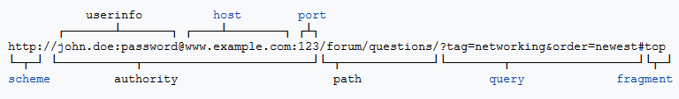
Communication Protocols Part 1 Recap: Rest API
Client queries a server
Each client message to server contains all necessary information to run algorithm
Each message treated independently

Slide 5
Publish-Subscribe Pattern
Publisher writes messages
Subscribers read messages
FIFO (First In – First Out)
Asynchronous – which is great because publisher will continue to write to file even when subscriber is still acting on an earlier message
Lossy format
No error checking to ensure all messages arrive
All messages may not be relevant
Very low computational overhead
Allows multiple publishers and subscribers
Publisher
M5
M4
M3
M2
M1
Subscriber
Notes:
Asynchronous means write and read may take unequal times.

Slide 6
Publish-Subscribe Pattern
Topics allow publisher to assign messages by type
Content filters allow subscribers to determine what messages to read
Publisher
M5
M4
M3
M2
M1
Subscriber
Notes:
Asynchronous means write and read may take unequal times.

Slide 7
API Summary
What | Coupling | Scalable | Lossy
Function | Tight | No | No
Signal/Slot | Loose | No | No
REST API | Loose | Yes | Depends
Publish/Subscriber | Loose | Yes | Yes

Slide 8
API Summary
Covered a lot about how to design (architecture) of communication between applications
Not a lot about how to communicate that information
What | Coupling | Scalable | Lossy
Function | Tight | No | No
Signal/Slot | Loose | No | No
REST API | Loose | Yes | Depends
Publish/Subscriber | Loose | Yes | Yes

Slide 9
Communication Protocols
Covered a lot about how to design (architecture) of communication between applications
Not a lot about how to communicate that information
What | Coupling | Scalable | Lossy
Function | Tight | No | No
Signal/Slot | Loose | No | No
REST API | Loose | Yes | Depends
Publish/Subscriber | Loose | Yes | Yes
Written in programming language
Compile translates to machine language
Physically manipulate memory on computer

Slide 10
Communication Protocols
Covered a lot about how to design (architecture) of communication between applications
Not a lot about how to communicate that information
What | Coupling | Scalable | Lossy
Function | Tight | No | No
Signal/Slot | Loose | No | No
REST API | Loose | Yes | Depends
Publish/Subscriber | Loose | Yes | Yes
May not be on the same computer
May not even be on the same operating system
Need another method to transfer information

Slide 11
Communication Protocols
Covered a lot about how to design (architecture) of communication between applications
Not a lot about how to communicate that information
What | Coupling | Scalable | Lossy
Function | Tight | No | No
Signal/Slot | Loose | No | No
REST API | Loose | Yes | Depends
Publish/Subscriber | Loose | Yes | Yes
May not be on the same computer
May not even be on the same operating system
Need another method to transfer information

Slide 12
ROS API
ROS combines a REST API (Server-Client) and Publisher-Subscriber
Ensures loose coupling between modules and highly scalable system
What | Coupling | Scalable | Lossy
Function | Tight | No | No
Signal/Slot | Loose | No | No
REST API | Loose | Yes | Depends
Publish/Subscriber | Loose | Yes | Yes

Slide 13
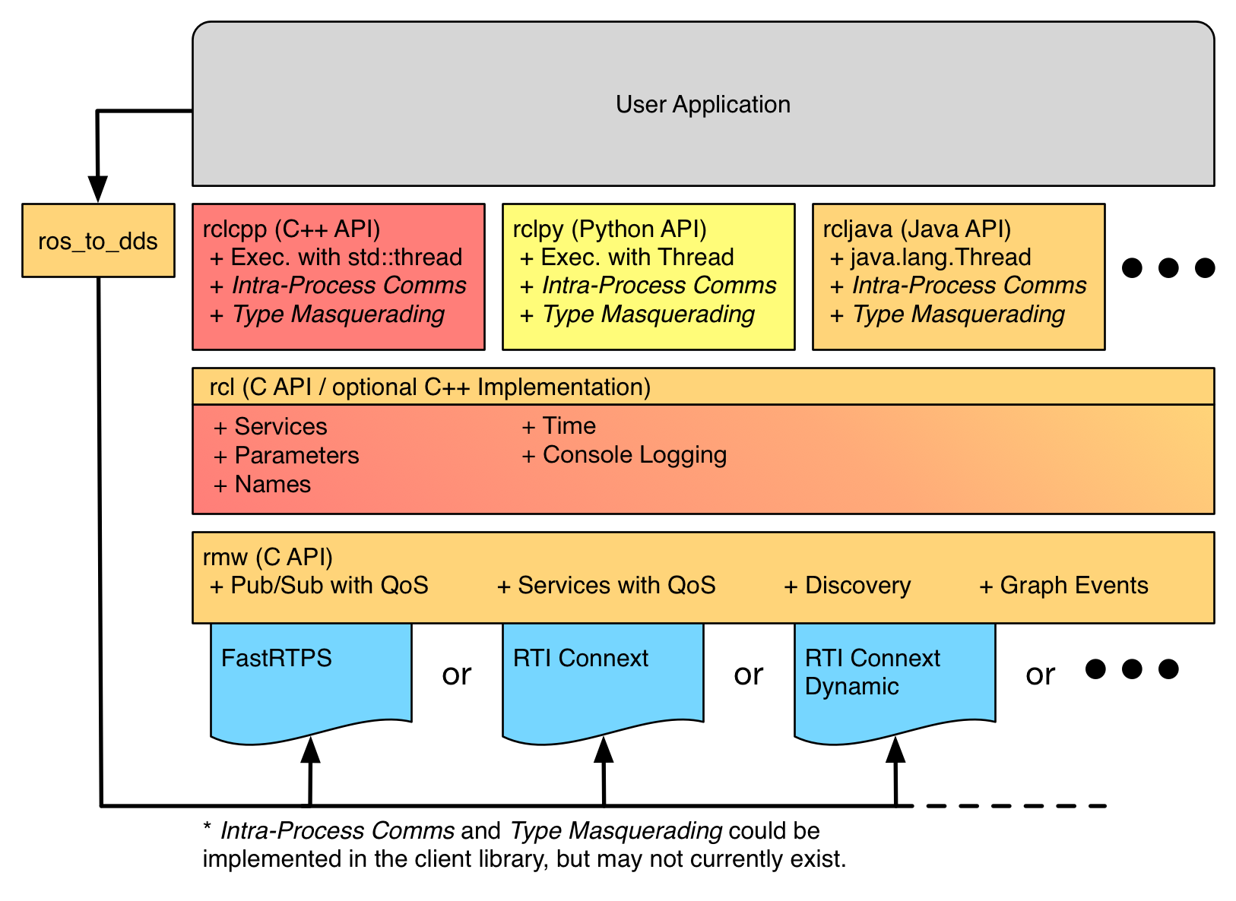
ROS2 API
All ROSw programs are built on top of ros_core:
A build system (colcon)
Client library interface (rcl)
How we find services
Manages names and parameters
Logging
ROS middleware interface (rmw)
Packages to manage specific interfaces with other middleware systems (ros_to_dds)

Slide 14
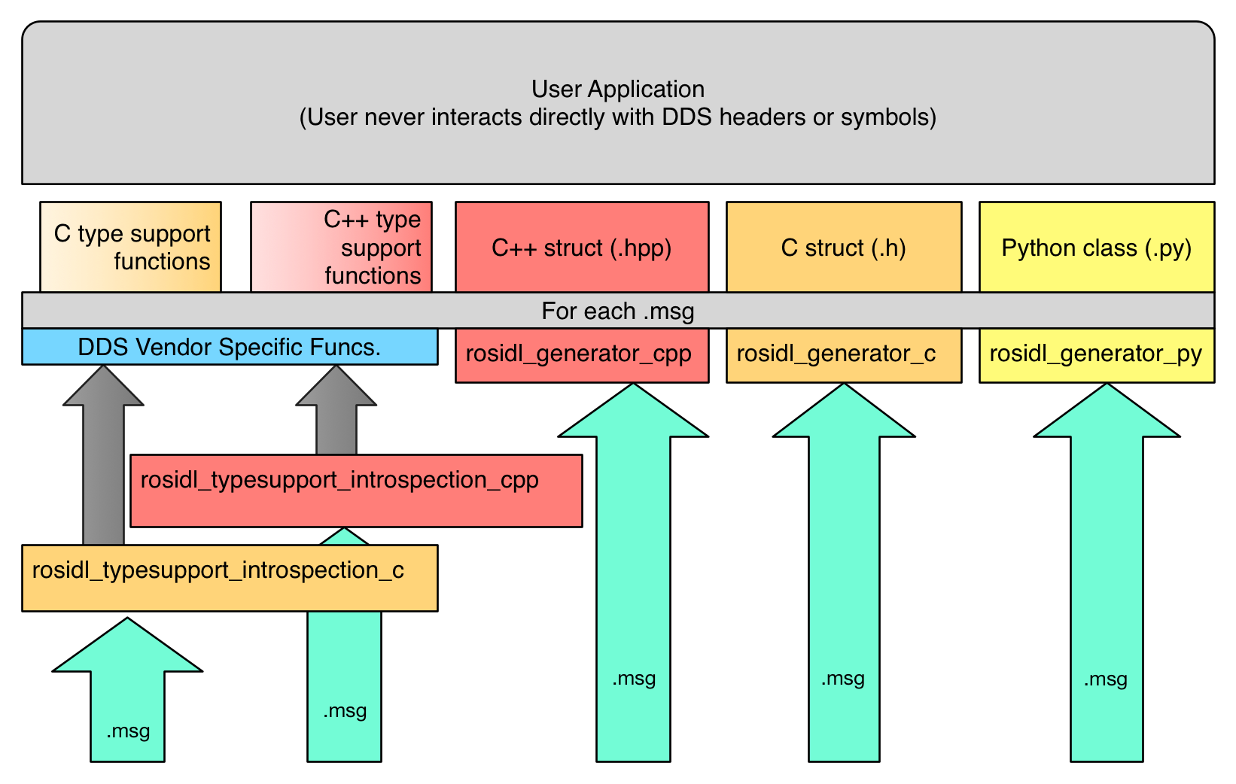
ROS2 API
All ROSw programs are built on top of ros_core
Regardless of which packages we are using messages (.msg) are generated and passed between processes to control behavior
Enables flexibility in terms of which packages and processes are running.
Messages supported in python, c and c++
as well as vendor specific APIs

Slide 15
ROS2 Build Tools
ROS is organized into workspaces that define a set of packages to be loaded and cross referenced with each other.
At any one time the base ROS2 workspace and one additional workspace may be loaded
The additional workspace is overlaid
Each package is identified by a unique name; overlaid workspaces are preferred when duplicates exist
In your workspace you can create as many packages as you like switching between workspaces enables rapid testing of different implementations.
Note Colcon has replaced ament and catkin but you will still see references to these other build tools as well

Slide 16
ROS2 Build Tools
How to create a workspace can be found here.
How to create a package can be found here.
These are the two fundamental steps to master to begin programming in ROS2.

Slide 17
ROS2 Message Handling
Message passing in ROS2 has two fundamental types
Publisher/subscriber:
Publishers send messages out at a fix rate on a topic.
Subscribers receive any message on the topic with the correct type.
This enables a many-to-many lossy coupling
Publishers and subscribers can be started in any order
Service/client
Clients send a request for data
Services process the request and send back a response
This enables a one-to-one lossless coupling
Services must be started before the client to appropriately receive the data
In the upcoming weeks we will talk more about message implementation

Slide 18
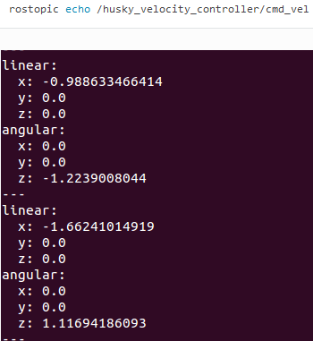
ROS2 Messages
Need to use the API to determine exact format
Bool, char, string, int, float, double, etc
Combined into some simple combo
Each value has a corresponding unique field name to identify it uniquely
Specification can be found in a .msg file
msg.linear.x=4*double(rand())/double(RAND_MAX)-2
msg.angular.z=6*double(rand())/double(RAND_MAX)-3
pub.publish(msg)

Slide 19
Communication Protocols
Covered a lot about how to design (architecture) of communication between applications
Not a lot about how to communicate that information
What | Coupling | Scalable | Lossy
Function | Tight | No | No
Signal/Slot | Loose | No | No
REST API | Loose | Yes | Depends
Publish/Subscriber | Loose | Yes | Yes
Data transfer lossyness depends on communication protocol
Server-client information in robots should be lossless for safety reasons

Slide 20
Transmission Control Protocol (TCP)
TCP guarantees a lossless transmission of all necessary data
Ensures security and correctness of transfer
Server recognizes the client as being a valid client
Server can receive the message from the client
Client recognizes the server
Client can receive the messages from the server
To reduce potential of losing the entire message it is broken up into packets
After packet transmission missing packets are tested for
Server will query client to resend missing packets

Slide 21
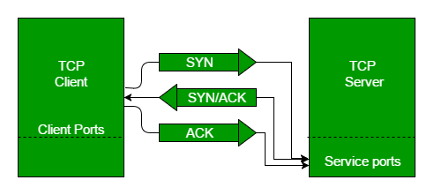
Transmission Control Protocol (TCP) – 3 way handshake
A handshake is used to establish a reliable communication port between client and server
The open channel will remain open for the entirety of the transmission
SYN: query server and provide sequence number (so server knows what packets to send where)
SYN/ACK: Server acknowledges receipt of message and relays its sequence number (so client know what packets to listen to)
ACK: Client acknowledges receipt of message

Slide 22



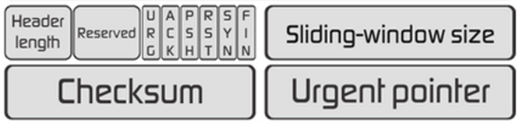


Transmission Control Protocol (TCP) – Data Packet
Once channel is open all data packets are transmitted along it
Checksum allows us to verify all data is present in packet
Acknowledgement messages passed back to client
Client should track packets without acknowledgements
Those without acknowledgement get resent
Timeouts and loss packets can result in an
inability to receive messages on low quality
networks
Increases lag time as entire message must
be transmitter prior to server processing

Slide 23
ROS2 TCP/IP
Implicitly when we start ROS2 we have an IP address
ROS_DOMAIN_ID defines this (read here for advice on setting this)
This parameter can allow you to pass messages between computers and/or robots. Nodes with different will ROS_DOMAIN_ID not send and receive messages
Can also send and receive information over a TCP with the right software.
In imaging/medicine OpenIGTLink is this system
ROS2 has an external package ROS2_IGTLink_Bridge supporting this
Network parameters (port, IP address) are treated as package parameters assigned to a node when created.
Notes:
Youtube video explaining this here: https://www.youtube.com/watch?v=qSjNQC2AT_4

Slide 24
Summary
In this lecture we talked about lossy data transfer methods including:
REST API
Publisher/Subscriber
ROs2 uses these data transfer methods and:
We discussed the inbuilt tools for these in ROS2
Where in ROS2 to find message and TCP specific parameters and nodes
Highlighted some useful packages for transfer information

