Slide 1
Image-Guided Navigation for Robotics
Feedback Control in ROS2
Rachel Sparks, Ph.D.
Rachel.sparks@kcl.ac.uk
Lecturer in Surgical & Interventional Engineering
School of Biomedical Engineering & Imaging Sciences

Slide 2
ROS Robot Controllers
Currently in ROS we are assuming
Perfect control over individual joints – we can specify an angle of a joint precisely
Perfect knowledge on the state of the robot – we know the precise configuration of all joints
This allows us to focus on the path planning and trajectory implementation without considering
How to translate desired state to robot position
Noisy measurements
Incomplete measurements
Feedback control
In this lecture we are going to focus on how to alter elements of our simulation to take these factors into account

Slide 3
Joint State Controller
Publishes the specific configuration of all joints in a robot
The joint may have some hard limits in terms of the range of positions it is allowed to take
Hard collisions between other objects can be taken into account (as in MoveIt!)
Can also link joints by creating dependent_joints using the mimic tag
<link name="arm2">
<visual>
<geometry>
<cylinder length="5" radius="0.75"/>
</geometry>
<origin rpy="0 0 0" xyz="0 0 2.5"/>
</visual>
<collision>
<geometry>
<cylinder length="5" radius="1"/>
</geometry>
</collision>
</link>
<joint name="arm1_to_arm2"
type="continuous">
<origin rpy="0 0 0" xyz="0 0 10"/>
<axis xyz="0 1 0" />
<parent link ="arm1"/>
<child link="arm2"/>
<limit effort="30" velocity="1.0"
lower="-0.75" upper = "0.75"/>
</joint>

Slide 4
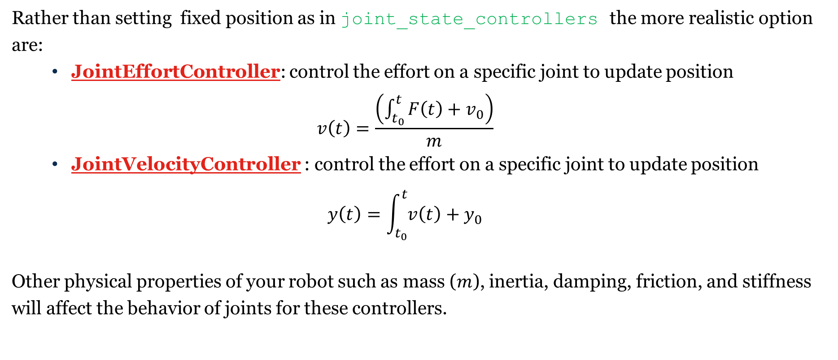
Proper Joint Controllers
Rather than setting fixed position as in joint_state_controllers the more realistic option are:
JointEffortController: control the effort on a specific joint to update position
$$v\left(t\right)=\frac{\left(\int_{t_{0}}^{t}{F\left(t\right)+v_{0}}\right)}{m}$$
JointVelocityController : control the effort on a specific joint to update position
$$y\left(t\right)=\int_{t_{0}}^{t}{v\left(t\right)}+y_{0}$$
Other physical properties of your robot such as mass ($m$), inertia, damping, friction, and stiffness will affect the behavior of joints for these controllers.

Slide 5
Adding Physical Constraints – Link information
Update the physical properties of a link to account for
Mass (kg)
Moment of Inertia (must be symmetric)
Note these cannot apply to your base link
These are only taken into account for effort controllers
<link name="arm2">
<visual>
<geometry>
<cylinder length="5"
radius="0.75"/>
</geometry>
<origin rpy="0 0 0" xyz="0 0 2.5"/>
</visual>
<collision>
<geometry>
<cylinder length="5" radius="1"/>
</geometry>
</collision>
<inertial>
<mass value="10"/>
<inertia ixx="0.4" ixy="0.0" ixz="0.0"
iyy="0.4" iyz="0.0" izz="0.2"/>
</inertial>
</link>

Slide 6
Adding Physical Constraints – Joint information
Update the physical properties of a joint to account for
Damping (Newton*meter)
Friction (Newton*meter/second)
These are taken into account for velocity and effort controllers
<joint name="arm1_to_arm2" type="continuous">
<origin rpy="1.57 1.57 0" xyz="0 0 10"/>
<axis xyz="0 1 0" />
<parent link ="arm1"/>
<child link="arm2"/>
<dynamics damping="1" friction="2"/>
</joint>

Slide 7
Adding Physical Constraints – Limits
Set hard limits that enforce maxima (and minimum for position)
Velocity ( <velocity)
Effort (<effort)
Position ( >lower, <upper)
<joint name="arm1_to_arm2" type="continuous">
<origin rpy="1.57 1.57 0" xyz="0 0 10"/>
<axis xyz="0 1 0" />
<parent link ="arm1"/>
<child link="arm2"/>
<dynamics damping="1" friction="2"/>
<limit effort="30" velocity="1.0"
lower="-0.75" upper = "0.75"/>
</joint>

Slide 8
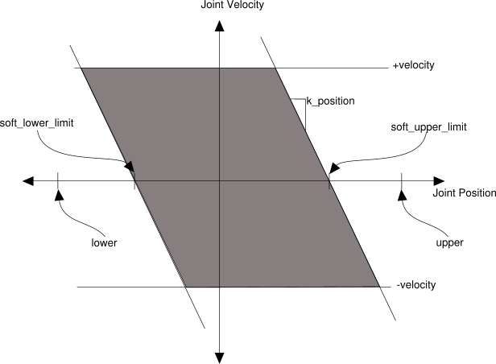
Adding Physical Constraints – Soft Limits
Set hard limits that enforce maxima (and minimum for position)
Velocity ( <velocity)
Effort (<effort)
Position ( >lower, <upper)
Soft limits: limits that can be overcome by “more force”
< sort_upper_limit+
k_position*velocity

Slide 9
Adding Physical Constraints – Soft Limits
Set hard limits that enforce maxima (and minimum for position)
Velocity ( <velocity)
Effort (<effort)
Position ( >lower, <upper)
Soft limits: limits that can be overcome by “more force”
< sort_upper_limit+
k_position*velocity
Soft limits must be less than hard limits
<joint name="arm1_to_arm2" type="continuous">
<origin rpy="1.57 1.57 0" xyz="0 0 10"/>
<axis xyz="0 1 0" />
<parent link ="arm1"/>
<child link="arm2"/>
<dynamics damping="1" friction="2"/>
<limit effort="30" velocity="1.0"
lower="-0.75" upper = "0.75"/>
<safety_controller
soft_lower_limit ="-0.5"
soft_upper_limit ="0.5"
k_position="1" k_velocity="1"/>
</joint>

Slide 10
Conversion between controllers
ros2_control collection of general controllers
can be used to instantiate position, velocity, and effort controllers.
contains forward and differential drive controllers
Implements PID and other feedback controllers
Use a publisher to monitor position, velocity, and effort concurrently for a given joint or robot
For that specific joint it should be easy to monitor how these three parameters interact
You can only go “up” the tree :i.e effort->velocity->position not position ->velocity->effort
effort_controllers/joint_position_controller: is given a joint_position computes the effort necessary to achieve that position.
effort_controllers/joint_velocity_controller: is given a joint_velocity computes the effort necessary to achieve that position.

Slide 11
TurtleSim Example – Proportional Control
while self.euclidean_distance(goal_pose) > distance_tolerance:
# Linear velocity in the x-axis.
vel_msg.linear.x = K_d * self.linear_diff(goal_pose)
# Angular velocity in the z-axis.
vel_msg.angular.z = K_d * self.angular_diff(goal_pose)
# Publishing our vel_msg
self.velocity_publisher.publish(vel_msg)
# Publish at the desired rate.
self.rate.sleep()
# Stopping our robot after the movement is over.
vel_msg.linear.x = 0
vel_msg.angular.z = 0
self.velocity_publisher.publish(vel_msg)
Git example: https://gitlab.com/rsparks/7mri0070/-/tree/master/ROSWeek8Lecture

Slide 12
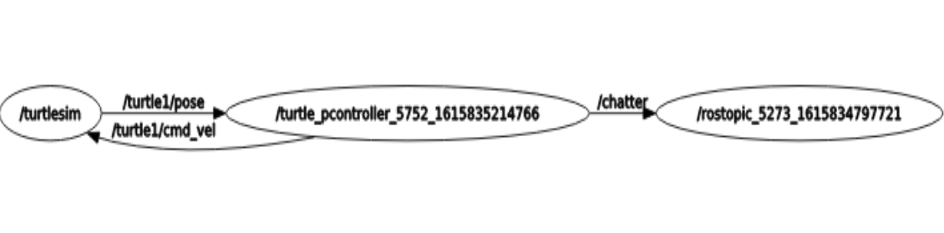
TurtleSim Example – Proportional Control

Slide 13
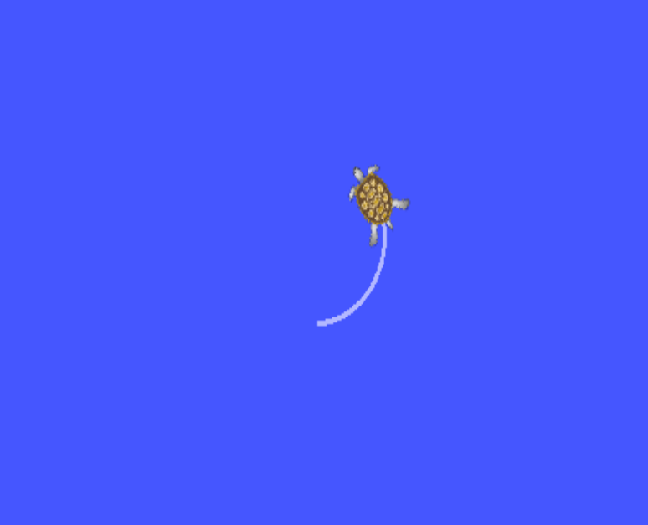
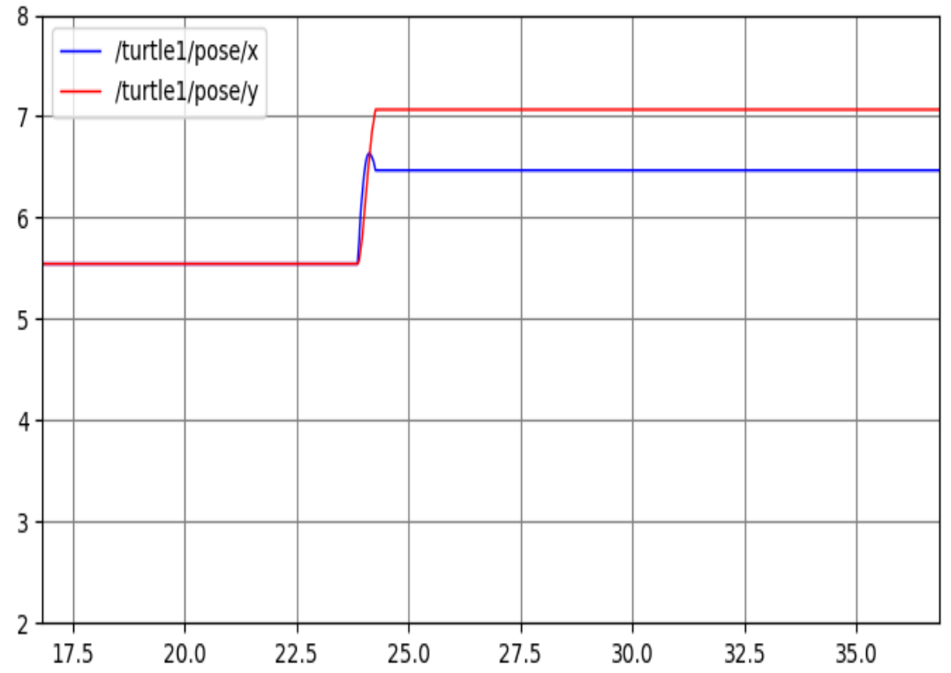

TurtleSim Example – Proportional Control
$K_{d}$= 5 goal pose = (6, 7)

Slide 14
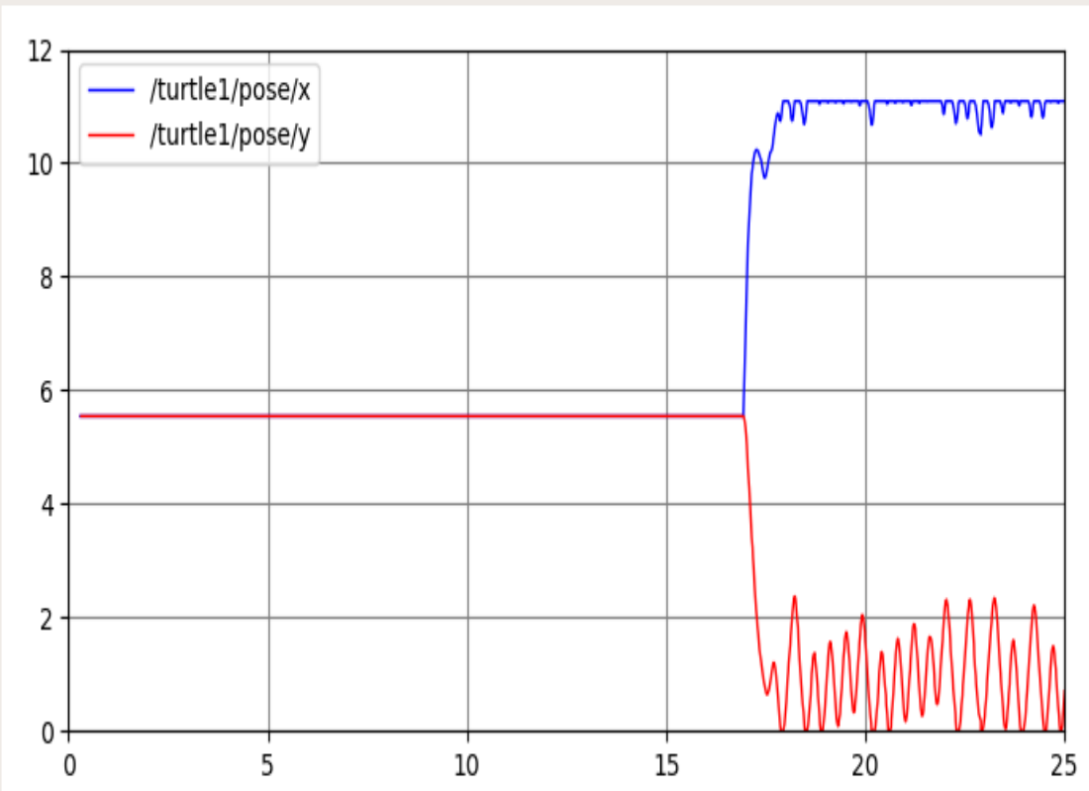


TurtleSim Example – Proportional Control 2
$K_{d}$= 5 goal pose = (9, 1)

Slide 15
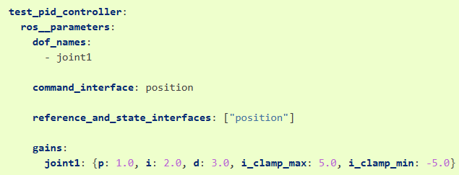
Feedback Control
PID controller package: provides general purpose and generalized PID controller
Define which joints are involved dof_names
Define the reference_and_state_interfaces (“position” and/or “velocity”)
Define command_interface (“position” or “velocity”)

Slide 16
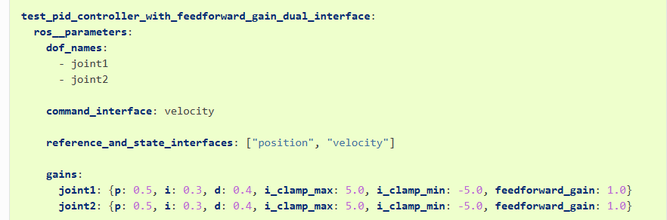
Feedback Control
PID controller package: provides general purpose and generalized PID controller
Define which joints are involved dof_names
Define the reference_and_state_interfaces (“position” and/or “velocity”)
Define command_interface (“position” or “velocity”)

Slide 17
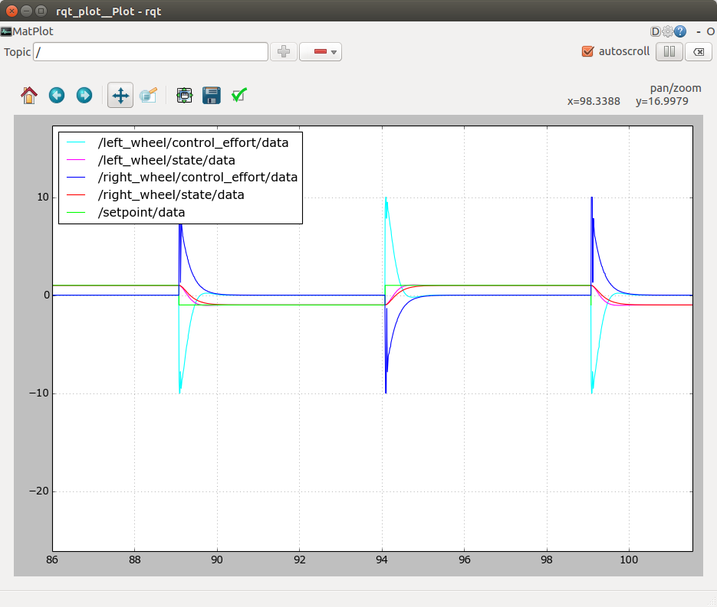
Plotting Feedback Control
Controller introspection publishes controller values to the topic~/introspection_data/full
Rqt_plot can be used to plot data
rqt_plot ~/introspection_data/full

Slide 18
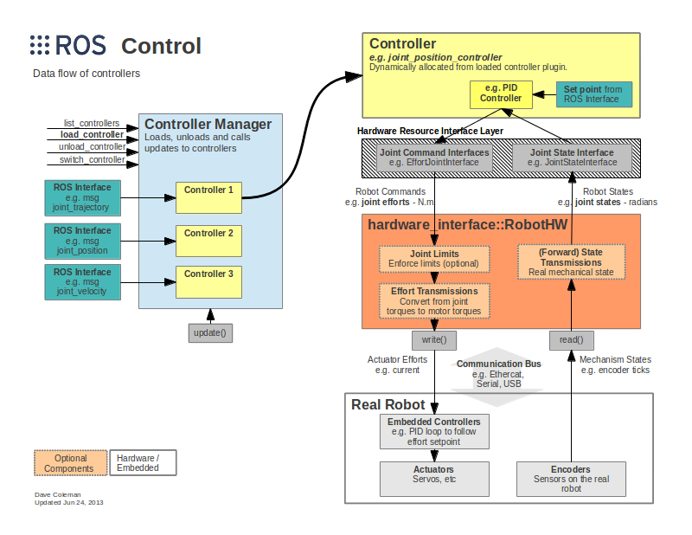
ROS – General Feedback Control
Ros_control is the general purpose controller framework
Integrates controllers, joint states and joint commands (limits & effort transmissions)

Slide 19
ROS – General Feedback Control
MoveIt 2 and specifically MoveItControllerManager
Takes as input a list of controllers for a robot
Passes controller properties to MoveIt 2
Turns controllers on/off as the kinematics solution solve indicates

Slide 20
MoveIt2 Planning Package
In this and next week tutorial we will be using MoveIt2 for motion planning of our robots
This is a powerful tool that
Using KDLKinematicsPlugin to perform robotic kinematics (only for serial robots!) or IKFast for inverse kinematics
Open Motion Planning Library which are a collection of sampling-based motion planning algorithms
All wrapped into a Robot Commander so at a high level you can move the robot to a specific pose, along a given path (given as way points), or perform a specific action.
Note this makes use of several other libraries and packages in ROS2 – as with most open-source code use what is already available to save your time.
Notes:
Kinematics: https://ros-planning.github.io/moveit_tutorials/doc/kinematics_configuration/kinematics_configuration_tutorial.html?highlight=kdl
IKFast: https://ros-planning.github.io/moveit_tutorials/doc/ikfast/ikfast_tutorial.html
OMPL: https://ros-planning.github.io/moveit_tutorials/doc/ompl_interface/ompl_interface_tutorial.html#ompl-settings

