Slide 1
Image-guide Navigation for Robotics
Version Control & Git
Rachel Sparks, Ph.D.
Rachel.sparks@kcl.ac.uk
Lecturer in Surgical & Interventional Engineering
School of Biomedical Engineering & Imaging Sciences

Slide 2
Why use Version Control
At its most basic
Allows tracking of changes in files
git diff to compare individual “branches” or individual files
git log to see commits over time
Allows storage of files in one remote place
git clone <url> to clone from source url to local file
git pull to retrieve changes on server
git push to put changes onto server

Slide 3
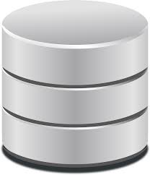

Code Repository
Version control gives users ways to access a repository (code located on a server)
Each user can git pull changes from the server
Each user can make changes to their own copy
Each user can git push changes back onto the server
Server
Dev A
Dev C
Dev B

Slide 4
Code Repository
Track desired changes with git commit
Associate the file changes with a commit
Message to describe the changes – nice to provide quick summary of changes
Each commit represented as a node
Nodes are sequential
Can have many parallel nodes – typically referred to as branches
A series of commits keeps a sense of “history”
git log to read the history of commits for a file or code database
Check for local file changes using git diff

Slide 5
Code Repository
Distributed code development model gives rise to certain issues
Dev A and Dev B could make different changes to the same file – which changes should we keep
Dev C may need to update their code base to use changes from Dev B
Server
Dev A
Dev C
Out of date!
Conflict!
Dev B

Slide 6
Version Control – Branch
git pull will query the changes to the server and then try to combine your local change with the remove changes
To integrate changes across branches with git merge
Will check changes between branches using history
If there are conflicts the user is responsible for resolving them
Easy way to “undo” changes
Roll back changes git revert HEAD~2
Undo local changes git stash (git stash pop to reapply local changes)

Slide 7
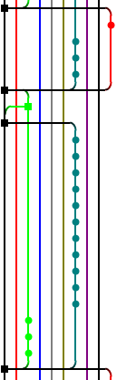
Version Control – Master
git merge has the potential to break things
Git only considers items conflicts it the same line has been altered by the same person
If two people fix a bug in two different ways git will apply both changes
To deal with this most projects have a “master branch”
Branch with the most up to date working version of the software
Often times continuous integration (CI) used to only allow people to merge to master if their code passes unit tests
Dev 1
Long Running Feature Branches
Dev 2
Master

Slide 8
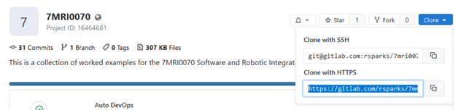
Git Workflow
git clone https://gitlab.com/rsparks/7mri0070.git ./src
git checkout –b myAwesomeBranch to create a new branch
Work on your branch as long as you want, using git commit to make local log files
git status and git revert to check local changes and undo any changes you would not like
git push to publish your log files to the server once tested

Slide 9
Git Workflow
git clone https://gitlab.com/rsparks/7mri0070.git ./src
git checkout –b myAwesomeBranch to create a new branch
Work on your branch as long as you want, using git commit to make local log files
git push will publish your log files to the server
When you are done with your branch and are ready to merge
git pull to update everything from the server
git merge myAwesomeBranch master to merge to master branch
If there are conflicts you will need to resolve them before finishing your merge
Remember git push to publish your merge to the server

Slide 10
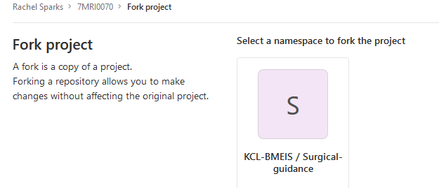
Why Fork?
If you try to push to rsparks/ 7mri0070 you are going to get an error because you are not a developer
Many project control who is allowed to publish commits to their code
While we could copy and paste that is bad form (similar to plagiarising, as you are hiding other contributions)
Fork can let you copy the project and history to make changes while keeping clear contributions of the original authors.

Slide 11
Other Git Resources
Git choose your own adventure: http://sethrobertson.github.io/GitFixUm/fixup.html
Git Documentation: https://git-scm.com/docs/gittutorial

Slide 12
Git Cheat Sheet
To retrieve data from repository
git clone: checkout out code from repository
git fetch: check repository for changes
git checkout: –b <branch> check out specific branch from repository
git pull: update local branch from repository
To check history
git status: check what local files differ from last commit to you branch; check commits differ from repository
git log: check history of all commits
To push data to repository
git push: push data to repository. This will fail if your local repository is not up to date
git merge: merge two branches
git push --dry-run to see what would happen if you pushed to repository

