Slide 1
Our Game

Slide 2
Project Overview
A simple yet fun Game
Casual Gaming
Premise to tie Mini games Together
Mini Games:
Life Source Game
Clicky Game
Barricade Game

Slide 3
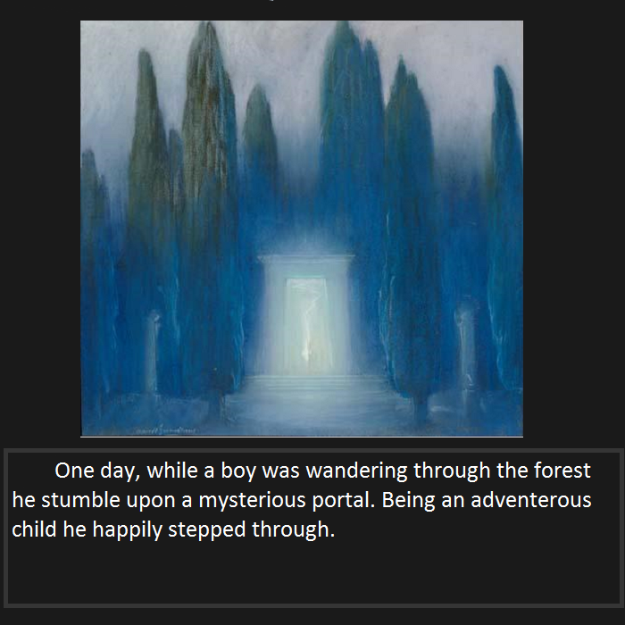

Slide 4
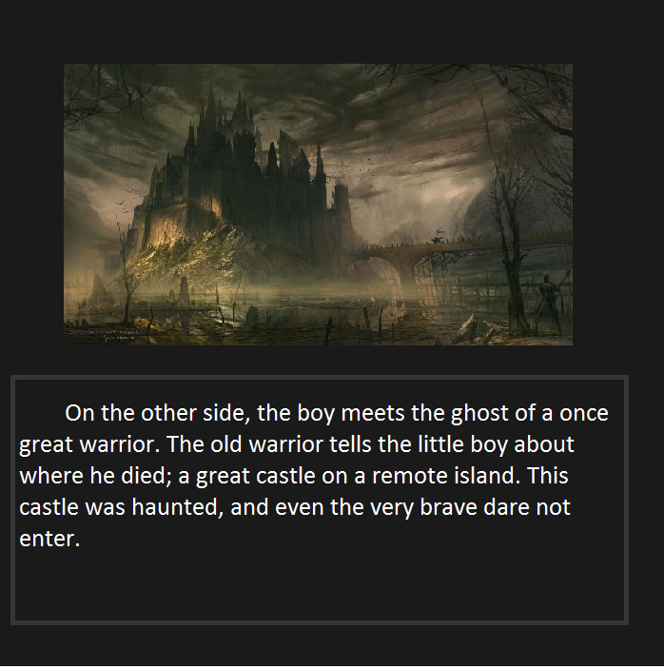

Slide 5
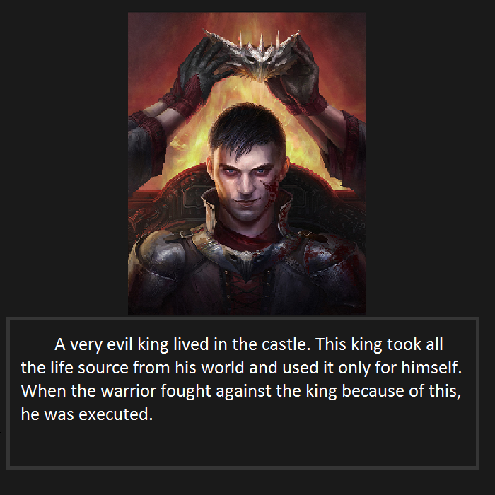

Slide 6
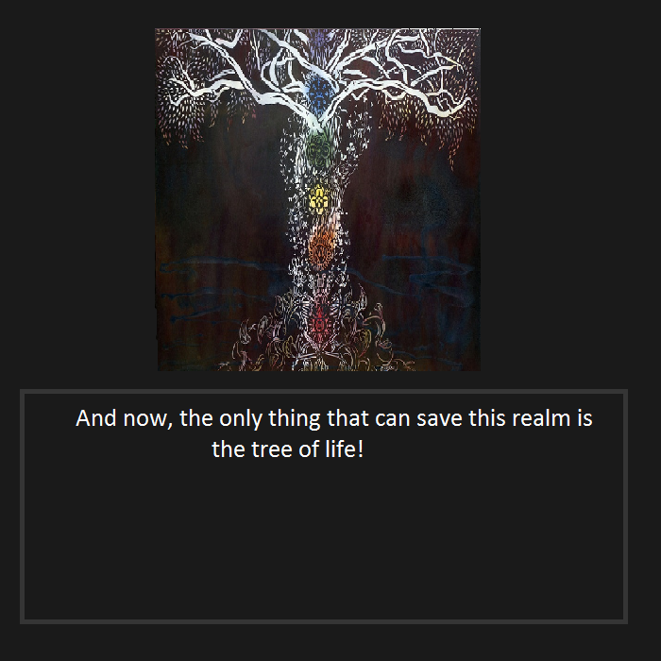

Slide 7
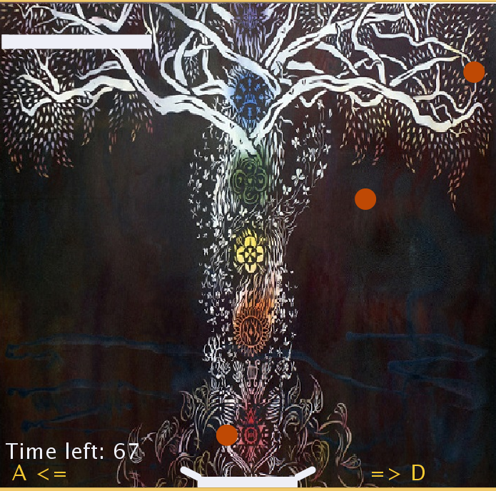
Life source Game

Slide 8
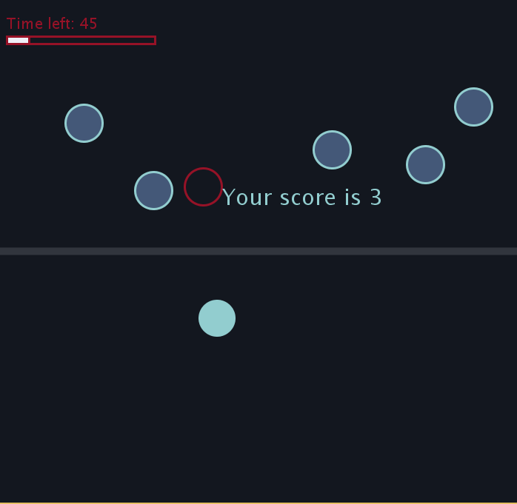
Clicky Game

Slide 9
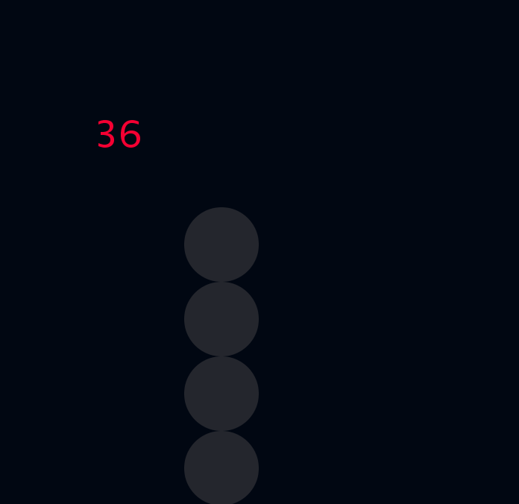
Barricade game

Slide 10
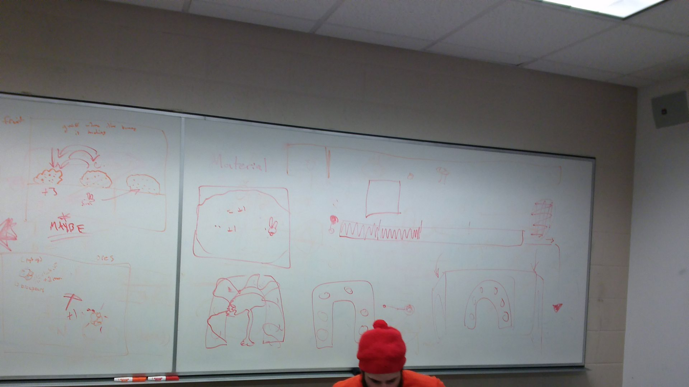
Design Approach: 1st Step

Slide 11
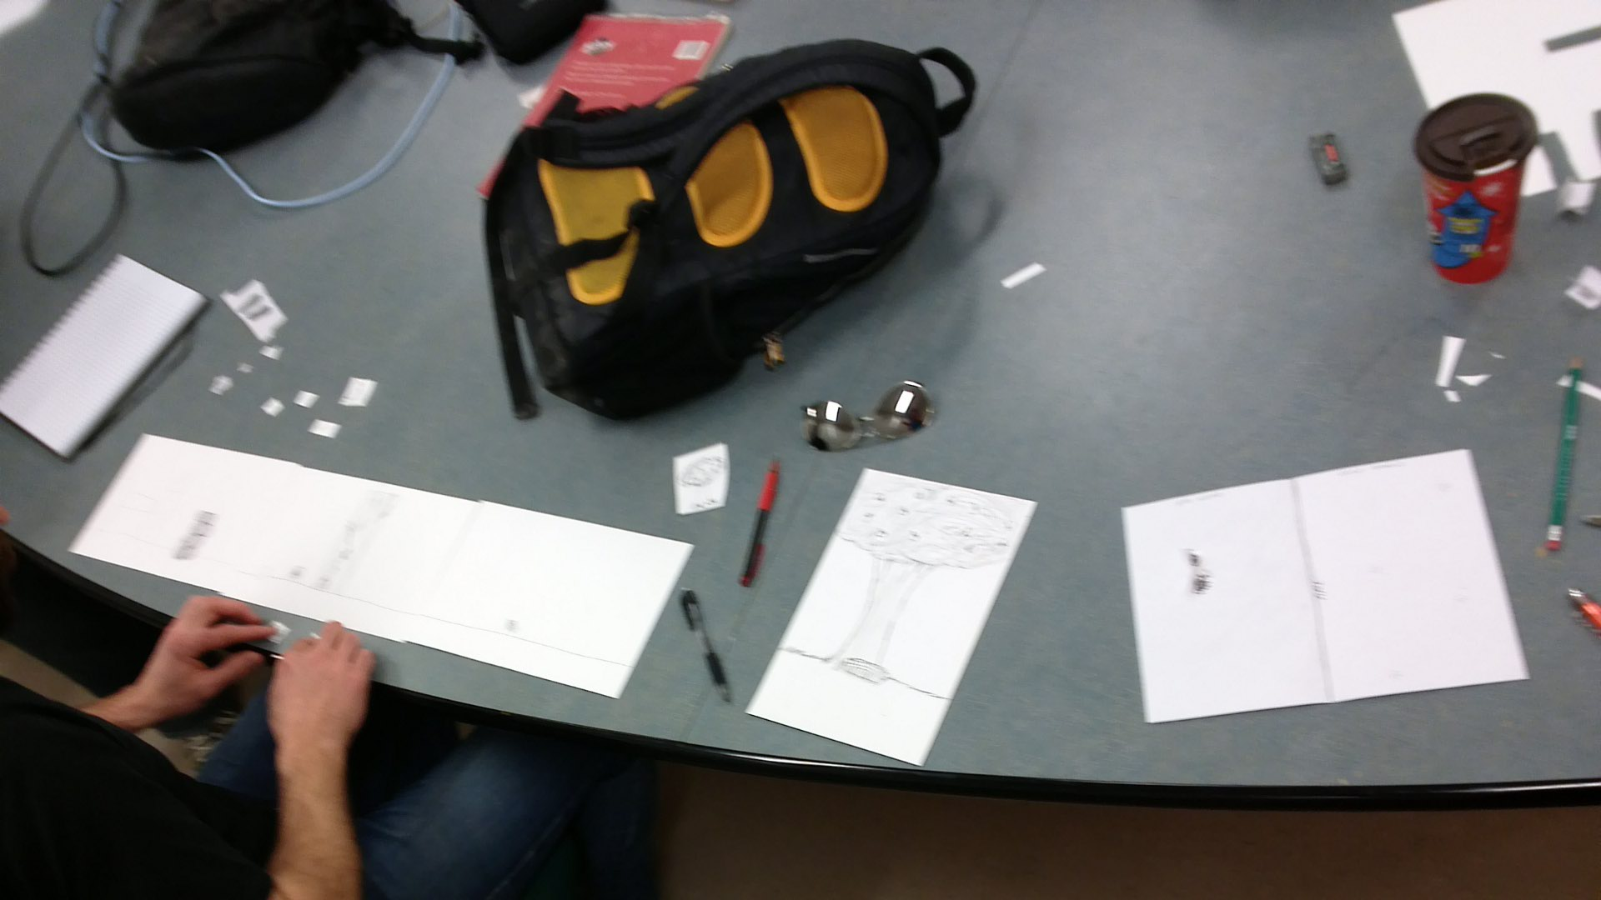
Design Approach: 2nd Step

Slide 12
DEMO
Startup
Life Source Game
Clicky Game
Barricade Game

Slide 13
Process of Testing Digital Prototype
Friends
Family
ClassMates

Slide 14
Result
One Main Observation: Hard to understand
Secondary: Very easy Games

Slide 15
Recommendations
Add more Instructions
Add more elements of games to the mini games

Slide 16
Thank you

