Slide 1
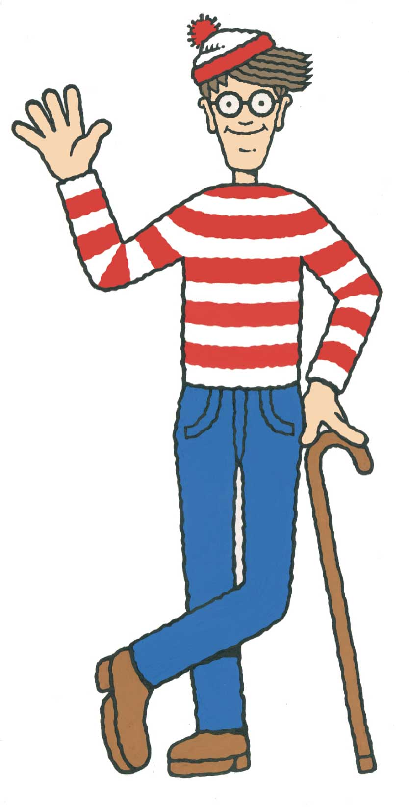
Where’s waldo? Genetic Algorithm and Multiple Sequence Alignment
2015/12/07

Slide 2
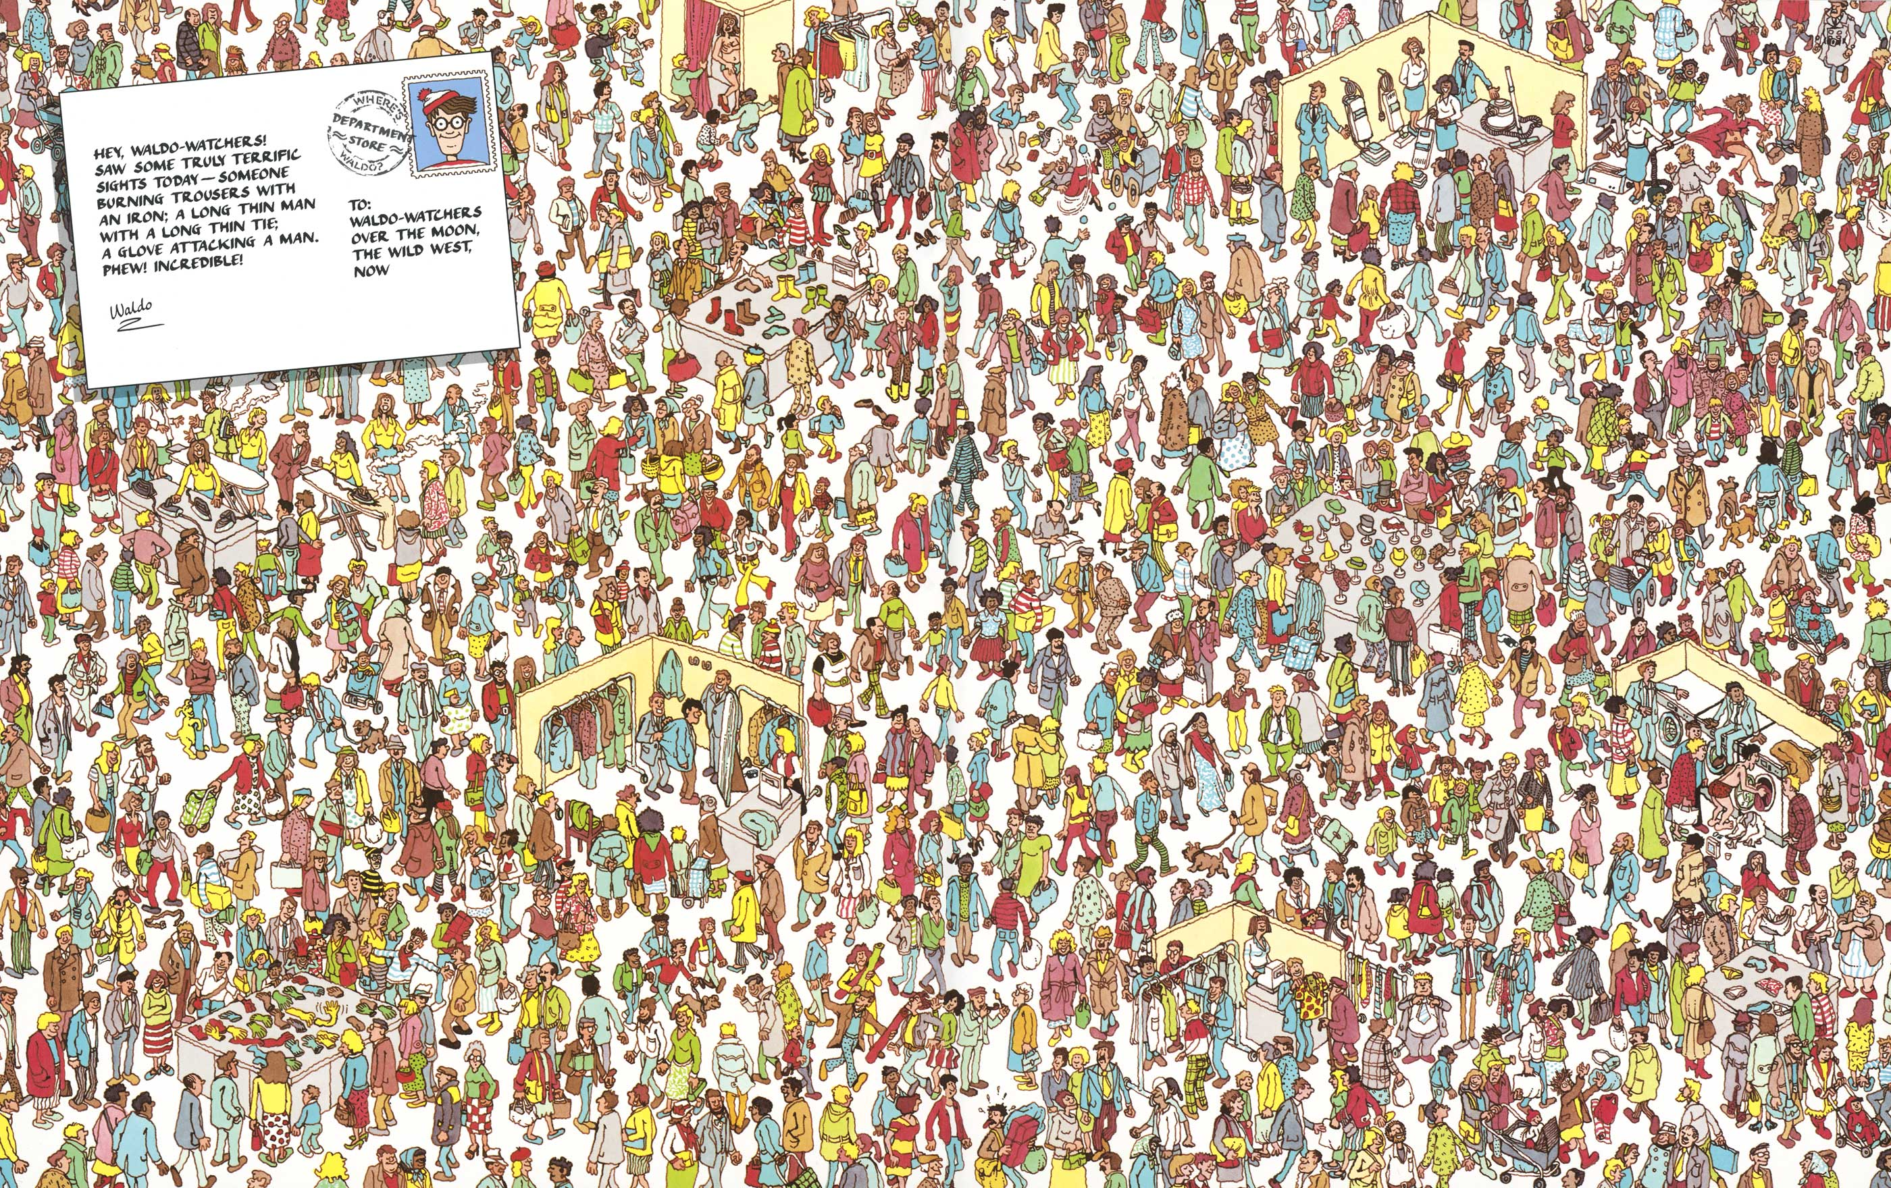

Slide 3
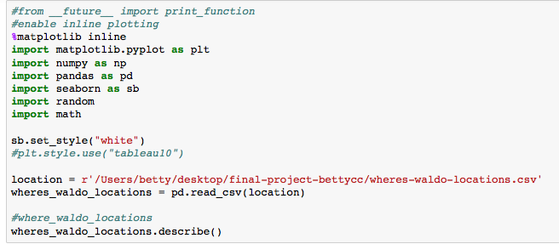
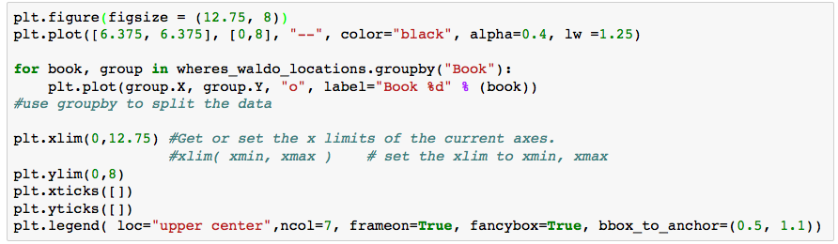
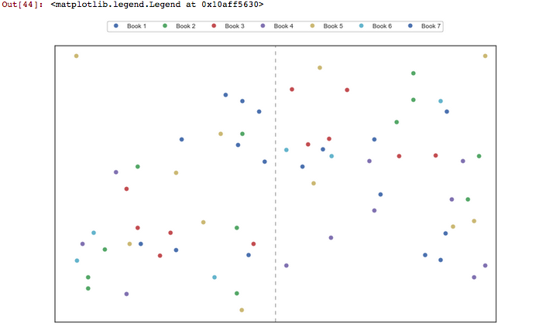
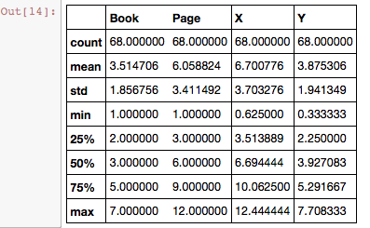
Where’s Waldo? Traveler Sales Problem & Genetic Algorithm
What’s ‘‘Where’s Waldo’’?

Slide 4
Where’s Waldo? Traveler Sales Problem & Genetic Algorithm
Traveler Sales Problem
-Given a list of cities and the distances between each pair of cities, what is the shortest possible route that visits each city exactly once and returns to the origin city?
-NP-hard Question
-Optimization!!
-Application:
DNA sequencing
City = DNA fragment
Shortest distance = score between DNA fragments
We need to check every possible location that Waldo could be at while taking as little time as possible.
We’re making a list of all 68 points that Waldo could be at, then sorting them based on the order that we’re going to visit them. So now we just need to try every possible arrangement of the points and find the one with the shortest distance traveled.
68 points →~2.48 x 10⁹⁶ possible ways
Optimal search path for finding Waldo
Optimize Algorithm!!

Slide 5
Where’s Waldo? Traveler Sales Problem & Genetic Algorithm
Genetic Algorithm
-Natural Selection
Only the individuals that have the best fitness to the environment can survive
-Great optimized search algorithm
gene/agent genome
Individual/agent
population
generation
Initialization
Randomize the population
Genetic Algorithm- How does it works?
1.Initialization – Create an initialize population
2.Evaluation – Use Fitness to calculate the individuals of a population.
Fitness is a function, the value of it shows how well it fits with
our desired requirement.
F(x) = value
3.Selection-To constantly improving our populations overall fitness.
Discarding the bad individuals(offspring/parents) and only kept the best individuals
4.Crossover-To create new individuals(offspring)
By combining certain traits or from 2 or more individuals (parents) may create
an even fitter offspring which will enhance the best traits from each of it’s parents
5.Mutation-to avoid local optimum
6.Repeat
Evaluation –
Selection-
Generation-
Survival Selection
calculate the fitness value
Mutation
Recombination/Cross-over

Slide 6
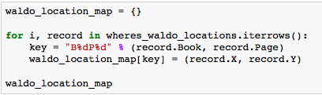

Where’s Waldo? Traveler Sales Problem & Genetic Algorithm
gene/agent genome
Individual/agent
population
generation
B1P1
B1P3
………..
B7P24
B1P1, B1P3,….
B5P1, B1P3,….
B5P1, B1P3,….
B5P1, B1P3,….
B5P1, B1P3,….
B5P1, B1P3,….
B5P1, B1P3,….
Pick the ones with highest fitness

Slide 7
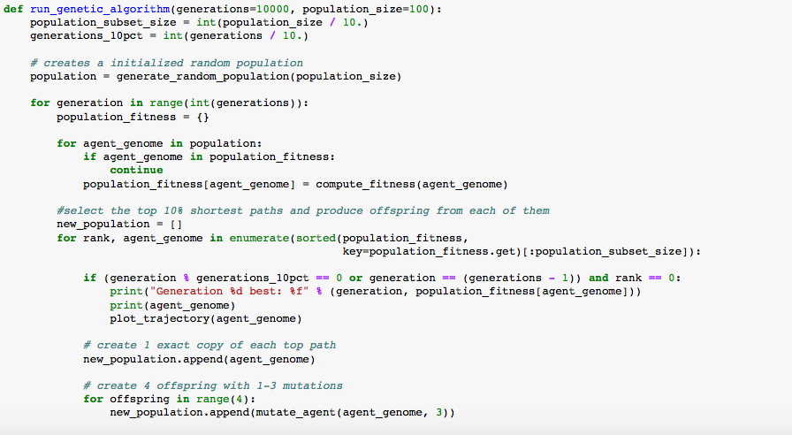
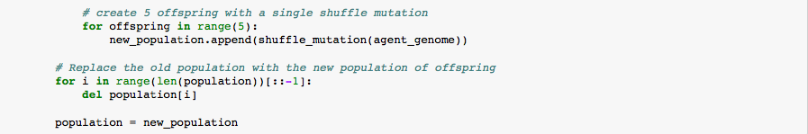
Where’s Waldo? Traveler Sales Problem & Genetic Algorithm
Initialization
Randomize the population
Evaluation –
Selection-
Generation-
Survival Selection
calculate the fitness value
Mutation
Recombination/Cross-over

Slide 8
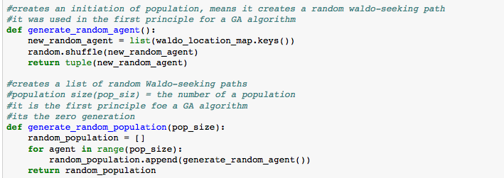
B1P1
B1P3
………..
B7P24
gene/agent genome
Individual/agent
population
B1P1, B1P3,….
B5P1, B1P3,….
B5P1, B1P3,….
B5P1, B1P3,….

Slide 9
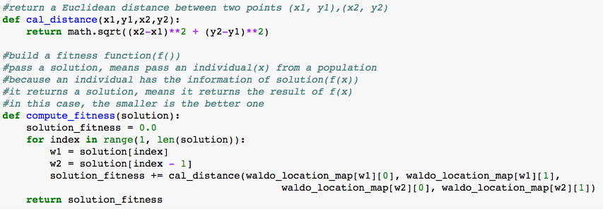
Where’s Waldo? Traveler Sales Problem & Genetic Algorithm
Initialization
Randomize the population
Evaluation –
Selection-
Generation-
Survival Selection
calculate the fitness value
Mutation
Recombination/Cross-over

Slide 10
Where’s Waldo? Traveler Sales Problem & Genetic Algorithm
Initialization
Randomize the population
Evaluation –
Selection-
Generation-
Survival Selection
calculate the fitness value
Mutation
Recombination/Cross-over

Slide 11
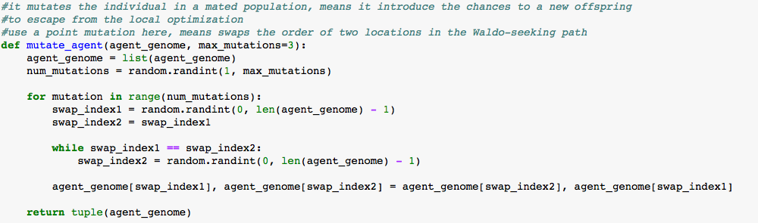
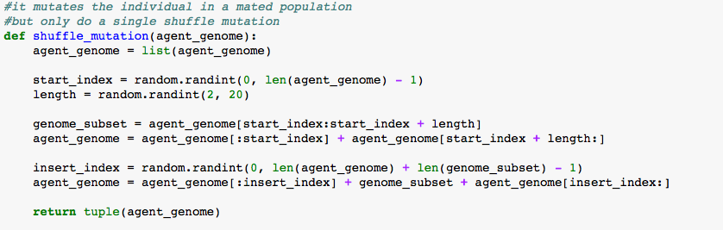
Where’s Waldo? Traveler Sales Problem & Genetic Algorithm
Initialization
Randomize the population
Evaluation –
Selection-
Generation-
Survival Selection
calculate the fitness value
Mutation
Recombination/Cross-over

Slide 12
Where’s Waldo? Traveler Sales Problem & Genetic Algorithm
Initialization
Randomize the population
Evaluation –
Selection-
Generation-
Survival Selection
calculate the fitness value
Mutation
Recombination/Cross-over

Slide 13
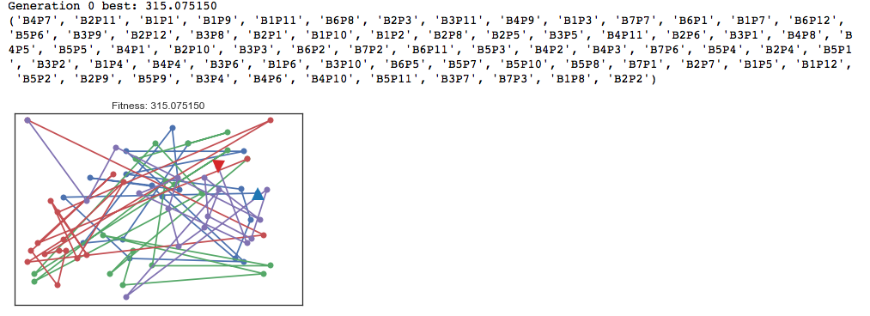
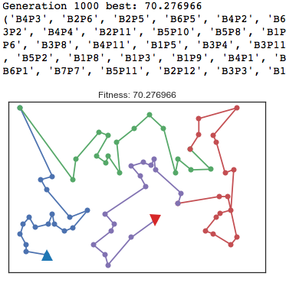
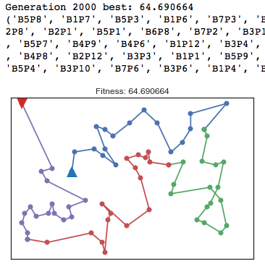
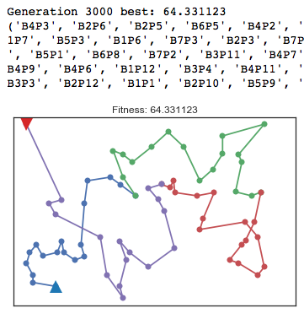
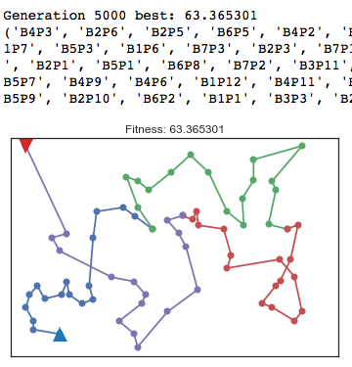
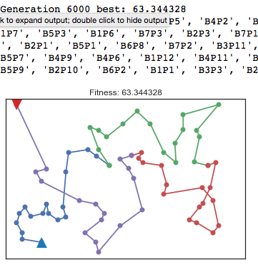
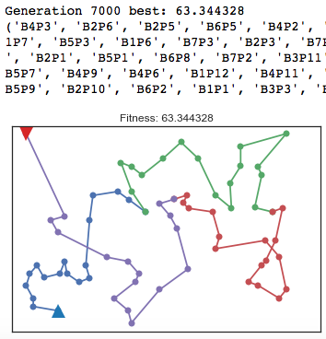
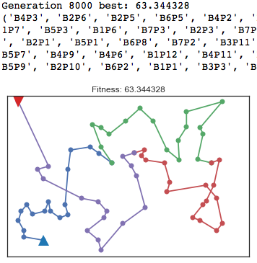
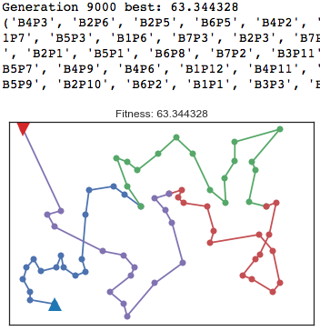
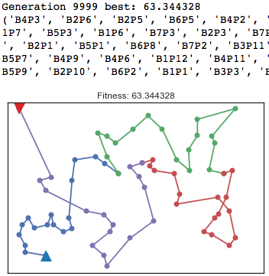
Results

Slide 14
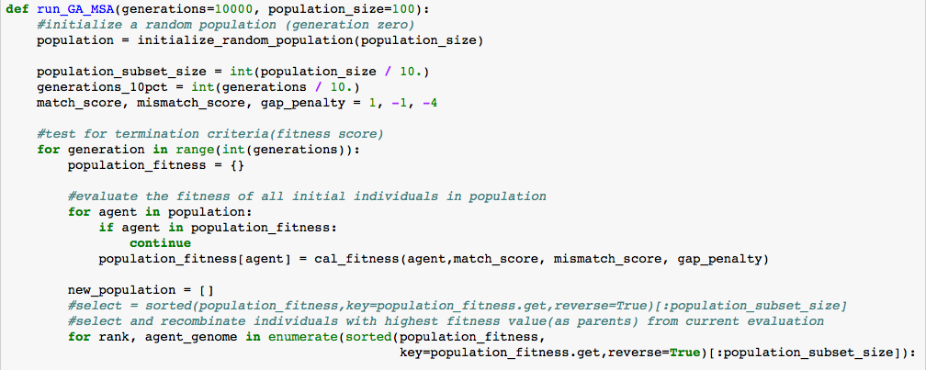
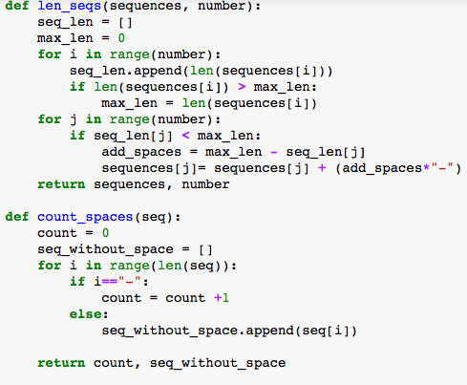
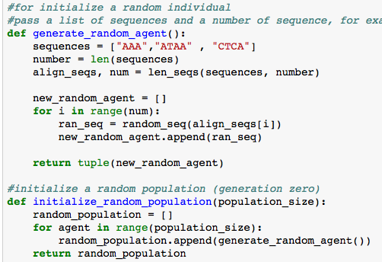
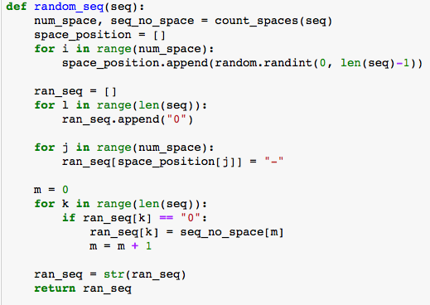
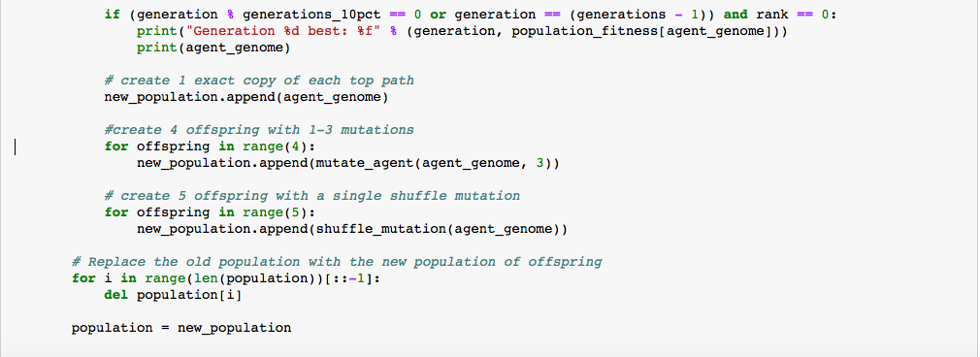
”ATAA”
”CTCA”
“AAA"
gene/agent genome
Individual/agent
population
”ATAA",”CTCA” ”AAA"
”ATAA",”CTCA” ”AAA-"
”ATAA",”CTCA” ”A-AA"
”ATAA",”CTCA” ”AA-A"
”ATAA",”CTCA” ”AA-A"
Initialization
Randomize the population
Evaluation –
Selection-
Generation-
Survival Selection
calculate the fitness value
Mutation
Recombination/Cross-over

Slide 15
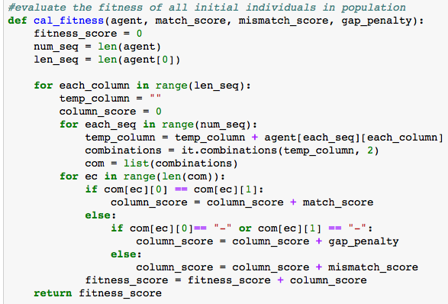

Slide 16
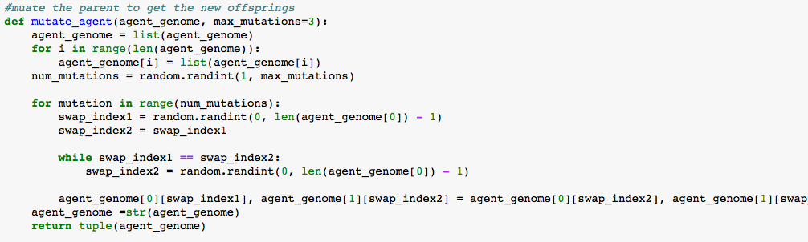

Slide 17
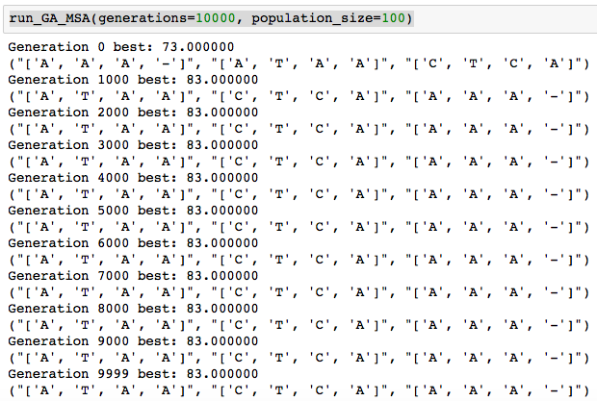
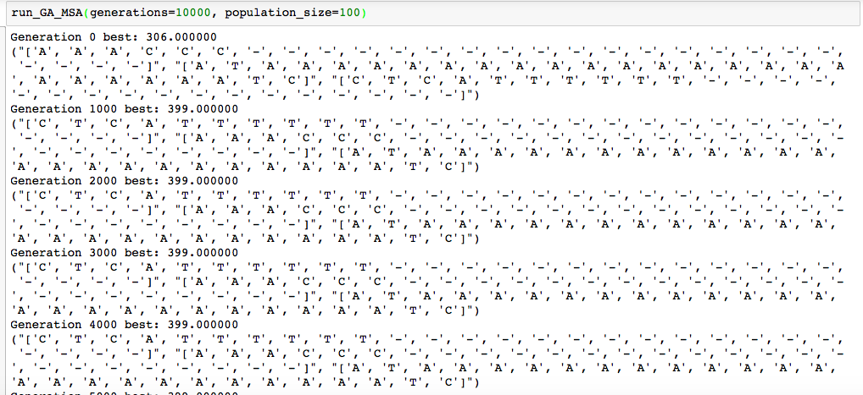
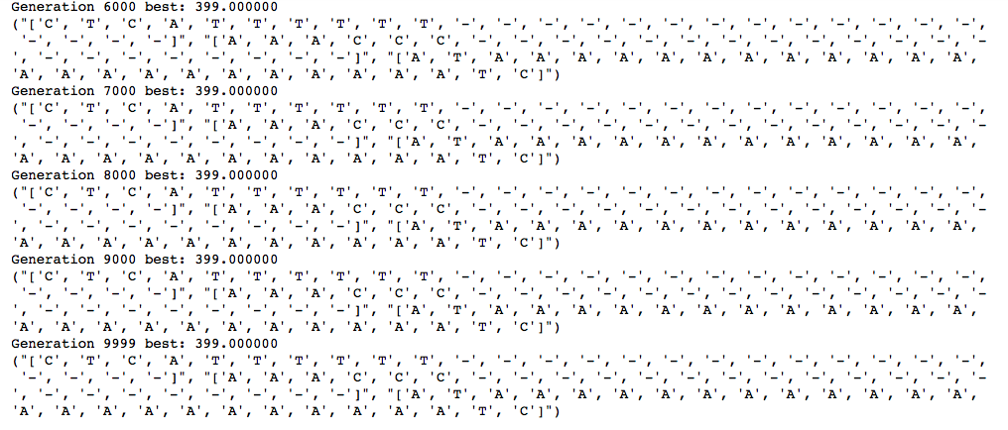
RESULTS

Slide 18
Summary-where’s Waldo? Traveler Sales Problem & Genetic Algorithm
While trying the GA for Waldo:
Increase the generation
Select the individuals(agent) that stay in the new population
Mutate more than 3 mutations
While trying the GA for Multiple Sequence:
100nucleotide
Select the individuals(agent) that stay in the new population
Mutate more than 3 mutations
Publication research

