Slide 1
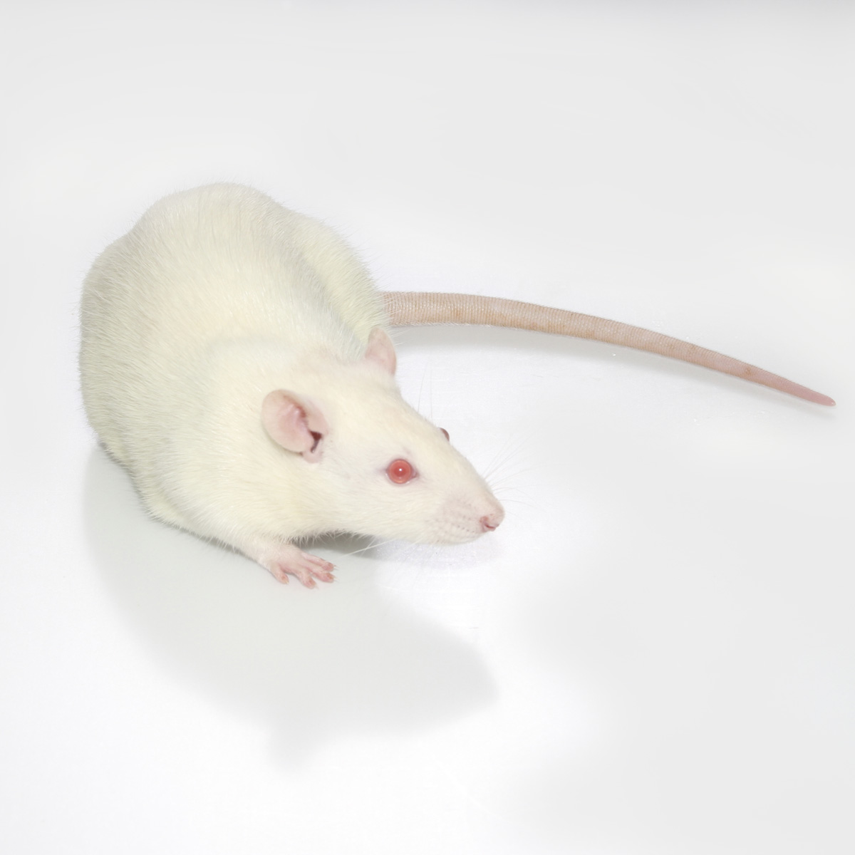
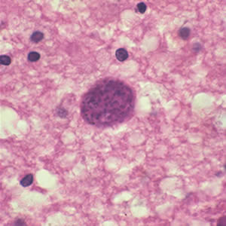
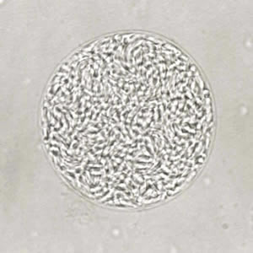
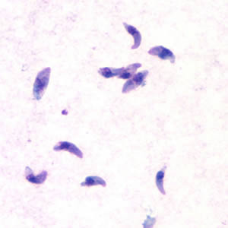
Toxo1 “locus of control”
Using a genetic screen to find genes related to Toxoplasmosis resistance in LEW rats.

Slide 2
Overview
What is Toxoplasmosis?
  Toxoplasma Gondii lifecycle
  Behavior modification
  Latent infection
The Experiment:
  Design (forward genetics)
  Results
Related Work
Future directions

Slide 3
What is Toxoplasmosis?
Caused by Toxoplasma Gondii
  “Obligate intracellular” protozoan parasite – can't reproduce outside the host cell
Infects most warm blooded animals, including humans
  “definitive host” is domestic cats
  asexual reproduction in all other hosts
Latent infection in most rats and humans
  In mice and immunocompomised humans, can be fatal
Related to malaria prasite (Plasmodium)

Slide 4
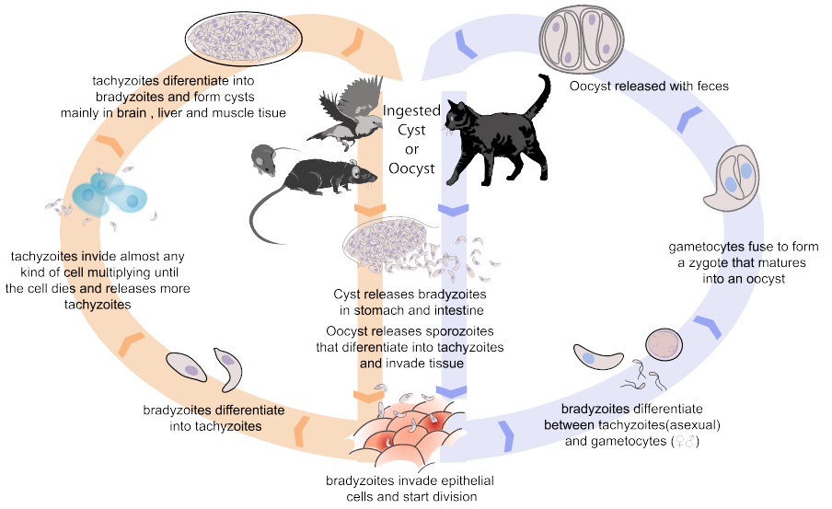
T. Gondii Lifecycle

Slide 5
Behavior Modification
Mice and Rats
  More active, less aversion to new stimuli
  Attracted to cat smells
  Increased chance of predation by definitive host
Humans (over 50% worldwide, 23% US)
  Traffic accidents
  OCD
  Schizophrenia

Slide 6
Experimental Design
Question: we know LEW rats are resistant, how can we figure out the genes that are responsible?
Cross breed them with non-resistant breeds
See which breeds maintain the resistance
Do in vitro study of invaded cells to determine mechanism of resistance
Sequence genomes for each breed, and see what parts are conserved
This is a forward genetic screen.

Slide 7
Results
Found conserved region with 7.6 megabases
  86 identified rat genes. Many have orthologs in mice and humans.
  Several are likely to be expressed in hemotopoietic cells, but no obvious candidates.
In Vitro results
  Macrophages from resistant rats prevented proliferation in parasitic vacuole
  No difference in infected fibroblasts
Other mechanisms
  The macrophage results don't completely explain the complete resistance in LEW rats, it's likely that other mechanisms are involved.

Slide 8
Related Work
Haloperidol – anti-psychotic drug
  Reduces impact of behavior modification in rats infected with toxoplasomosis, as much as T. gondii specific drugs
  In vitro tests show that it actually interferes with the parasite replication and invasion of brain cells

Slide 9
References
Cavaillès P, Sergent V, Bisanz C, et al. The rat Toxo1 locus directs toxoplasmosis outcome and controls parasite proliferation and spreading by macrophage-dependent mechanisms. Proceedings of the National Academy of Sciences of the United States of America. 2006;103(3):744-749. doi:10.1073/pnas.0506643103. http://www.ncbi.nlm.nih.gov/pubmed/16407112/
Webster J., Lamberton PH., Donnelly C., Torrey E. Parasites as causative agents of human affective disorders? The impact of anti-psychotic, mood-stabilizer and anti-parasite medication on Toxoplasma gondii’s ability to alter host behaviour. Proceedings of the Royal Society B: Biological Sciences. 2006;273(1589):1023-1030. doi:10.1098/rspb.2005.3413. http://www.ncbi.nlm.nih.gov/pmc/articles/PMC1560245/
Webster JP. The Effect of Toxoplasma gondii on Animal Behavior: Playing Cat and Mouse. Schizophrenia Bulletin. 2007;33(3):752-756. doi:10.1093/schbul/sbl073. https://www.ncbi.nlm.nih.gov/pmc/articles/PMC2526137/
Flegr J, Prandota J, Sovičková M, Israili ZH. Toxoplasmosis – A Global Threat. Correlation of Latent Toxoplasmosis with Specific Disease Burden in a Set of 88 Countries. Fernandez-Reyes D, ed. PLoS ONE. 2014;9(3):e90203. doi:10.1371/journal.pone.0090203. https://www.ncbi.nlm.nih.gov/pmc/articles/PMC3963851/
Images
  Rat picture: http://hilltoplabs.com/public/lewis.html
  T. gondii pictures: http://www.cdc.gov/dpdx/toxoplasmosis/gallery.html#cyst
  Lifecycle: https://en.wikipedia.org/wiki/Toxoplasma_gondii

