Slide 1
Uncertainty-Aware Modeling of
Second-Language Acquisition
A tutor that knows when it doesn't know.
Shane Dunkle · Richard Pollitt
ADSP 32014 — Bayesian Machine Learning with Generative AI Applications · Summer 2026
Duolingo SLAM 2018 · Bayes nets · hierarchical models · HMMs · MCMC · uncertainty & decision theory
Notes:
Two-person project. One sentence framing: adaptive tutors must decide not just whether a learner will err, but when to trust that prediction. We built a Bayesian pipeline that outputs calibrated probabilities and an explicit route-to-human option.

Slide 2
The problem: error prediction that admits what it doesn't know
Duolingo SLAM 2018 — public corpus of learner exercise responses over each learner's first 30 days
Point predictions aren't enough.
A standard classifier outputs one probability and hides its own uncertainty. An adaptive tutor acting on a wrong, confident prediction wastes learner time — or worse, misdiagnoses them.
Our reframing: Bayesian inference under uncertainty.
Predict per-token error probability with calibrated uncertainty, decompose why the model is unsure (inherent difficulty vs. not enough data), and let a decision layer abstain and route to a human when confidence is low.
Rich features per token: learner, L1/country, days-in-course, exercise format, session type, response time, POS, morphology, dependency structure.
5.5M+
exercise tokens across three courses
6,400+
learners (es_en, fr_en, en_es tracks)
~15%
of tokens are errors — the minority class we predict
30 days
per learner; dev/test are later in time than train
2
Notes:
Emphasize the dataset is public (Harvard Dataverse) and the shared-task benchmark exists (AUROC ~0.86 for top 2018 systems with heavy engineering). Errors are the minority class, so we report AUROC and calibration, never accuracy.

Slide 3
Three coupled Bayesian components
Each maps directly onto the course syllabus
A
B
C
Hierarchical Bayesian error model
Latent acquisition stages (HMM)
Uncertainty & routing
Multilevel logistic regression with partial pooling: learners nested within L1 groups and skill/format types. Sparse learners borrow strength; group effects expose L1 transfer and difficulty.
Per-learner Hidden Markov Model over the 30-day timeline: latent states as acquisition stages (unlearned → learning → acquired), tested for predictive value under forward validation.
Aleatoric vs. epistemic decomposition from hierarchical posterior draws; a Bayesian utility layer abstains and routes to a human when uncertainty is high. Evaluated with risk–coverage curves.
Bayes nets · hierarchical models · MCMC (NUTS) · ADVI
Markov models · HMMs
Decision theory · Bayesian deep learning ideas
Final predictive model: the hierarchical Bayesian logistic regression (A). B became a descriptive model; C became the deployment story.
3
Notes:
Division of labor: Richard — data engineering, scale, baselines, validation protocol. Shane — Bayesian modeling and SLA interpretation. Tools: PyMC/NumPyro, ArviZ, hmmlearn, scikit-learn.

Slide 4
The hierarchical model earns its structure
Native-fit performance on the official development sets
0.755
0.777
0.777
AUROC — es_en (English speakers learning Spanish)
AUROC — fr_en (learning French)
AUROC — en_es (learning English)
Partial pooling wins decisively over the pooled baseline.
ELPD improvement +2,158 ± 77 (PSIS-LOO) — about 28 standard errors. Calibration is strong: ECE 0.014 vs 0.020 pooled, with better Brier and NLL across the board.
Interpretable by construction.
Group-level posteriors expose which exercise formats are hard, which skills trip up which learner populations, and how much individual learners deviate — the SLA story falls straight out of the model's parameters.
Reference points
Tuned non-Bayesian logistic baseline: AUROC 0.814 (heavier feature set)
2018 shared-task top systems: ≈ 0.86 with extensive engineering
Our goal: calibrated uncertainty + interpretability at competitive discrimination
4
Notes:
ELPD numbers from the LOO comparison (run_summary.json). If asked about the gap to 0.86: those systems used massive feature engineering and ensembling without uncertainty; our extended ladder (slide 8) closes much of the gap while staying interpretable.

Slide 5
An honest negative result: acquisition stages don't add prediction
Three-state HMM per learner — interpretable, but gated out by forward validation
What the HMM found ✓
Interpretable unlearned → learning → acquired states over each learner's 30-day timeline
Stage transitions track known difficulty and pacing patterns
Kept in the report as a descriptive latent-learning model
What it didn't ✗
Ungated hybrid significantly worsened NLL (+0.00055, 95% CI [+0.00018, +0.00092]) and Brier — in all four forward folds
Entropy-gated hybrid statistically indistinguishable from the logistic baseline
The small dev-set 'gain' was selection optimism — exactly what the gate exists to catch
Takeaway: learner state matters, but it drifts continuously rather than jumping between discrete stages — not every interpretable Bayesian structure needs to improve prediction.
5
Notes:
This is a strength, not a weakness: we predefined a confirmation gate and it correctly failed. Foreshadow slide 8: a continuous dynamic-ability signal DOES pass the same gate — the dynamics are real, the discreteness was wrong.

Slide 6
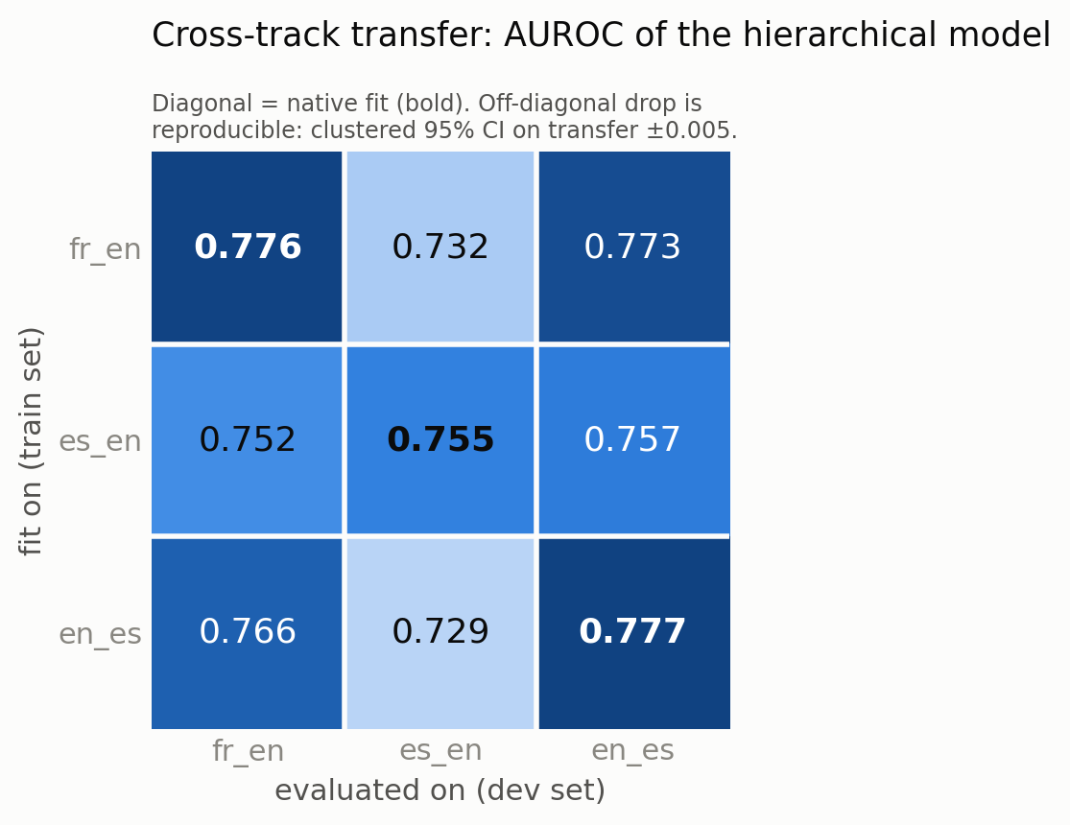
Cross-course transfer: the gap is real — and diagnosable
The penalty is reproducible.
Learner-clustered bootstrap on the model's own posterior draws: transfer AUROC 0.732, 95% CI [0.727, 0.737] — native 0.755 sits far outside. Refit variance is 5× smaller than the gap.
The ranking is not.
Which source transfers worst (fr_en vs en_es) lies within sampling noise — we report the penalty, not a ranking.
It's concept shift, not covariate shift.
Importance-weighting the source data toward the target feature distribution makes transfer worse. Refitting only group-level intercepts on ~10% of target learners recovers most native performance: the difficulty map shifts, the model structure transfers.
6
Notes:
Practical recipe: deploying on a new course needs only a cheap group-intercept recalibration on a small slice of target data, not a full refit. fr_en and es_en share the same L1-English population (only 2 shared users) yet still show the gap — it's about the course, not the people.

Slide 7
Difficulty geometry follows the language contrast, not the learner
Joint model over all three tracks: global effects + shrunk per-track deviations (partial pooling across courses)
The mirror pair clusters.
es_en and en_es — the same Spanish↔English contrast seen from opposite banks — are by far the closest tracks in deviation space (cosine −0.18 vs a −0.5 chance baseline), with session and pacing effects strongly positively aligned (+0.83, +0.53).
Shared learners don't cluster.
fr_en and es_en share the same L1-English learner population, yet sit at chance-level similarity (−0.51). What transfers is the structure of the language contrast, not the population.
Wrong-track adaptation is worse than none.
Applying another course's deviation block underperforms the global model — track deviations carry real, course-specific signal.
mirror pair: cosine −0.18
(chance ≈ −0.5)
es_en
en_es
fr_en
fr_en: the outlier —
largest deviation norm
Deviation-space similarity (schematic)
7
Notes:
This is the quantitative version of Prof. Gundogdu's 'languages as points in a latent space' remark from our topic-selection email — a publishable-flavored SLA finding. Cosine baseline is ~-0.5 because three deviation blocks approximately sum to zero under shrinkage.

Slide 8
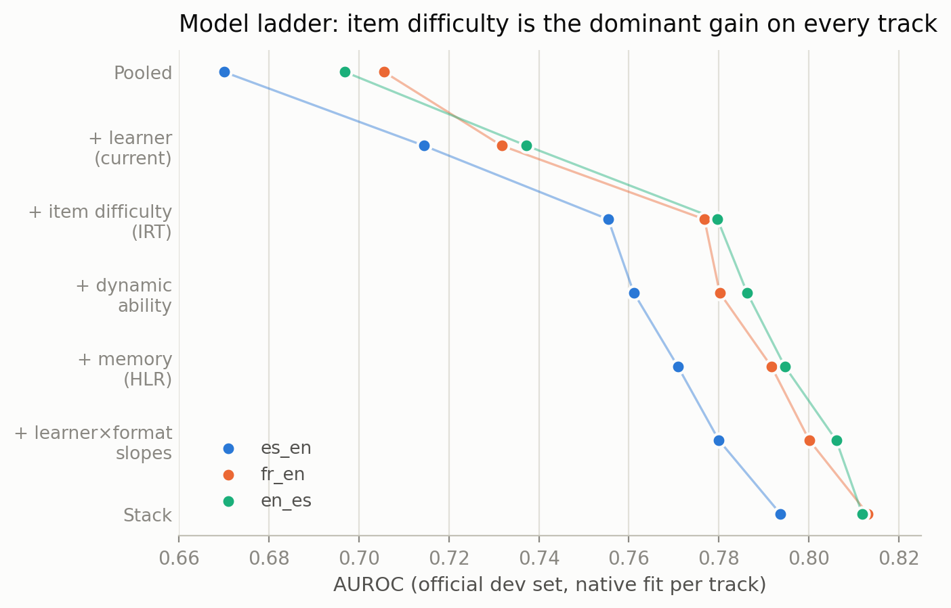
Where the remaining signal lives: an item-response ladder
+0.04 AUROC
from word-level item difficulty alone (Bayesian IRT view: ability − difficulty). The dominant gain on every track — 4× any other addition.
Passed the same forward-validation gate the HMM failed:
IRT: +0.036 AUROC, −0.017 NLL — better in every out-of-time fold
Full ladder (+ dynamic ability, memory/HLR, learner×format slopes): +0.059 AUROC, −0.030 NLL
Continuous ability drift passes where discrete stages failed
The interpretable GLM matches or beats gradient-boosted trees on the same features — nonlinearity buys no consistent gain
8
Notes:
All extensions are MAP estimates of hierarchical priors and port directly to PyMC (item difficulties = item-level random effects; slopes = LKJ-correlated random effects). Every rung is significant under a learner-clustered bootstrap; the ladder replicates on all three language tracks.

Slide 9
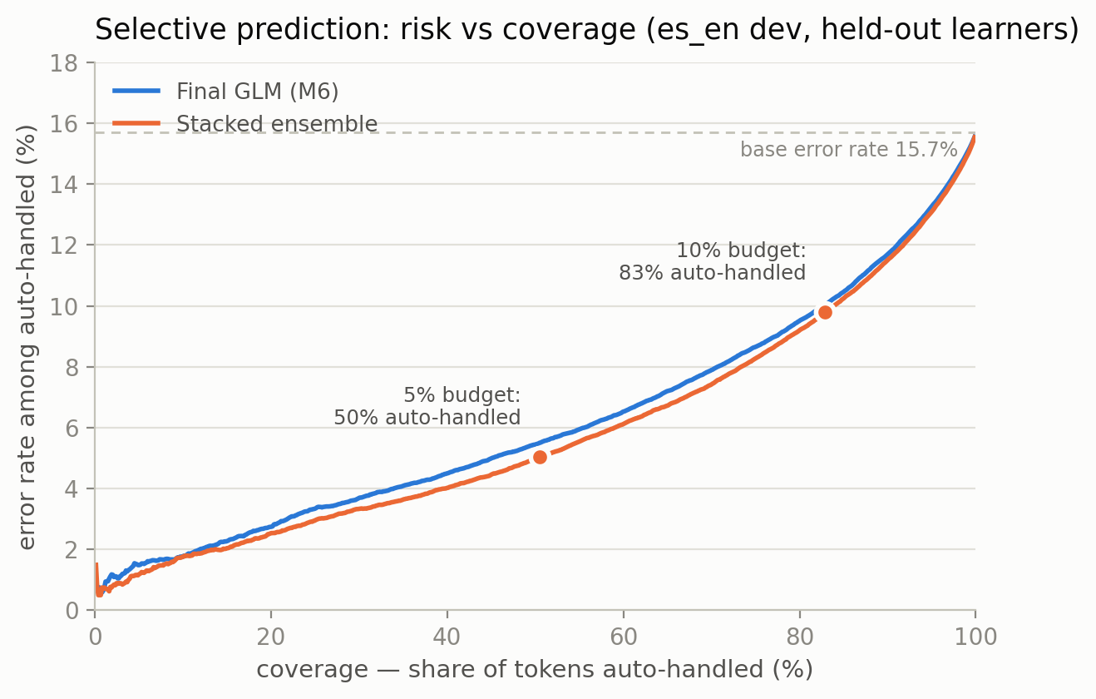
Knowing its limits — with a guarantee
50%
of tokens auto-handled at a 5% error budget
83%
auto-handled at a 10% error budget
Two layers of trust:
Bayesian utility layer picks the routing threshold from posterior uncertainty (aleatoric vs. epistemic — epistemic rises 4.6× under cross-course shift, flagging exactly where to defer)
Split-conformal layer adds a distribution-free, finite-sample guarantee on the error rate among auto-handled tokens — it held within 0.3pp on held-out learners
9
Notes:
This is the deployment story: the tutor handles the easy half provably safely and routes the rest for review. Conformal is assumption-free, so it protects against miscalibration of the posterior itself.

Slide 10
What we learned
1
Hierarchy + item difficulty is the model.
Partial pooling wins decisively, and an IRT reading (ability − difficulty) captures the dominant remaining signal on every language track.
2
Negative results are results.
Discrete acquisition stages are interpretable but add no forward-validated prediction; continuous ability drift does. The predefined gate caught the difference.
3
Transfer gaps are concept shift.
The difficulty map changes across courses — and follows the language contrast, not the learner population. A cheap group-level recalibration mostly erases it.
4
Uncertainty is the product.
Calibrated posteriors + conformal guarantees turn a classifier into a tutor that provably knows when to hand off to a human.
Next: dynamic IRT (state-space ability), full PyMC port of item effects and correlated slopes, half-life forgetting models — and a write-up beyond the course.
Shane Dunkle · Richard Pollitt — thank you
Notes:
Close on the publication angle: the instructor flagged this topic as publishable; the latent-space finding plus the IRT ladder is the core of that paper.

