Slide 1

Dan Olsen

Slide 2

What is an Alamo Fire?
The state flower of Texas
A Bluebonnet with an "Attitude” for the 21st century.

Slide 3
What is Alamofire?
Swift-based HTTP networking library
iOS, tvOS, watchOS, macOS
Provides an interface on top of the foundation networking
Doesn’t use anything from Objective-C / AFNetworking

Slide 4
What is Alamofire?
Swift-based HTTP networking library
iOS, tvOS, watchOS, macOS
Provides an interface on top of the foundation networking
Doesn’t use anything from Objective-C / AFNetworking

Slide 5
Using Alamofire
Requirements
iOS 8.0+ / macOS 10.10+ / tvOS 9.0+ / watchOS 2.0+
Xcode 8.1+
Swift 3.0+
Optional
CocoaPods (or other dependency manager)
(can be installed manually without)

Slide 6
What can it do?
HTTP Requests
JSON parameters and response serialization
Authentication
…and more!
Chainable Request / Response Methods
URL / JSON / plist Parameter Encoding
Upload File / Data / Stream / MultipartFormData
Download File using Request or Resume Data
Authentication with URLCredential
HTTP Response Validation
Upload and Download Progress Closures with Progress
cURL Command Output
Dynamically Adapt and Retry Requests
TLS Certificate and Public Key Pinning
Network Reachability
Comprehensive Unit and Integration Test Coverage

Slide 7
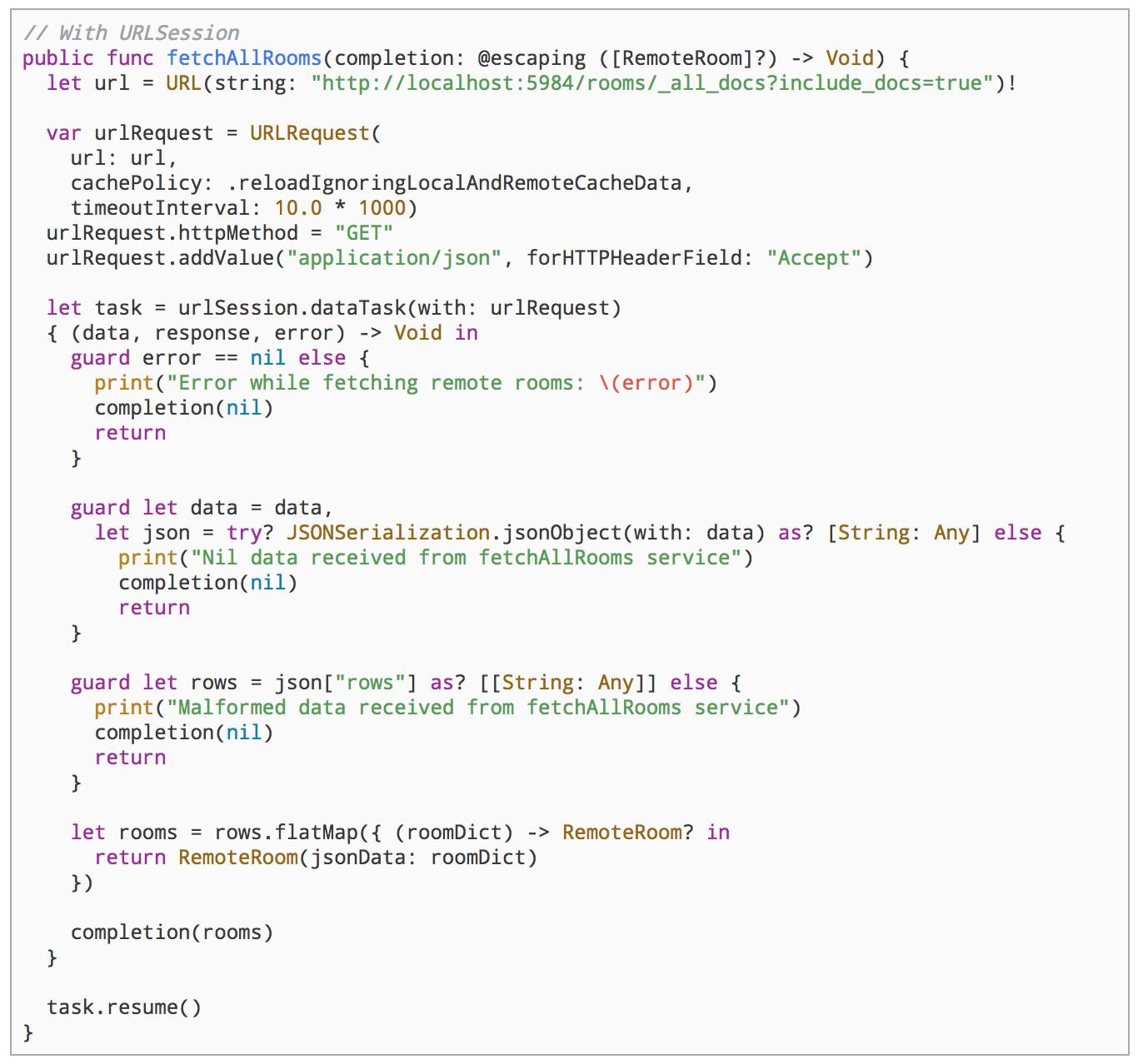
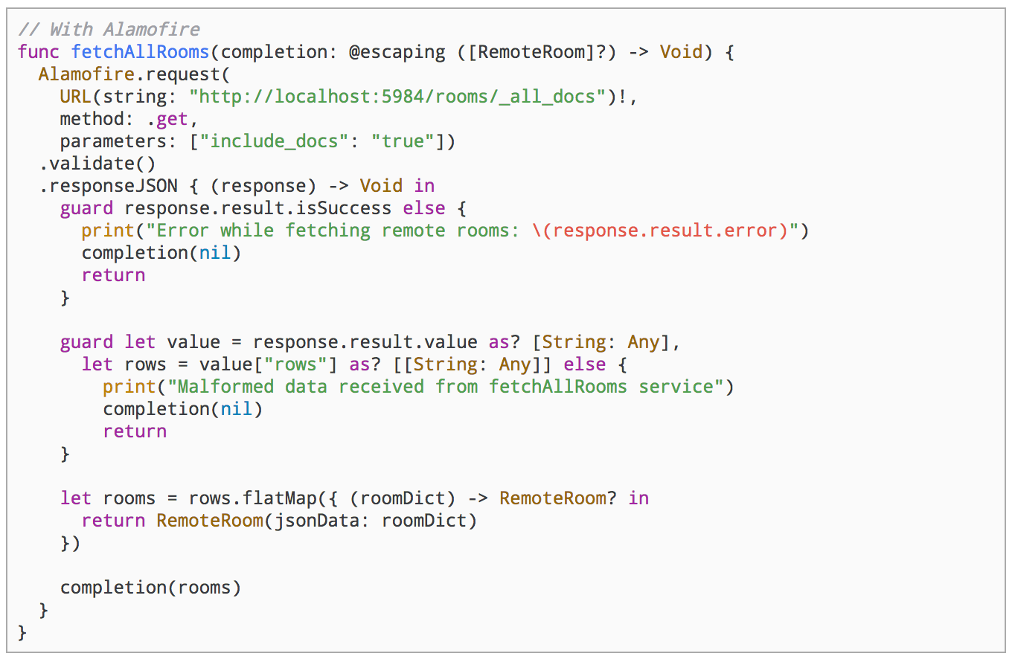
Less Code
URLSession
Alamofire Request

Slide 8
Additional Components
AlamofireImage
UIImage and UIImageView extensions
Image filters
Auto-purging cache and a priority-based downloading
AlamofireNetworkActivityIndicator
Controls the visibility of the network activity indicator on iOS using Alamofire.
Reduces flicker with time delays

Slide 9

CocoaPods
Dependency manager for Swift and Objective-C Cocoa projects
AlamoFire is a cocoa project

Slide 10
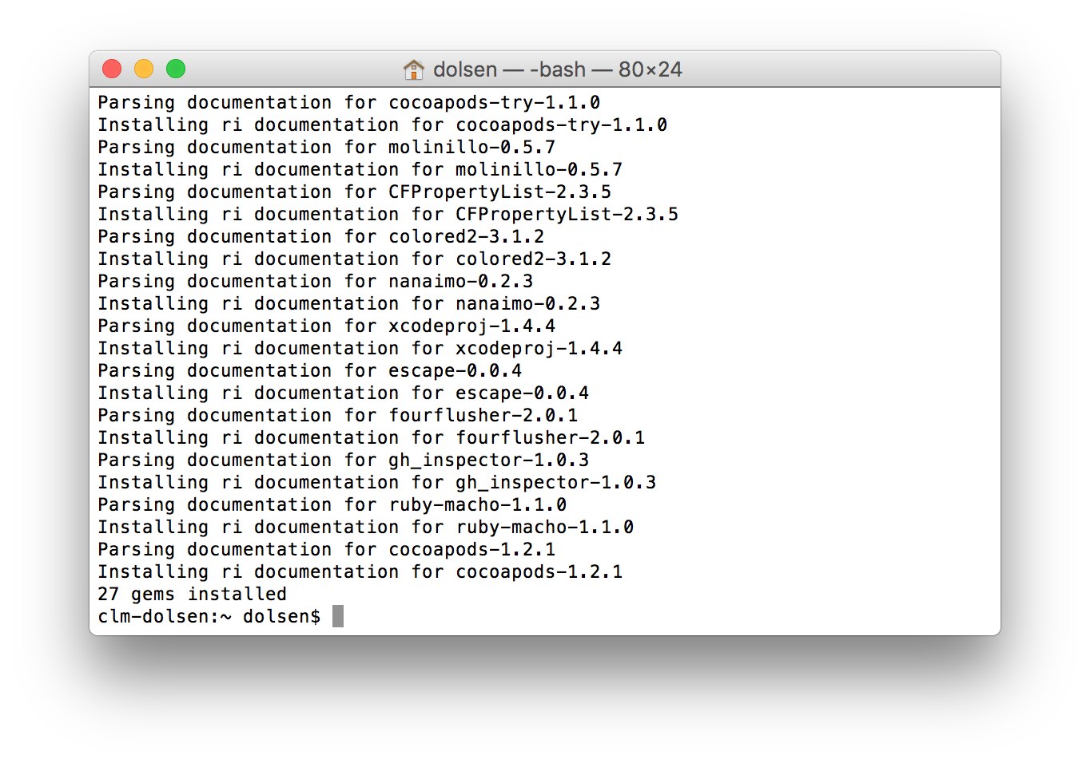
CocoaPods
Install:
# Xcode 7 + 8
$ sudo gem install cocoapods

Slide 11
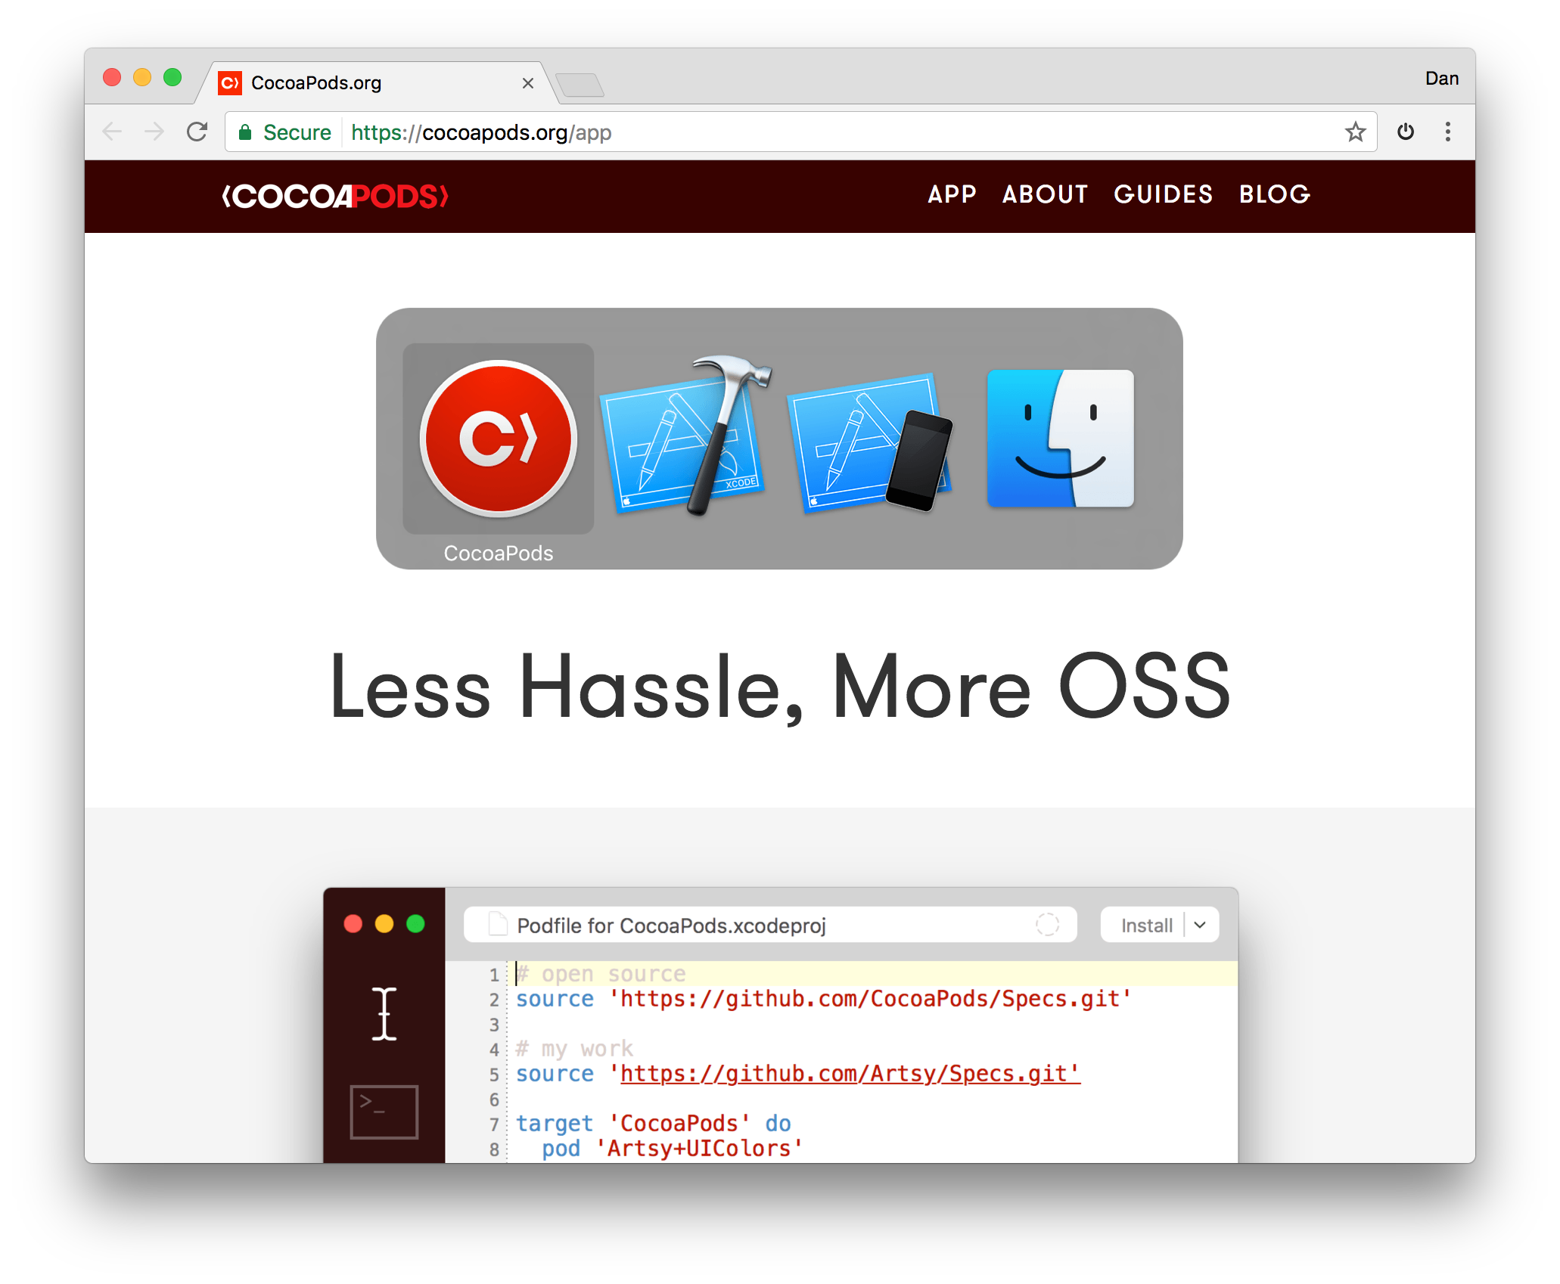
CocoaPods Desktop App

Slide 12
Adding CocoaPods to XCode
Create Xcode project
Change directories in Terminal to Xcode project folder
Create your pod file:
$ pod init

Slide 13
Adding Alamofire to CocoaPods
Edit your pod file:
source 'https://github.com/CocoaPods/Specs.git' platform :ios, '10.0’
use_frameworks!
target '<Your Target Name>' do
pod 'Alamofire', '~> 4.4'
end

Slide 14
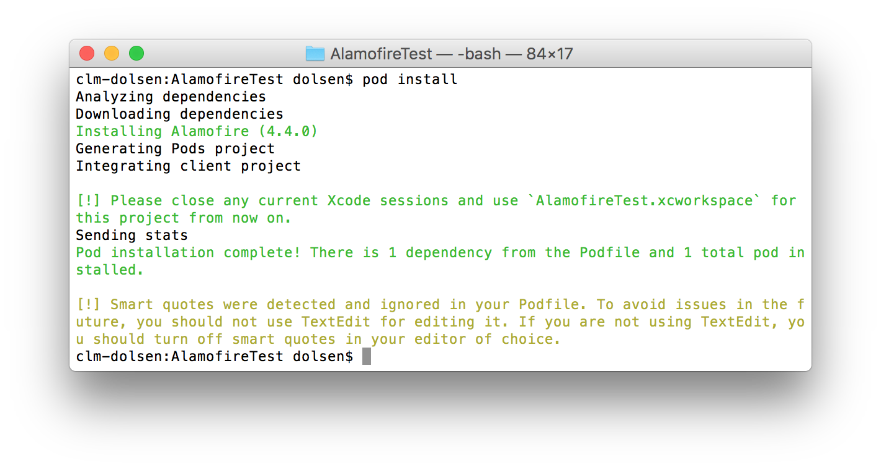
Adding Alamofire to CocoaPods
Install the Alamofire pod:
$ pod install

Slide 15

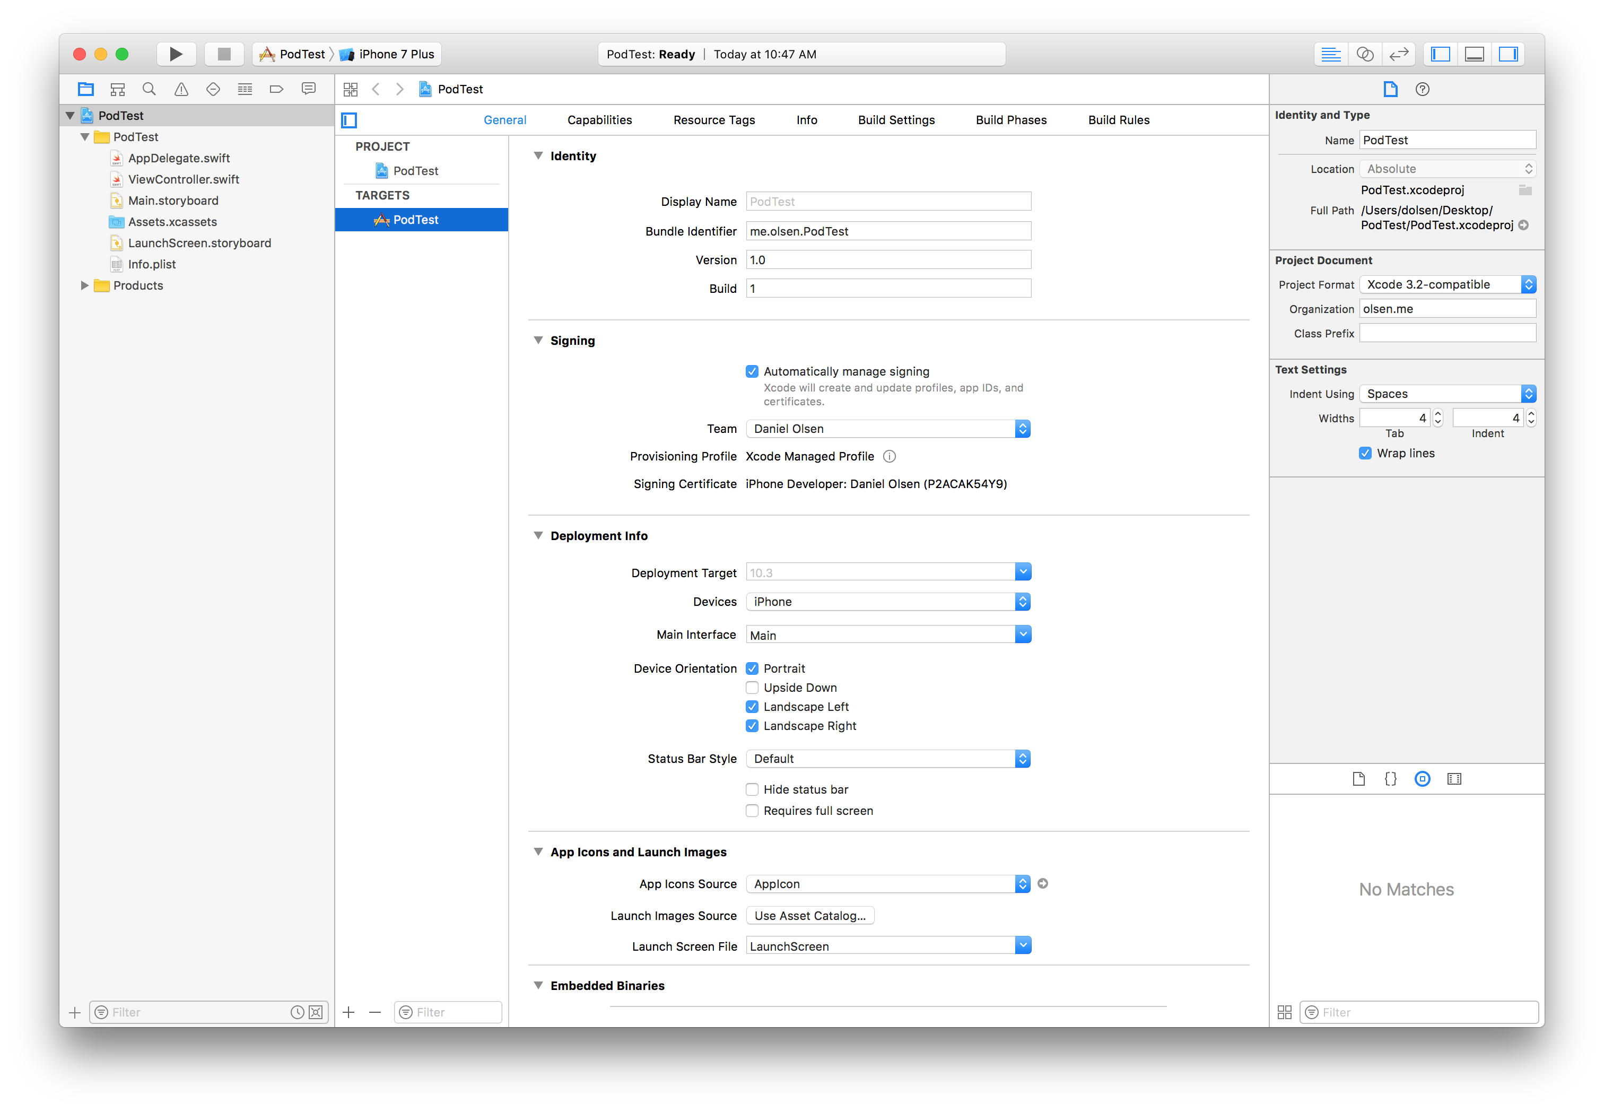

Slide 16
Making a Request
import Alamofire Alamofire.request(”<URL>")

Slide 17
Demo App

Slide 18
Dan Olsen

Slide 19
References
Alamofire Github
https://github.com/Alamofire/Alamofire#usage
Alamofire Tutorial
https://www.raywenderlich.com/147086/alamofire-tutorial-getting-started-2
Alamofire Article
http://nshipster.com/alamofire/
Cocopods
https://cocoapods.org/
Alamo Fire (Flower)
http://aggie-horticulture.tamu.edu/wildseed/alamofire.html

