Slide 1
MONTHLY PROGRESS PRESENTATION
CHiPS e-Procurement AI Chatbot
Focus this month
• Improve answer quality
• Strengthen routing and validation
• Refine UI and voice support
• Prepare demo-ready documentation
Department / Organization assigned: CHiPS, Government of Chhattisgarh
Reporting period: July 2026
Presentation duration: 15 minutes + 5 minutes discussion
CHiPS e-Procurement AI Chatbot | Monthly Progress Presentation
1

Slide 2
MONTHLY REVIEW
The chatbot addresses a real procurement guidance gap
Problem statement
Project objectives
• Procurement manuals and rules are lengthy and difficult to search quickly.
• Users need role-specific help for tenders, bids, vendor registration, EMD, and rules.
• Queries arrive in English, Hindi, and Hinglish, making manual support slower.
• Provide source-grounded conversational answers for CHiPS e-Procurement workflows.
• Support multilingual interactions with clear, context-aware responses.
• Reduce answer drift by improving routing, retrieval, and deterministic responders.
Key features
• Multilingual chatbot widget, source-linked answers, quick prompt chips, PDF/source viewing, and voice support.
• Coverage across tender methods, bid submission, evaluation, registration, EMD, auctions, and procurement rules.
CHiPS e-Procurement AI Chatbot | Monthly Progress Presentation
2

Slide 3
MONTHLY REVIEW
Methodology combined document processing, retrieval, and answer controls
1
Document pipeline
Preprocess PDFs, clean OCR, and prepare chunkable text from procurement manuals and rules.
2
Knowledge indexing
Create embeddings, store searchable vectors, and attach metadata for better retrieval.
3
Query routing
Classify actor, intent, and language before selecting response strategy.
4
Grounded response
Retrieve top evidence, rerank context, and generate or serve deterministic answers.
5
Validation loop
Run regression tests, live API checks, and benchmark/UAT reviews to refine quality.
CHiPS e-Procurement AI Chatbot | Monthly Progress Presentation
3

Slide 4
MONTHLY REVIEW
System architecture separates UI, API, retrieval, and model layers
Web UI
Flask API
Retrieval Layer
LLM Layer
Portal page + chatbot widget
Quick prompts, source drawer, voice controls
Streaming answers
Routing, diagnostics, language control
Qdrant vector store
Embedding + reranking context selection
Local Ollama-hosted models
Final answer generation
Technology stack: Python 3.11, Flask, Node.js / Express, Qdrant, BGE-M3 embeddings, bge-reranker-v2-m3, local Ollama models, HTML/CSS/JavaScript, and browser-based speech support.
CHiPS e-Procurement AI Chatbot | Monthly Progress Presentation
4

Slide 5
MONTHLY REVIEW
This month focused on UI polish, answer quality, and validation
Activities completed
Technical work
Quality work
• Prepared monthly and project reports.
• Captured chatbot screenshots and demo assets.
• Reorganized project documentation and support files.
• Added routing, context diagnostics, and language enforcement.
• Improved voice latency with browser STT fallback.
• Refined UI interactions and answer presentation flow.
• Ran exact-answer validation and UAT quality audit.
• Added high-risk deterministic responders and regression cases.
• Documented benchmark outcomes and remaining defects.
CHiPS e-Procurement AI Chatbot | Monthly Progress Presentation
5

Slide 6
MONTHLY REVIEW
Technical contributions improved correctness on sensitive procurement queries
Backend / answer engine
Validation / UX
• Introduced direct anti-splitting guidance for purchase-splitting questions.
• Added explicit intent for vendor registration approval time.
• Added deterministic responses for DSC, eligibility, bid opening, and evaluation-report cases.
• Extended regression coverage for routing and procurement workflows.
• Added exact-question answering metric to the benchmark runner.
• Improved UI support for Auto-Voice and browser-friendly interaction.
CHiPS e-Procurement AI Chatbot | Monthly Progress Presentation
6

Slide 7
MONTHLY REVIEW
AI and data-science components power multilingual retrieval and grounded generation
Tools and technologies used
• BGE-M3 for multilingual embeddings
• bge-reranker-v2-m3 for reranking
• Qdrant as vector database
• Local LLMs through Ollama
• Flask and Node.js for application delivery
• Automated benchmark and regression scripts for evaluation
CHiPS e-Procurement AI Chatbot | Monthly Progress Presentation
7

Slide 8
MONTHLY REVIEW
Progress is visible in targeted validation even as broad benchmark gaps remain
49
12 / 12
37
120
Regression tests passed
Focused live checks passed
UAT remediation tests passed
Production benchmark queries
Fine-intent, actor boundary, workflow checks
Mean latency 1.51 seconds
High-risk cases validated
Used for gap discovery
Progress against planned milestones
The planned milestone for this month was to move from broad prototype behavior toward more reliable, demo-ready procurement assistance. That milestone was partially achieved: focused validation improved significantly, but the full 120-query benchmark still shows major gaps in fallback reduction, actor classification, and procedural completeness.
CHiPS e-Procurement AI Chatbot | Monthly Progress Presentation
8

Slide 9
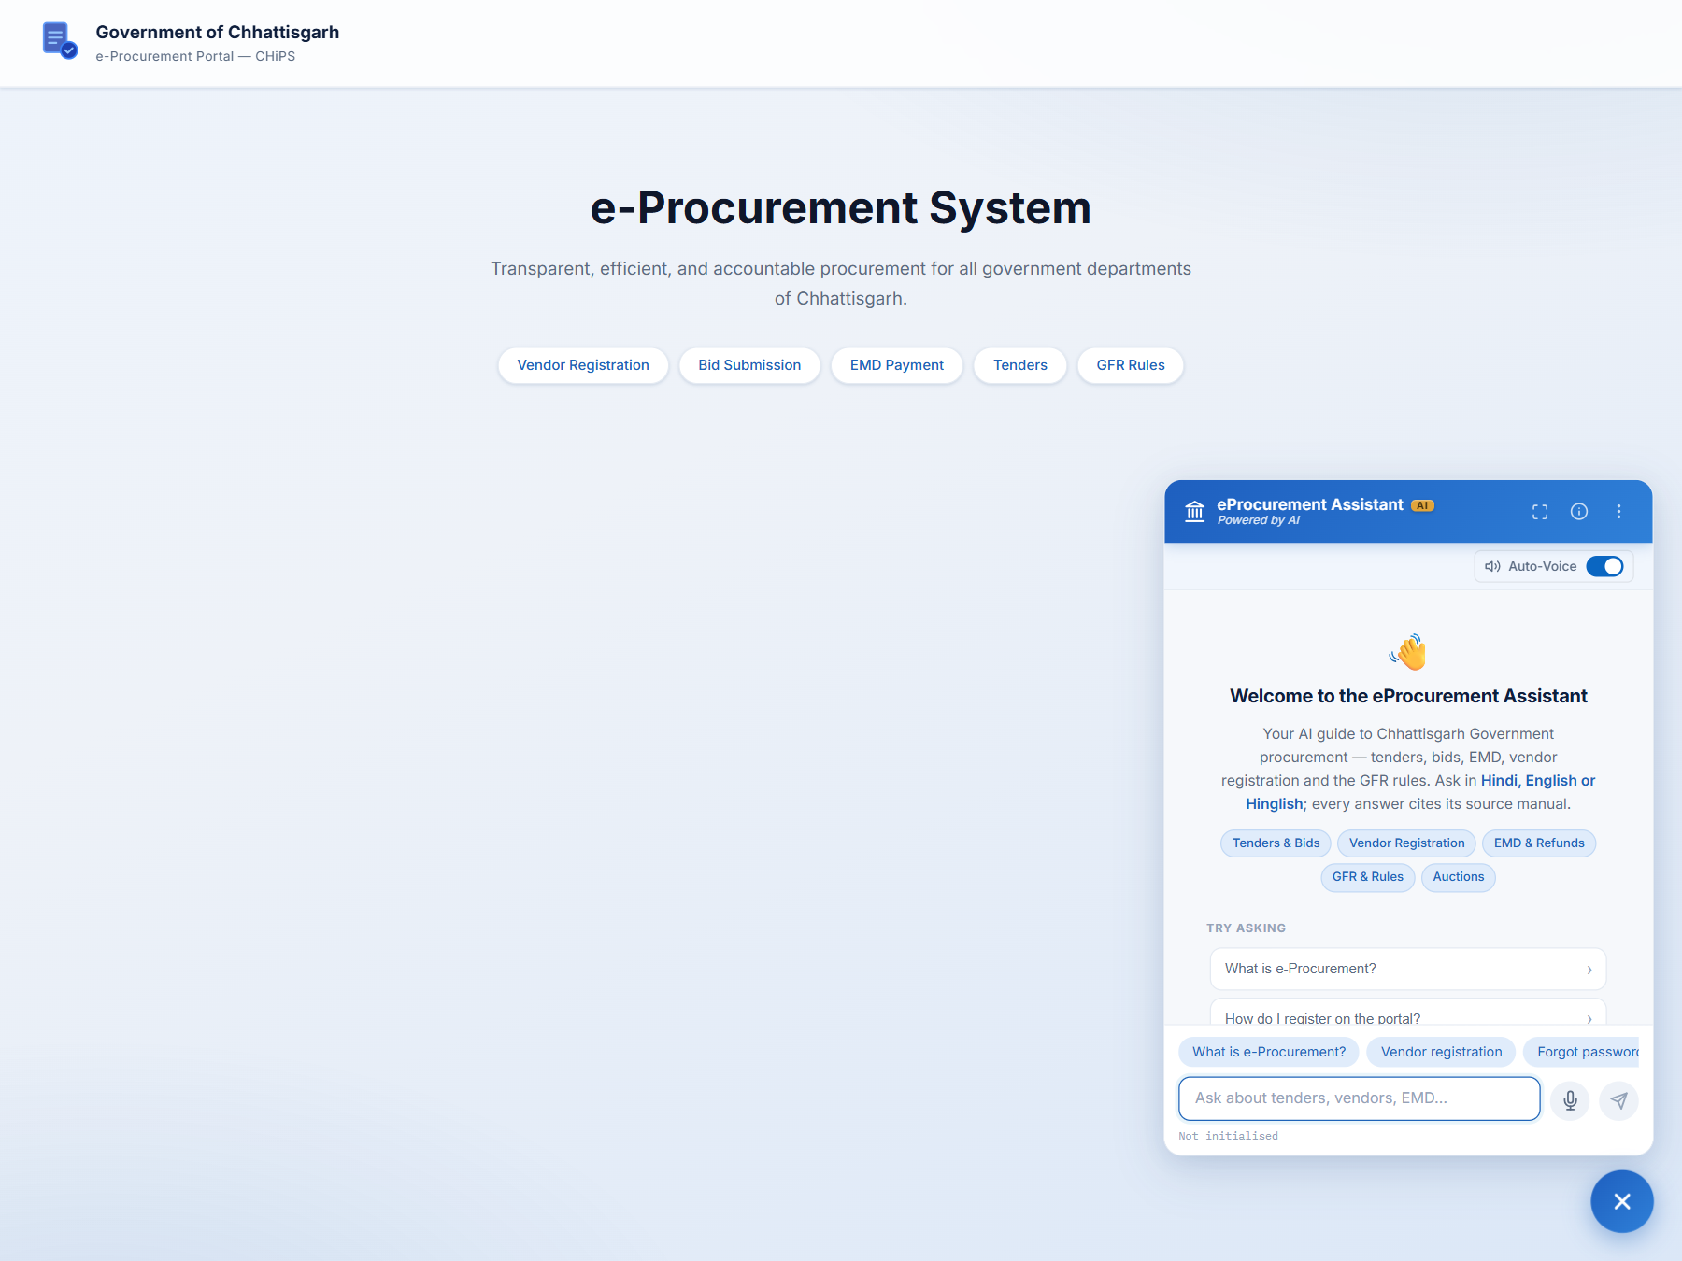
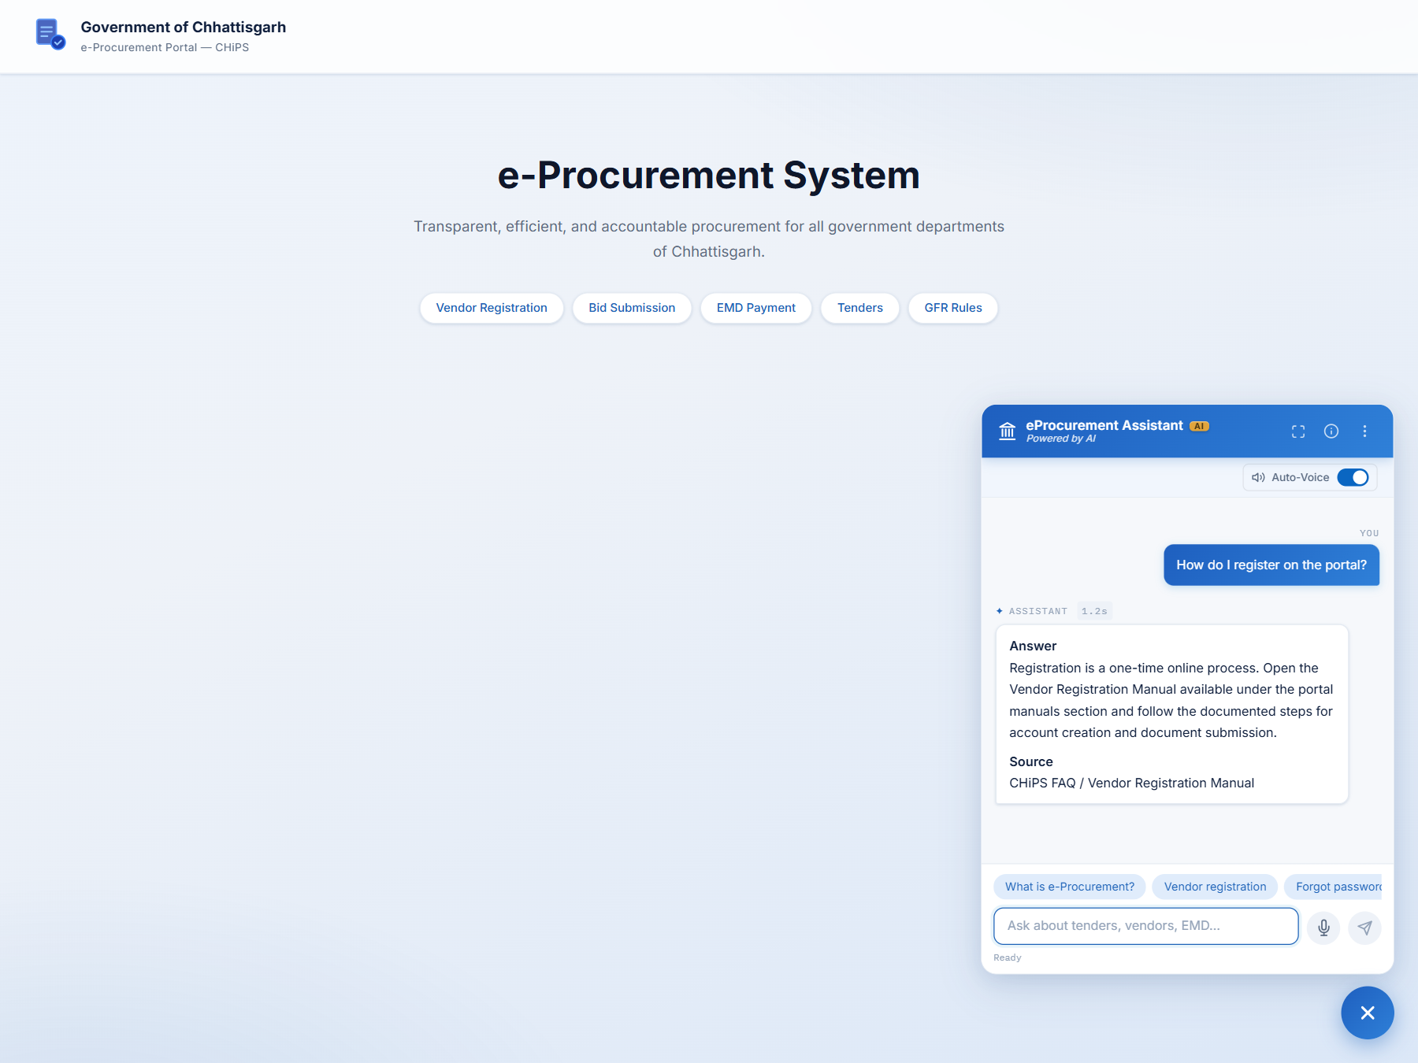
MONTHLY REVIEW
Demonstration: the chatbot now presents a cleaner and more usable interface
Widget view: quick prompts, Auto-Voice, and multilingual entry
Answer view: concise response + source visibility
CHiPS e-Procurement AI Chatbot | Monthly Progress Presentation
9

Slide 10
MONTHLY REVIEW
The main challenges are accuracy gaps at scale and environment constraints
Challenges encountered
Implications
• Broad benchmark still shows low pass rate and high fallback behavior.
• Actor and fine-intent errors affect retrieval and answer quality.
• Some UI/browser validation is blocked by local environment issues.
• Need tighter evidence contracts for sensitive procurement answers.
• Need stronger semantic UAT acceptance criteria, not only routing checks.
• Need continued live verification before wider deployment.
CHiPS e-Procurement AI Chatbot | Monthly Progress Presentation
10

Slide 11
MONTHLY REVIEW
Next month’s plan focuses on targeted quality improvement and review support
Work plan for next month
Support required
• Reduce fallback-heavy cases and improve procedural completeness.
• Re-run multilingual UAT with stricter semantic assertions.
• Continue UI verification and live demo readiness improvements.
• Feedback from IIIT-NR on evaluation focus and expected output quality.
• Department-side confirmation of priority use cases for the next validation cycle.
• Access/support for broader demo testing and deployment-readiness review.
Central takeaway: the chatbot is now more structured, more grounded, and more demo-ready, but it still needs another cycle of focused quality work before it can be treated as broadly reliable.
CHiPS e-Procurement AI Chatbot | Monthly Progress Presentation
11

