Slide 1
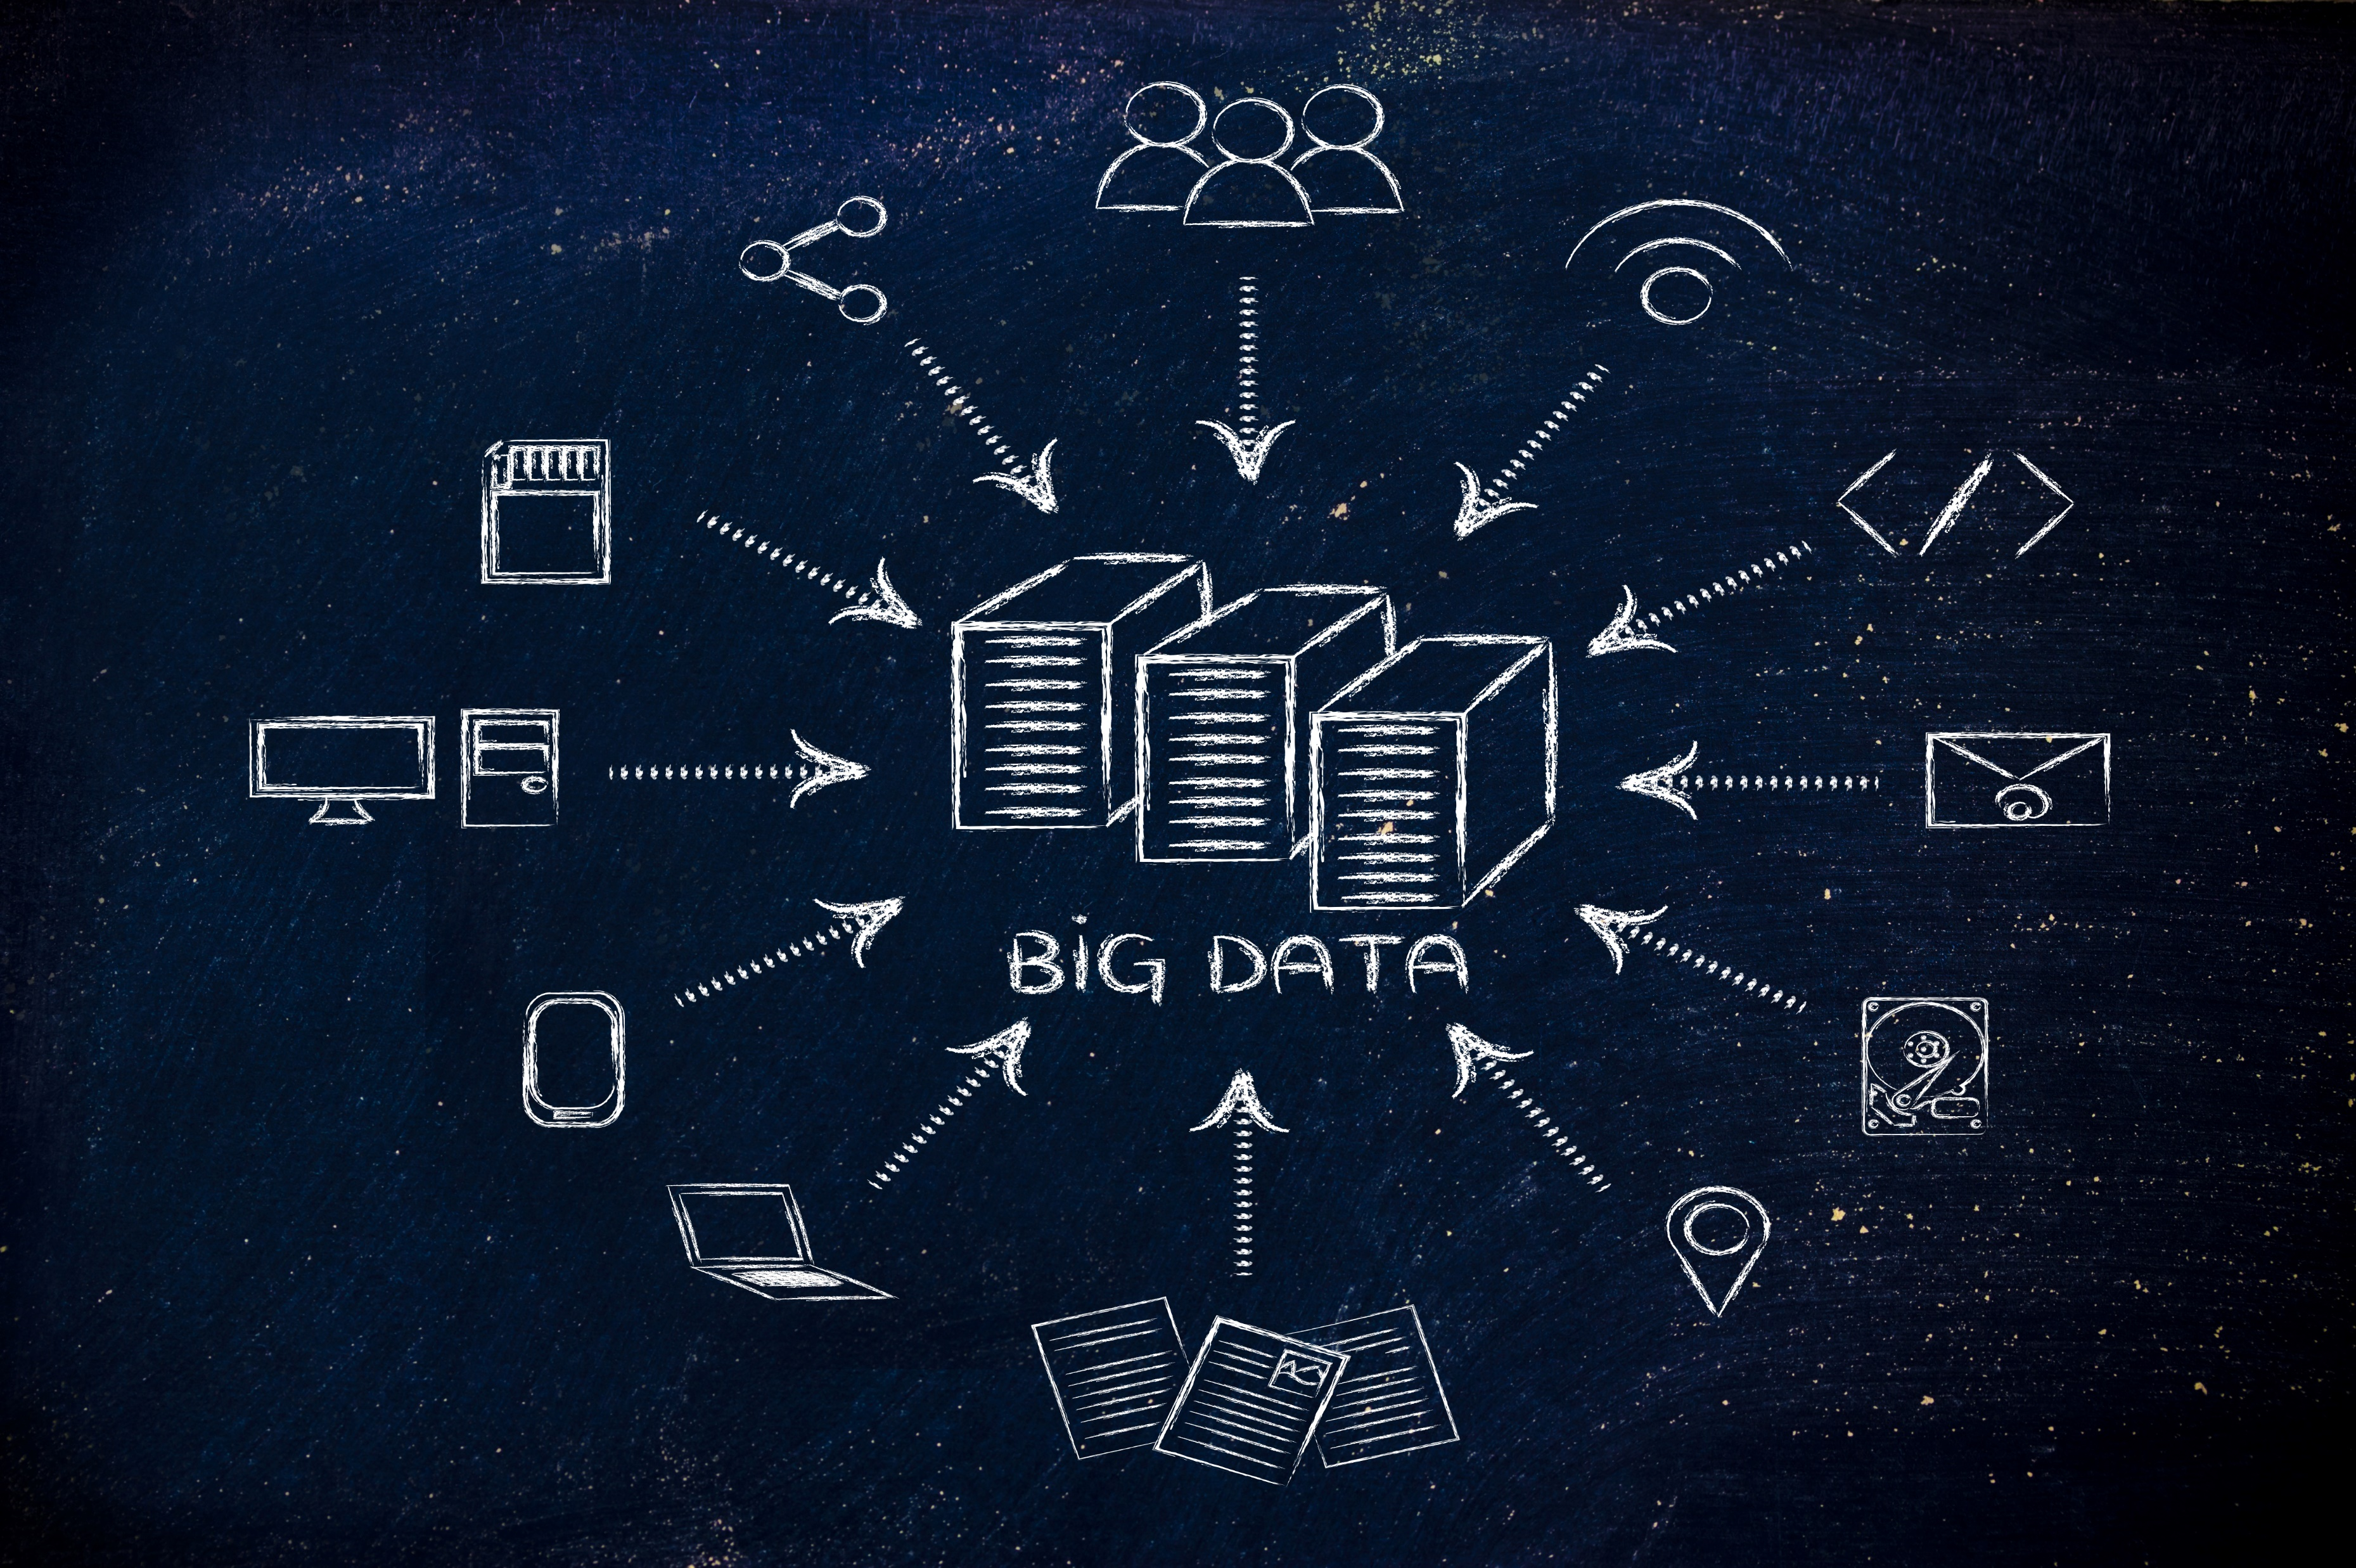
DE-ZOOMCAMP WEEK 5
This Photo by Unknown Author is licensed under CC BY-SA

Slide 2
Batch Processing
Batch processing is a computer processing technique in which a large volume of data is collected, processed, and executed in groups or batches simultaneously.
The data is usually collected and stored for a specific period, and then the processing is done in a batch during a predefined time window.
In batch processing, the input data is collected, sorted, and organized into groups called batches. The batches are then processed one after another without human intervention. This approach is helpful for large, repetitive tasks like payroll processing, billing, and report generation.
Batch processing allows for the efficient use of computing resources, enabling the processing of large amounts of data without requiring continuous manual intervention. It can also help ensure data integrity by allowing consistent processing rules to be applied across large datasets.
However, batch processing typically results in longer processing times than real-time processing, as the data must be collected and organized before processing can begin.

Slide 3
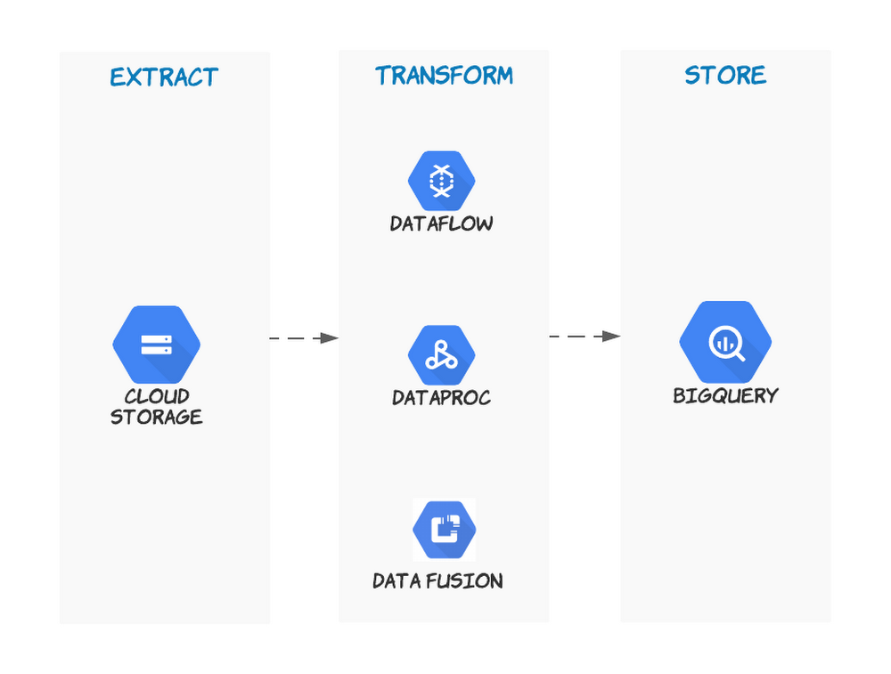
Batch Job
Why they are not real-time, they can be scheduled to run at frequent interval or invent.
Weekly
Daily
Hourly
3 times per hour
Every 3 minutes

Slide 4
Tools For Batch Processes
The standard tools for batch processes are:
Spark
Hadoop
Pandas
Flink
NiFi

Slide 5
SPARK
Apache Spark is an open-source distributed computing system designed for processing large datasets across clusters of computers.
It provides a fast and general-purpose data processing engine that can be used for various tasks, including batch processing, real-time processing, machine learning, and graph processing.

Slide 6
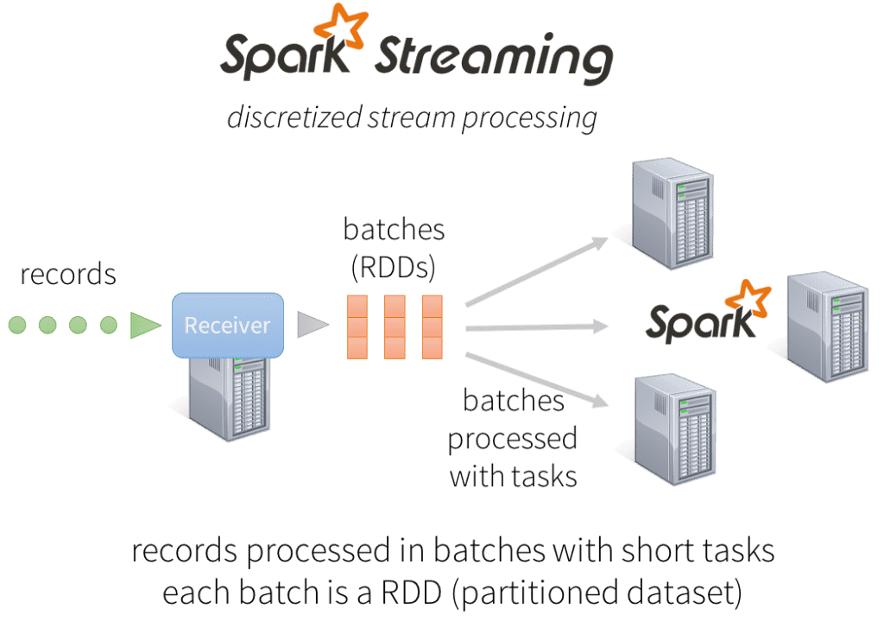
Key features
It requires Java 8 or 11
Resilient Distributed Datasets (RDD) are the fundamental data structure
Speed
Scalability
Master Node
Master Node: is responsible for coordinating the task
Worker Nodes: are responsible for executing tasks

Slide 7
Why Spark and not pandaS
SPARK
PANDAS
It can handle data that is too large for Pandas to handle
It runs on a cluster of machines, which makes it run faster on large data
It can read data from a wide variety of sources, including Hadoop Distributed File System (HDFS)
In-build machine learning support
It is designed to work with smaller datasets that can fit into RAM
It runs on a single machine, resulting in its slow processing of large data
It is limited to reading data from local files or remote URLs
Limited machine learning support

Slide 8

Google data proc
Fully-managed cloud service offered by Google Cloud Platform (GCP)
Used to create and manage Spark and Hadoop clusters for large-scale data processing.
Key Features
Automatic scaling
Easy integration with other GCP services
Pre-installed software
Flexible pricing

Slide 9
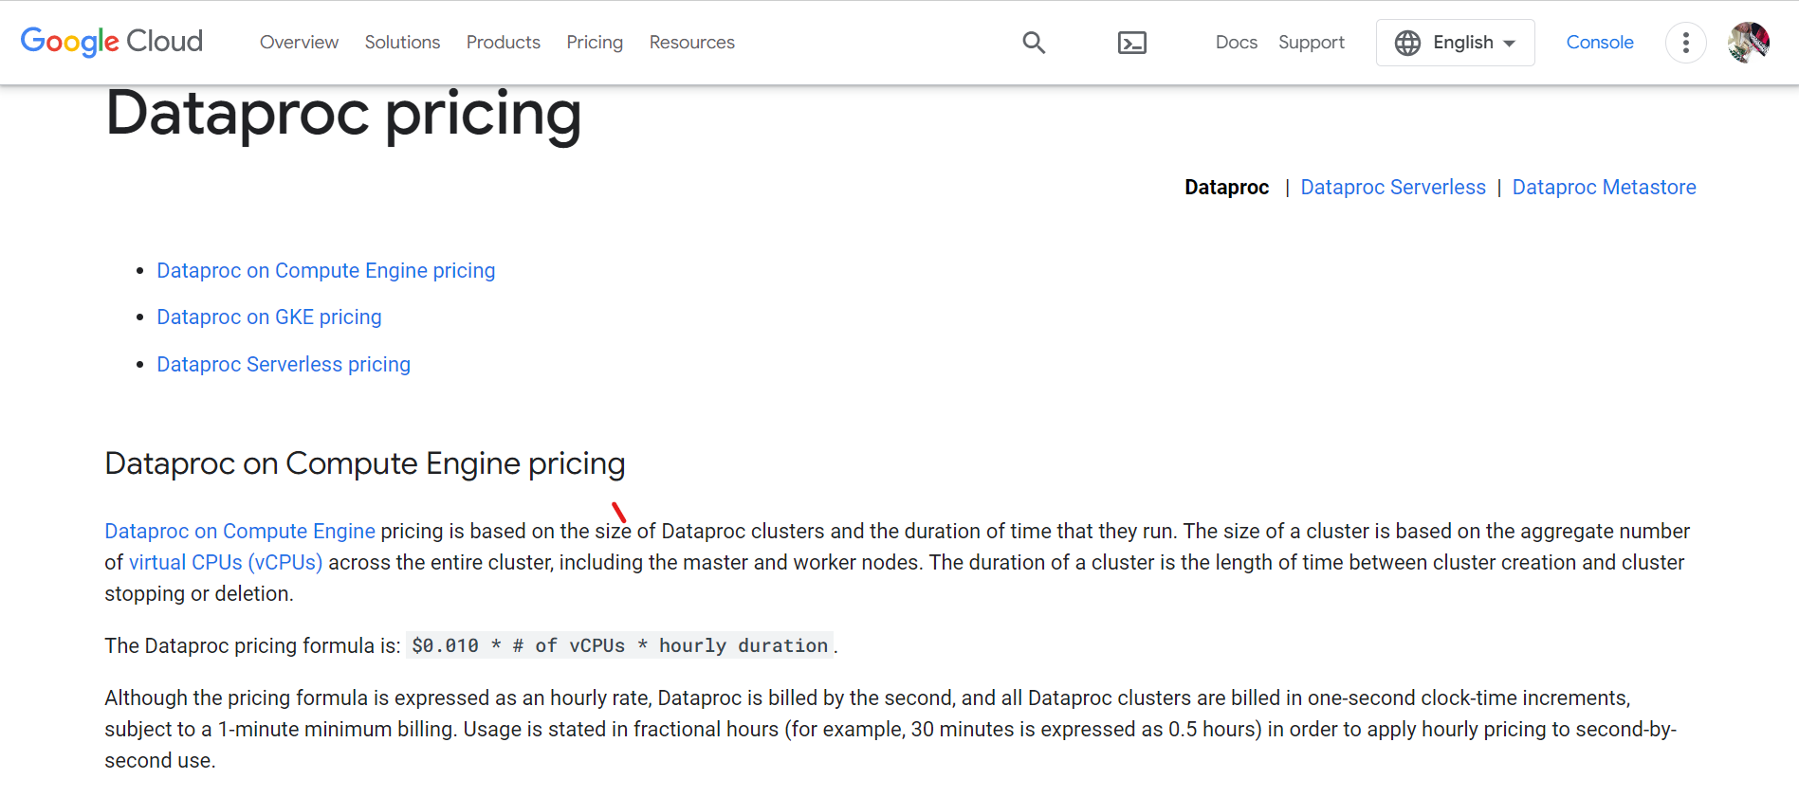

Slide 10
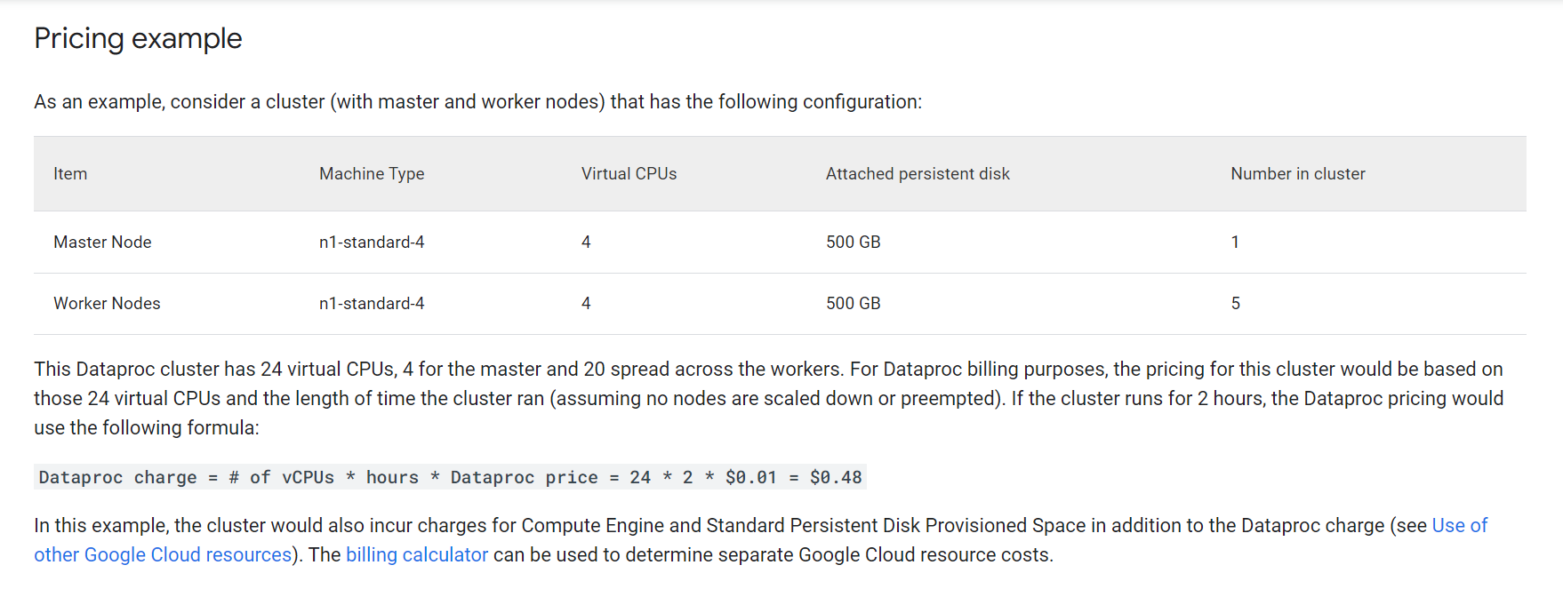
Google dataproc: pricing cont…
For more: https://cloud.google.com/dataproc/pricing

Slide 11
Code sample
Overview of my code: https://github.com/uchiharon/data-engineering-zoomcamp/tree/main/week_5_batch_processing

Slide 12
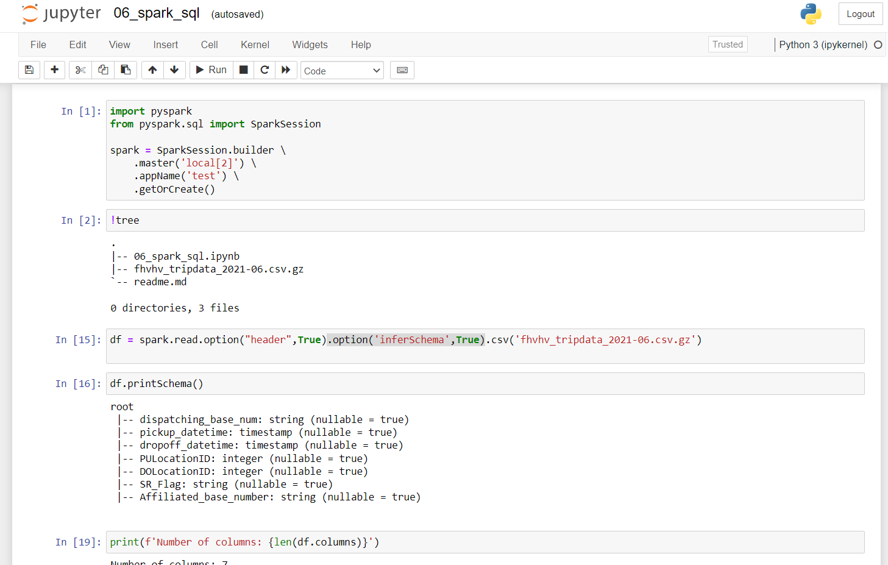
PYSpark cluster creation and data reading

Slide 13
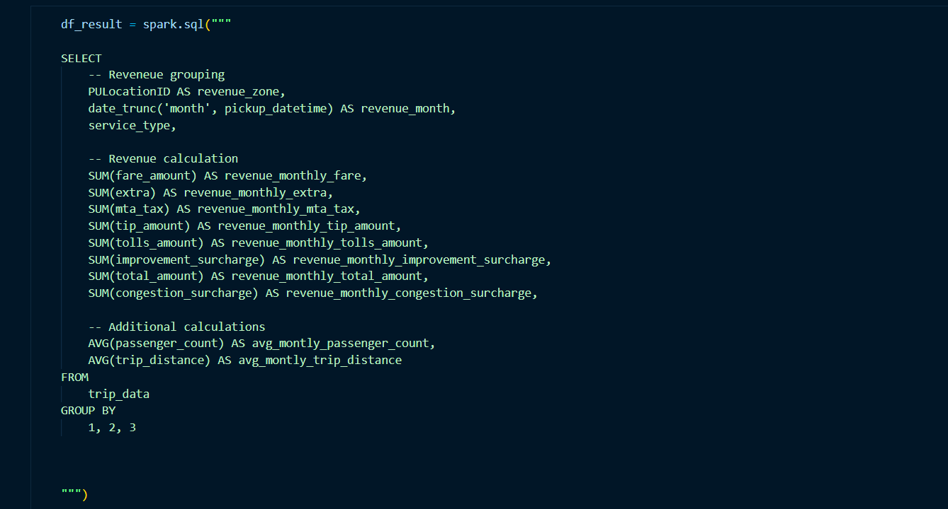
Spark sql

Slide 14
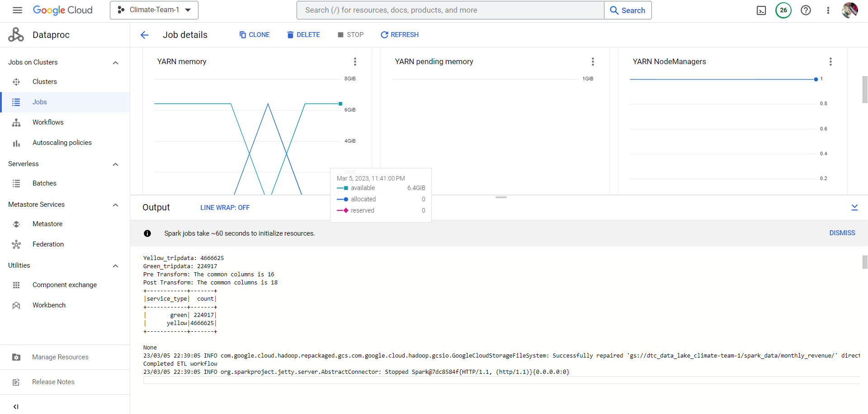
Job details on dataproc

