Slide 1
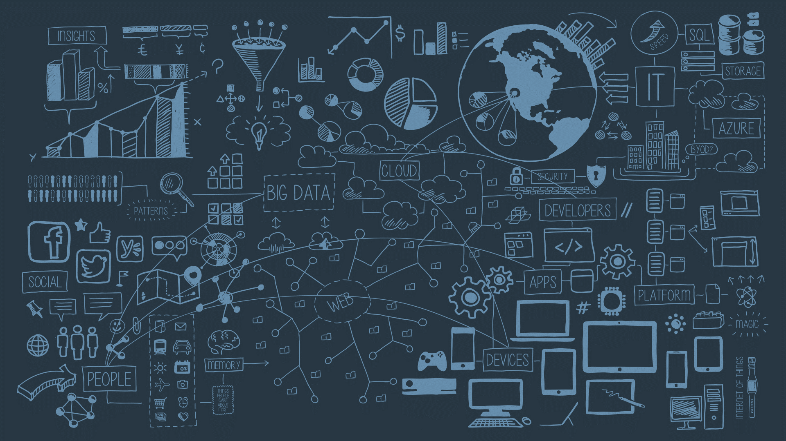
DE-ZOOMCAMP WEEK 2
This Photo by Unknown Author is licensed under CC BY

Slide 2
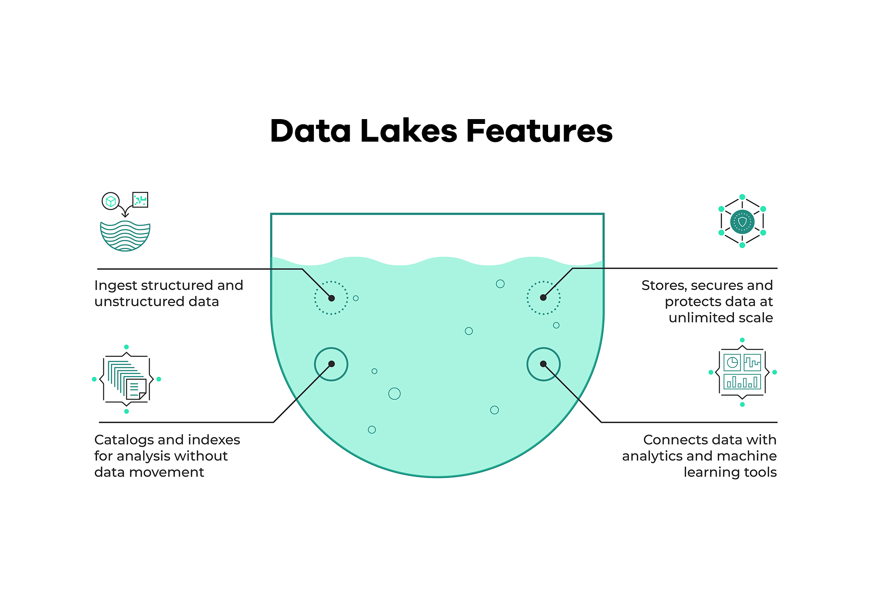
DATA LAKES
WHAT
A data lake is a centralized repository that allows you to store all your structured and unstructured data at any scale. It is designed to handle large volumes of data and different data types, providing a single source of truth for your data and making it easily accessible for data analytics, machine learning, and big data processing.
USE
Streaming processing
Machine learning
Real-time analytics

Slide 3
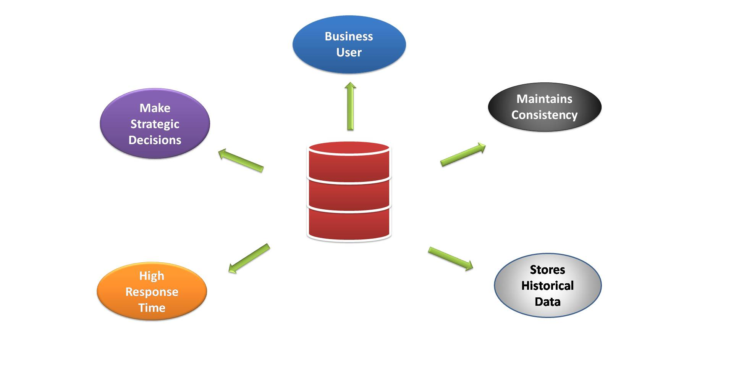
DATA WAREHOUSE
WHAT
A data warehouse is a centralized repository for storing and managing large amounts of data from multiple sources. It is designed for use by Data in a data warehouse, is typically stored in a structured format, and is optimized for fast querying and analysis. The data is often cleansed, transformed, and integrated from various sources before loading it into the warehouse, making it easier to access and analyze.
USE
Analytics
Business intelligence
Data-driven decision

Slide 4
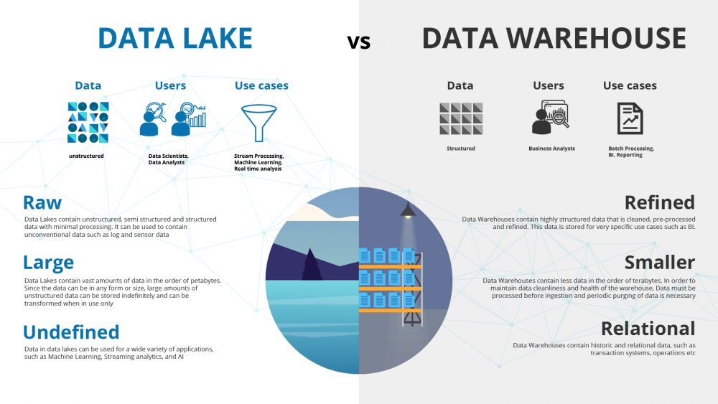

Slide 5
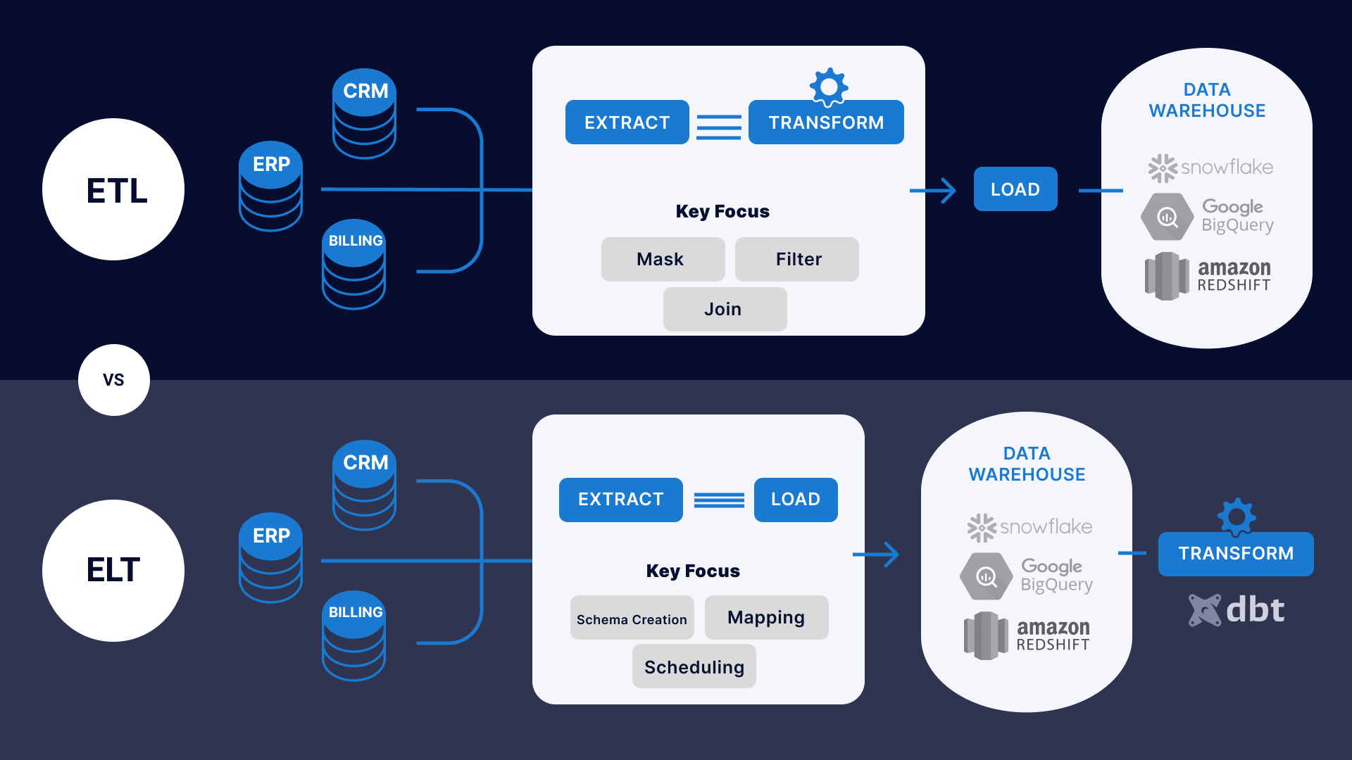

Slide 6
ETL
Extract, Transform, Load
In ETL, data is extracted from its sources, transformed into the desired format, and loaded into the target destination, such as a data warehouse.
The transformation step often involves cleaning and transforming the data and enforcing data consistency and quality standards.
ELT
Extract, Load, Transform
In ELT, data is first extracted from its sources and loaded into a target destination, such as a data lake.
The transformation step takes place within the target destination, using tools such as data processing engines and data integration platforms.
This approach allows organizations to take advantage of modern data platforms' scalability and processing power, which can handle large volumes of data.
VS

Slide 7
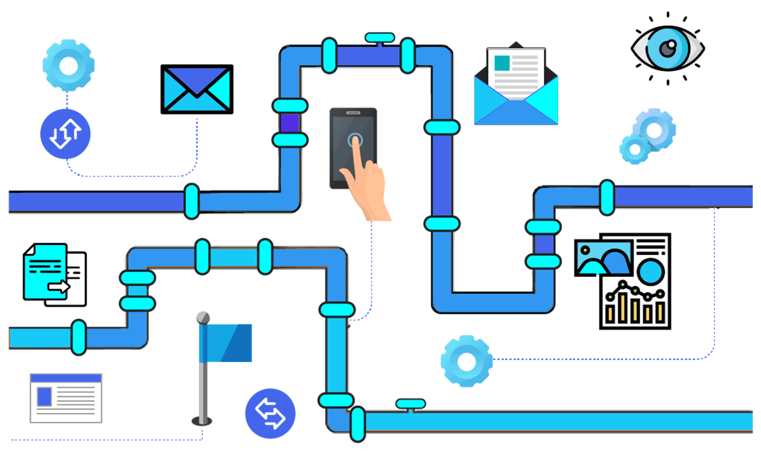
WORKFLOW ORCHESTRATION

Slide 8
Workflow orchestration refers to coordinating and managing tasks and processes within a workflow.
It involves;
defining the order in which tasks are executed,
determining the conditions under which tasks are triggered,
and ensuring that the workflow runs smoothly and efficiently.
The goal of workflow orchestration is to;
automate and optimize the flow of work,
reducing manual intervention and errors,
and improving overall productivity.

Slide 9
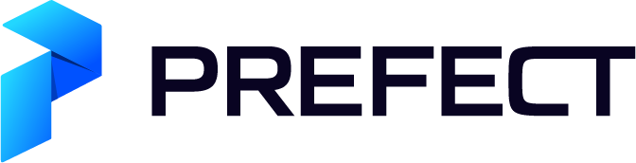
Prefect is an open-source workflow management platform designed to simplify and automate the process of creating, running, and monitoring data pipelines.
It provides a comprehensive set of tools and features to help users define, execute, and manage complex workflows, including a visual interface for designing workflows, a scalable engine for executing workflows, and a centralized dashboard for monitoring the status of workflows.
With Prefect, users can automate and streamline various data-related tasks, such as data ingestion, transformation, and storage, reducing the time and effort required to manage these processes.

Slide 10
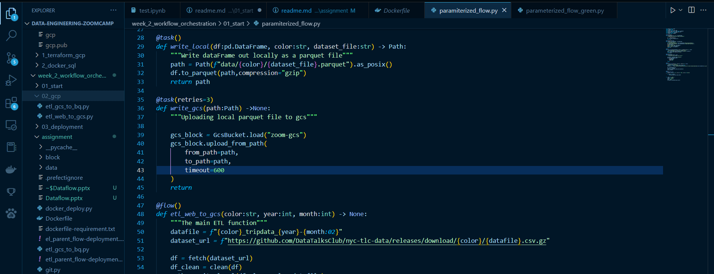
Prefect On A Python Script Flows are defined with @flow Tasks are defined with @task

Slide 11
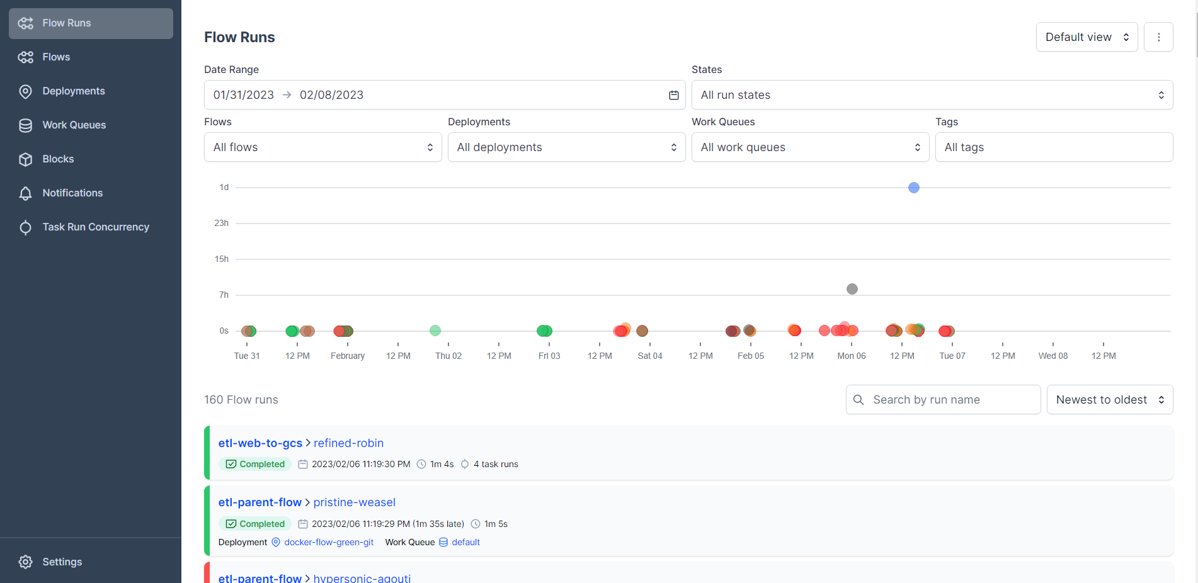
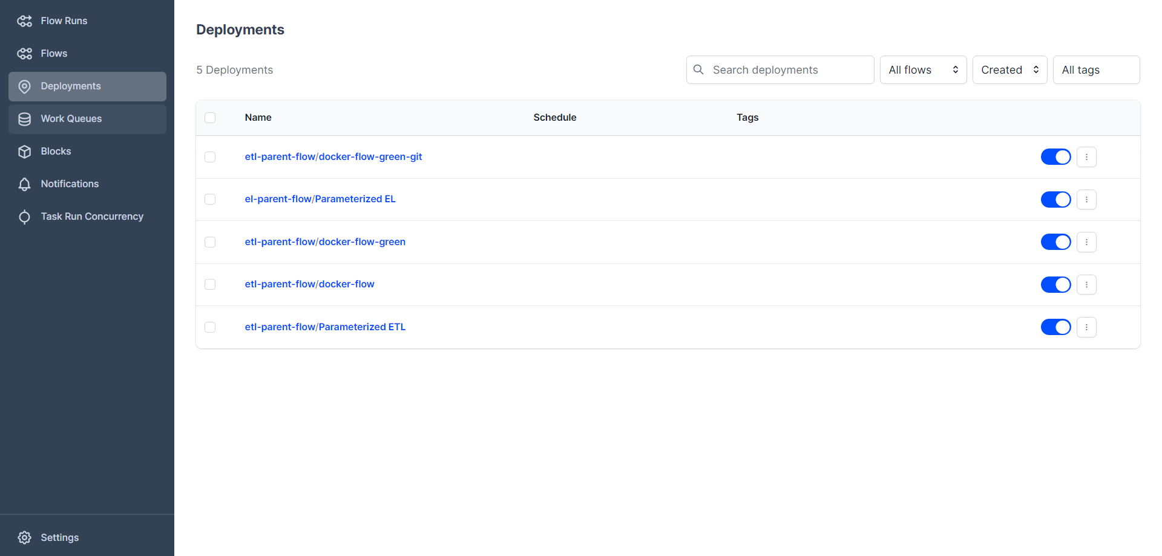
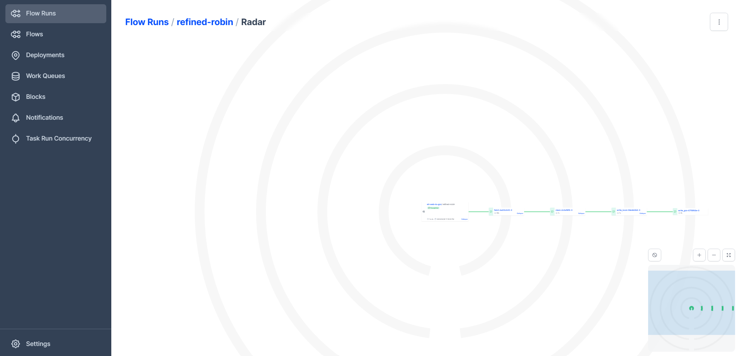
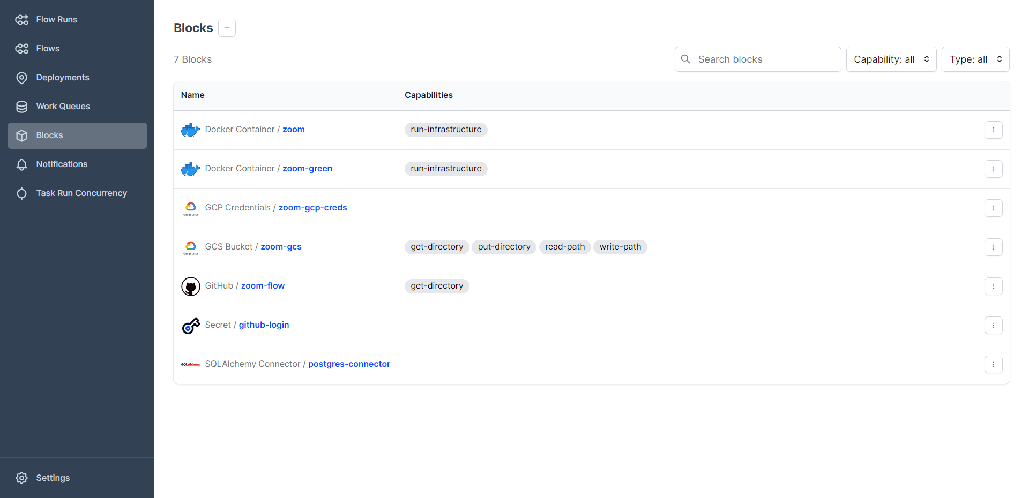
PREFECT UI

