Slide 1


Adaptive Multi-Stage Behavioural Progression Architecture for Early Detection of SIP Toll Fraud
K.M.U.P. Kosgoda
MS24913188
MSc in Information Systems
Sri Lanka Institute of Information Technology
Supervisor: Dr. Nimal Ratnayake
Notes:
My research topic is Adaptive Multi-Stage Behavioural Progression Architecture for Early Detection of SIP Toll Fraud.
This research focuses on VoIP security, especially SIP-based toll fraud. The main idea is to detect suspicious SIP behaviour before it reaches the final fraud burst stage.
In the previous proposal stage, I mainly presented the research problem, gap, conceptual framework, and methodology. In this progress presentation, I will briefly remind the background and then mainly focus on the practical progress I have completed so far.
I will explain the lab setup, the normal SIP behaviour baseline, the simulated SIP traffic generation using SIPp, and how these outputs will be used for feature extraction, stage detection, risk scoring, and validation.

Slide 2

Introduction
Voice over IP is widely used because it is flexible, scalable, and cost-effective.
SIP is a core signalling protocol used in modern VoIP environments.
However, this openness also creates security risks.
SIP toll fraud can cause serious financial and operational damage.
In many cases, fraud develops through several suspicious stages.
Therefore, early detection is important before the fraud burst occurs.
Need: early detection before the fraud burst happens
Notes:
Voice over IP is widely used in modern organizations because it is flexible, scalable, and cost-effective.
SIP, or Session Initiation Protocol, is one of the main signalling protocols used in VoIP systems. SIP is responsible for actions such as registration, call setup, call control, and call termination.
However, because SIP services can be exposed through networks, they also become a target for attackers. One important threat is SIP toll fraud. In toll fraud, attackers abuse the VoIP system to make unauthorized calls, which can create financial loss and operational disruption.
The important point in my research is that toll fraud usually does not happen suddenly. Before the fraud call burst happens, there can be early warning signs such as scanning, probing, failed registration attempts, and unusual SIP behaviour.
Therefore, the need of this research is to detect these early signs before the fraud burst happens.

Slide 3
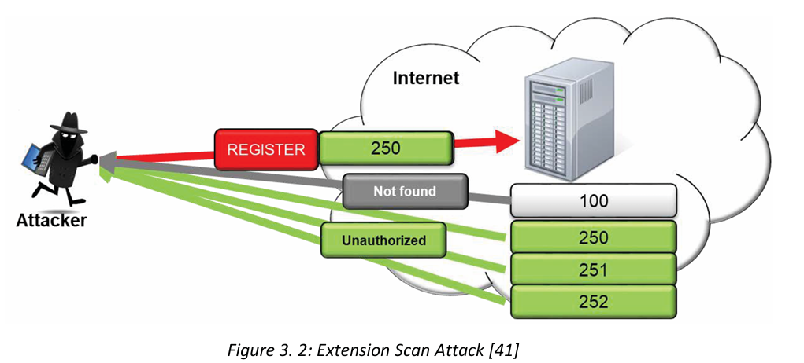
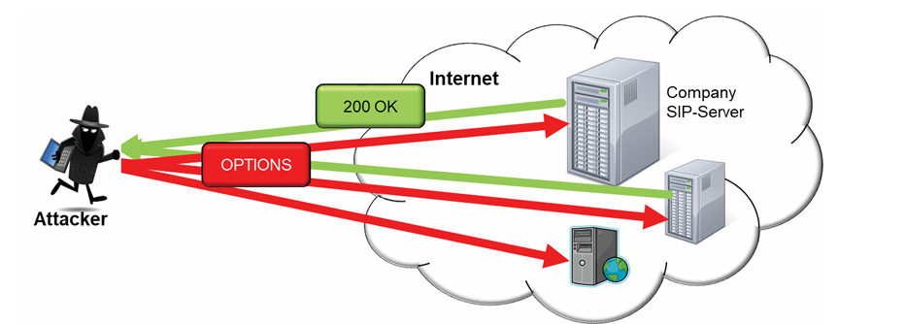


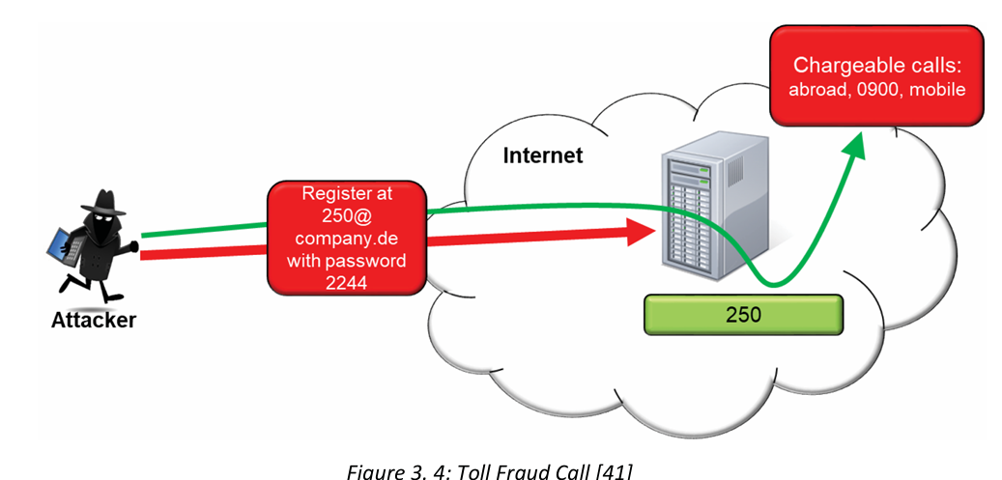
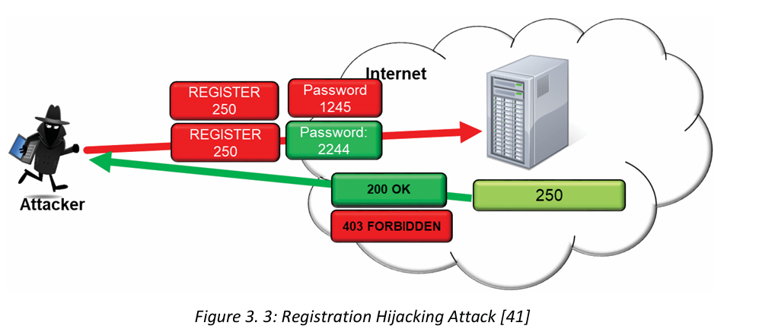


Introduction (contd.)
Need: early detection before the fraud burst happens
Notes:
This slide shows the basic idea of the fraud progression.
The first stage is reconnaissance. In this stage, the attacker tries to check whether the SIP service is reachable. They may send messages such as OPTIONS or INVITE to see how the PBX responds.
The second stage is authentication attack. Here, the attacker tries to register as a valid SIP extension or account. This may appear as repeated REGISTER attempts or repeated 401 and 403 responses.
The third stage is compromise. This means the attacker may successfully register or gain access using valid credentials.
The final stage is fraud burst. This is where the attacker starts making unauthorized outbound calls, usually to expensive or unusual destinations.
My research focuses on detecting the earlier stages, not only the final fraud call. That is why this is called a multi-stage behavioural progression approach.

Slide 4

Research Aim and Objectives
Aim
To design, build, and evaluate an adaptive multi-stage behavioural progression architecture for early detection of SIP toll fraud.
Objectives
Identify early SIP and behavioural indicators before fraud starts.
Develop a stage-aware progression model for monitored entities.
Implement the framework in a VoIP lab environment.
Apply lightweight machine learning to improve risk scoring.
Evaluate using accuracy, false alerts, time-to-detect, and overhead.
Notes:
The aim of this research is to design, build, and evaluate an adaptive multi-stage behavioural progression architecture for early detection of SIP toll fraud.
There are five main objectives.
First, I need to identify early SIP and behavioural indicators before fraud starts. These include messages like OPTIONS, INVITE, REGISTER, and SIP response codes such as 401, 403, and 404.
Second, I need to develop a stage-aware progression model. This means the system should track how an entity, such as an IP address or extension, moves from reconnaissance to authentication attack and then possibly to fraud.
Third, I need to implement the framework in a VoIP lab environment. This is why I created the Asterisk PBX and SIPp traffic generator lab.
Fourth, I plan to apply lightweight machine learning to improve the risk scoring. But before that, I am first building the rule-based stage logic and dataset.
Fifth, I need to evaluate the framework using metrics such as accuracy, false alert rate, time-to-detect, and overhead.
So this research is not only a theoretical proposal. It is moving toward a practical prototype and measurable evaluation.
. It is also about building a prototype and testing whether it works in practical conditions.

Slide 5
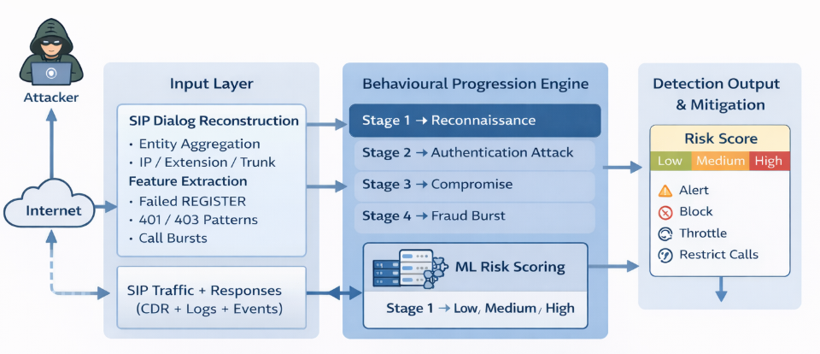
Proposed Conceptual Framework
Main idea:
Performs entity-based behavioural analysis by tracking SIP activity for entities such as IP addresses, extensions, trunks, and destinations.
Shifts SIP security from isolated event detection to progression-aware early detection with practical mitigation support.
Notes:
This slide shows the main conceptual framework of my research.
The framework starts with evidence collection. The system collects SIP traffic, PBX logs, and CDR records.
Then it performs behavioural representation. Instead of looking at only one SIP message, it groups activity by monitored entities. An entity can be a source IP address, SIP extension, trunk, or destination group.
After that, features are extracted. For example, the system can count how many OPTIONS requests came from an IP, how many REGISTER attempts failed, how many 401 responses occurred, or whether there is an unusual outbound call attempt.
The core part is the behavioural progression engine. This engine maps the observed behaviour into stages such as reconnaissance, authentication attack, compromise, and fraud burst.
The output is a stage label and risk score. Later, this can support mitigation actions such as alerting, throttling, temporary blocking, or route restriction.
In simple words, my framework moves from isolated event detection to progression-aware early detection.

Slide 6
Practical Progress After PP1
01 | INFRASTRUCTURE MIGRATION
From two Azure VMs to two physical Raspberry Pis for repeatable SIP tests
Earlier — Azure laboratory
Current — isolated Raspberry Pi laboratory
Asterisk PBX VM
SIPp traffic-generator VM
Initial OPTIONS / REGISTER / INVITE checks
Astrix-lab · Asterisk 20.6.0 · 172.16.200.81
Sipp-generator · SIPp · 172.16.200.68
PCAP + PJSIP logs + CDR evidence
LAB ISOLATED · NO PSTN
TWO CONTROLLED ACCOUNTS
CONTROLLED SIP TRAFFIC
PP2 change: we moved beyond collecting logs to detector development, ML and measured evaluation.
PP2 • Research progress | Controlled lab evidence | October 2026
Notes:
In my first progress presentation I demonstrated the Asterisk and SIPp lab using two Azure virtual machines. Later I migrated the experiment to two Raspberry Pis so I could run repeated controlled tests locally. The SIPp generator uses the address 172.16.200.68, and the Asterisk PBX uses 172.16.200.81. Both were reachable at the latest check. Our tests use only isolated extensions and temporary lab routes; no external paid calls are involved. This slide is about what changed since PP1, not a comparison of Azure and Pi performance.

Slide 7
Experimental Workflow and Evidence
02 | END-TO-END IMPLEMENTATION
1
2
3
4
5
6
SIPp
Generator
Asterisk
PBX
PCAP + logs
+ CDR
Event parser
+ features
V6 stage
detector
ML review
+ evaluation
Independent verification
Early-decision boundary
Packet timestamps • confirmed PBX failures • completed call records
Future call outcome must NOT be used as a live prediction feature.
PP2 • Research progress | Controlled lab evidence | October 2026
Notes:
This is the practical workflow. SIPp on the generator Pi sends specific normal or simulated attack patterns to Asterisk. We save network packet captures, PBX logs, and call-detail records. The parser turns these sources into time-stamped events. The stage detector observes reconnaissance, confirmed authentication failures, successful registration and outbound attempts. The lightweight ML part is a separate review layer. We verify alert stages against independent PCAP, log and CDR evidence. CDR confirms the final outcome of a call, but we cannot use it in a detector claiming to make an early-time decision.

Slide 8
Detector Evolution: V2 to V6
03 | IMPLEMENTATION ITERATIONS
V2
Initial request/count rules
Simple thresholds
V3
First stage-event replay
Alert gaps exposed
V4
Timing and behaviour refinement
Robustness experiments
V5
Confirmed authentication failures
Avoid raw 401 overcounting
V6
Linked progression stages
Multi-step behaviour tracked
Main improvement: observe meaningful SIP transitions, not only raw message totals
PP2 • Research progress | Controlled lab evidence | October 2026
Notes:
I did not build the final detector in one step. I changed the detection logic after finding false alerts and missed scenarios. Early versions largely counted SIP requests. V5 improved the handling of transaction-confirmed authentication failure: one normal 401 digest challenge is not itself a failed password. V6 then linked events into behavioural stages, including reconnaissance, authentication attack, recovery after failed login, and linked outbound activity. These are research iterations, not production releases.

Slide 9
Controlled Lab Scenarios: F01–F12
04 | STAGE-DETECTION EVALUATION
V3
66.7% F1
V6 CONFUSION MATRIX
6
1
V5
83.3% F1
TP
FP
V6
92.3% F1
5
0
TN
FN
Limitation: false alert in F05 (legitimate password recovery + authorized call).
PP2 • Research progress | Controlled lab evidence | October 2026
Notes:
I registered twelve controlled scenarios: six benign controls and six simulated attack scenarios. For V6, all six assigned attack scenarios were flagged, but one benign recovery scenario was also flagged. This gave six true positives, one false positive, five true negatives and no false negatives. Precision was 85.7 percent, recall 100 percent, and F1 92.3 percent. V3 and V5 were weaker on this particular small set. The cases are deliberately controlled; these numbers should not be presented as real-world accuracy.

Slide 10
Why Benign Behaviour Can Look Like Fraud
05 | GROUND-TRUTH AND FALSE ALERTS
AUTHORIZED USER
SIMULATED UNAUTHORIZED ROLE
Old password → confirmed failures
Password corrected → successful REGISTER
Normal call may follow
Controlled wrong-password attempts
Supplied lab credential → valid REGISTER
Isolated emulated outbound attempt
Same observable SIP sequence → Same stage / ML result
Finding: independent account + destination permission context is required.
PP2 • Research progress | Controlled lab evidence | October 2026
Notes:
A key finding is that SIP behaviour alone does not always tell us whether a person has permission. For example, an authorized user may have an old password stored on a phone, generate several real authentication failures and then successfully register. Our isolated simulated-abuse scenarios can deliberately create the same sequence. In the matched pairs H003 versus H007 and H004 versus H008, the SIP evidence produced the same V6 stage output and the same frozen ML decision even though the assigned roles were opposite. Therefore an alert is a signal for investigation, not proof of theft, compromise or toll fraud.

Slide 11
Dataset Generation and Evidence Validation
06 | LOCAL SCENARIOS + CDR
24
10
34/34
21/21
Development
scenarios
Frozen held-out
scenarios
PCAP evidence
verified
Answered lab
CDRs reconciled
Evidence recorded per scenario
Important distinction
Manifest + packet capture + auth log + CDR delta + model hash
Retrospective CDR confirms the call; it does not identify the caller’s permission.
PP2 • Research progress | Controlled lab evidence | October 2026
Notes:
For the local modelling experiment, I collected 24 development scenarios and froze the model before collecting 10 held-out scenarios. All 34 archived runs passed independent SIP packet, authentication-log and call-outcome verification. On 10 October I also recalculated the archive hashes and reconciled the run-local call records: 21 new answered lab CDR rows were found, all with six seconds billable time and isolated test destinations. This verification increases reproducibility but does not transform existing test data into new held-out observations.

Slide 12
Local Machine Learning: Held-out Results
07 | DECISION TREE VS V6
Method | TP | FP | TN | FN | Bal. accuracy
Frozen decision tree | 1 | 0 | 5 | 4 | 60%
V6 any-stage rules | 3 | 2 | 3 | 2 | 60%
V6 answered-stage | 2 | 1 | 4 | 3 | 60%
6 / 10
1 / 5
60%
Retrospective ML correct
Simulated abuse detected
Balanced accuracy
PP2 • Research progress | Controlled lab evidence | October 2026
Notes:
I evaluated lightweight machine learning, including logistic regression and a shallow decision tree. The first frozen local model was evaluated on ten held-out scenarios, five assigned benign and five assigned simulated abuse. It classified six correctly, but it detected only one of the five simulated abuse cases. Its true-positive, false-positive, true-negative and false-negative counts were 1, 0, 5 and 4. The V6 any-stage result also had balanced accuracy of 60 percent, but it had a different false-alert and missed-case pattern. Also, this first model used final CDR information, so it is retrospective, not a live early predictor. We cannot claim ML improved fraud-intent detection.

Slide 13
Public SIP Dataset: Separate ML Experiment
08 | PUBLISHED INVITE-FLOODING BENCHMARK
1,351,310
4
Train on file 1
Public INVITE message rows
Public CSV files
Evaluate on files 2, 3 and 4
File 2
91.44%
File 3
96.67%
File 4
96.82%
Balanced accuracy measures the two labels fairly; it is not local toll-fraud accuracy.
PP2 • Research progress | Controlled lab evidence | October 2026
Notes:
I also reviewed eight publications and separately studied an author-linked public dataset containing 1,351,310 SIP INVITE message rows across four files. These are SIP messages, not 1.35 million completed calls. I trained a small decision tree on file 1 using only timing information: the gap from the previous INVITE, the count in the past one second and the count in the past ten seconds. On files 2 to 4, balanced accuracy was 91.44, 96.67 and 96.82 percent. This is a different flooding-classification task on a synthetic published dataset; the figures do not improve or validate the local fraud-intent model.

Slide 14
Live Native vs External Detector Comparison
09 | ASTERISK MODULE AND PYTHON SERVICE
7 / 7
21
5
Declared test cases passed
Answered isolated lab calls
Online stage categories
Stage | Native median | External median
Reconnaissance | 0.085 ms | 628.5 ms
Authentication attack* | 1,016.0 ms | 1,907.2 ms
Recovery + ML review | 4.709 ms | 394.0 ms
Linked outbound attempt | 0.090 ms | 522.1 ms
Third distinct call burst | 0.091 ms | 640.7 ms
*Includes a one-second retry grace; stage timing origins are not identical.
PP2 • Research progress | Controlled lab evidence | October 2026
Notes:
I compared a passive C-based observer inside Asterisk with an external Python detector fed by SIP events. Seven predeclared live laboratory cases passed packet, authentication-log, CDR and cleanup checks, with 21 answered lab calls. The native and external paths reproduced the same five online stage categories and frozen ML metadata in the declared enabled cases. Native median packet-to-decision delay was lower in this small pilot. The authentication row includes a one-second retry grace, so that delay is not pure processing time. Seven cases are not enough to establish a general production speed guarantee.

Slide 15
Call Setup and Resource Measurements
10 | PERFORMANCE LIMITATIONS
Deployment mode | Case A: median setup | Case B: median setup
Detector OFF | 15.710 ms | 12.900 ms
Native in Asterisk | 60.539 ms | 43.350 ms
External detector | 38.099 ms | 19.613 ms
What was measured
What is not established
Packet-to-decision, call setup, CPU and process memory
Causal overhead, long-term stability or production throughput
PP2 • Research progress | Controlled lab evidence | October 2026
Notes:
I also measured how the deployments behaved while calls were set up. In the primary live comparison, the two disabled-detector control cases had median setup times of 15.710 and 12.900 milliseconds. Native cases were 60.539 and 43.350 milliseconds, while external cases were 38.099 and 19.613 milliseconds. The whole PBX CPU was about 0.20 to 0.22 percent of one core in primary cases, but Wi-Fi variation, very few repetitions and measurement limits prevent a causal overhead conclusion. Native decisions were faster in the pilot, but we cannot claim zero PBX call-setup overhead.

Slide 16
Latest Lab Checkpoint: 10 October 2026
11 | VERIFIED ARCHIVE + PARTIAL FRESH CONTROL
Archive integrity
Call record reconciliation
34 / 34 PCAP files + frozen model hash verified
21 / 21 isolated answered CDRs verified
New control | Description | Status
P001 | Repeated REGISTER to 1 configured account | PASS
P002 | REGISTER across 2 configured accounts | STOPPED — timeout
P003 | Single unused identity repeated | NOT RUN
P004 | Multiple unused identities | NOT RUN
PP2 • Research progress | Controlled lab evidence | October 2026
Notes:
At the latest checkpoint I verified the historical evidence again. All 34 archived PCAP hashes and the frozen model hash matched. Twenty-one new answered CDR records across those archived scenarios reconciled correctly. I also started a separate, bounded four-case unauthenticated REGISTER-only control test on the isolated Pi network. P001, repeated requests to one configured account, passed without a diversity alert. P002, using two configured accounts, stopped after a missing response at the generator despite a response visible in packet capture. It is a failed or incomplete case, not a passed control. The remaining P003 and P004 cases are still pending. This new test is not a fraud-intent accuracy experiment.

Slide 17
Research Objectives: Current Evidence
12 | PROGRESS AGAINST THE PROPOSAL
O1
Early SIP indicators
Implemented; permissions still need validation
O2
Stage-aware progression
V6 works; no universal early-detection proof
O3
Internal/external deployment
Both paths compared in a live lab pilot
O4
Lightweight ML refinement
Model evaluated; improved local outcome not shown
O5
Detection + runtime evaluation
Initial metrics complete; broader tests pending
PP2 • Research progress | Controlled lab evidence | October 2026
Notes:
This slide maps the actual results to my five research objectives. For O1, I identified meaningful SIP indicators, but independent permission context still needs testing. For O2, a stage-aware V6 engine is working, but it has not been universally earlier than simple rules. For O3, both native and external implementations were tested on a declared pilot. For O4, lightweight ML was evaluated, but it did not establish better local fraud-intent classification. For O5, I measured accuracy, false alerts, timing, call setup and CPU and memory, but longer live and real-world validation remains. The research is progressing, although not every hypothesis is proven.

Slide 18
Remaining High-Priority Validation
13 | WORK REQUIRED AFTER THE CURRENT PP2 CHECKPOINT
01
Permission context
Predefine allowed accounts, destinations and sessions
02
Normal traffic controls
Recovery, multi-account source and mixed patterns
03
Fair comparative holdout
Same early-time endpoint for rules, policy and ML
04
CDR + stress validation
Consented normal calls; repeated live load and stability
PP2 • Research progress | Controlled lab evidence | October 2026
Notes:
The next priority is to use independent account and destination policy context, rather than assigning an intent label from a SIP pattern. Then I need more realistic normal controls, including multi-account traffic behind a shared source, legitimate recovery and mixed traffic. I must freeze a common early-detection endpoint and compare simple baselines, the V6 progression rules, permission-context checks and a causal ML model on a genuinely fresh grouped test set. Finally I should collect a stronger normal CDR baseline and repeat controlled load tests. Those experiments remain to be done, so I am presenting this as a research plan rather than a completed finding.

Slide 19
PP2 Conclusion: What I Can Demonstrate
14 | MAIN RESEARCH CONTRIBUTION TO DATE
What I built
What I measured
Two-Pi lab + event parser
V2–V6 detection engine
Native + external observers
F01–F12 and H001–H010
Public flooding benchmark
21-call live deployment pilot
Suspicious SIP progression ≠ verified unauthorized toll fraud
PP2 • Research progress | Controlled lab evidence | October 2026
Notes:
To conclude, I have moved from the initial Azure-based demonstrations to a two-Raspberry-Pi laboratory with a working stage-aware detector, a reproducible scenario and evidence process, a local ML experiment, a separate public flooding benchmark and an initial native-versus-external deployment comparison. My most important research finding is not simply a high accuracy number. It is that suspicious SIP behaviour can be tracked through stages, but the same observable sequence can belong to a legitimate user or a simulated abuse role. Therefore, alerts are signals for review, and we need independent permission context and broader prospective evaluation before making strong claims about unauthorized toll fraud.

Slide 20
Thank You
Questions and Discussion
Notes:
Thank you for reviewing my second research progress presentation. The prototype and controlled evidence are available, including archived packet captures, Asterisk logs, isolated call records and ML checkpoints. I welcome feedback on independent permission context, the fresh held-out evaluation plan and the scope of the remaining research before final thesis submission.

