Slide 1
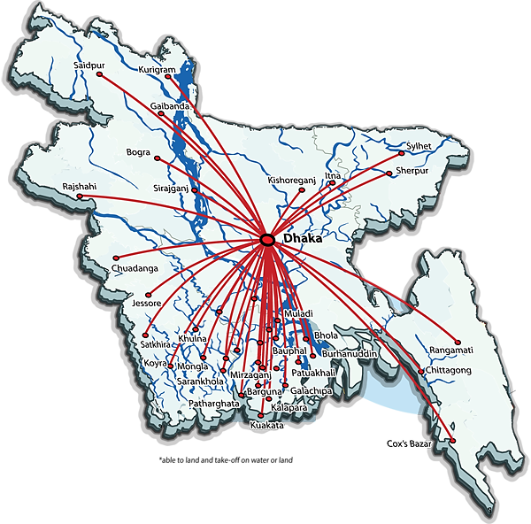

ne click
Simple| Easy | Handy

Slide 2
“Where there is problems, there is opportunity.”
Notes:
Insert a map of your country.

Slide 3
motivation
Bangladesh is a country with many beautiful and historical places but there is no digital tour guide
There is no simple way to know the distances between these great and visit worthy places
Notes:
Insert a picture of one of the geographic features of your country.

Slide 4
Objective
Computes travel distance
Journey duration
Visiting places between cities (Four, for now)
Types of vehicle (Bus, for now)

Slide 5
Existing project Analysis
Could not found one
Started from scratch

Slide 6
project analysis (general view - 1)
Starting point
P₁
P₂
Final destination
Destination city
bus station

Slide 7
project analysis (Example)
Press -1 to exit
From:
Press respected number to choose respected city:
Dhaka – 1, Khulna – 2, Sylhet – 3, Chittagong - 4
1
Dhaka
To:
2
Khulna
Choice:
Mawa resort – 1
Padma Resort – 2
Khan Jahan Ali Bridge – 3
There are some places worth visiting between Dhaka and Khulna. Do you want to visit any of them?
Yes – 1, No -2
1
2
Visiting places in here:
Sixty Dome Mosque – 1
Shilaidaha Kutibari – 2
Sundarbans – 3
Padma Resort to Khulna bus station:
Distance : 184 km
Approximate Time: 6 h 46 min
Dhaka to Padma Resort:
Distance : 40.2 km
Approximate Time: 1 h 49 min
Khulna bus station to Si Sixty Dome Mosque :
Distance : 29.1 km
Approximate Time: 39 min
-1
Exit
1

Slide 8
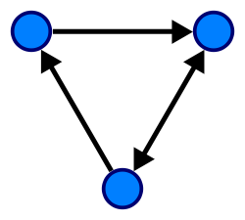
Used Data Structure (Graph)
A graph is a pictorial representation of a set of objects where some pairs of objects are connected by links.
A graph data structure consists two thing:
Nodes / Vertices
Connecting lines / Edges

Slide 9
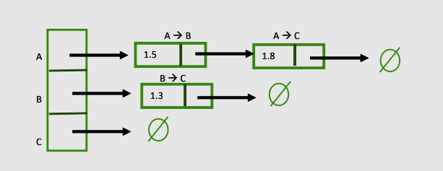
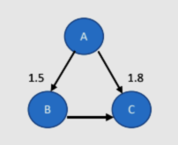
Graph Data structure
Link list based implementation (Directed)

Slide 10
Expected outcome
Enrich our tourism industry
Suitable guidance for people ( specially, for foreign tourists)
Simple way to know and visit worthy places
Reducing tour-guide cost
Keep up with today’s digital world

Slide 11
Challenges we faced
We had to start from scratch
Did not have any guide line, so we need to invent one
Do not have enough knowledge about graph data structure
Did not have enough man power to work on a large scale
Normally, these kind of project is built on JAVA, which is easer to work with than C. With a very short time, it makes things harder.

Slide 12
Future
With enough man power and a good knowledge, this project can be improved and can be used in real life
It can be implemented for whole BANGLADESH.
It can be a very good milestone for our tourism industry

Slide 13
reference
[1] Md Rahim Iqbal, “Data Structure Complete Self-study”, Unpublished Manuscript, DIU, Dhaka, Bangladesh, pp. 58-60 [Online]. Available: https://drive.google.com/file/d/0B9Mv1JjCg9jpNmJpUVFhWmN3TTQ/view. [Accessed: Mar. 23, 2018]
[2] Block Diagram [Online]. Available: https://www.smartdraw.com/block-diagram/. [Accessed: Mar. 23, 2018]
[3] Maps [Online]. Available: https://www.google.com.bd/maps/@23.7925904,90.3701279,15z?hl=en. [Accessed: Mar. 23, 2018]
[4] A guide to IEEE referencing style for Murdoch University students and staff [Online]. Available: http://libguides.murdoch.edu.au/IEEE/internet. [Accessed: Mar. 23, 2018]

Slide 14
Presented by
Abdullah AL Noman – 172 – 15- 10134
Hasib Ratul – 172-15-9973
Safia Khatun – 172-15-9933
Zuhayer Mohtasim Bin Sarwar – 172-15-10133

Slide 15
THANK YOU!

