Slide 1
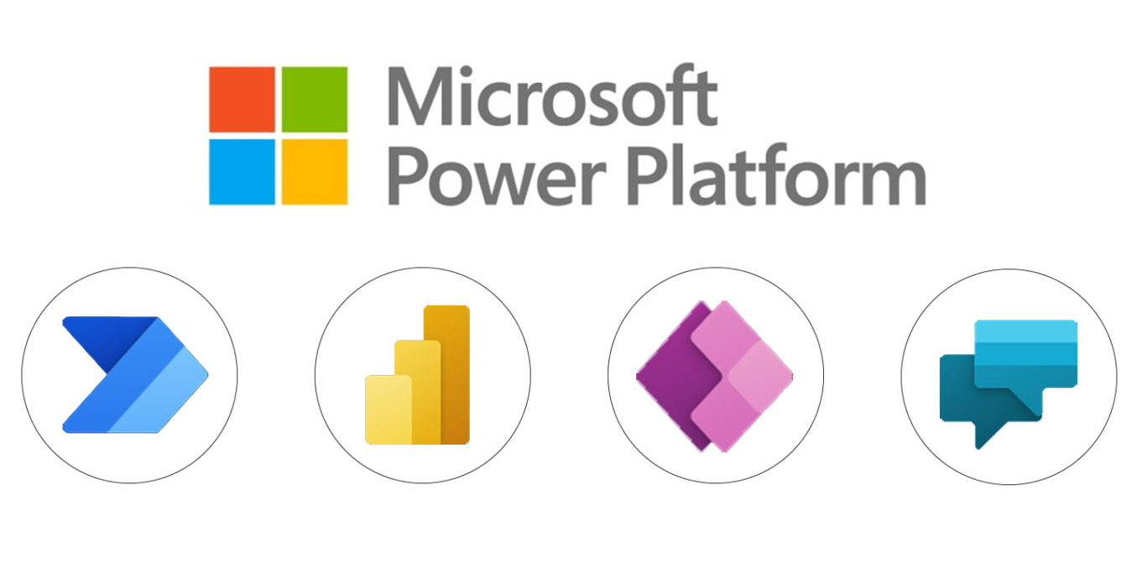
Power Automate
Power BI
Power Apps
Copilot Agents
Process Automation
Business Analytics
App Development
Custom Agent

