Slide 1

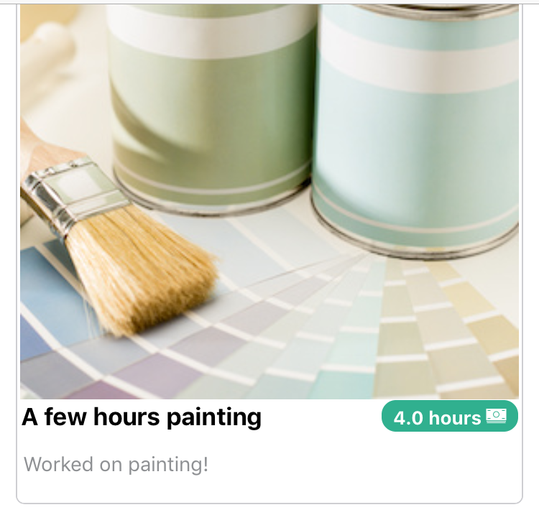
Coloryzer
Coloring the world a little at a time
Daniel Epstein & Fake Fakerson
IN4MATX 241/CS 248A, Winter 2018
The Problem
Our Solution
The world does not have nearly enough color in it
Color ink is too expensive, graduate students cannot afford it
The Coloryzer app lets people track their painting progress
Can log photos, hours spent, and cost
Formative Findings
Evaluation
Surveyed 15 people
7 suggested that paint could be an effective alternative to ink
“Can you paint with all the colors of the wind?” –p12
Ran a lab study with 11 participants
8 participants preferred Coloryzer to Not Coloryzer
”Coloryzer is a game-changer” -p4

