Slide 1

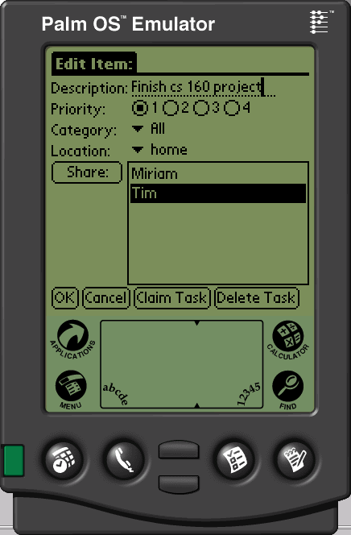
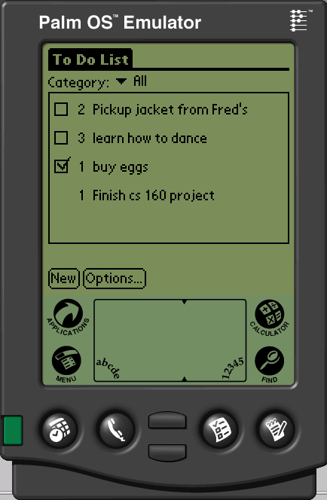
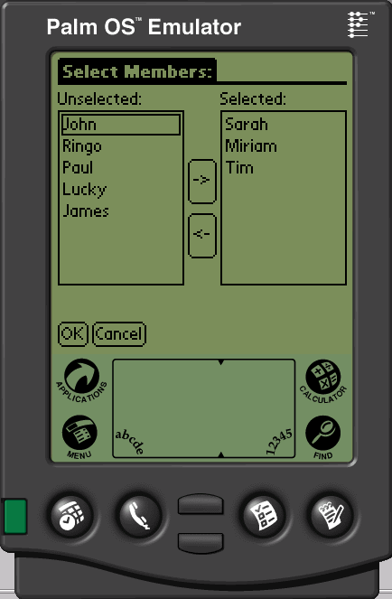
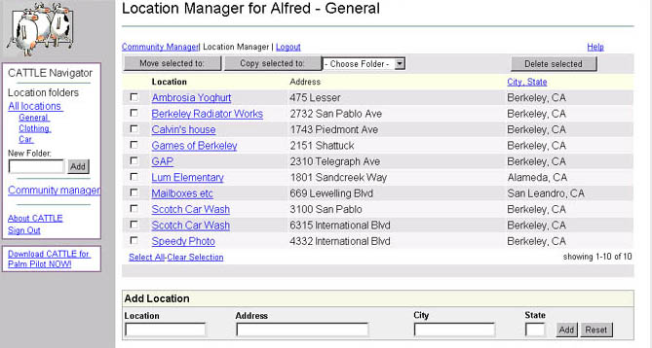
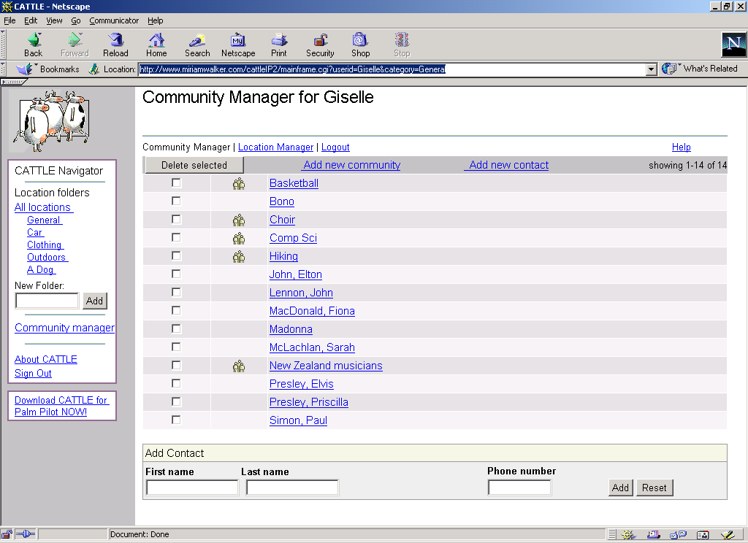
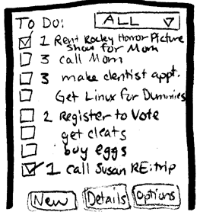
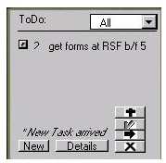
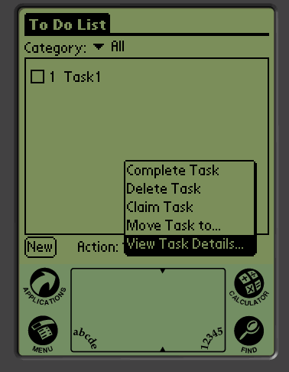
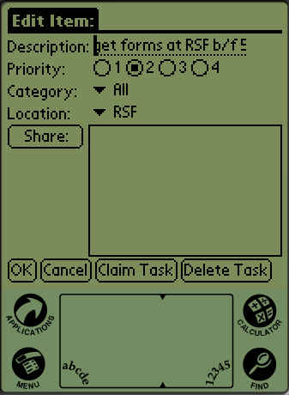
The Cow Project
Saving the world, one cow at a time
Overview
The basic problem you are attacking. Short and sweet introduction.
Our Solution
Put key features here. Lots of images & limited text. Annotate!
Design Iteration
Annotate changes with design rationale
Alexis Hope, Ryder Ziola, James Fogarty, Waldo
http://www.cs.washington.edu/440/sp11/project_files/hamburger/
CSE 440
Spring 2011

