Slide 1
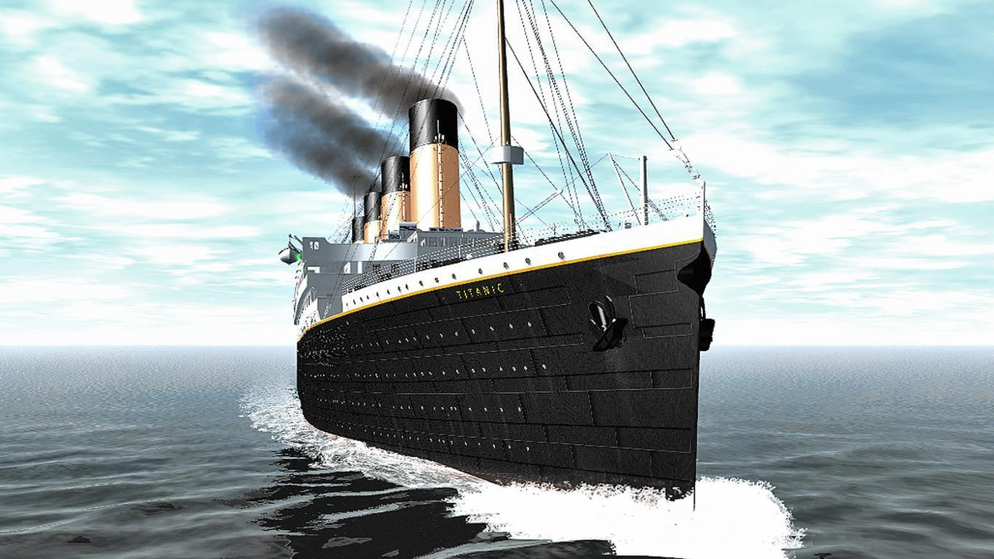
Titanic : Machine Learning From Disaster
Presented By -
Neha Singh

Slide 2
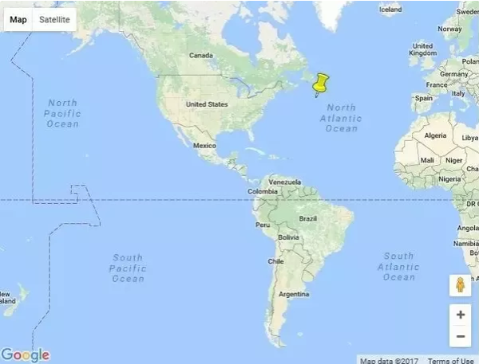
The Titanic Disaster
Date – April 15, 1912
Place – East 1610km of
Boston, Massachusetts, the
U.S.A
Location – Saint Jones offing
604k, Newfoundland
Overview - The luxury passenger liner Titanic, which was said to be unsinkable, on it's way from England to New York collided with an iceberg and sank.
Incident - When crews discovered an iceberg, they steered the ship to evade it, but the vessel collided, the hull eventually broke in half, and sank. Insufficient number of lifeboats and the late call for help were responsible for many of the 1,517 deaths.

Slide 3
Introduction
Here we have applied Machine Learning tools to analyze how the survival of passenger was related to other passenger data like Age, Gender etc.
Later we will be able to use this model to predict the possibility of survival for a new passenger data input.

Slide 4
Tools Used:
Libraries Needed:
Algorithms Used:
Numpy
Pandas
Sklearn
Matplotlib
Seaborn
Random Forest
Decision Tree
Logistic Regression
K-Nearest Neighbors
Support Vector Classifier

Slide 5
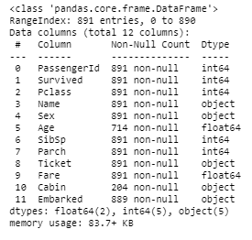
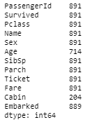
Dataset Information
Count
Information

Slide 6
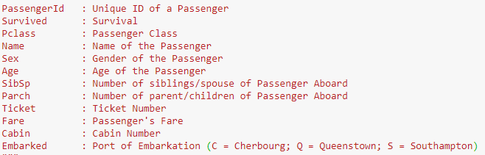
Abbreviations used for Column names in the Dataset:

Slide 7
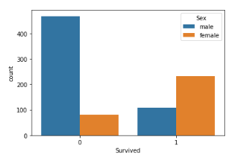
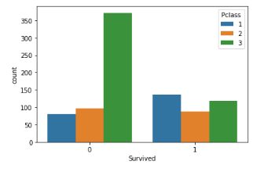
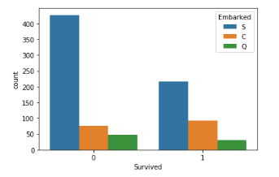
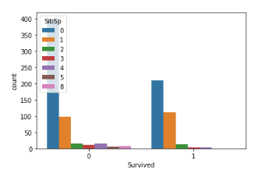
Survived VS Possible Features

Slide 8
Analysis:
Percentage of Female survival is far better than Male.
Female: 74.2% Male: 18.9%
The plot confirms our assumption about Pclass 1,but we can also spot a high probability that a person in Pclass 3 will not survive.
The passengers Embarked from Port C are having better survival percentage than that that of other 2 ports.
C: 55.35% Q: 38.96% S: 33.69%
The survival of passenger having 1 or 2 sibling/spouse is having a better chance of survival. But percentage variation isn’t considerable
0: 34.5% 1: 53.6% 2: 46.4% 3: 25%
4: 16.6% 5: 0% 8: 0%

Slide 9
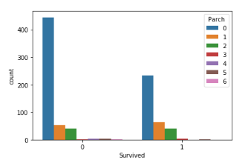
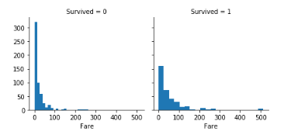
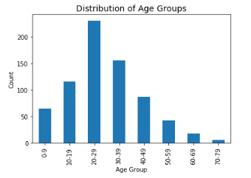
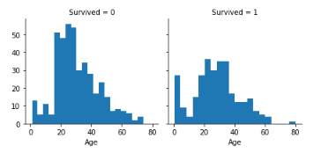
Continued…

Slide 10
Analysis
The survival of passengers with 1,2 or 3 Parents/Children along are having better survival percentage than that of one having no Parch value. But variation isn’t that much of use to learn.
0: 34.3% 1: 55% 2: 50% 3: 60% 4: 0% 5: 20% 6: 0%
Looking at Fare VS Survived graph we can see that the survival percentage of the ones who have given more fare is higher.
->Infants (Age <=4) had high survival rate.
->Oldest passenger (Age = 80) survived.
->Large number of 15-25 years old passengers did not survive.
->Most passengers are in age range of 15-35 years.

Slide 11
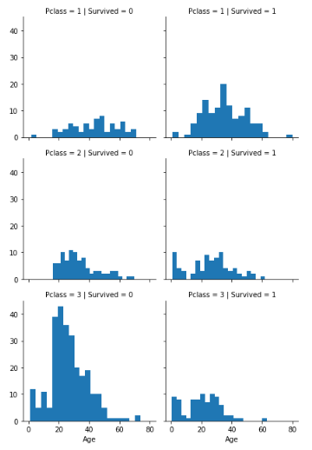
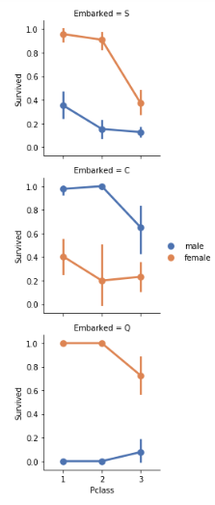
Inter-Relation Between Features

Slide 12
Inter-Relation Conclusion:
Survival of Pclass 1 is more than any other in case of Age-> 15-25.
But we can also spot that the Age group of 15-25 in Pclass 3 have a very low percentage of survival as compared to other two Pclasses.
Embarked seems to be correlated with survival, depending on the gender.
Women from port Q and from port S have a higher chance of survival. The inverse is true, if they are from port C.
Men have a high survival probability if they are from port C, but a low probability if they are from port Q or S.

Slide 13
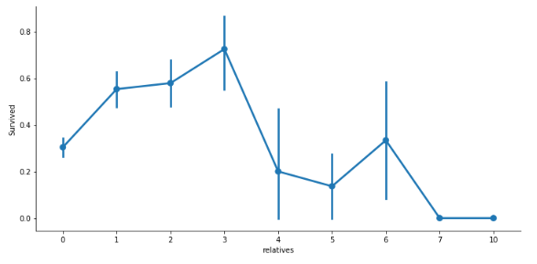
Merging the Pclass and SibSp into Relative
Here we can see that a passenger had a high probability of survival with 1 to 3 relatives, but a lower probability if he had less than 1 or more than 3 relatives (except for some cases with 6 relatives). But this doesn’t affect much.

Slide 14
What we Analyzed:
As the Cabin column in the data had insufficient number of entries(i.e. 23%), we need to exclude that from the features in consideration.
The features Parch and SibSp doesn’t make much difference in survival percentage when compared to each other, thus excluded.
Passenger ID , Ticket ,Name doesn’t seem to be useful feature as they are independent of the target value ‘Survived’ and thus it can’t be used for analysis.
Rest of the features seem to be useful as per what we have seen in the graph visualization.

Slide 15
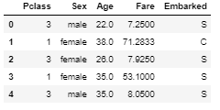
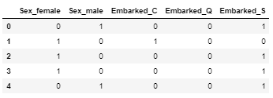
Features Taken:
Encoding Object Values of features taken:
Pclass
Sex
Age
Fare
Embarked

Slide 16
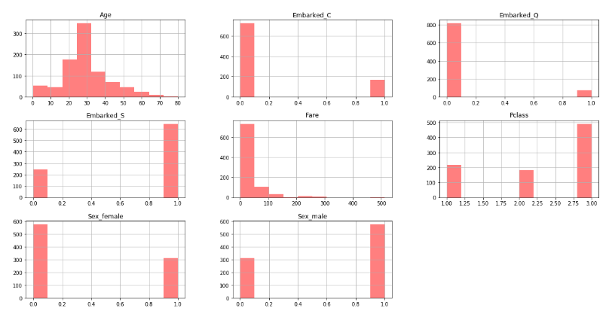
Each Feature with Corresponding Values

Slide 17
Algorithms Used :
Logistic Regression
Random Forest Classifier
Decision Tree
Support Vector Classifier
K – Nearest Neighbors

Slide 18
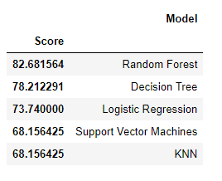
Accuracy Score of each Algorithm

Slide 19
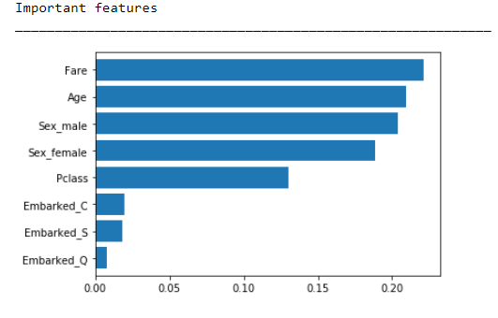
Feature Importance
According to Random Forest Classifier

Slide 20
Conclusion:
Random Forest seems to be the best model for prediction here with accuracy of around 83%,followed by Decision Tree and Logistic Regression with accuracy of 78% and 73% respectively.
K-Nearest Neighbors and Support Vector Classifier doesn’t seem to fit the data good with 68% of accuracy in prediction .
No Algorithm can predict with 100% accuracy

Slide 21
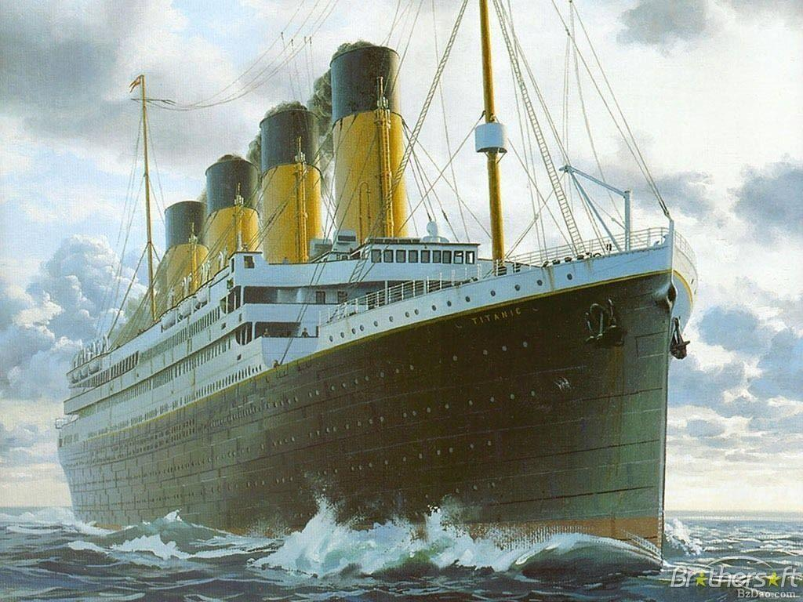
Thank You

