Slide 1
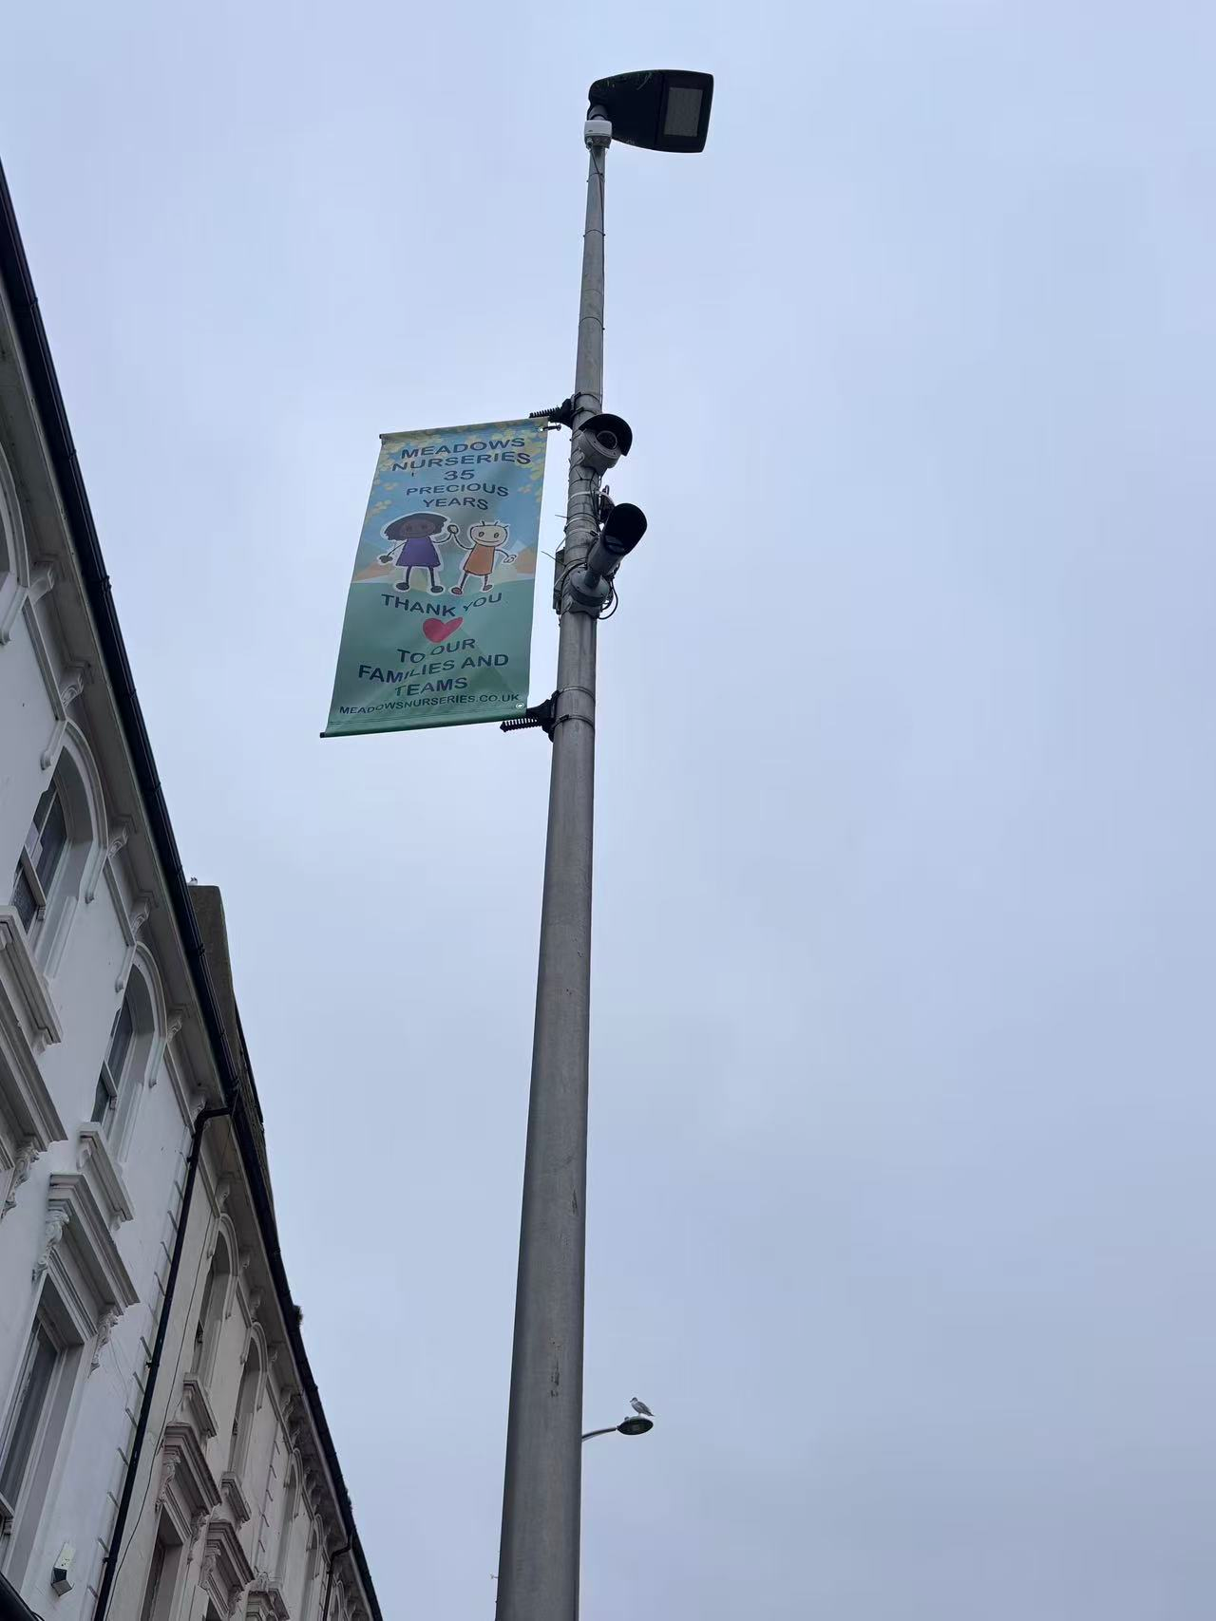
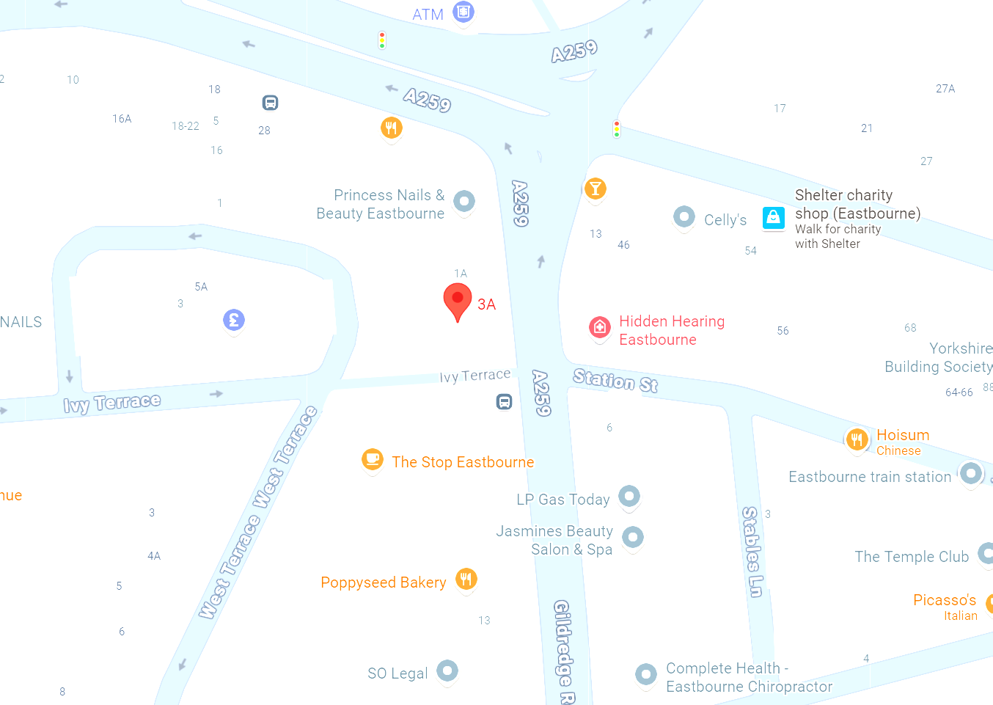
Traffic Monitoring Sensor.
This traffic monitoring sensor might is part of a smart city technology system designed to collect data about road use and vehicle movements.
It uses cameras and sensors to detect traffic flow, vehicle speed, and congestion patterns. The information gathered helps local councils and transport authorities improve traffic management, safety, and air quality.
Questions when visiting site?
What type of data do these sensors collect about vehicles and traffic?
How might this technology help to reduce congestion?
Who is this technology for?
Location info:
@50.7686, 0.2847
3a Gildredge Rd, Eastbourne, BN21 4RD
https://maps.app.goo.gl/vpfRCFcet6P5BMe58
what3words: https://w3w.co/agreed.scans.guilty
Submitted: Xintong Shao Oct 2025
Notes:
A title and a couple of sentences describing the technology and possibly linking to further information online.
A photo of the technology in situ with a corresponding map showing where it is.
2 or 3 questions that you might ask when you are in situ at the site of the technology to engage others in a discussion about that technology
The following geographic data:
Lat Long
Street Address
Google maps link
What3words location
Also add in the names of those submitting this data.

Slide 2
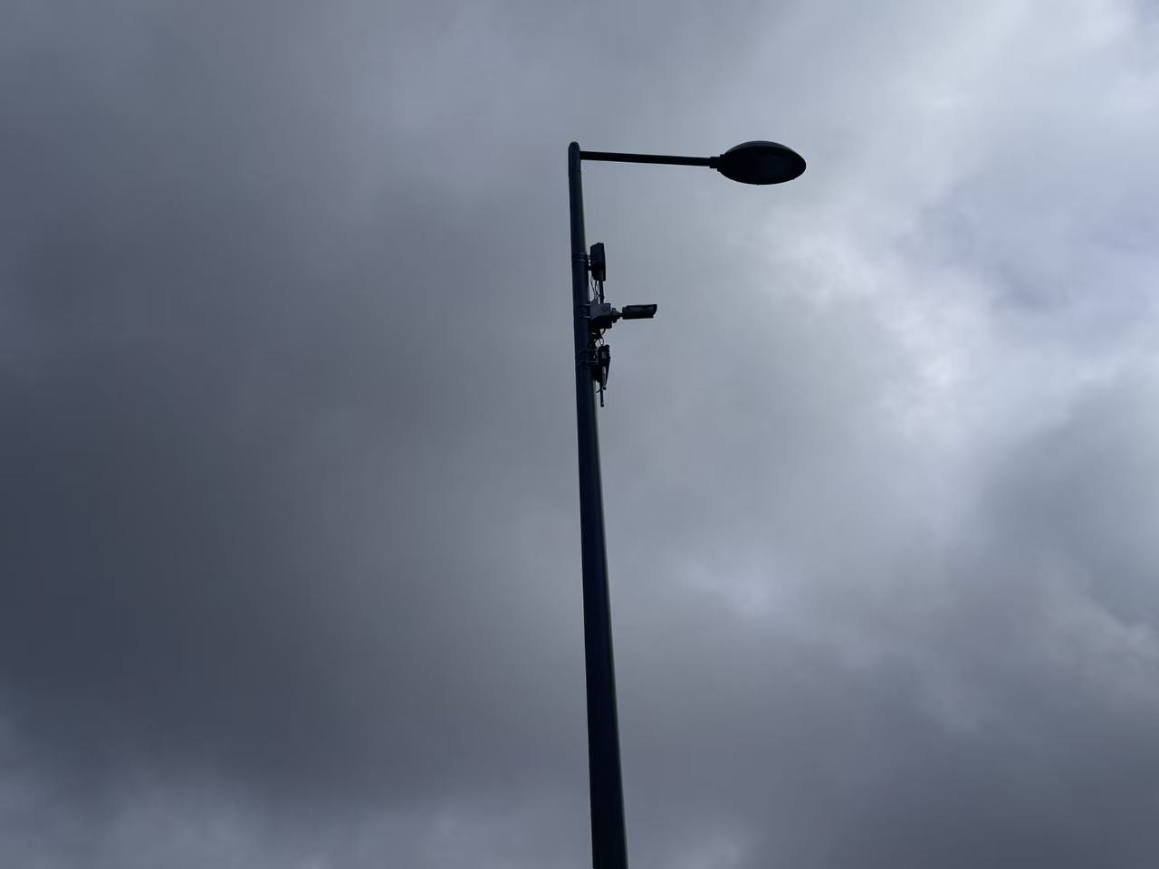
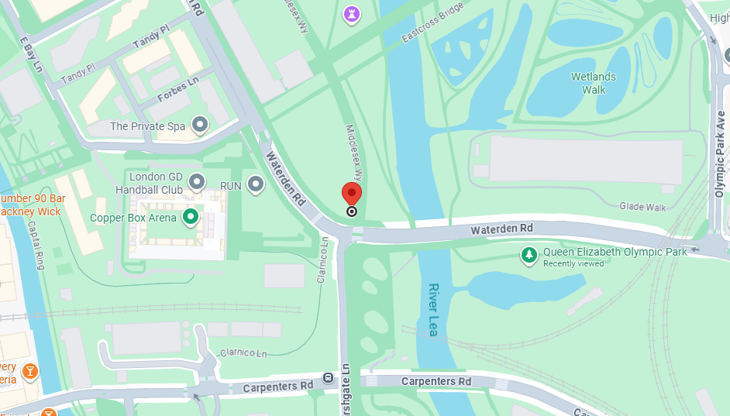
Cars in street monitoring.
This sensor may be used to measure how many vehicles pass through a specific section of the road within a certain period of time.
Questions when visiting site?
How many vehicles passed during the time period when I went through this road.
How often do they need maintenance, and how can rainwater erosion be prevented?
Location info:
@51.544418, -0.017674
Middlesex Wy., London E20 3AZ
https://maps.app.goo.gl/hh5GoTQhvDLBzFzV6
what3words: ///brands.live.calculating
Submitted: Xinyuan Sun 2025
Notes:
A title and a couple of sentences describing the technology and possibly linking to further information online.
A photo of the technology in situ with a corresponding map showing where it is.
2 or 3 questions that you might ask when you are in situ at the site of the technology to engage others in a discussion about that technology
The following geographic data:
Lat Long
Street Address
Google maps link
What3words location
Also add in the names of those submitting this data.

Slide 3
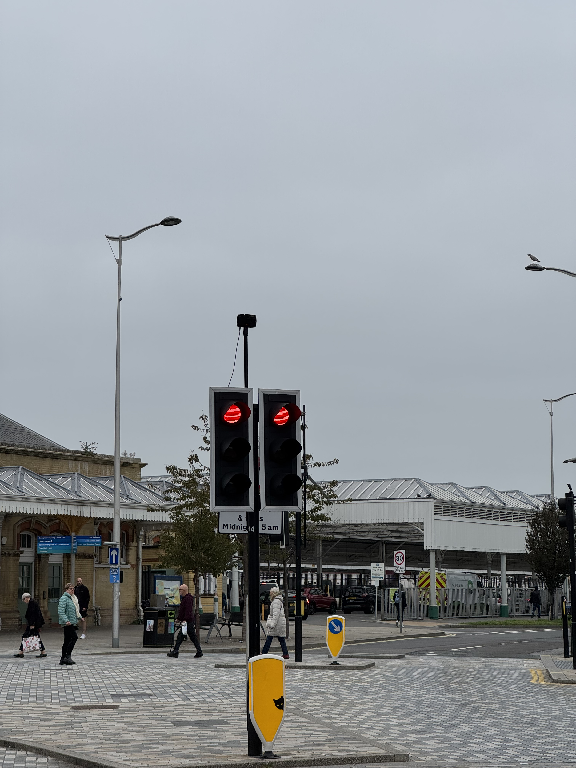
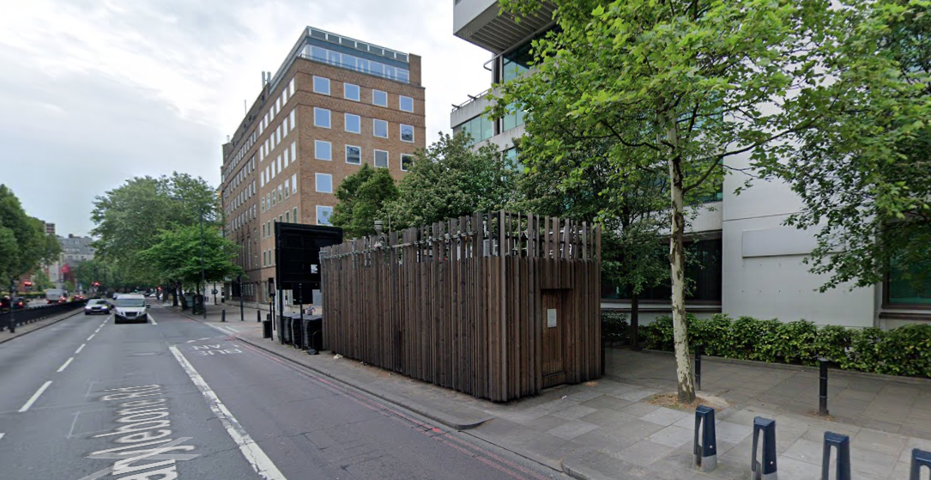
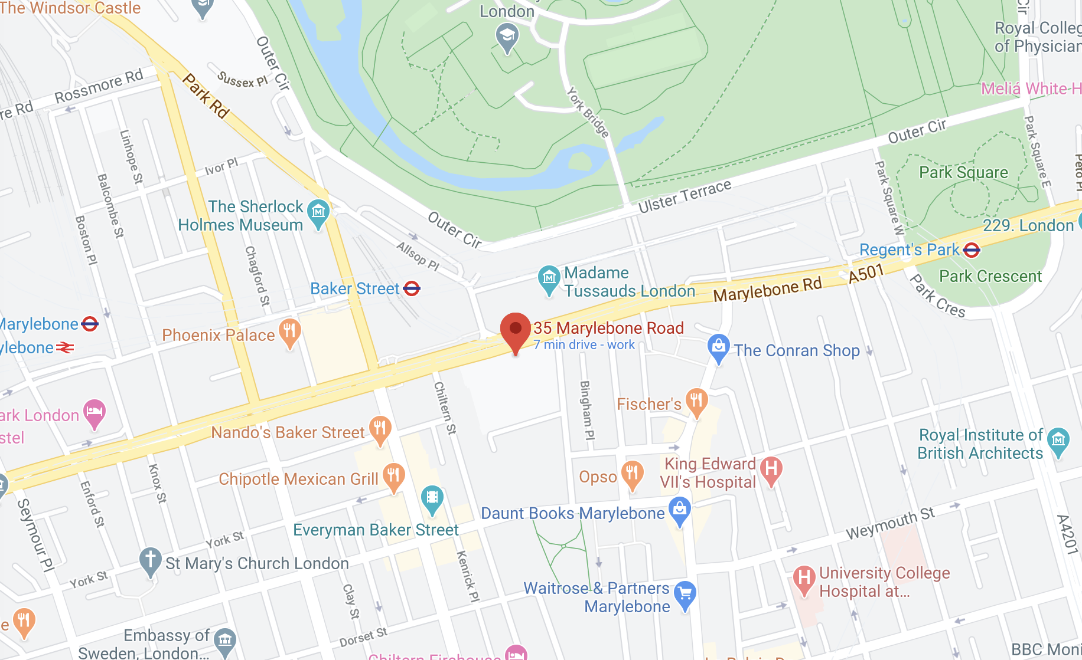
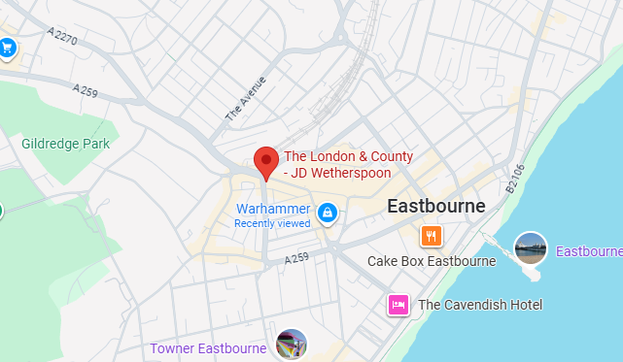
Traffic Monitor
This traffic monitor is one of many sensors in the traffic monitoring system of Eastbourne
This traffic monitor uses doppler radar and a camera to monitor vehicle number and speed.
Questions when visiting site?
What was the wire connected to?
Why is the monitor set to this angle?
Why the city selected this place to mount it?
Location info:
@50.7689167,0.2814167
46 Terminus Rd, Eastbourne BN21 3LX
(In the middle of the street)
https://maps.app.goo.gl/iQFns5SUTw1iW3RY7
what3words: ///spin.trains.voices
Submitted: Haoyu Hu Oct 2025
Notes:
A title and a couple of sentences describing the technology and possibly linking to further information online.
A photo of the technology in situ with a corresponding map showing where it is.
2 or 3 questions that you might ask when you are in situ at the site of the technology to engage others in a discussion about that technology
The following geographic data:
Lat Long
Street Address
Google maps link
Also add in the names of those submitting this data.

Slide 4
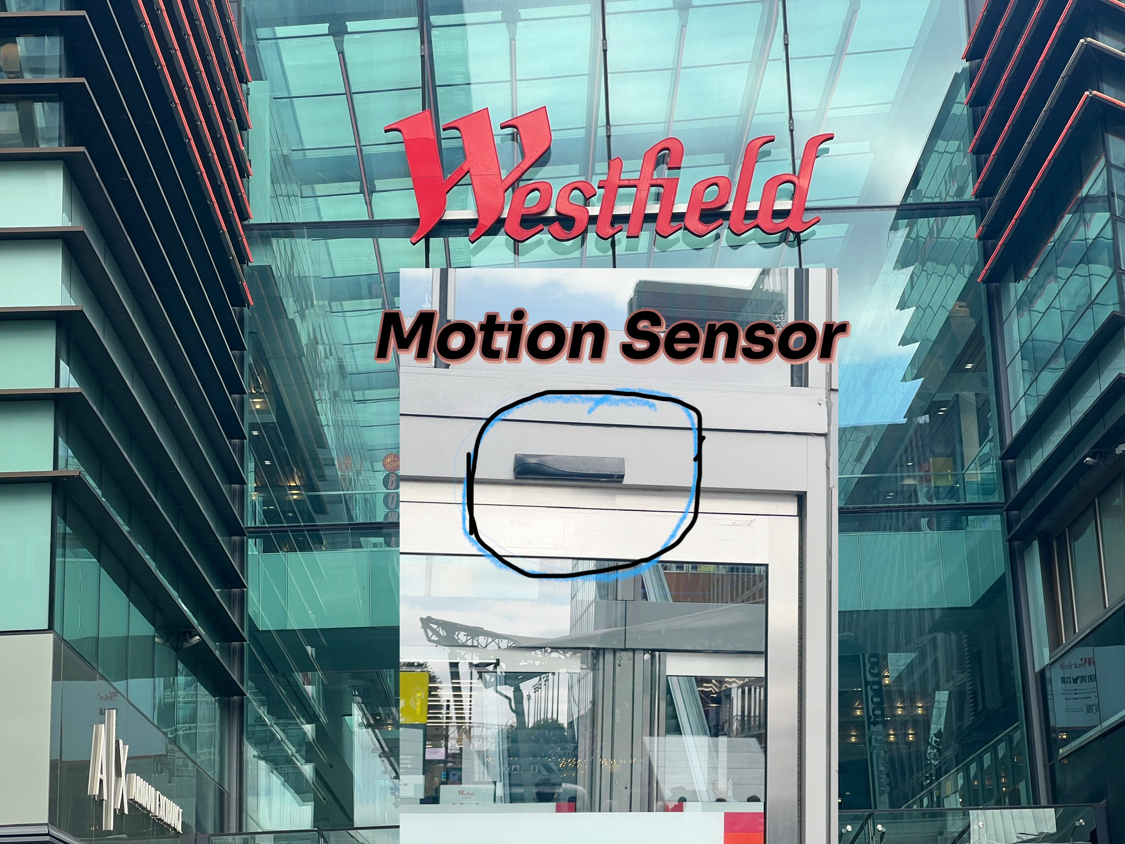
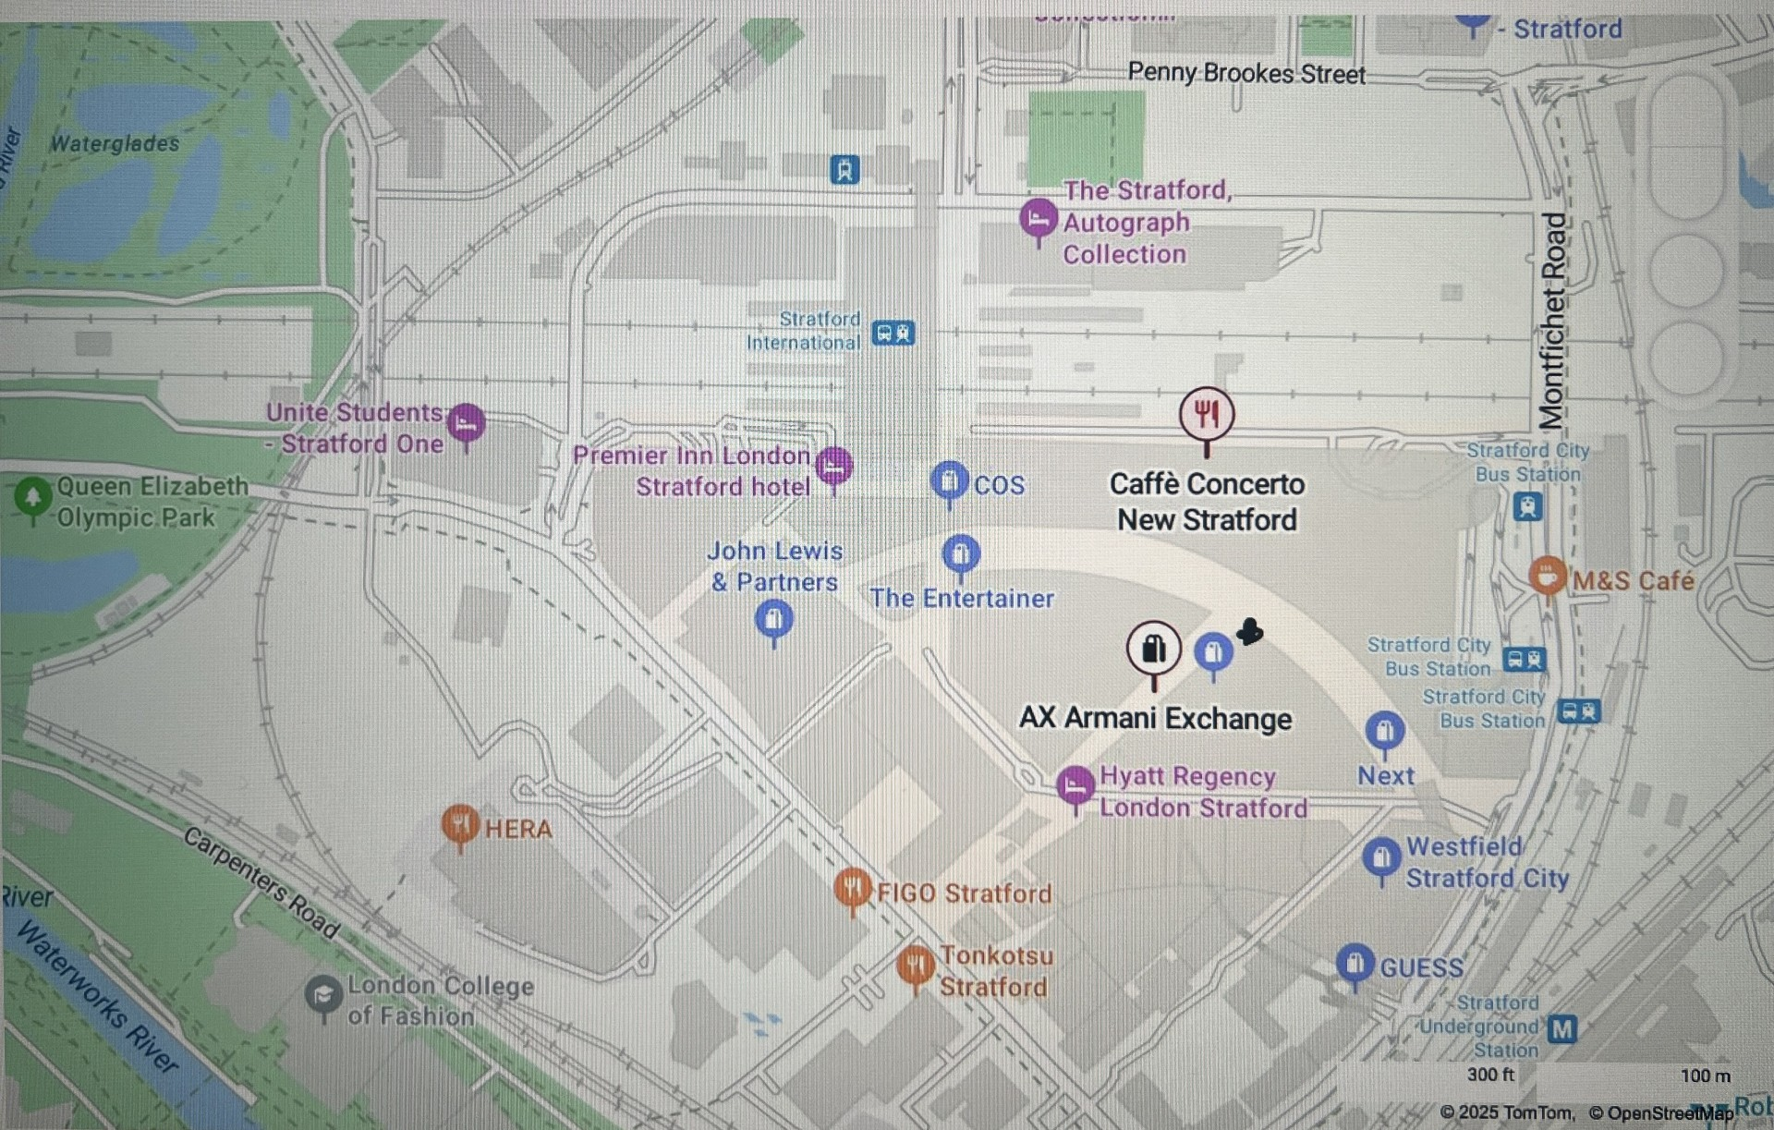
Motion Sensor
The black device above the glass door in the picture, located in Stratford Westfield shopping centre, is a motion sensor used to automatically open sliding doors and continuously scans the area below it .
When it detects movement or a change in infrared energy (from a person approaching), it sends a signal to the door’s control system. The doors then open automatically and close after a short delay when no motion is detected.
It provides hands-free access and improves accessibility and hygiene.
https://rutlanduk.co.uk/westfield-stratford-city-shopping-centre-ts-9205/
provide links to trusted websites that talks about the motion door sensors in westfield stratford
Questions when visiting site
Has this sensor ever had false activations or failures? If so, how are these issues handled?
Is this sensor/door system integrated with safety protocols like: in fire mode, lockdown mode, or for crowd control?
Location info:
Unit 101,Westfield Stratford City, Ground Floor, E20 1EP https://maps.app.goo.gl/KpkbJ7zc7h7Darar9
Submitted: Madina Diallo Oct 2025

Slide 5
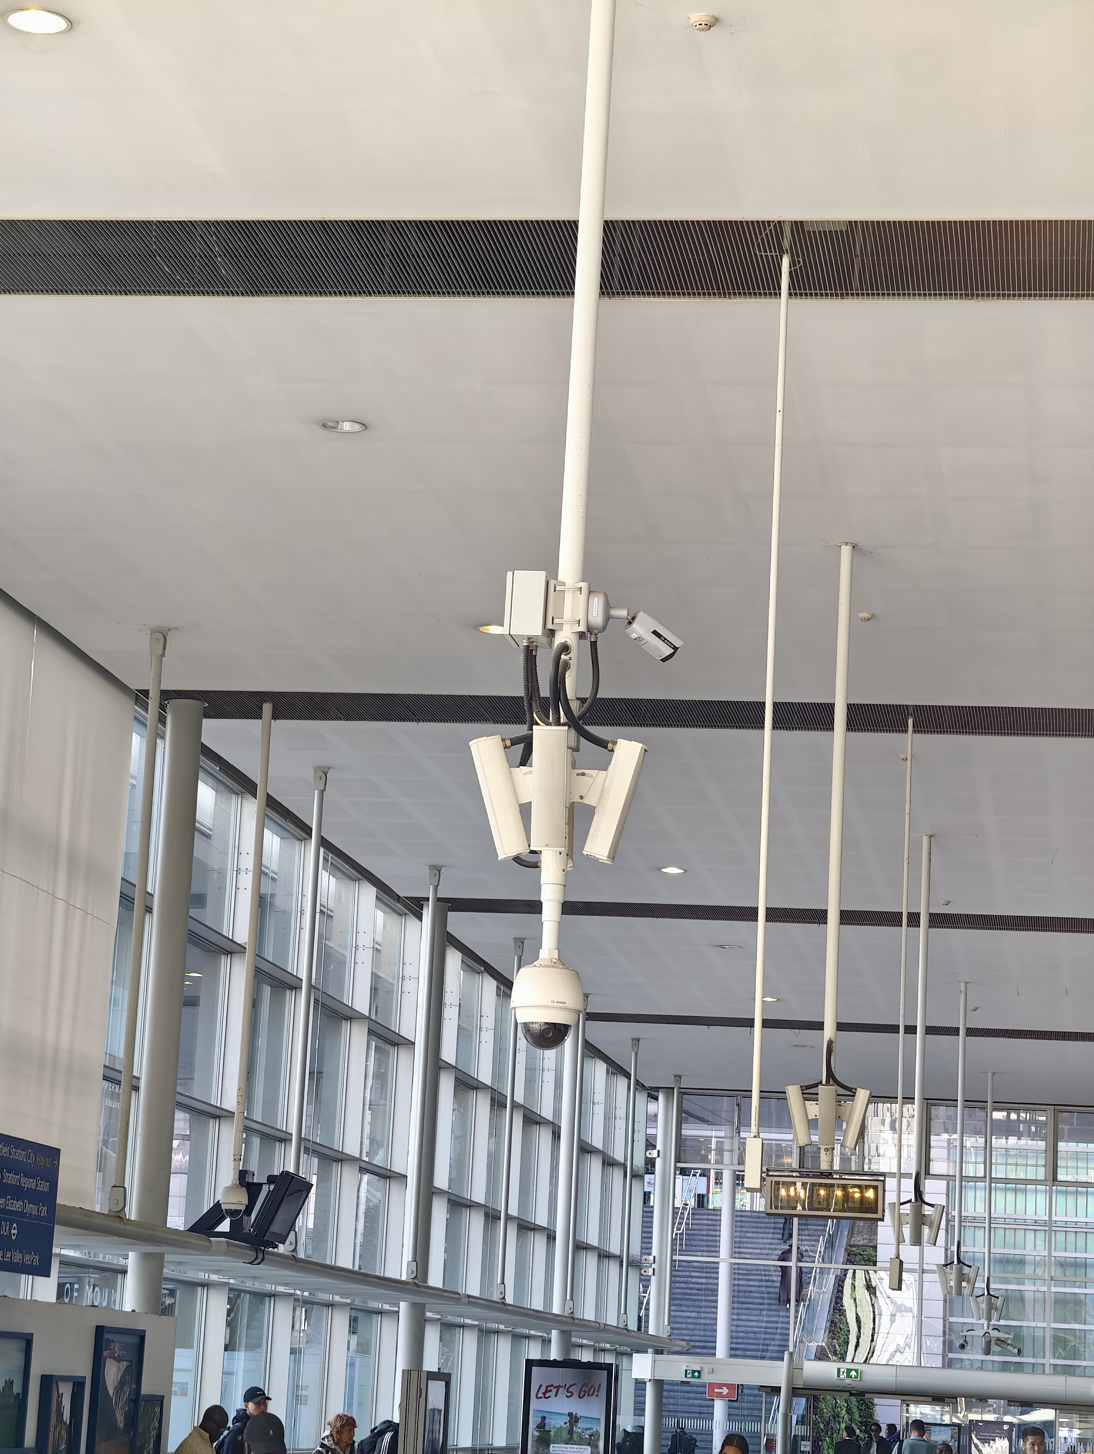
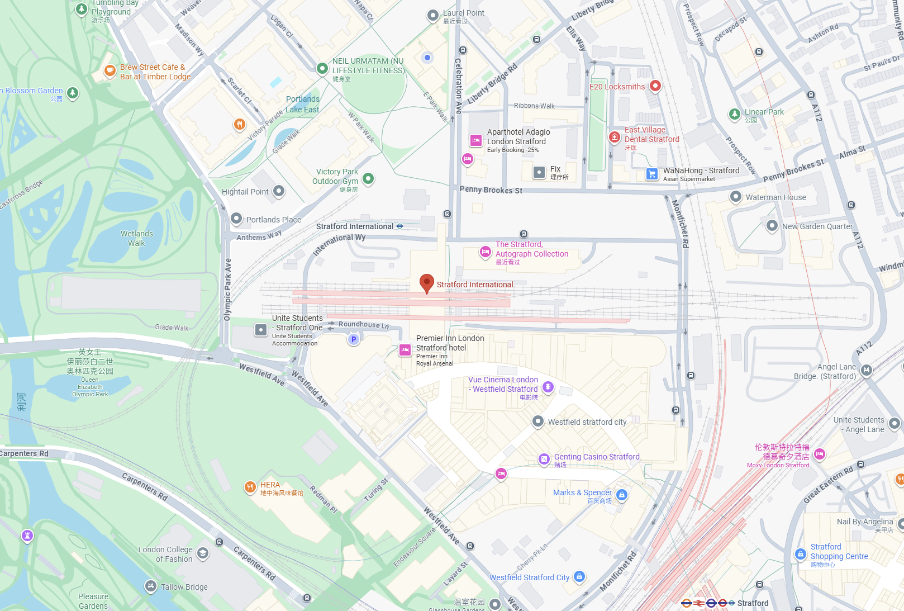
Public Surveillance and Safety Monitoring
This system is a PTZ (Pan-Tilt-Zoom) CCTV camera unit installed in a public indoor area such as a transport hub or station hall.
It continuously captures and records video footage to ensure public safety and situational awareness.
Questions when visiting site?
What areas are being monitored by this camera?
Who can access the recorded footage?
How long is the video data stored?
How is citizens’ privacy protected?
Location info:
@51.54503219729111, -0.008665316508736129
Queen Elizabeth Olympic Park, International Wy, London E20 1YY
https://maps.app.goo.gl/z6JYRgSRHhPrTzb38
Submitted: Yewei Bian Oct 2025
Notes:
A title and a couple of sentences describing the technology and possibly linking to further information online.
A photo of the technology in situ with a corresponding map showing where it is.
2 or 3 questions that you might ask when you are in situ at the site of the technology to engage others in a discussion about that technology
The following geographic data:
Lat Long
Street Address
Google maps link
What3words location
Also add in the names of those submitting this data.

Slide 6
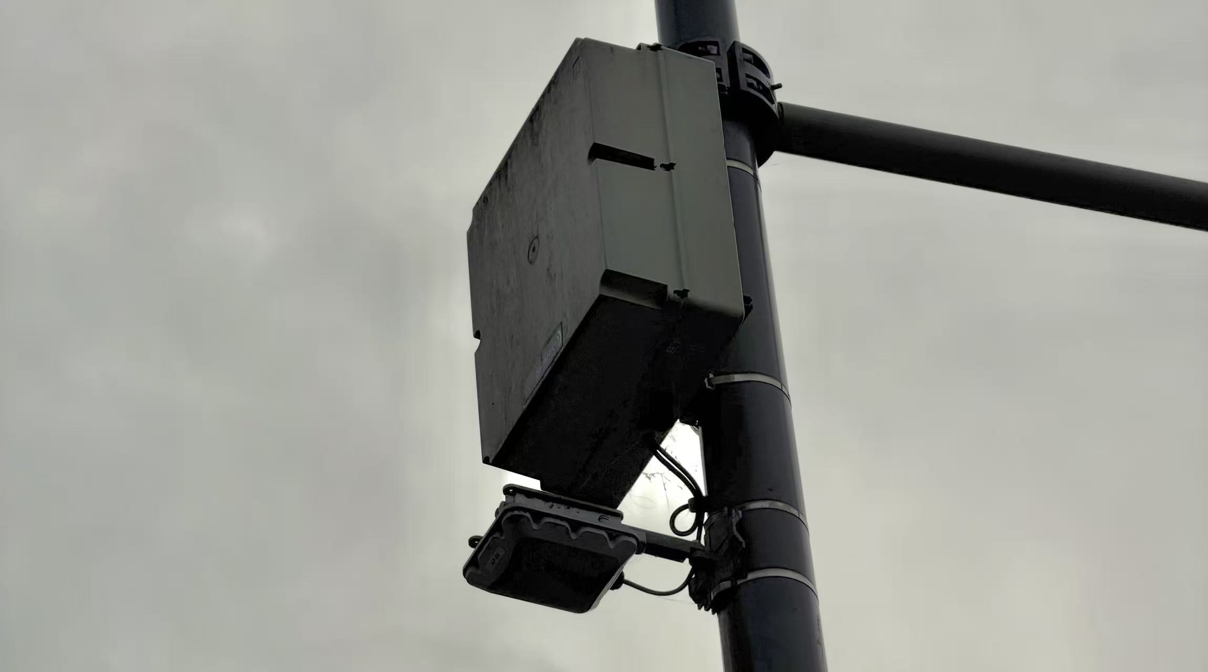
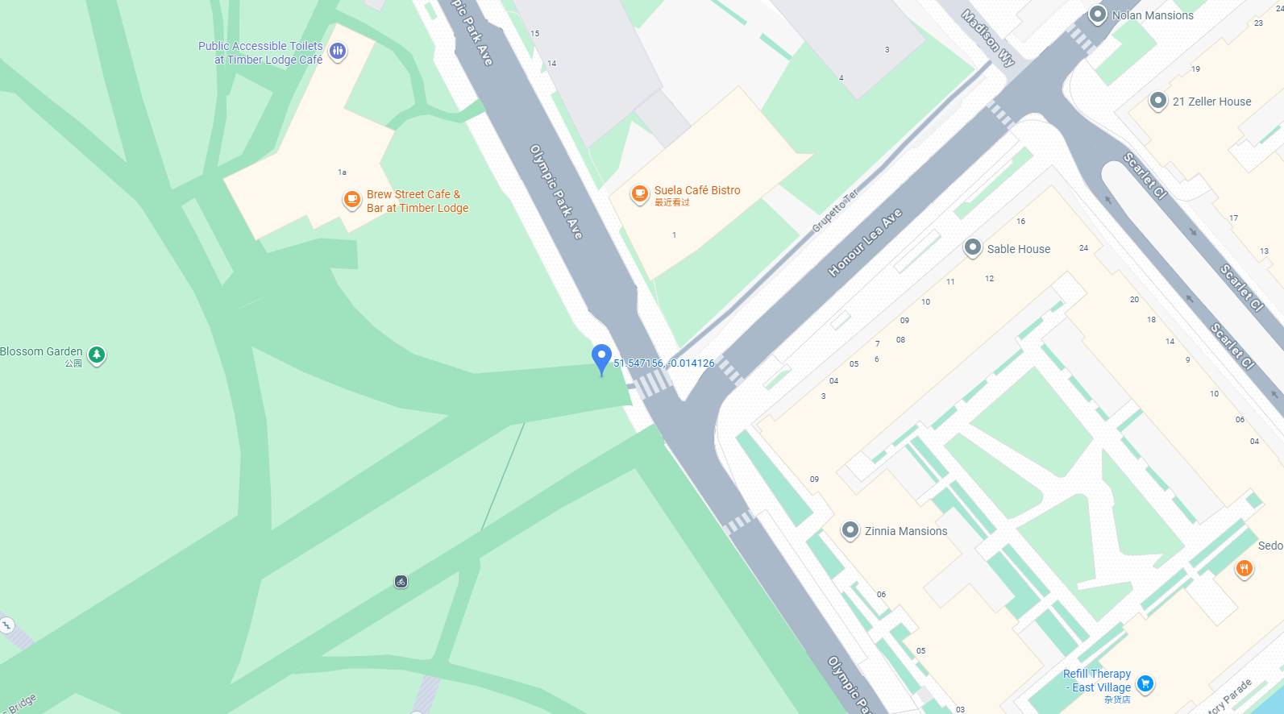
Traffic Monitoring and Smart City System.
This traffic monitoring station is part of a smart city network used to collect real-time traffic data.
It is measuring vehicle count, traffic flow rate, average speed, and vehicle type recognition through an AI-enabled camera system. The data is used for traffic management, congestion prediction, and improving road safety.
Questions when visiting site?
What time of day shows the highest traffic flow here?
How might a citizen check real-time traffic information?
Who benefits most from this technology (drivers, city planners, or pedestrians)?
Location info:
@51.547156,-0.014126
Celebration Avenue, Stratford, London, E20
https://maps.app.goo.gl/JKiWBB5um4mRTZmv9
what3words: ///remove.tolls.matter
Submitted: Ziyi Wang Oct 2025
Notes:
A title and a couple of sentences describing the technology and possibly linking to further information online.
A photo of the technology in situ with a corresponding map showing where it is.
2 or 3 questions that you might ask when you are in situ at the site of the technology to engage others in a discussion about that technology
The following geographic data:
Lat Long
Street Address
Google maps link
What3words location
Also add in the names of those submitting this data.

