Slide 1
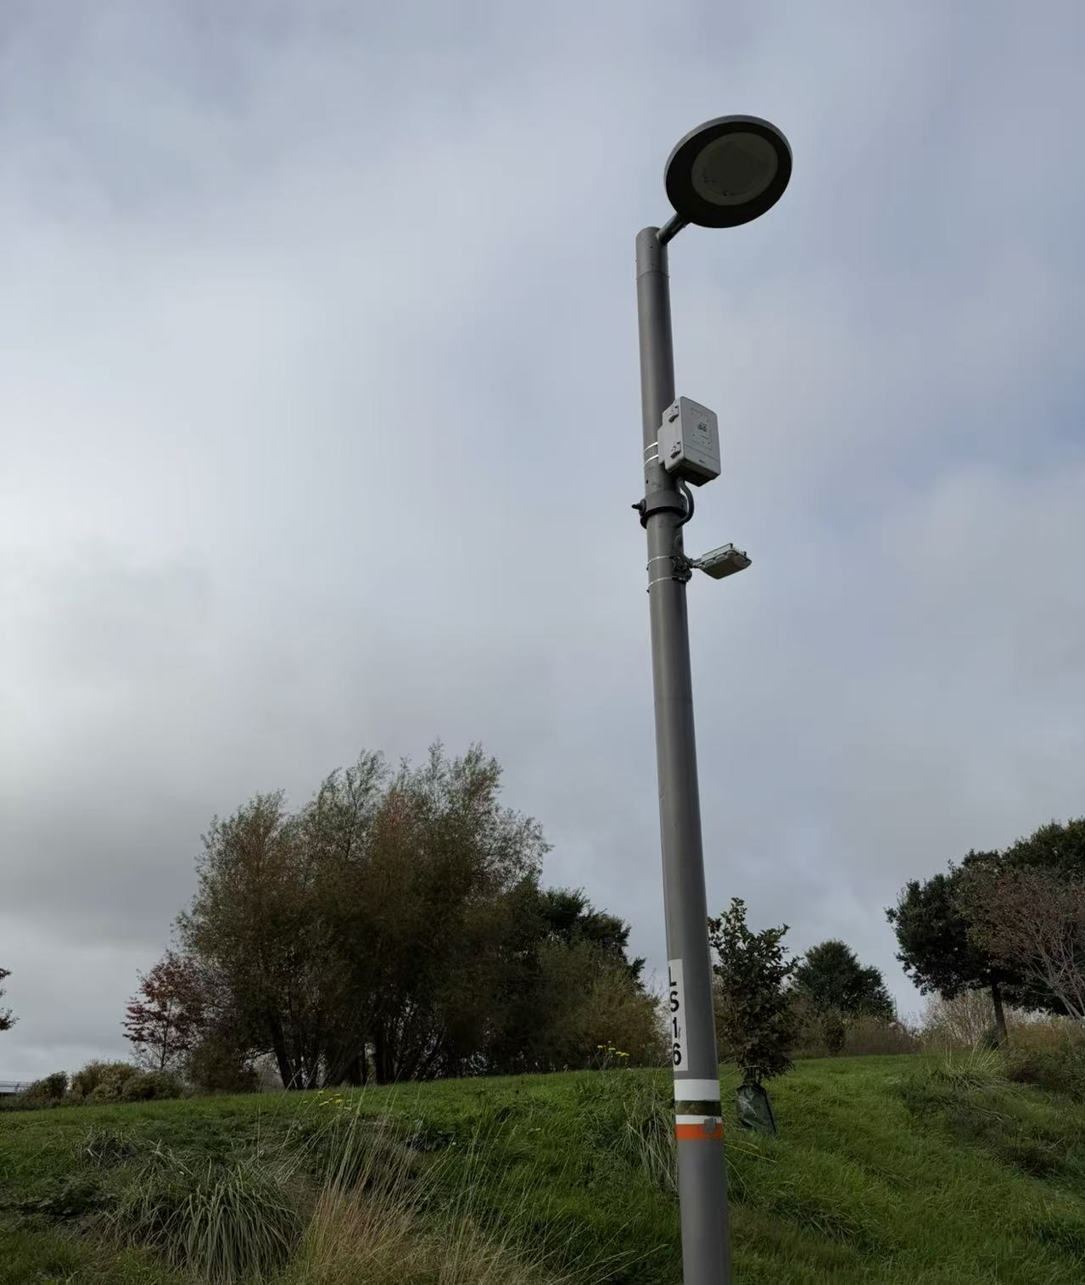
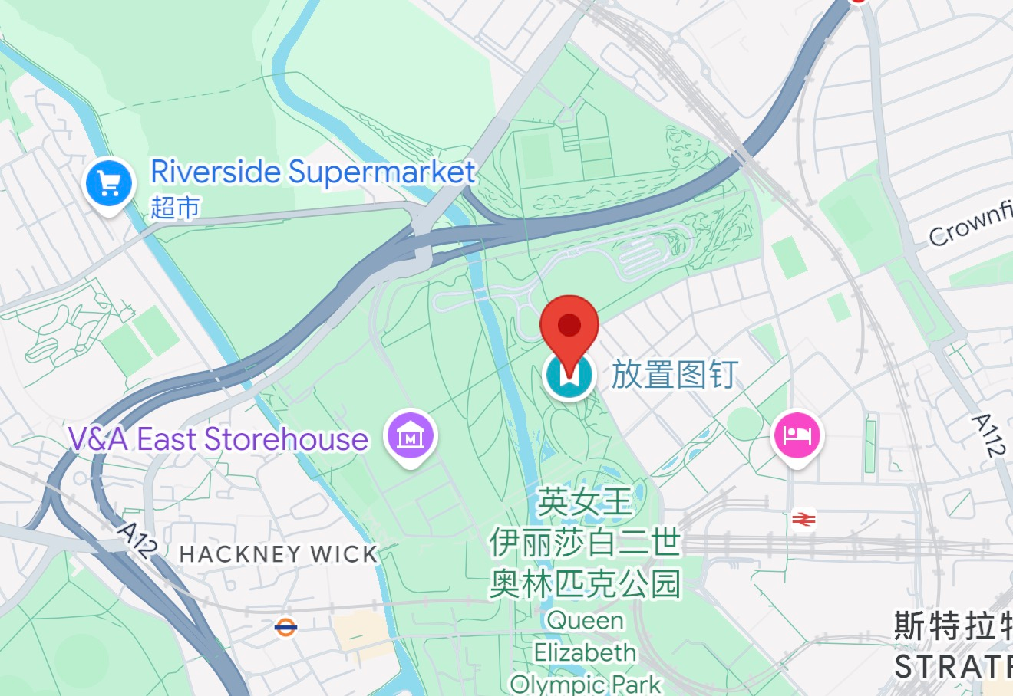
Air Quality and
pollution monitoring.
On my visit to a park, I encountered a device mounted on a streetlight pole. This object seems like an IoT sensor, likely used to measure air quality or other environmental factors. The presence of a small sensor box suggests that it may be gathering data on pollutants such as CO2 or PM2.5 particles.
Questions when observing the device:
What type of data is this sensor collecting?
How might this device contribute to urban environmental monitoring?
Could the device also provide feedback on air quality to nearby citizens?
Location info:
@51.5399920, -0.0131750
https://maps.app.goo.gl/2h115yCCBDXK84vy7?g_st=ipc
Submitted: Freya Yifei 2025
Notes:
A title and a couple of sentences describing the technology and possibly linking to further information online.
A photo of the technology in situ with a corresponding map showing where it is.
2 or 3 questions that you might ask when you are in situ at the site of the technology to engage others in a discussion about that technology
The following geographic data:
Lat Long
Street Address
Google maps link
What3words location
Also add in the names of those submitting this data.

