Slide 1
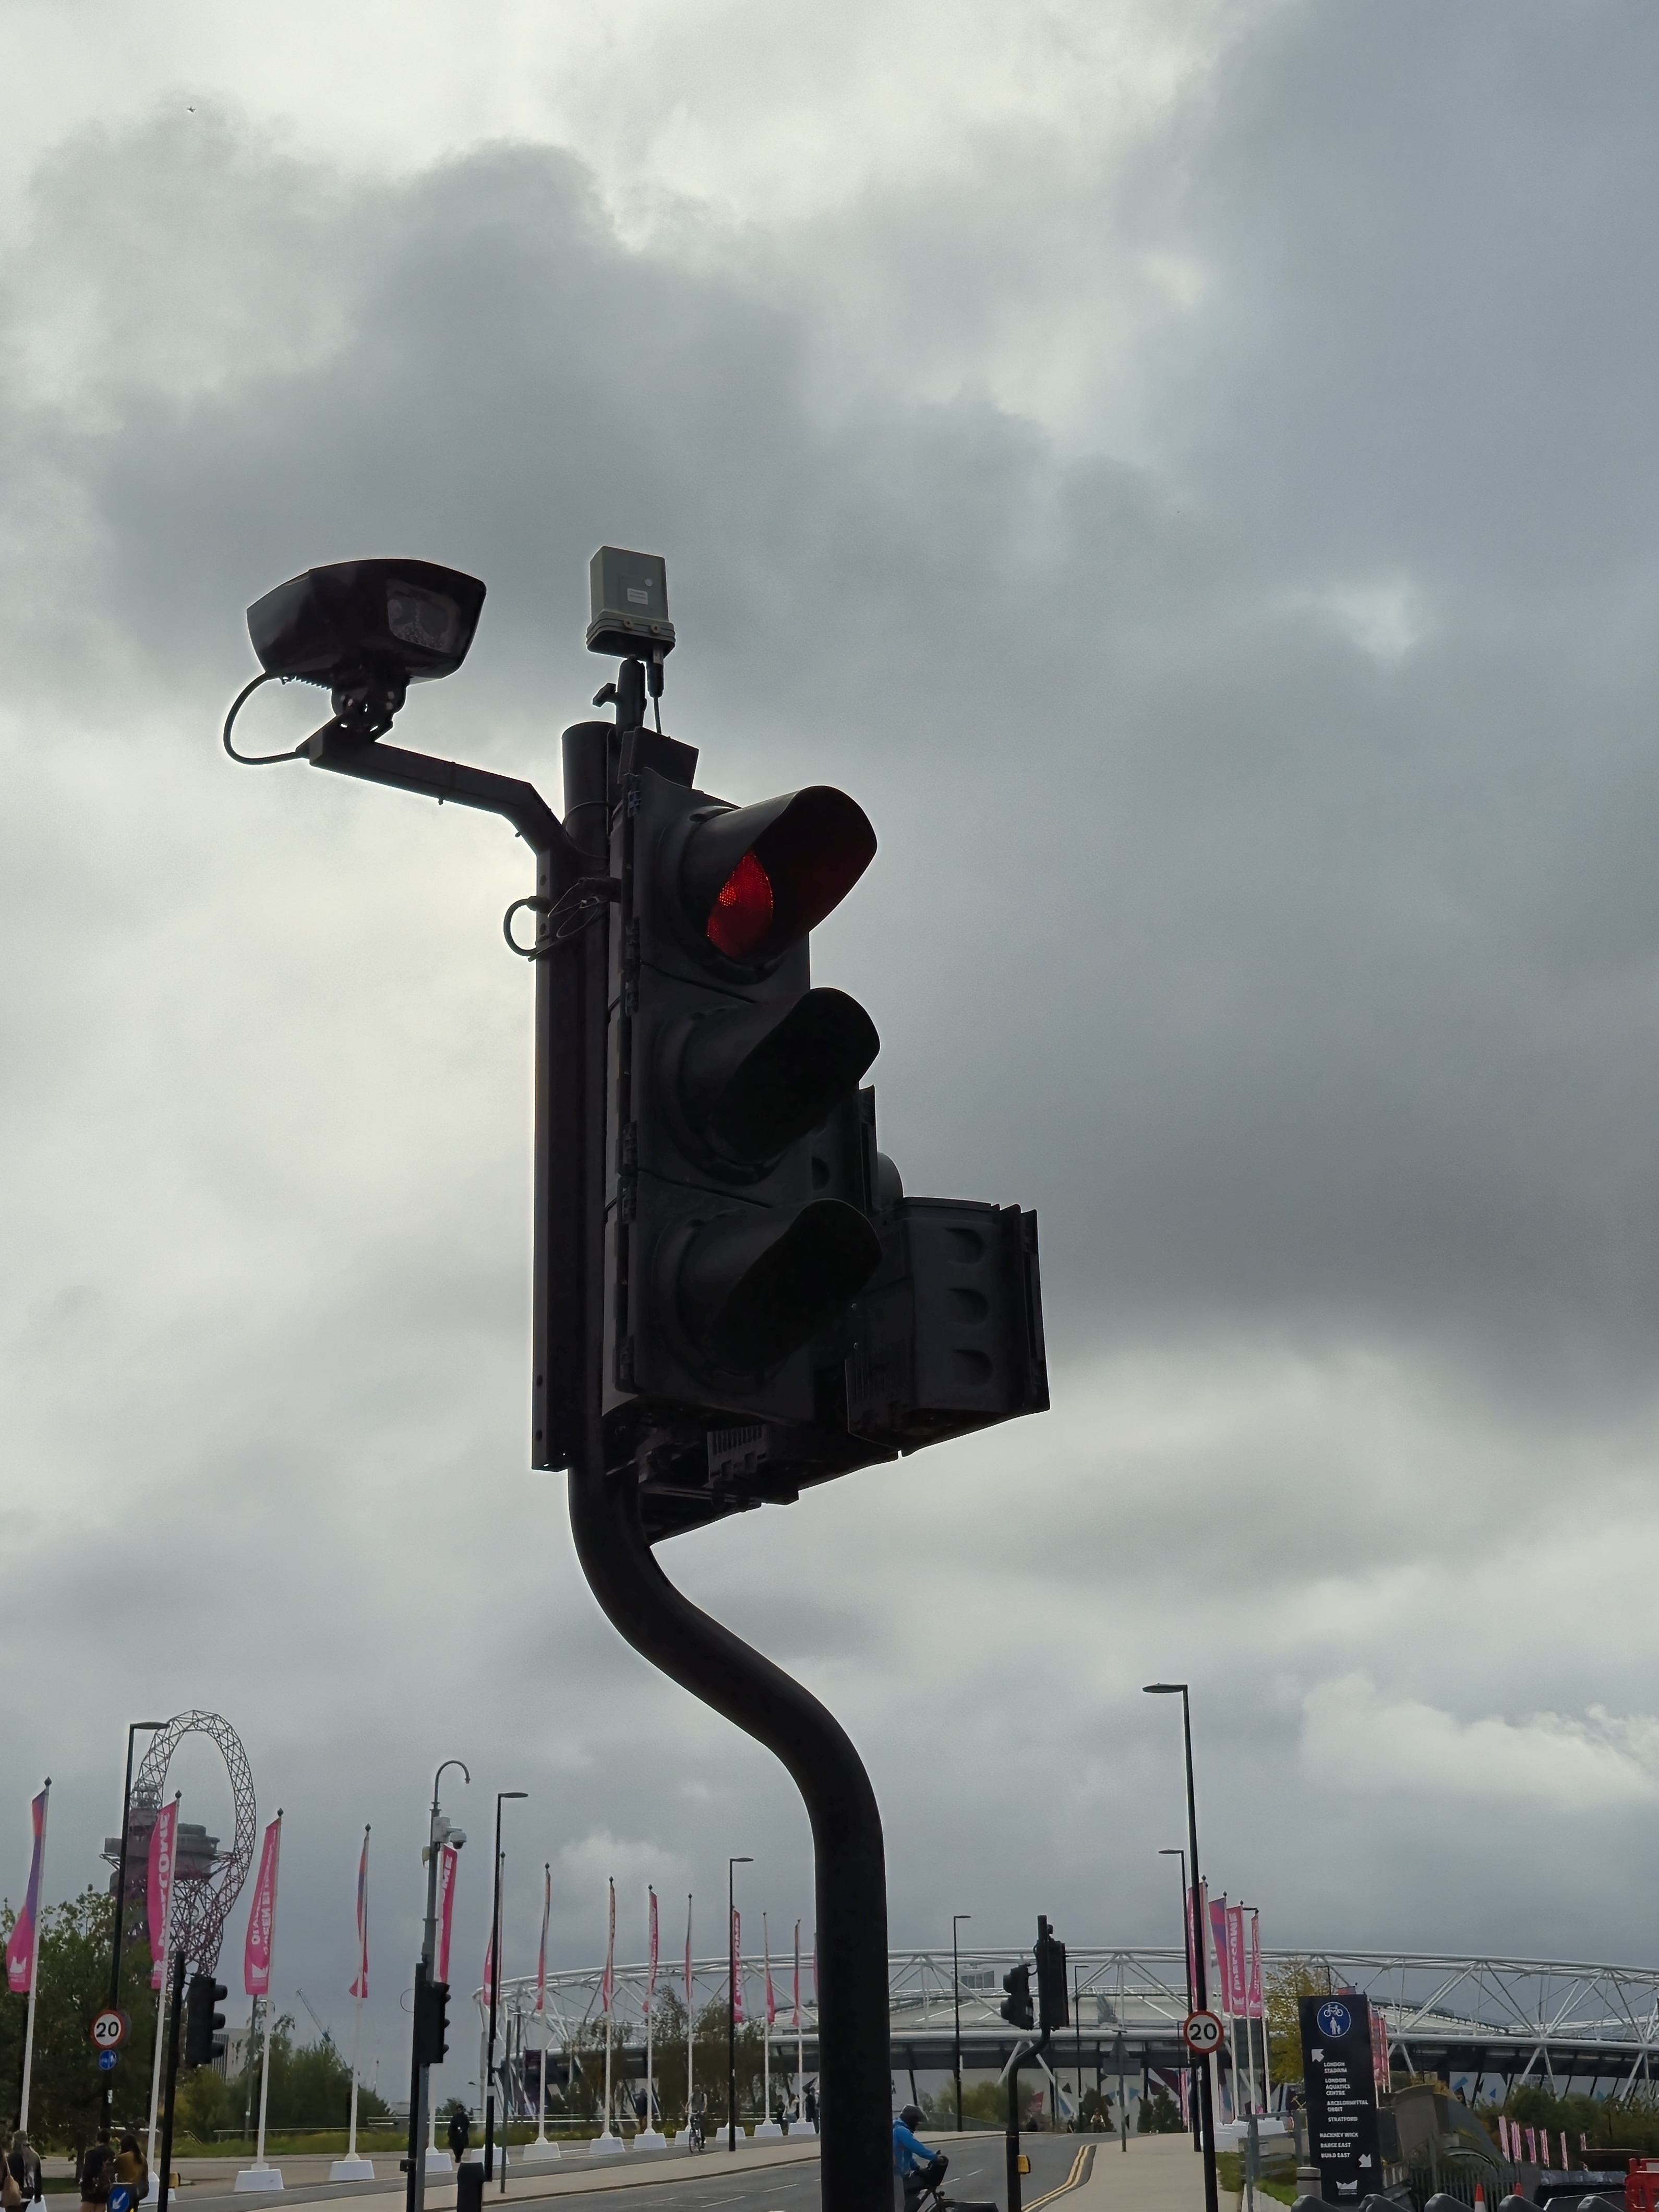
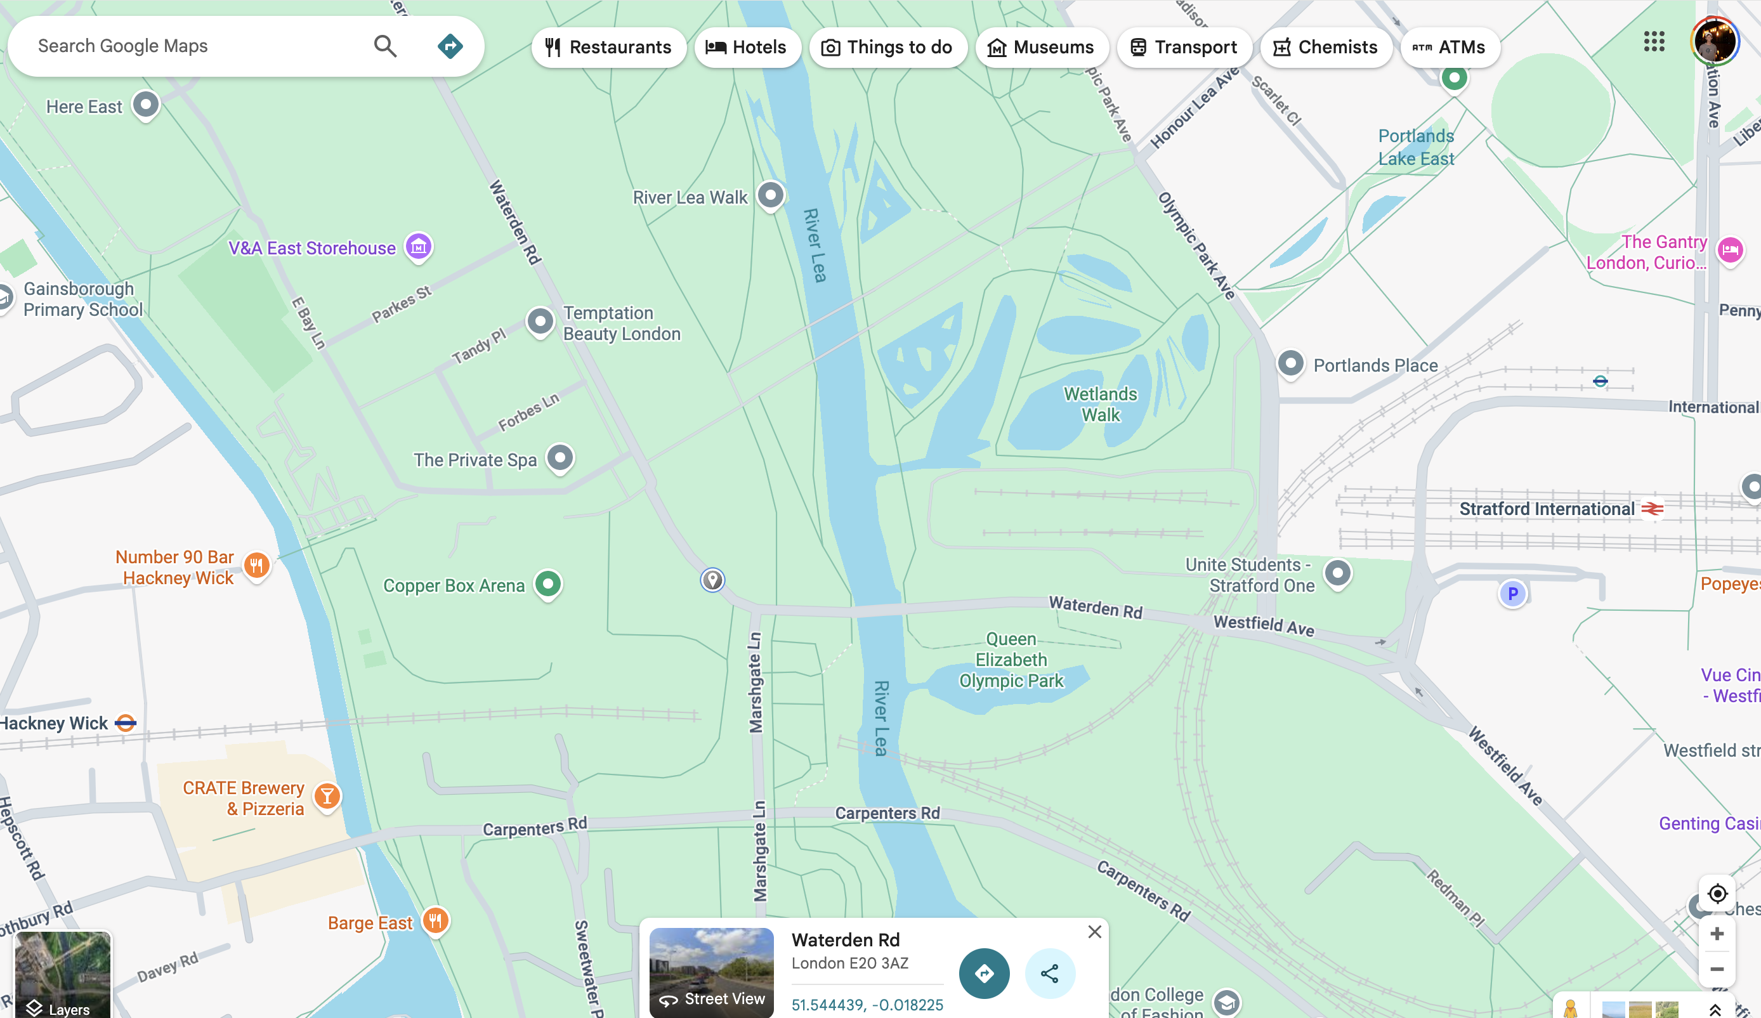
Radar Sensor on Traffic Light.
A radar sensor (Radio Detection and Ranging) uses radio waves to detect the presence, speed, and movement of vehicles (and sometimes pedestrians or cyclists).
It works by:
Emitting continuous or pulsed microwave radio waves (typically 24 GHz or 77 GHz frequencies).
Measuring the reflected signals that bounce back from objects.
Calculating:
  Distance (based on how long it takes the signal to return)
  Speed (using the Doppler effect)
  Direction and sometimes angle (using multi-antenna setups)
What was the traffic like when you visited?
Around 1 PM on a weekday, traffic was moderate, with a steady flow of vehicles but minimal congestion.
How might a citizen find out current traffic levels?
TfL open data portal, London Datastore
Who is this technology for?
City authorities, transport operators, citizens, urban planners, researchers
Location info:
51°32'40.0"N 0°01'05.6"W
Waterden Rd, Stratford, London, E20 3AZ
https://maps.app.goo.gl/Aiz33E66DFBVRUmp8
https://what3words.com/radar.cloth.intro
Submitted: Gilang Pamungkas Oct 2025
Notes:
A title and a couple of sentences describing the technology and possibly linking to further information online.
A photo of the technology in situ with a corresponding map showing where it is.
2 or 3 questions that you might ask when you are in situ at the site of the technology to engage others in a discussion about that technology
The following geographic data:
Lat Long
Street Address
Google maps link
What3words location
Also add in the names of those submitting this data.

