Slide 1
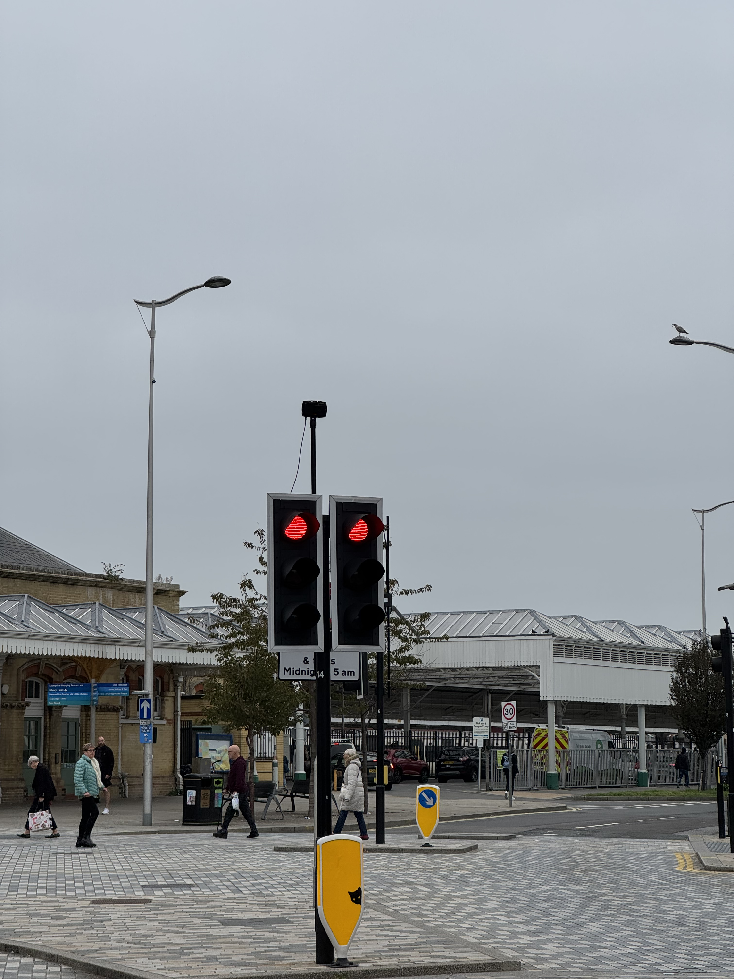
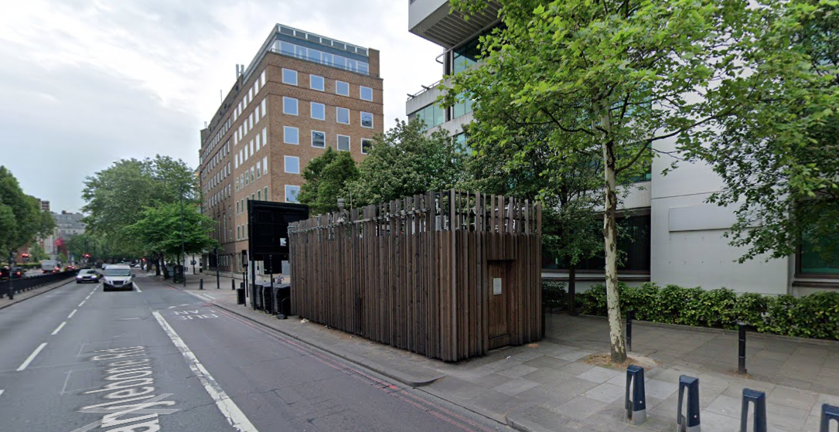
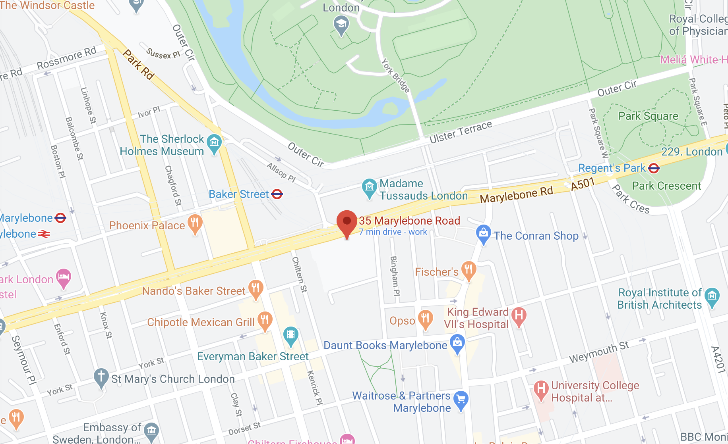
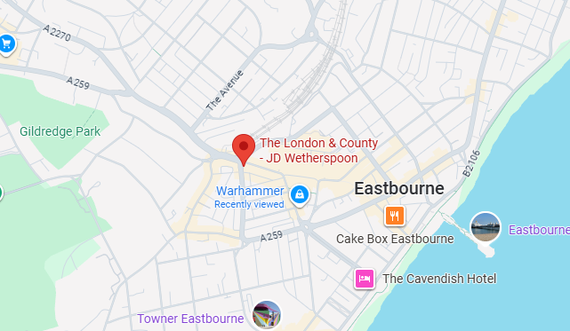
Traffic Monitor
This traffic monitor is one of many sensors in the traffic monitoring system of Eastbourne
This traffic monitor uses doppler radar and a camera to monitor vehicle number and speed.
Questions when visiting site?
What was the wire connected to?
Why is the monitor set to this angle?
Why the city selected this place to mount it?
Location info:
@50.7689167,0.2814167
46 Terminus Rd, Eastbourne BN21 3LX
(In the middle of the street)
https://maps.app.goo.gl/iQFns5SUTw1iW3RY7
what3words: ///spin.trains.voices
Submitted: Haoyu Hu Oct 2025
Notes:
A title and a couple of sentences describing the technology and possibly linking to further information online.
A photo of the technology in situ with a corresponding map showing where it is.
2 or 3 questions that you might ask when you are in situ at the site of the technology to engage others in a discussion about that technology
The following geographic data:
Lat Long
Street Address
Google maps link
Also add in the names of those submitting this data.

