Slide 1
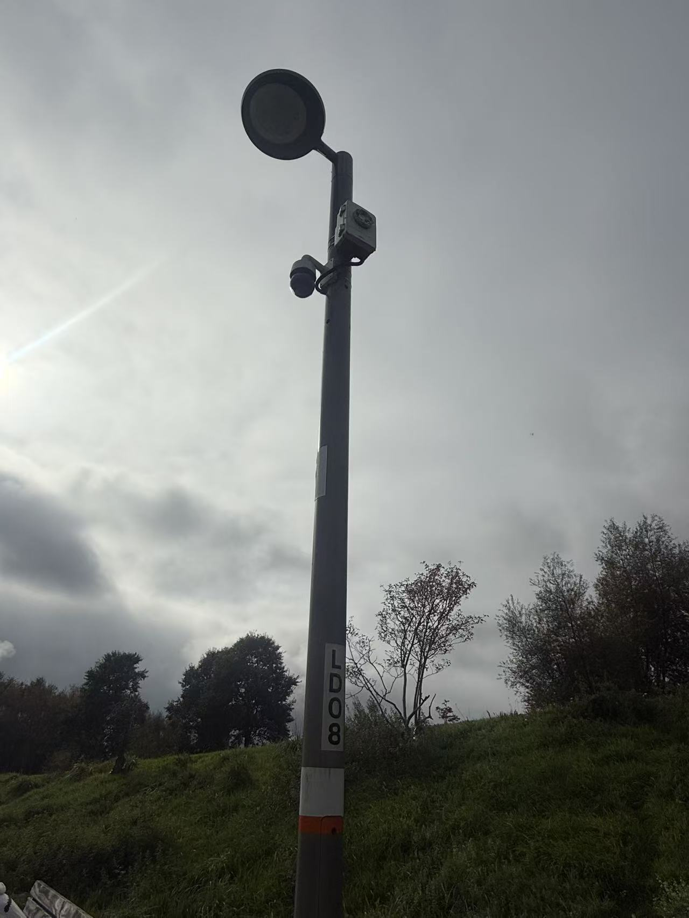
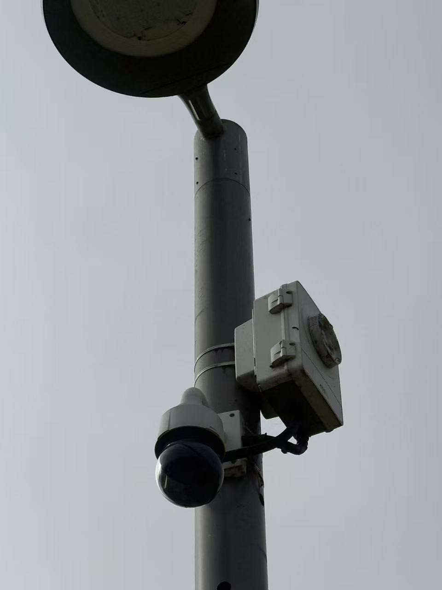
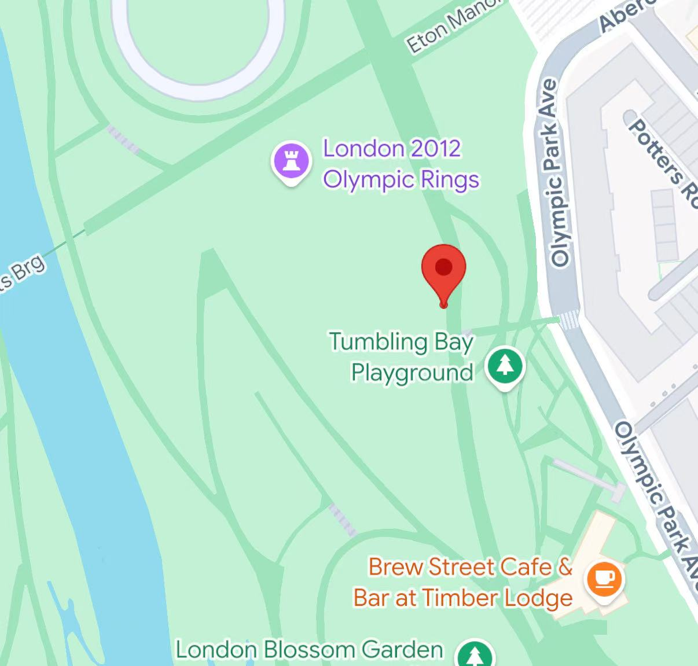
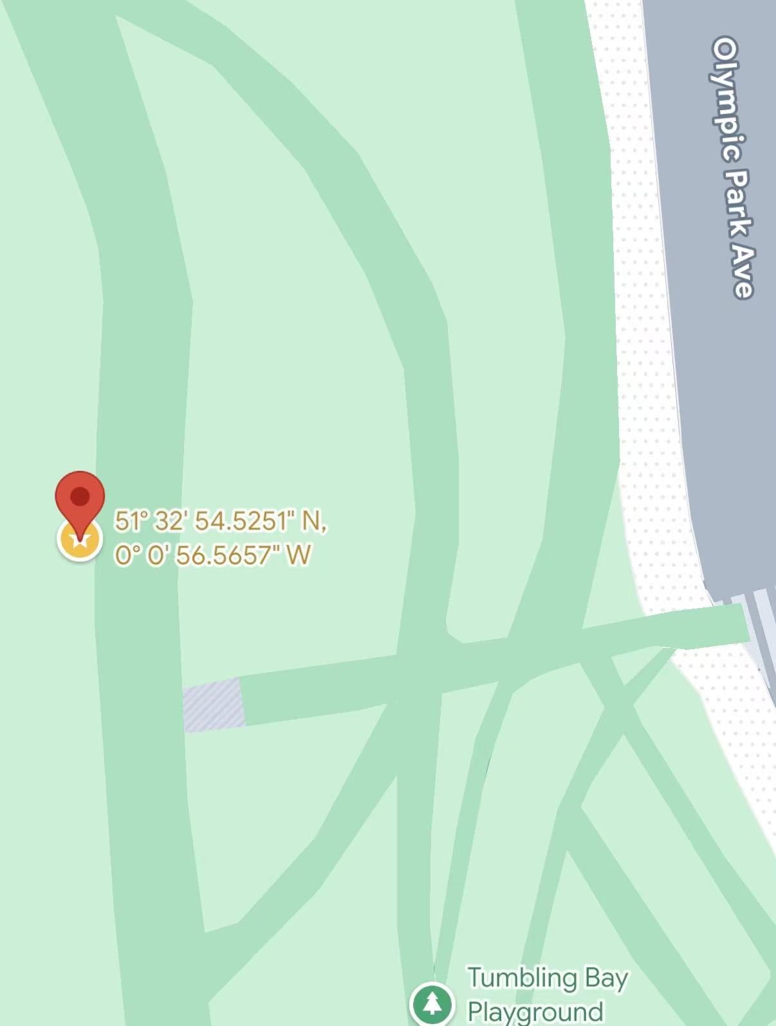
Smart Streetlight (estimated)
This device was found on the pedestrian pathway beside Tumbling Bay Playground in the park.
It is installed on a metal lamp post and consists of a lamp head, a dome-shaped CCTV camera mounted below the lamp, and a rectangular equipment box attached to the pole, which likely houses sensors or communication modules.
At first, based on the dome-shaped camera, the lamp, and the small rectangular box, I inferred that this device might also be used to monitor pedestrians and give alerts if someone walked in the wrong direction.
However, it is placed along a straight, one-way path with no intersections, so this seems unlikely.
Considering the surrounding environment, I inferred that it is more likely part of a smart lighting and surveillance system in the park.
Location info:
@51.5484792, -0.0157127
Olympic Park Ave, London, E20 1DY
https://maps.app.goo.gl/9LFm5JbeXq1zwWBq8?g_st=ipc
Submitted: Xinyi Zhang October 2025
Notes:
A title and a couple of sentences describing the technology and possibly linking to further information online.
A photo of the technology in situ with a corresponding map showing where it is.
2 or 3 questions that you might ask when you are in situ at the site of the technology to engage others in a discussion about that technology
The following geographic data:
Lat Long
Street Address
Google maps link
What3words location
Also add in the names of those submitting this data.

